Slide 1
Proton Plan Meeting
Agenda:
  Review of parameter list:
    Prebys, Kourbanis
  Status of writing assignments
    Prebys, Kourbanis
  Proton Projection methodology
    Prebys, discussion
  Practice talks for next week
    discussion

Slide 2
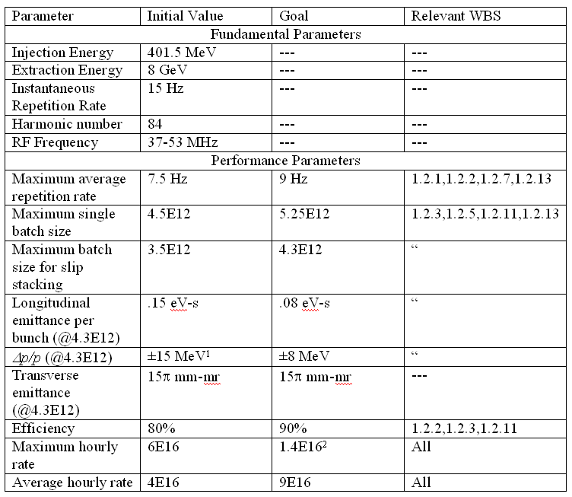
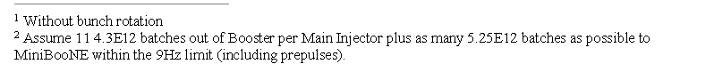
Booster Parameters

Slide 3
Proton Projections
Successes
  First realistic attempt at estimating proton delivery
  Fairly accurate in FY05
Problems
  Don’t incorporate realistic ramp up curves after shutdowns.
  Handling of single batch size vs. slip stacked batch size probably reasonably accurate, but very confusing.
  Ongoing debate of “peak” vs “average”
  No attempt to factor in possible large variations in beamline uptime
    This is why we will miss badly for NuMI this year.

Slide 4
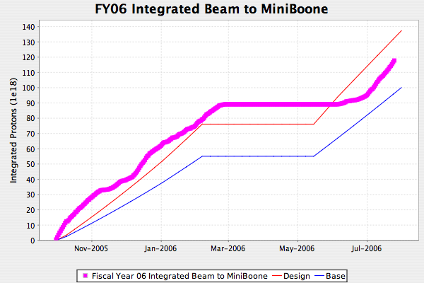
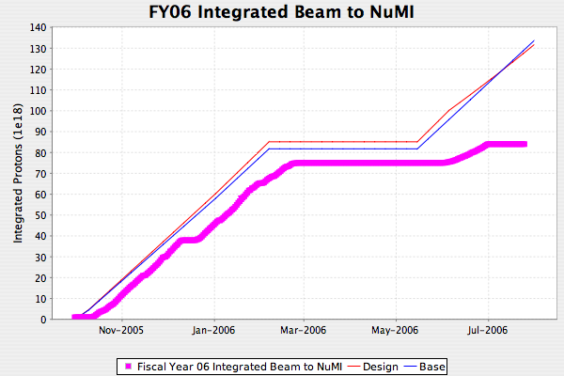
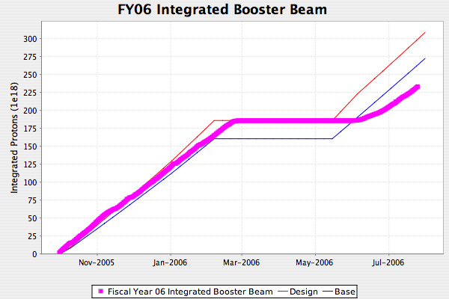
How we’re doing this year
Benefits from NuMI hardships
Beads
Horn
Tritium
Slope approaching base

Slide 5
Batch sizes
Fact: we can deliver larger single batches to MiniBooNE than we can slip stack for NuMI or pbar.
Historical handling: use one batch size, but put in a lower “efficiency” for slip stacked cycles
  Leads to accurate projections
  Appears predict 20% beam loss in MI
  Leads to confusing comparison to actual performance
Proposed new scheme:
  One batch size for protons to MiniBooNE
    Largest batch size with acceptable losses
  Separate batch size for slip stacking
    Batch size will reflect batch out of Booster.
    “Efficiency” will be difference between injected and extracted beam in MI

Slide 6
Batch Sizes (cont’d)
Currently
  Design
    Single batch size rising from 4.5E12 to 5.25E12 by 1/1/09
    Slip stack “efficiency” 80%
  Base
    Single batch size stays at 4.5E12
Propose
  Design
    Single batch same
    Slip stack batch (to MI) rising from 4E12 to 4.3E12 over the next year.
    Slip stack efficiency going from 90% to 95% over the same period
  Base
    Batch sizes stay about where they are now?

Slide 7
Uptime
Historically have put in same uptime for MiniBooNE and NuMI
  In fact, (lack of) uptime has been the single most important factor for NuMI.
Currently (MiniBooNE and NuMI)
  Design: uptime goes from 81% to 85% by 1/1/08
  Base: stay at 81%
Propose
  Design: same
  Base:
    NuMI: uptime they’ve had up to now
    MiniBooNE: budget in 1 unplanned horn failure (3 weeks)

Slide 8
After Shutdown
Currently
  No turn-on curve after shutdown
  Compensated by budgeting a longer shutdown than planned.
  Problems:
    Shutdown has always been extended to be as long as the budget
    Even if it hadn’t, start-up time is an important figure of merit.
  Propose.
    Add exponential turn-on after shutdown (tau ~2weeks)

Slide 9
Hourly Rates: Peak vs. Avg.
Peak values
  Pros
    can verify by taking a calculator a plugging in basic numbers
    Give a good number to tune toward
  Cons
    Some people will always neglect to throw in reality factors
Average value
  Pros
    Really tell what’s important
    Avoid unrealistic expectations
  Cons
    Can result in a relaxed attitutde toward tuning
Propose
  Do both

