Slide 1
Proton Plan Meeting
Agenda:
  Project/campaign reorganization: Prebys
  Status updates: all
  Booster Water Proposal: Cooper

Slide 2
What’s in a Name?
Scenarios (current name shown in green):
  “Stage 1”: MINOS era (concurrent with Run II), aka: “business as usual”, Proton Plan, Proton Plan 1, Proton Plan
    Ramp up to deliver slip stacked protons to both NuMI and antiproton production
    Continue to deliver protons to the 8 GeV line at some level
    Goal:
      ~380 kW to NuMI
      1-2E20 protons to 8 GeV line
    Status: in progress
  “Stage 2”: Nova era (after collider program), aka: SNuMI I, Proton Plan 2, “part of Nova”
    Use Recycler as a pre-loader to the Main Injector to eliminate loading time
    Becoming a formal plan.
    Goal
      ~700 kW to NuMI line
    Status: “probable”
  “Stage 3’ ”: enhanced NoVA++, aka: Obietron, McGinnis-o-tron, SNuMI II, SNuMI
    Use Antiproton Accumulator Ring to momentum stack protons
    Boxcar stack these protons into Recycler
    Load into Main Injector
    Goal
      ~1.2 MW to NuMI line
    Status: “wait and see what happens with ILC”.
  “Stage 3”: 8 GeV Linac, aka: Proton Driver, Foster’s folly, “HINS”
    Always a possibility, but not part of our baseline thinking at the moment.
    Status: only if the ILC is not built, or not built for a very long time.

Slide 3
Recent Developments
It was decided in Washington the NoVA project would be combined with the accelerator activities required to make it a success
  Not so crazy when you think about it
  NoVA now “assimilates” the effort to retask the recycler as a MI preloader (most recently called “SNuMI”).
  NoVA goes from $200M->$240M
By the end of the Proton Plan, the Booster/Linac will be “good enough” to support NoVA alone
  All Booster activity dropped from NoVA/SNuMI
  Moved to Proton Plan
    Only included 15 Hz hardware upgrades needed for things beyond, or in addition to, NoVA
The good news:
  Booster and Linac people will not have to go to NoVA/SNuMI reviews
Bad news:
  MI/Recycler people will now have like 10 reviews/year.

Slide 4
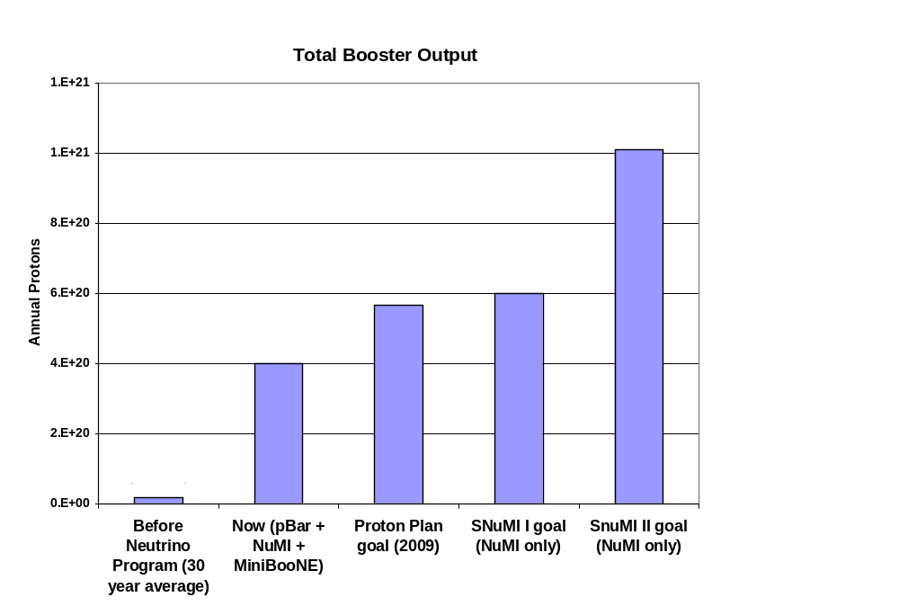
Total Protons
Present

Slide 5
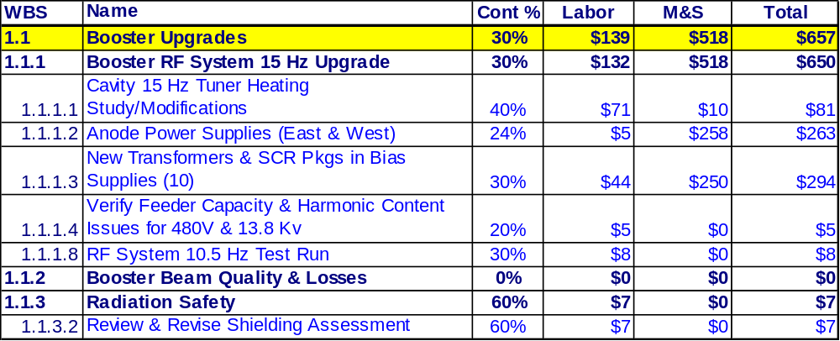
Booster Upgrades Cost Overview
(no G&A or contingency, FY06K$)
The cost is driven by the upgrades that are required to increase the average repetition rate of the Booster RF system
  Tuner cooling
  Bias supply improvement
  Anode supply refurbishment

Slide 6
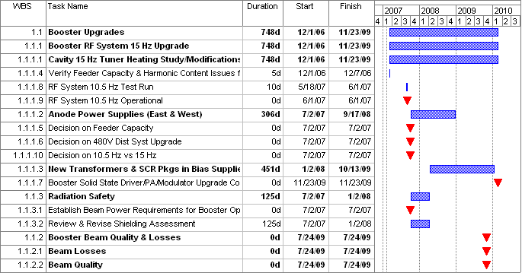
Booster Upgrades
Schedule Overview
Will move everything substantial to FY08 or beyond

