Slide 1
Proton Plan (short version)
(BEAMS-DOC-1441)
Eric Prebys, FNAL Accelerator Division

Slide 2
Charge
Develop a plan for a reasonable set of improvements and operational initiatives to maximize proton delivery to NuMI and the Booster Neutrino Beam (BNB) over the next ten years or so.
Estimate the budget and timeline for these improvements.
Estimate proton delivery to both beam lines if the Plan proceeds on schedule.
Note: this plan is exclusive of the Proton Driver, which we assume will one day replace the existing Proton Source (Linac+Booster).

Slide 3
Acknowledgements
Proton Plan Team
  Jeff Spalding
  Bruce Baller
Significant contributors (in no particular order)
  Alberto Marchionni (MI)
  Ioannis Kourbanis (MI)
  Kiyomi Koba (MI)
  Bill Pellico (PS)
  Jim Lackey (PS)
  Larry Allen (PS)
  Elliott McCrory (PS)
  John Reid (RF)
  Dave Harding (TD)
  Dan Wolf (EE)
  Weiren Chou (Integration)
  Peter Garbincius (Management)
  Dave McGinnis (Management)
  + others

Slide 4
Review: What Limits Total Proton Intensity?
Maximum number of Protons the Booster can stably accelerate: 5E12
Maximum average Booster rep. Rate: currently 7.5 Hz, may have to go to 10 Hz for NuMI+ (full) MiniBooNE
(NUMI only) Maximum number of booster batches the Main Injector can hold: currently 6 in principle, possibly go to 11 with fancy loading schemes in the future
(NUMI only) Minimum Main Injector ramp cycle time (NUMI only): 1.4s+loading time (at least 1/15s*nbatches)
Losses in the Booster:
  Above ground radiation
  Damage and/or activation of tunnel components
Our biggest worry at the moment and probably forever

Slide 5
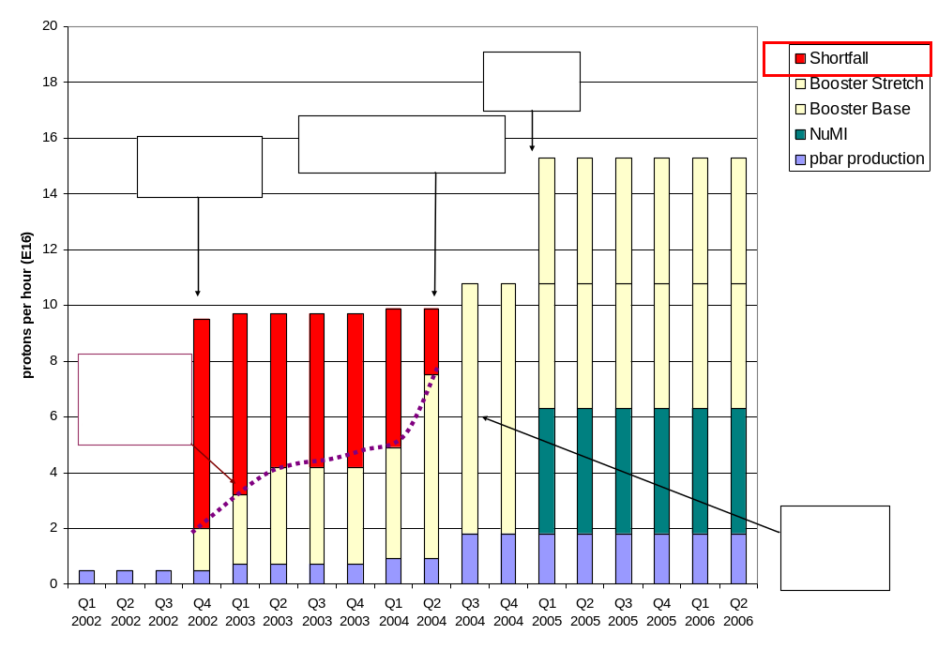
History: Proton Demand
7.5 Hz
Have now exceeded initial NuMI needs!!!!

Slide 6
Plan Strategy
Increasing the proton delivery from the Booster to NuMI and MiniBooNE
  Increase maximum average Booster repetition rate.
  Increase acceptance by improving orbit control and beam quality.
Increasing the beam intensity in the Main Injector for NuMI
  Main Injector multi-batch operation.
  Slip stacking in Main Injector (requires RF upgrade).
Improving operational reliability and radiation limitations
  Linac quad supplies
  Booster and Linac Instrumentation
  Booster RF Upgrade
  Investigate 7835 Problem

Slide 7
Breakdown of Plan
WBS | Description
1 | Proton Plan
1.1 | Linac Upgrades
1.1.1 | Linac PA Vulnerability
1.1.2 | Linac Quad Power Supplies
1.1.3 | Linac Instrumentation Upgrade
1.2 | Booster Upgrades
1.2.1 | Determination of Rep Rate Limit
1.2.2 | ORBUMP System
1.2.3 | Corrector System
1.2.4 | 30 Hz Harmonic Upgrade
1.2.5 | Gamma-t System
1.2.6 | Alignment Improvements
1.2.7 | Drift Tube Cooling
1.2.8 | Booster RF Cavity #20
1.2.9 | Booster Solid State RF PA’s
1.2.10 | Booster Instrumentation Upgrade
1.3 | Main Injector Upgrades
1.3.1 | Large Aperture Quads
1.3.2 | Main Injector Collimator
1.3.3 | NuMI Multi-batch Operation
1.3.4 | Main Injector RF Upgrade
1.4 | Management

Slide 8
Linac 7835 Task Force (Rich Andrews)
1.1: PA Vulnerability
  If you haven’t heard of 7835’s, you should have
    Need 5 to run linac.
    Made by one company (Burle), which is for sale
    Occasionally forget how to make them
    Seldom more than one or two spares
    We use around 6 a year
    Seldom have more than one or two spares. Often have had to borrow from other labs
    ONLY LUCK this has not caused a significant down time.
  Short term
    Identify ways to build up a two year supply of spare 7835’s
      Increase lifetime (compare to BNL)
      Work with Burle to increase yield and production.
    Report to Dixon by Feb.
  Longer term
    Identify a long term strategy
      Burle OK?
      New 200 MHz?
      New Linac
      Build our own 7835’s
    Report to Dixon by July

Slide 9
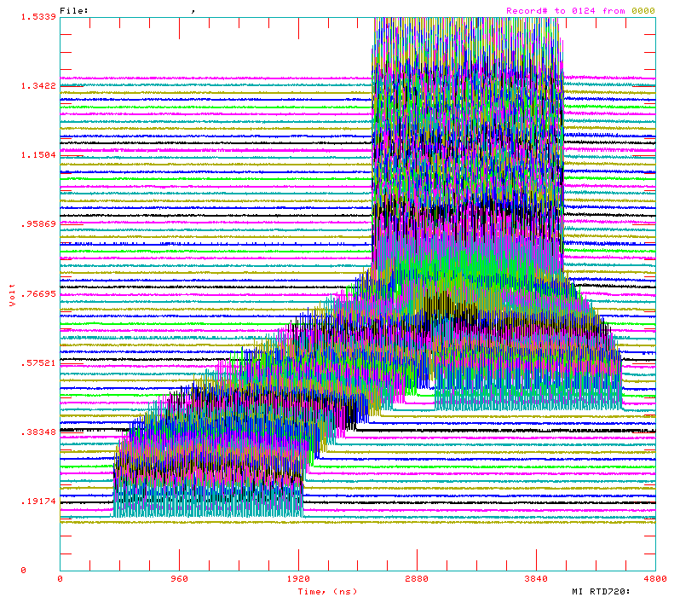
Main Injector Loading
The Main Injector has six usable “slots”, into which Booster batches may be placed.
More batches may be loaded, using “slip stacking”, in which batches are injected at slightly different energy, drift together, and are captures as one batch (with at least twice the longitudinal emittance).

Slide 10
Main Injector Loading (cont’d)
Initial NuMI operation (“2+5”):
  Two batches will be slip stacked for antiproton production.
  Five more batches will be loaded for NuMI
  All will be accelerated together.
Ultimate NuMI operation (“2+9”):
  Five batches will be loaded into the Main Injector, leaving one empty slot.
  Six more batches will be loaded and slipped with the first to make two for antiproton production and 9 for NuMI.
  This is beyond the capacity of the current RF system.

Slide 11
Main Injector RF Upgrade (3.4)
The existing RF system can accelerate about 4E13 protons
This is enough for 2+5 operation (~3.5E13 protons), but not enough for 2+9 (~5.5E13).
Each RF station has a port for a second PA.
The plan is to verify that this will provide enough power to accelerate 7E13 protons, then proceed with procurement to add a second PA.
This is the most expensive part of the plan and the most vital to NuMI operation.
It would require new modulators, which would make the old ones available for the Booster RF upgrade (2.9)
Plan
  Build prototype station this year to establish performance
  Proceed with procurement

Slide 12
Cost by Year (aggressive)
WBS | Description | Base Estimate: M&S and SWF |  |  |  | Total with Contingency
 |  | FY05 | FY06 | FY07 | Total
1 | Proton Plan | 8,341 | 10,965 | 3,854 | 23,161 | 33,904
1.1 | Linac Upgrades | 1,039 | 2,097 | 550 | 3,686 | 6,661
1.1.1 | Linac PA Vulnerability | 650 | 1,100 | 550 | 2,300 | 4,600
1.1.2 | Linac Quad Power Supplies | 248 | 997 | 0 | 1,245 | 1,867
1.1.3 | Linac Instrumentation Upgrade | 141 | 0 | 0 | 141 | 194
1.2 | Booster Upgrades | 1,945 | 4,718 | 2,613 | 9,276 | 13,027
1.2.1 | Determine Rep Rate Limit | 110 | 0 | 0 | 110 | 165
1.2.2 | ORBUMP System | 486 | 0 | 0 | 486 | 702
1.2.3 | Corrector System | 583 | 761 | 0 | 1,344 | 2,119
1.2.4 | 30 Hz Harmonic | 146 | 1,165 | 0 | 1,310 | 1,835
1.2.5 | Gamma-t System | 50 | 0 | 0 | 50 | 100
1.2.6 | Alignment Improvements | 30 | 30 | 0 | 60 | 90
1.2.7 | Drift Tube Cooling | 20 | 0 | 0 | 20 | 30
1.2.8 | Booster RF Cavity #20 | 420 | 0 | 0 | 420 | 630
1.2.9 | Booster Solid State RF PA's | 0 | 2,680 | 2,480 | 5,160 | 6,900
1.2.10 | Booster Instrumentation | 100 | 82 | 133 | 315 | 456
1.3 | Main Injector Upgrades | 5,010 | 3,860 | 450 | 9,320 | 12,900
1.3.1 | Large Aperture Quads | 600 | 0 | 0 | 600 | 900
1.3.2 | Main Injector Collimator | 250 | 100 | 0 | 350 | 700
1.3.3 | NUMI Multi-batch Operation | 50 | 150 | 50 | 250 | 500
1.3.4 | Main Injector RF Upgrade | 4,110 | 3,610 | 400 | 8,120 | 10,800
1.4 | Management | 348 | 290 | 241 | 879 | 1,316

Slide 13
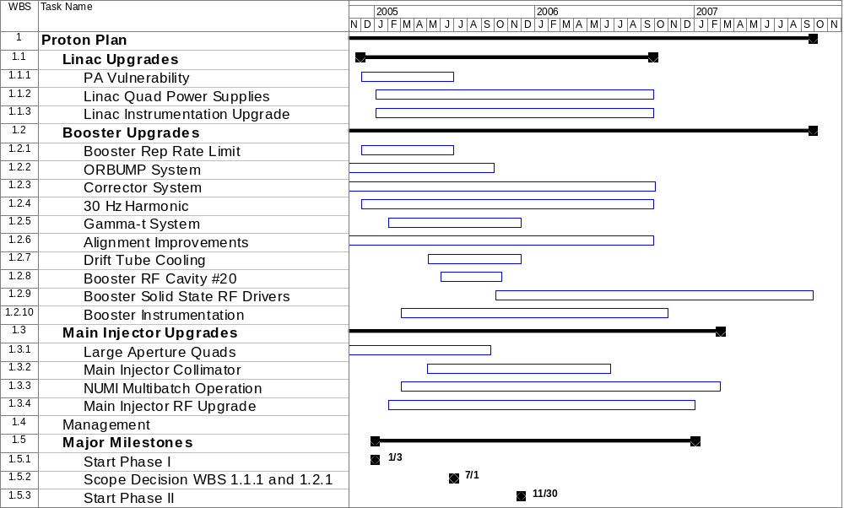
Time Table

Slide 14
Proton Projections
Phases of Operation
  Phase I
    After this shutdown
    Dogleg problem ameliorated
    Booster limited to 7.5Hz total repetition rate
    Main Injector limited to 4E13 protons (2+5 operation)
  Phase II
    After 2005 shutdown
    ORBUMP replaced
    RF cooling finished
    Booster capable of 9Hz operation
    MI still limited
  Phase III
    After 2006 shutdown
    MI RF upgrade complete
    2+9 operation to NuMI
2007

Slide 15
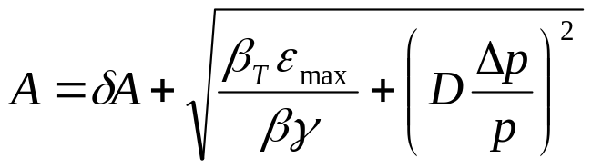
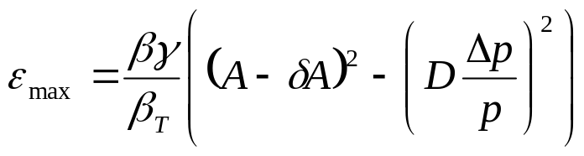
Evaluate Effect of Booster Improvements
Calculate effect of various improvments based on increased acceptance (a la McGinnis):
Use:
Effective aperture
reduction
Condition | Date | δA | max D | max beta | Acceptance | Relative
 | Completed | (mm) | (m) | (m) | (π-mm-mr) | Increase (%)
Start of MiniBooNE | --- | 10 | 6.2 | 45.8 | 15.7 | -15
Dogleg 3 Fix | Oct-03 | 10 | 4.5 | 40.8 | 18.4 | 0
Dogleg 13 Fix | Oct-04 | 10 | 3.8 | 36.1 | 21.0 | 14
Alignment | Oct-05 | 8 | 3.8 | 36.1 | 24.3 | 32
ORBUMP | Oct-05 | 5 | 3.8 | 36.1 | 29.5 | 60
correctors | Oct-06 | 2 | 3.8 | 36.1 | 35.2 | 92
Ideal | --- | 0 | 3.19 | 33.7 | 42.3 | 130

Slide 16
Effect on Max Proton Intensity
Prior to this shutdown, regularly delivering 7.5E16pph with ~40% reduction in activation around most of the Booster.
  Assume after another year of tuning and collimator optimization, we could have hit 1E17 pph with no other improvments (“fallback” = .9E17).
Operational experience: tuning asymptotically approaches benefit of a particular improvement:
  Assume after one year of tuning, 50% of the benefit of a particular improvement is realized (fallback = 25%).
Date | “Design” Limit (1E16 p/hr) | Fallback Limit (1E16 p/hr) | Comment
1/2006 | 10.7 | 9.3 | Effect of collimators, dogleg fix, plus some alignment
1/2007 | 13.0 | 10.4 | Alignment and ORBUMP
1/2008 | 14.6 | 11.0 | New corrector system

Slide 17
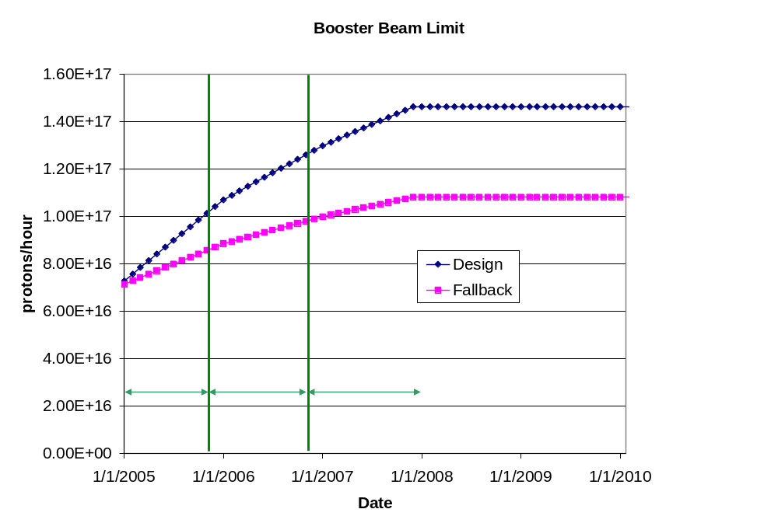
Predicted Proton Intensity Limits

Slide 18
Estimating PoT
Even the fallback proton scenario accommodates NuMI operation.
Total proton output continues to be limited by radiation losses, rather than Booster repetition rate.
We assume:
  NuMI and antiproton production get what they need
  The BNB gets whatever it can beyond that, within the total output limit of the Booster
This is a programmatic decision:
  Protons can be diverted from NuMI to the BNB, but not the other way around.
The BMB PoT estimates are extremely sensitive to the total proton limit, which is uncertain.

Slide 19
Calculating NuMI PoT
Even the fallback scenario accommodates NuMI operation.
Assume the following
  Booster batch intensity rises steadily to 5.5E12 over the next three years.
  Ramp up to full 2+5 operation by April 2005
  Ramp up to full 2+9 batch slipstacked operation a few months after MI RF upgrade.
  90% efficiency for slip stacking.
  10 month operation each year.
  81% total uptime for remainder of year
    based on MiniBooNE. Includes scheduled and unscheduled downtime
  90% avg/peak operating efficiency
  10% down time for shot setup
  5% down time for fast Recycler transfers
  5% down time during 2005 for Ecool accesses.
  Does NOT include SY120

Slide 20
Calculating BNB PoT
Trickier:
  Still limited by beam loss, NOT rep. rate.
  Assume antiproton and NuMI have priority, so
  BNB VERY sensitive to proton limit and its fluctuations.
Use:
(avg pph) = (pph lim.)*η – (NuMI pph) – (pbar pph)
Also assume:
  10 month operation
  81% up time (based on 2004)
  5% downtime in 2005 for ECool access
  BNB gets all the beam during shot setup (10% of the time)
Booster output limit, as discussed
Avg/pk ~ 86% from July 2004 MiniBooNE operation

Slide 21
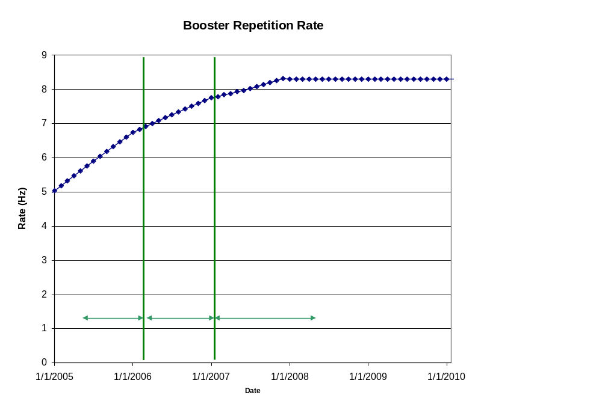
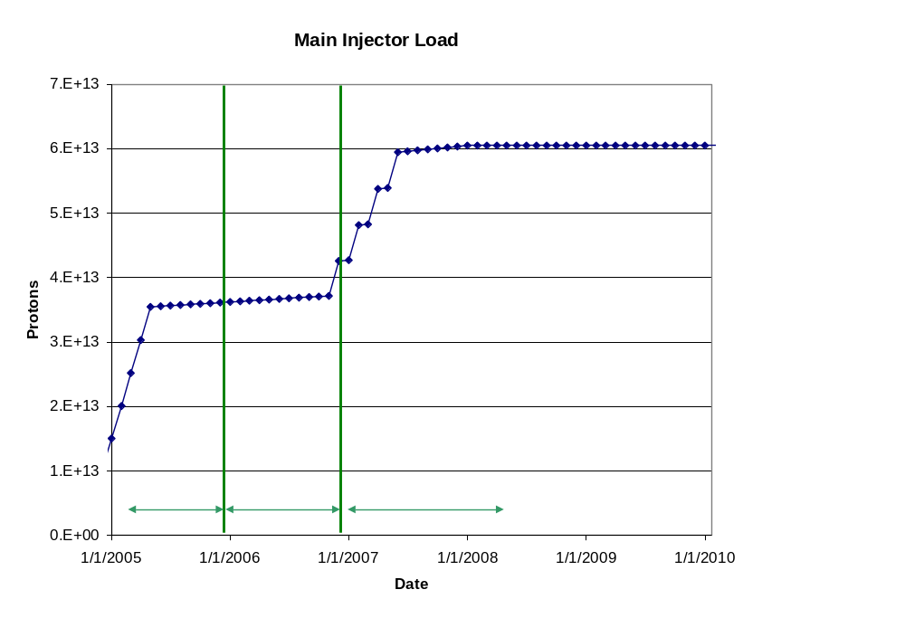
Machine Loading

Slide 22
“Design” PoT
 | Booster Batch Size | Main Injector Load | Cycle Time | MI Intensity | Booster Rate* | Total Proton Rate | Annual Rate at end of Phase
 |  | (AP + NuMI) | (sec) | (protons) | (Hz) | (p/hr) | NuMI | BNB
Actual Operation
July, 04 | 5.0E+12 | 1+0 | 2.0 | 0.5E+13 | 5.1 | 0.8E+17 | 0 | 3.3E+20
Proton Plan
Phase I | 5.10E+12 | 2+1→2+5 | 2.0 | 3.6E+13 | 6.3 | 1.0E+17 | 2.0E+20 | 1.5E+20
Phase II | 5.3E+12 | 2+5 | 2.0 | 3.7E+13 | 7.5 | 1.2E+17 | 2.2E+20 | 2.8E+20
Phase III | 5.50E+12 | 2+9 | 2.2 | 6.0E+13 | 8.3 | 1.5E+17 | 3.4E+20 | 2.2E+20
Beyond Scope of Present Plan
11 Hz | 5.50E+12 | 2+9 | 2.2 | 6.1E+13 | 11.0 | 2.0E+17 | 3.4E+20 | 5.0E+20

Slide 23
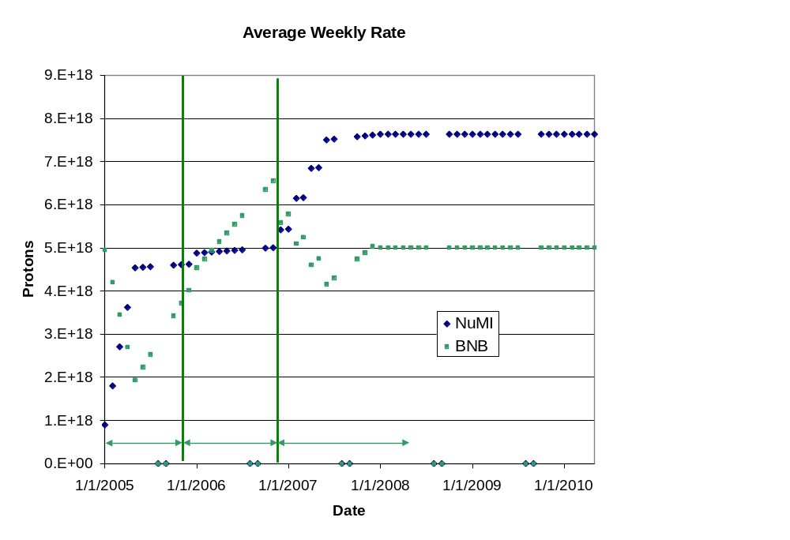
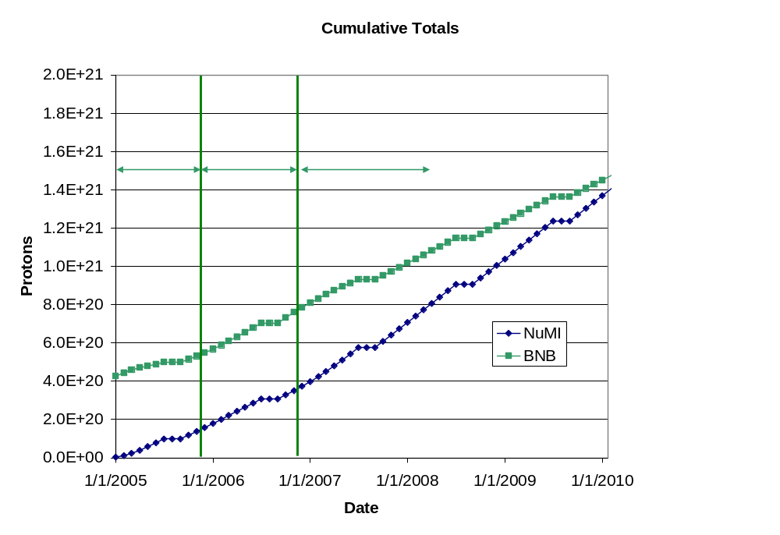
“Design” Totals (almost certainly outdated)

Slide 24
Fallback Scenarios
NuMI
  Project totals if the MI RF upgrade is delayed by a year (probable!!)
  Project totals if slip stacking fails entirely for one reason or another (pessimistic)
BNB
  Project totals if both the MI RF upgrade and the corrector upgrade are delayed by a year (probable)
  Project totals if the aperture improvements have only 25% of their calculated benefit (pessimistic)

Slide 25
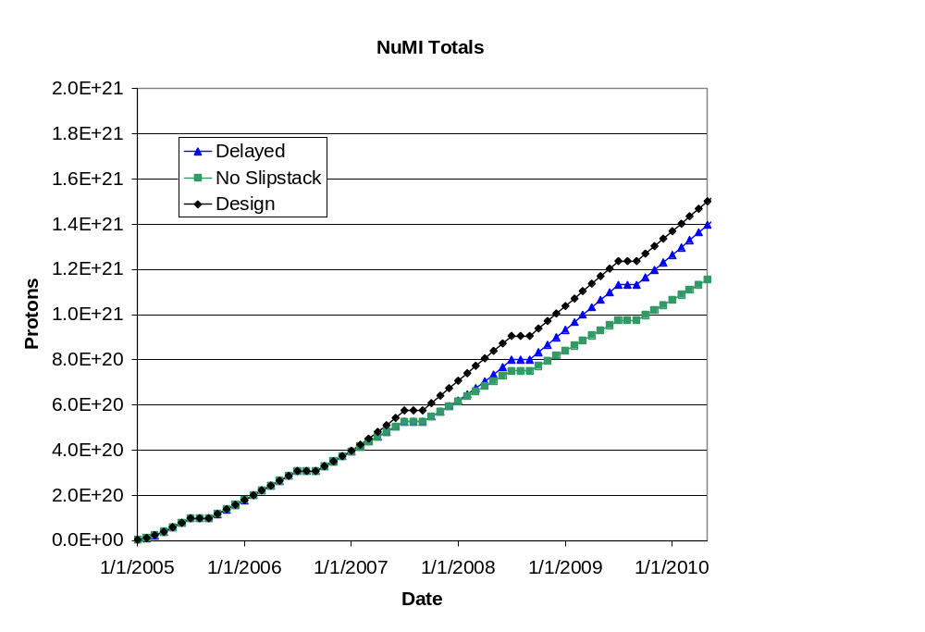
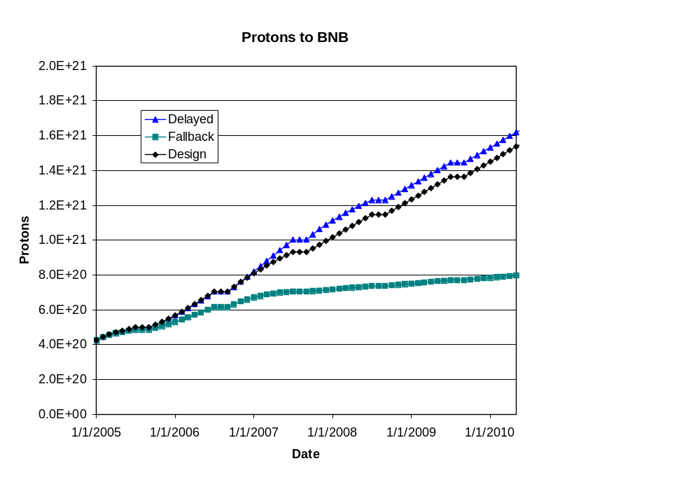
Fallback Projections (delayed scenario most likely)
BNB benefits from delayed slip stacking
BNB only during shot setup

Slide 26
What’s next for the Plan
Redo schedule to reflect probably funding realities
  Extremely unlikely RF will be in place before Fall 2007
Fill out management structure and focus on the most critical short term issues
  MI RF
  7835 task force
  Ongoing Booster projects

Slide 27
Summary
We have a plan for a set of improvements to maximize proton delivery to NuMI and the BNB for the foreseeable future.
We have made an attempt to estimate the benefits of these improvements.
NuMI proton delivery will be determined by how successful we are with the RF upgrade and the implementation of slip stacking.
BNB proton delivery will depend on the total proton output capacity of the Booster, and is therefore still highly uncertain.

Slide 28
Linac Projects
1.1: PA Vulnerability
  Come up with a plan for dealing with the Linac Power Amplifier (7835) situation once and for all. Investigate:
    Low Energy Linac replacement
    Other tubes (e.g. Thales 629)
    Other 200 MHz power (e.g. multi-beam klystrons)
    In-house fabrication
    Significant collaboration with Burle
  Submit report to AD head by Feb, 2004.
1.2: Pulse Quad Power Supplies
  Replace pulsed quadrupoles in the old Linac
  Very similar to pulsed supplies in newer linac
1.3: Instrumentation Upgrade
  Inadequate Linac instrumentation has led to extended periods of non-optimal running
  Only 1/3 of BPM’s instrumented.
  Project started in 2004
  Add 10 MHz digitizers to old linac RF stations
  Move existing BPM digitizers to High Energy Linac
  Instrument all BPM’s with 10 MHz digitizers.

Slide 29
Booster Projects
2.1: Determine the Booster repetition rate limit
  Once the other upgrades described here are complete, the Booster will be capable of extended running at 15Hz, except for the RF system.
  The limit is believed to be 8-9Hz, limited by the main power, but this is not well understood.
  Although the current scope of the plan does not require us to go beyond 9 Hz, we feel it is important to understand the limitation and what would be required to elimniate it.
2.2: ORBUMP System
  Existing injection bump (ORBUMP) has two problems
    Average repetition rate of the magnet and power supply is limited to 7.5 Hz by heating.
    It lacks the power to move the beam out far enough at injection, resulting in a mismatch
  Plan is to replace the (4) magnets and power supply
  Magnet fabrication is under way, with the first magnet just completed.
  Aim to put new system in place during 2005 shutdown.

Slide 30
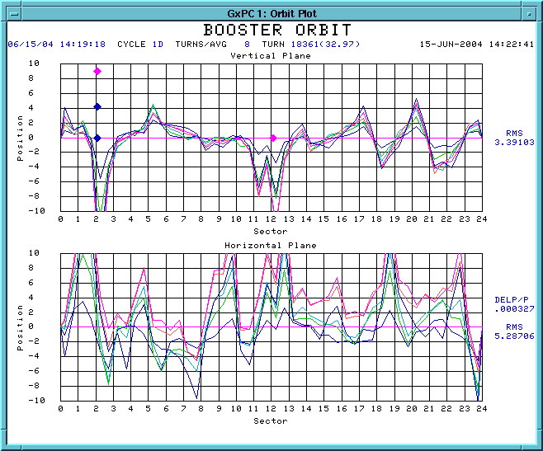
Booster Projects (cont’d)
2.3: Booster corrector system
  Each of the 48 subperiods of the Booster have a trim package which contains H and V dipoles, as well as a quadrupole and a skew quadrupole.
  These are not adequate to control beam position or tune through the cycle.
  There would also be benefits to putting a sextupole in each package.
  We are working with TD to design a new corrector package for the Booster, which will allow precise control of both beam position and tune throughout the cycle.
V
Beam position around ring, relative to injection, at various times in cycle
H

Slide 31
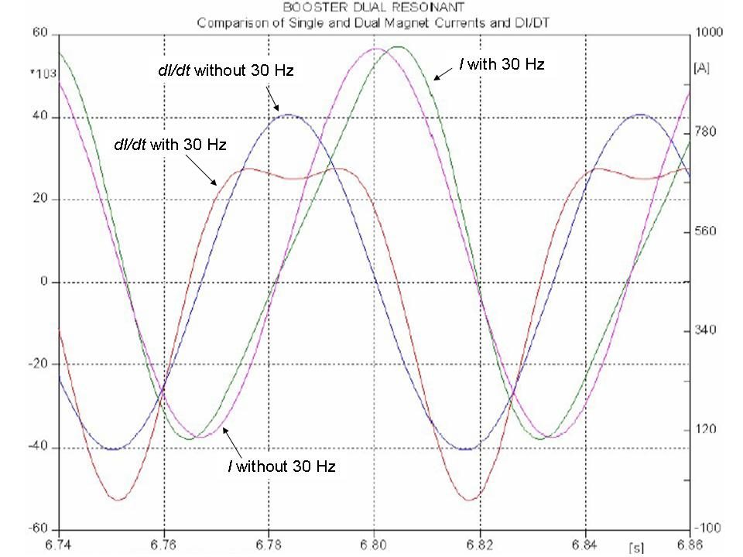
Booster Projects (cont’d)
2.4: 30 Hz harmonic
  The booster lattice magnets operate in a 15 Hz offset resonant circuit.
  By modifying the magnet girdirs to ad a 30 Hz component, we could reduce the maximum acceleration rate, which is equivalent to increasing RF accelerating voltage
  This would allow us to accelerate more beam per batch.

Slide 32
Booster Project (cont’d)
2.6: Gamma-t System
  The booster transition jump system has a long history.
  May be necessary to fully take advantage of other upgrades to increase batch intensity.
  It suffers from misalignment problems and exacerbates coupled bunch instabilities, so we don’t use it.
  Will schedule a series of studies to make a either make it work or decide to abandon it within a year.
2.7: Alignment
  The Booster has never been properly aligned
  Made significant progress in the vertical plane and with RF cavity alignment over the last year.
  Over the shutdown, did a TeV style 3D laser tracker network and as-found.
  Will use this data to form a plan for girder moves over the next year or so.

Slide 33
Booster Projects (cont’d)
2.8: RF Drive tube cooling
  Once the ORBUMP project is complete, the next rate limit comes from heating of the RF cavities.
  The cavities contain internal cooling channels, which are no longer used because some of them leak.
  We are building water cooled slip rings, which can be installed in cavities during normal maintenance.
  Once this is done, the cavities themselves should be good for 15 Hz.
2.9: RF Power Amplifier Upgrade
  The booster RF Power amplifiers are our highest maintenance item.
  Servicing them results leads to some of the higher radiation exposures at the lab (typically 100-150 mRem/quarter).
  These can be replaced with Main Injector style solid state drivers, which have a MTBF of three to four times longer.
  This is expensive, but the cost is offset by the $400K we currently spend on tubes for the existing PA.

Slide 34
Booster Projects (cont’d)
2.10: Instrumentation Upgrade
  The Booster instrumentation is largely antiquated.
  There are a large number of ramped devices, which are difficult to monitor in our existing alarms and limits system
  A software package has been developed to automatically monitor ramped devices in the Booster, but it is limited by the existing instrumentation.
  Also, our BPM system, while adequate, is becoming difficult to service.
  We plan to install a new readout system based on the Hotlink Rack Monitor (HRM) standard, which will allow much more reliable, high rate data acquisition from the Booster.

Slide 35
Main Injector Projects
3.1: Large Aperture Quadrupoles
  A number of the existing quadrupoles cause losses near injection and extraction Lambertsons.
  These will be replaced with larger aperture quads designed as part of the Proton Driver R&D.
  The fabrication is already under way.
3.2: Main Injector Collimation System
  It is possible that the large amount of beam being transported and the increased longitudinal emittance of slip stacking may result in unacceptable losses and activation in the MI.
  This may require a collimation system, similar to the Booster.
  We will investigate the need for such a system, and determine the cost if it proves to be necessary.

Slide 36
Cost and Schedule
Methodology.
  Establish total costs based on best available estimates on individual components.
  Assign contingency to individual components as:
    Recent experience or direct quote: 20%
    Similar experience, rules of thumb, etc: 50%
    Good faith estimate: 100%

Slide 37
Background: What Limits Total Proton Intensity?
Maximum number of Protons the Booster can stably accelerate: 5E12
Maximum average Booster rep. Rate: currently 7.5 Hz, may have to go to 10 Hz for NuMI+ (full) MiniBooNE
(NUMI only) Maximum number of booster batches the Main Injector can hold: currently 6 in principle, possibly go to 11 with fancy loading schemes in the future
(NUMI only) Minimum Main Injector ramp cycle time (NUMI only): 1.4s+loading time (at least 1/15s*nbatches)
Losses in the Booster:
  Above ground radiation
  Damage and/or activation of tunnel components
Our biggest worry at the moment!!!!

Slide 38
Big Improvements in the Last Year
Primary extraction “dogleg fix”
  Increase spacing between magnets in chicane system
  Reduces distortion to injection lattice by ~40%
Vertical alignment
  Eliminate ¼” misalignment at collimator region
  Improve high field orbit
400 MeV line work
  Better understanding
  Improved stability and repeatability
Injection bump (ORBUMP) improvements
  Improved water flow
  New, lower resistance capacitors
  Much more reliable
Collimator installation and commissioning
Advent of slip stacking
  Booster “cogging” + MI slipping

Slide 39
Major Performance-related Shutdown Projects
Modify L13 extraction region:
  Overall ~5 reduction in original “dogleg effect”
  Factor of 3 reduction over present effect
Adding 19th RF cavity:
  Use large aperture prototype
  Increase maximum batch size (~6.5E12)
  Increase reliability (can run with one failure)
Prep. for 20th cavity next year
Complete modern laser tracker 3D network and as-found in the Booster and 400 MeV line:
  Will be used to fully align the Booster next year
Move “pinger” girder to period 5:
  Extraction pre-notch will now fire into collimators
  Phased to aid extraction at both extraction regions!

Slide 40
Main Injector Loading Projects
3.3: Main Injector Multi-Batch Operation
  This item comprises the studies and development time necessary to operate NuMI in a multi-batch operation, as described earlier.
    Initial 2+5 operation
    Slip stacking for 2+9 operation
3.4: Main Injector RF Upgrade
  The existing RF system can accelerate about 4E13 protons
  This is enough for 2+5 operation (~3.5E13 protons), but not enough for 2+9 (~5.5E13).
  Each RF station has a port for a second PA.
  The plan is to verify that this will provide enough power to accelerate 7E13 protons, then proceed with procurement to add a second PA.
  This is the most expensive part of the plan and the most vital to NuMI operation.
  It would require new modulators, which would make the old ones available for the Booster RF upgrade (2.9)

Slide 41
Cost
WBS | Description | M&S Base | M&S Cont | M&S Total | SWF Base | SWF Cont | SWF Total
1 | Proton Plan | 16,513 | 42% | 23,486 | 6,648 | 57% | 10,419
1.1 | Linac Upgrades | 2,705 | 86% | 5,039 | 981 | 65% | 1,622
1.1.1 | Linac PA Vulnerability | 2,000 | 100% | 4,000 | 300 | 100% | 600
1.1.2 | Linac Quad Power Supplies | 617 | 50% | 925 | 628 | 50% | 942
1.1.3 | Linac Instrumentation Upgrade | 88 | 30% | 114 | 53 | 50% | 80
1.2 | Booster Upgrades | 6,499 | 35% | 8,765 | 2,777 | 54% | 4,262
1.2.1 | Determine Rep Rate Limit | 0 | 0 | 0 | 110 | 50% | 165
1.2.2 | ORBUMP System | 256 | 42% | 364 | 231 | 47% | 338
1.2.3 | Corrector System | 629 | 58% | 995 | 715 | 57% | 1,124
1.2.4 | 30 Hz Harmonic | 1,031 | 35% | 1,388 | 279 | 60% | 447
1.2.5 | Gamma-t System | 0 | 0 | 0 | 50 | 100% | 100
1.2.6 | Alignment Improvements | 0 | 0 | 0 | 60 | 50% | 90
1.2.7 | Drift Tube Cooling | 10 | 50% | 15 | 10 | 50% | 15
1.2.8 | Booster RF Cavity #20 | 300 | 50% | 450 | 120 | 50% | 180
1.2.9 | Booster Solid State RF PA's | 4,200 | 30% | 5,460 | 960 | 50% | 1,440
1.2.10 | Booster Instrumentation | 73 | 27% | 93 | 242 | 50% | 363
1.3 | Main Injector Upgrades | 7,294 | 32% | 9,661 | 2,026 | 60% | 3,239
1.3.1 | Large Aperture Quads | 194 | 50% | 291 | 406 | 50% | 609
1.3.2 | Main Injector Collimator | 200 | 100% | 400 | 150 | 100% | 300
1.3.3 | NUMI Multi-batch Operation | 0 | 0 | 0 | 250 | 100% | 500
1.3.4 | Main Injector RF Upgrade | 6,900 | 30% | 8,970 | 1,220 | 50% | 1,830
1.4 | Management | 15 | 32% | 20 | 864 | 50% | 1,296

Slide 42
Linac Projects
1.1: PA Vulnerability
  Come up with a plan for dealing with the Linac Power Amplifier (7835) situation once and for all. Investigate:
    Short term
      Work to maximize tube yield and lifetime
        Oven or test stand for Burle?
        Compare FNAL to BNL
      Report to AD head by Feb. 2005
    Long term
      Recommendation for next 10 years
        Burle OK?
        New 200 MHz tube?
        Multi-beam klystron?
        In-house production?
      Report to AD head by July, 2005

