Slide 1
Proton Plan
Status and Projections
Eric Prebys

Slide 2
Proton Plan Charge
Develop a plan for a reasonable set of improvements and operational initiatives to maximize proton delivery to NuMI and the Booster Neutrino Beam (BNB)
Estimate the budget and timeline for these improvements.
Estimate proton delivery to both beam lines if the Plan proceeds on schedule.
Note:
  This project precedes other work that must be done to support the NoVA program
  This project precedes a proton driver or other significant improvements to the complex that are under discussion.

Slide 3
Limits to Proton Intensity
Total proton rate from Proton Source (Linac+Booster):
  Booster batch size
    ~4-5E12 protons/batch
  Booster repetition rate
    15 Hz instantaneous
    Prior to 2006 shutdown: 7.5Hz average (injection bump+RF)
    Now: 9 Hz (including conditioning pre-pulses)
  Beam loss
    Damage and/or activation of Booster components
    Above ground radiation
Total protons accelerated in Main Injector:
  Maximum main injector load
    Six “slots” for booster batches (3E13)
    Up to ~11 with slip stacking (4-5E13)
    Some RF issues
  Cycle time:
    1.4s + loading time (1/15s per booster batch)
Historically our biggest worry

Slide 4
NuMI Operating Modes
Initial NuMI operation (“2+5”):
  Two batches slip stacked for antiproton production.
  Five more batches loaded for NuMI
  All will be accelerated together.
  This is the current standard operation.
Ultimate NuMI operation (“2+9”):
  Five batches will be loaded into the Main Injector, leaving one empty slot.
  Six more batches will be loaded and slipped with the first to make two for antiproton production and 9 for NuMI.
  This is under study, but will probably not result in a net increase in protons until after the next shutdown

Slide 5
Context: Staged Approach to Neutrino Program
Proton Plan
NuMI era (concurrent with Run II)
  Ramp up to deliver slip stacked protons to both NuMI and antiproton production
  Continue to deliver protons to the 8 GeV line at some level
  Goal:
    ~400 kW to NuMI
    1-2E20 protons to 8 GeV line
S(uper)NuMI era (after collider program)
  Use Recycler as a pre-loader to the Main Injector to eliminate loading time
  Details being worked out. Becoming a formal plan.
  Goal
    ~700 kW to NuMI line
SNuMI 2 (tentative)
  Use Antiproton Accumulator Ring to momentum stack protons
  Boxcar stack these protons into Recycler
  Load into Main Injector
  Goal
    ~1.2 MW to NuMI line
Proton Driver?
  Always a possibility, but not part of our baseline thinking at the moment.

Slide 6
Goals of Plan
120 GeV (NuMI)
  Accelerate 4-5E13 protons per 2.2s cycle
  This alone is within demonstrated performance of the Booster (at least in terms of total protons):
    7.5Hz adequate
    Total proton rate ~OK
  Most of the necessary work is in Main Injector
  Maintaining acceptable longitudinal quality from Booster for slip stacking presents an operational challenge
8 GeV (BNB)
  Maintain ~2e20 p/year to maintain 8 GeV neutrino program
  Requires ~50% increase in total protons
  Requires Booster to go to ~9Hz
Future
  Pave the way for increased beam throughput needed by SNuMI and beyond

Slide 7
Proton Plan Time Line
Ancient history: “optimism”
2001-2003: Series of reports raising red flags about beam delivery do NuMI
11/04: First draft of “proton plan”
8/05: First Director’s Review
9/05: “Baseline”
Since baseline:
  Plan carefully tracked with monthly PMG meetings
  Change control through formal change request (CR) procedure.
    So far, 19 CR’s of varying magnitude

Slide 8
Significant Elements of Plan
Linac
  Stockpile two year supply of spare 200 MHz power amplifier tubes (7835’s), in the event of an interruption in supply
  Characterize and improve Low Energy Linac Low Level RF
Booster:
  Replace and reconfigure injection bump (ORBUMP) system.
  Relocate 8 GeV dump from Booster tunnel to MI-8 transfer line
  Make Booster robust to 9 Hz, and understand requirements to go to 15 Hz
  Design, build, and install new corrector system
Main Injector:
  Replace seven quadrupoles with increased aperture versions, to reduce injection and extraction losses.
  Operationally develop multi-batch and multi-batch slip stacked operation
  Design and install collimation system, both in the MI-8 line and in the MI ring
  Modify injection kicker to allow multi-batch slip stacked operation
  Characterize and perhaps make improvements to RF system, to support high intensity operation.
Red = completed by end of shutdown

Slide 9
Major 2006 Shutdown Projects
Linac
  Used shutdown to make characterization measurements needed for LLRF project (1.1.4.1.1)
Booster
  New injection bump (ORBUMP) scheme installed and 400 MeV line reconfigured (1.2.2)
  RF cavity drift tube cooling completed (1.2.7)
  One of the two extraction regions removed from Booster and relocated to the MI-8 transfer line (1.2.11)
  New 13.8 kV tranformers and switch gear installed for Booster RF system (1.2.13.1)
  Significant non-Plan Booster projects:
    400 MeV line LVPS replacement
    Sump water rerouting
Main Injector
  Seven large aperture quad magnets installed to eliminated aperture restriction (1.3.1)
  Collimation system installed in MI-8 line (1.3.2.2)
  MI-10 kicker modified to allow rep. rate needed for slip stacked NuMI operation (1.3.3.2)

Slide 10
Effect of Shutdown work
ORBUMP
  New injection scheme works well
  Injection orbit slewing reduced from ~1cm to about 2mm
  Removed rate issue
Booster dump relocation
  New dump works fine
  Now able to maintain a more stable orbit during acceleration in Booster
MI-8 collimation
  Not yet commissioned
Main Injector Large Aperture Quads
  Significantly increased aperture (see Kourbanis’ talk)
MI-10 kicker
  Now capable of full slip stacked operation
  Better pulse quality
-> Record Booster Intensities

Slide 11
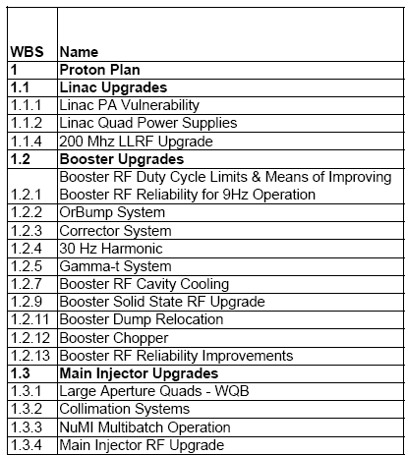
Summary at a Glance
= Task completed during shutdown
= Significant element completed during shutdown
= Non-shutdown task completed
= Task descoped
New 13.8 kV transformers and switch gear for Booster RF
MI-8 Collimation Complete
MI-10 kicker upgrade

Slide 12
Future
A significant part of the Proton Plan was completed (or descoped) by the end of the recent shutdown.
This will free up some badly needed expertise to focus on optimizing the system to take advantage of the improvements that have been made.
The most significant remaining tasks are:
  Linac LLRF (1.1.4)
  Booster Corrector System (1.2.3)
    This would be a major project all by itself
  Main Injector Ring Collimation (1.3.2.1.3)
  Main Injector RF Upgrade (1.3.4)
    Series tube modulator power dissipation
    Anode power supply rectifier transformer
    Solid State Driver power supplies

Slide 13
Where we stand with respect to NuMI
The Booster has demonstrated the performance necessary to deliver the protons and quality necessary for ultimate NuMI performance.
  Remaining Booster projects are aimed at providing overhead for 8 GeV operation, maintaining stable operation, and laying the groundwork for SuperNuMI.
The Main Injector has demonstrated full 2+5 operation.
Things remaining to be done for 2+9 NuMI operation
  MI ring collimation
    Conceptual review passed
    On track for construction and installation in the 2007 shutdown
  MI Upgrades
    On track (if we get resources) for 2007 shutdown

Slide 14
Procedure for estimating Proton Delivery
Assume traditional operational priority:
  Protons for pBar production
    Limited by ability to slip stack
    Limited by max cooling rate
  Protons for NuMI
    Limited by max Booster batch size
    Limited by max MI cycle rate
    Limited by max MI proton capacity
    (will be) limited by ability to slip stack NuMI protons in MI
  Protons for BNB (currently MiniBooNE)
    Determined by difference between Booster capacity and maximum MI loading.
    Currently limited by Booster lossesUltimately limited by Booster rep. rate.
    Extremely sensitive to fluctuations in total Booster output

Slide 15
Important Milestones
2006 Shutdown
  Maximum Booster rep. rate increases from 7.5Hz->9Hz
  Main Injector Improvements will allow studies of full 2+9 operation
  Assume beam loss in Main Injector limits us to 2+5 as standard operation.
2007 Shutdown
  Installation of half of Booster correctors will allow increased throughput
  Collimation and RF Improvements in the Main Injector will allow operational slip stacking (2+9) operation to NuMI
2008 Shutdown
  With the installation of last Booster correctors and improved gamma-t magnets, all Proton Plan projects complete.

Slide 16
Estimating Booster Output
History has shown that the lab tends to overestimate the benefits of particular improvements.
  Tuning and optimization take a long time
  Tend to asymptotically approach the goal, then get distracted by other things.
So we…
  Evaluate the potential of particular improvements based on effective aperture increase or uncontrolled beam loss reduction:
    For example, if something reduces uncontrolled loss by 10%, it has the potential to allow us to send 10% more beam.
  Consider the following scenarios:
    “Design”: After one year of tuning, we realize half of the potential benefit.
    “Fallback”: After one year of tuning, we realize one quarter of the potential benefit.

Slide 17
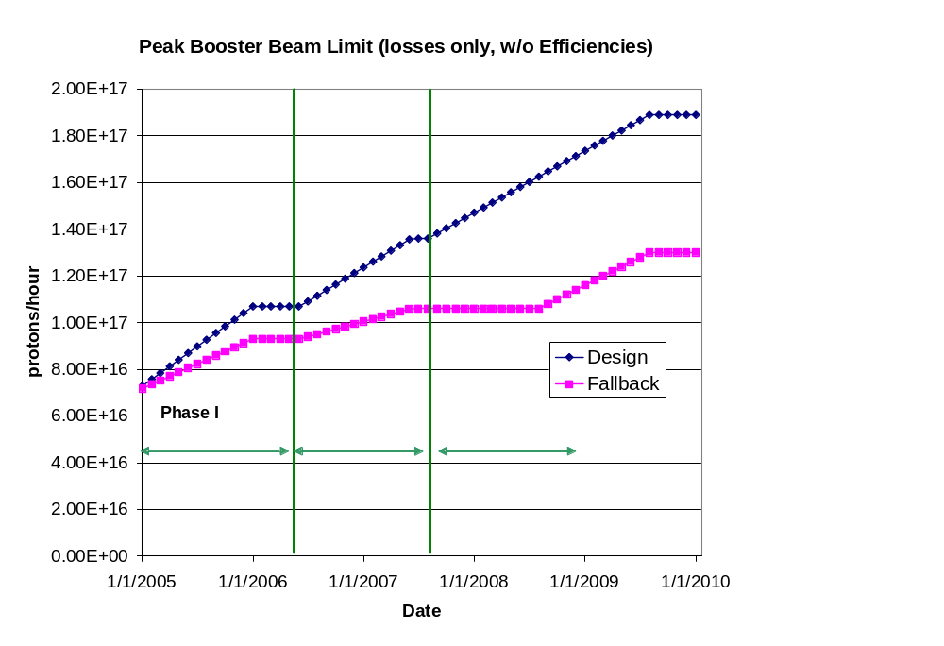
Peak Booster Intensities
These are “peak” numbers
An “average to peak” correction is applied to get average values
These are the numbers from loss limits
The real peak value will be limited by the 9Hz rep rate at about 1E17, depending on batch size.

Slide 18
Factors Considered in FY05, FY06 Projections
Linear ramp-up to see benefit of improvements
Slip stacking efficiency
  Done in a confusing way (more about this later)
Annual shutdowns (assume 2 mo/yr)
Uptimes: based on MiniBooNE 2004
Peak to average corrections
  For BNB, based on MiniBooNE 2004
  For NuMI, used reasonable guess
Effects of shot setup
Implemented as VB routines in Excel spreadsheet
  Easy to modify

Slide 19
How are we doing so far?
Compare NuMI and MiniBooNE to FY05 and FY06 “blue and red” curves
  Approximately equal to Proton Plan projections shown at last review
General comments
  Booster peak intensities have not been quite as high as projected
  NuMI rate has been severely affected by unplanned down times
  MiniBooNE benefited significantly from these downtimes

Slide 20
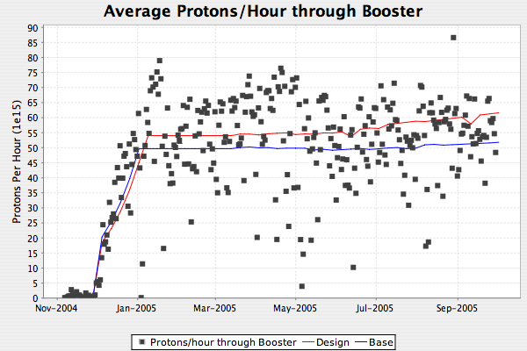
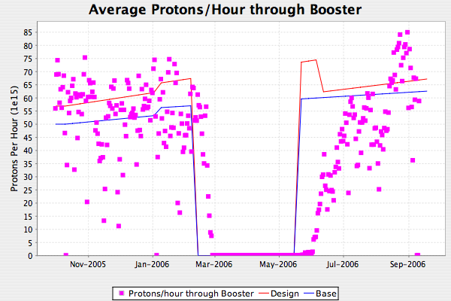
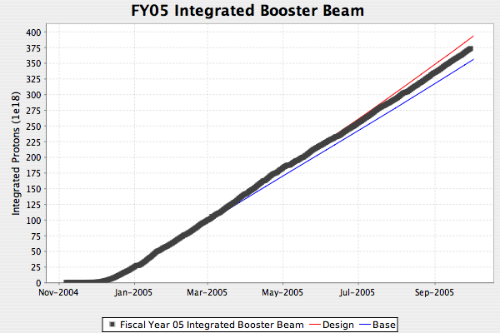
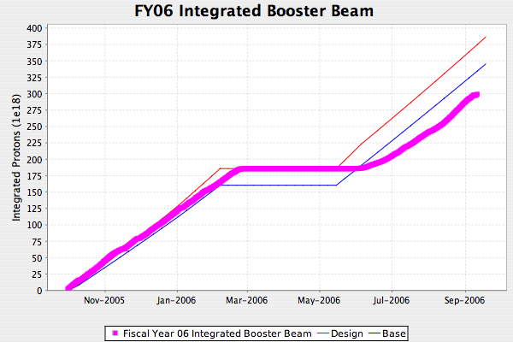
Total Protons Through Booster
Turn on slower than expected

Slide 21
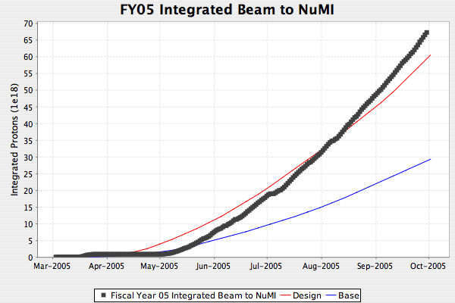
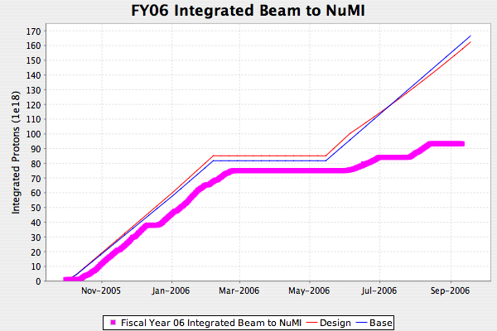
Protons to NuMI
NuMI Beam delivery significantly impacted by unforseen down times
Water in target
Resin beads in water system
Resin beads in water system
Horn ground fault (loose foot)
Tritium in water
Special runs
Note: without slip stacking, NuMI rate set by 5 booster batch limit, so no way to get back to curve by end of FY

Slide 22
Revisions to Long Term Projections
Batch size
  Old scheme used one batch size with low “efficiency” for slip stacked batches
    Accurate but confusing
  New scheme has two explicit batch sizes
Slip stacking to NuMI
  Originally believed we could start slip stacking after the 2006 shutdown.
  Now believe slip stacking losses will necessitate collimators, which will not be installed until 2007 shutdown
Uptime
  Major factor in NuMI beam delivery
  Old scheme had only small variation between design and base (~81%)
  New scheme:
    NuMI “base” will be ~uptime from turn-on through shutdown (70%)
    BNB base will budget 1 unscheduled horn replacement every two years (78%)

Slide 23
Revisions (cont’d)
Post shutdown turn-on
  Historically tried to cover this by using a projection shutdown longer than actual shutdown
    Real shutdown always extended to same length
    Still looks bad
  New scheme:
    Post shutdown exponential ramp up with (τ ~2 weeks)
Cogging losses
  Old scheme did not account for the fact that cogged cycles (pbar and NuMI) lose more energy than uncogged cycles.
  Somewhat compensated by the old way we handled slip stacked batch sizes.
  Now include 20% increased energy loss for cogged cycles.

Slide 24
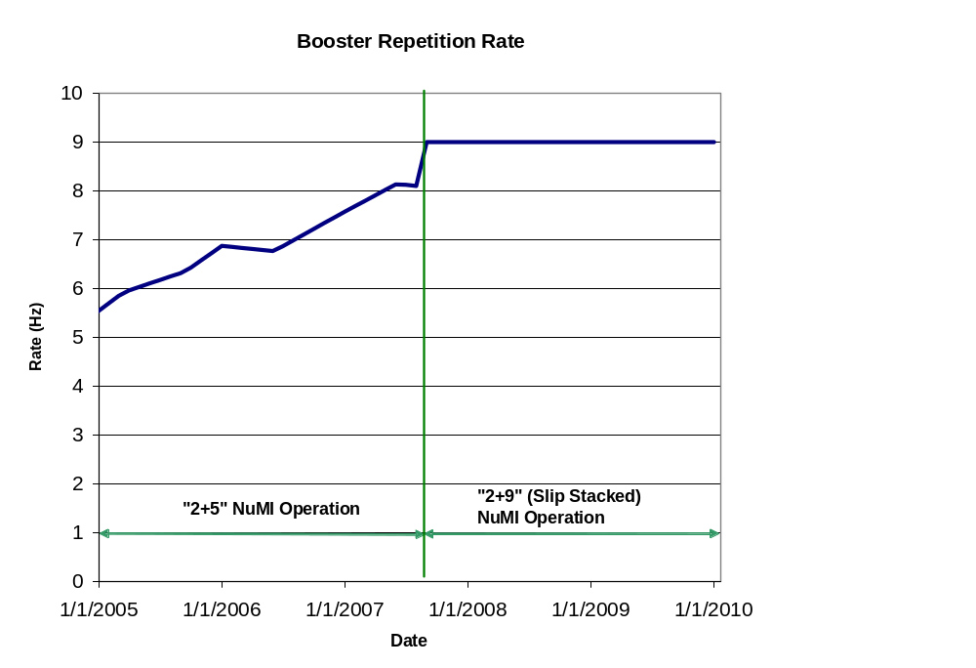
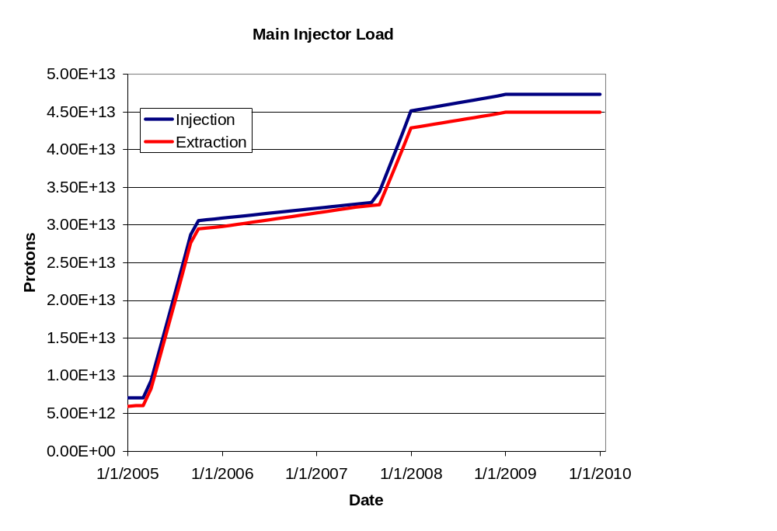
Machine Loading
Assumes model where slip stacking is implemented by going immediately to 2+9, but with reduced batch sizes to NuMI.
Ultimate goal (44 week year)
  NuMI: 3.2E20 p/yr
  BNB: 1.8E20 p/yr

Slide 25
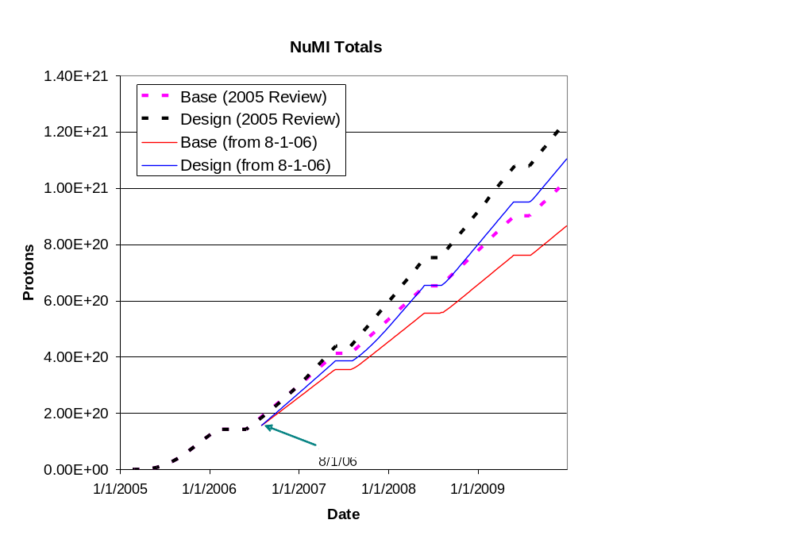
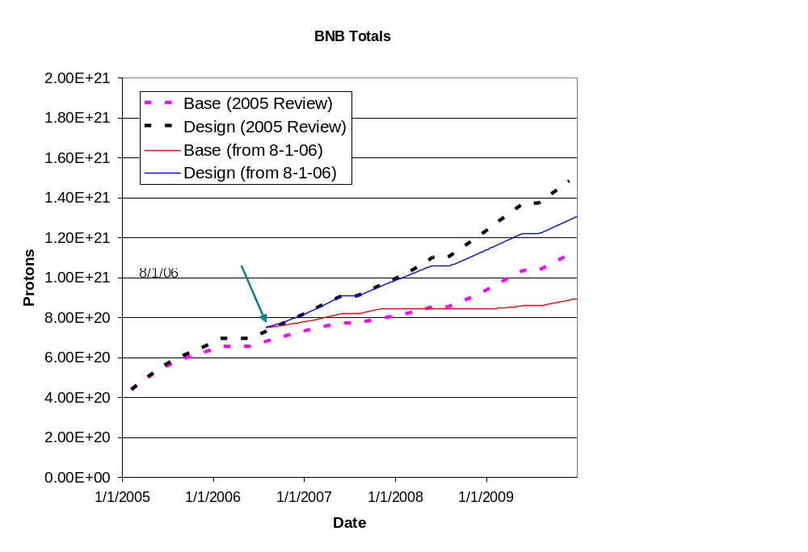
Cumulative Totals

