Slide 1
Proton Plan
Eric Prebys, FNAL Accelerator Division

Slide 2
Charge
Develop a plan for a set of upgrades and operational improvements to maximize proton delivery to:
  NuMI beamline (120 GeV from MI)
  Booster Neutrino Beam (BNB) (8 GeV from Booster)
Goal: complete the upgrades over the next 3 years, and operate through 2015 or beyond
  Note: this plan precedes the Proton Driver replacement of the existing Proton Source (Linac+Booster)
Develop the budget and timeline for these improvements
Estimate projected proton delivery (PoT) to both beam lines

Slide 3
Management Organization
Accelerator Projects
Jeff Spalding (Head)
Bruce Baller (Deputy)
Project Support Team
(Bruce Baller), Leader
Ken Domann
Ann Nestander
Jeff Sims
Alan Wehmann
Proton Plan
Eric Prebys, PM
Jeff Sims, Deputy
Run II Upgrades
Pushpa Bhat, PM
Mike Martens (Deputy)
Project support team:
  Resource-Loaded Schedule (MS Project) – Domann
  Accounting - Cobra interface to Lab’s system - Nestander
  Project management support – Sims
  Web and documentation support - Wehmann

Slide 4
Context: Staged Approach to
Neutrino Program
Stage 0 (now):
  Goal: deliver 2.5E13 protons per 2 second MI cycle to NuMI (~2E20 p/yr
  Deliver 1-2E20 protons per year to Booster Neutrino Beam (currently MiniBooNE)
Stage 1 (~2008):
  A combination of Main Injector RF improvements and operational loading initiatives will increase the NuMI intensity to 4-5E13 protons per 2.2 second cycle (~3E20 p/yr)
  This will increase by ~20% as protons currently used for pbar production become available
  It is hoped we can continue to operate BNB at the 2E20 p/yr level during this period.
Stage 2 (post-collider):
  Consider (for example) using the Recycler as a preloader to the Main Injector and reducing the Main Injector cycle time
  The exact scope and potential of these improvements are under study
Stage 3 (proton driver)
  Main Injector must accommodate 1.5E14 protons every 1.5 seconds
  NuMI beamline and target must also be compatible with these intensities.

Slide 5
Limits to Proton Intensity
Total proton rate from Proton Source (Linac+Booster):
  Booster batch size
    Typical ~5E12 protons/batch
  Booster repetition rate
    15 Hz instantaneous
    Currently 7.5Hz average (limited by injection bump and RF cooling)
  Beam loss
    Damage and/or activation of Booster components
    Above ground radiation
Total protons accelerated in Main Injector:
  Maximum main injector load
    Six “slots” for booster batches (3E13)
    Up to ~11 with slip stacking (5.5E13)
    RF stability limitations (currently ~4E13)
  Cycle time:
    1.4s + loading time (1/15s per booster batch)
Operational Limit

Slide 6
Plan Strategy
See document: BEAMS-DOC-1441 (11/09/04) at http://beamsdocs.fnal.gov/cgi-bin/public/DocDB/DocumentDatabase
Increase the proton delivery from the Booster (to both NuMI and BNB)
  Increase acceptance by improving orbit control and beam quality
  Increase maximum average Booster repetition rate
Increase the beam intensity in the Main Injector for NuMI
  Main Injector multi-batch operation
  Slip stacking in Main Injector (requires RF upgrade)
Improve operational reliability
  Alleviate 7835 Problem
  Linac quad supplies
  Booster and Linac Instrumentation
  Booster RF Upgrade

Slide 7
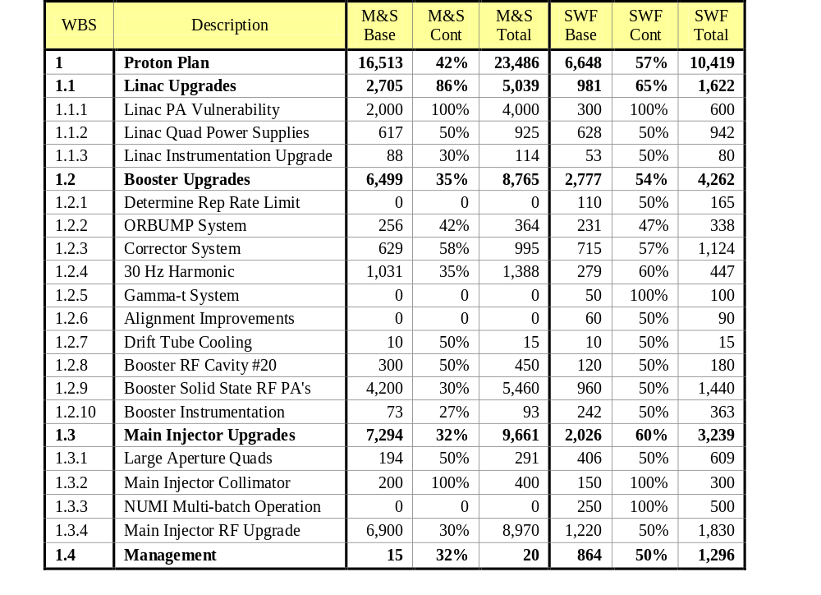
Cost Tables from Beams-Doc-1441 (a)
TABLE 2: M&S and SWF in $K at Level 3
46% contingency in M&S+SWF
Dominated by M&S (esp RF parts)
WBS is aligned to AD Organization by Accelerator

Slide 8
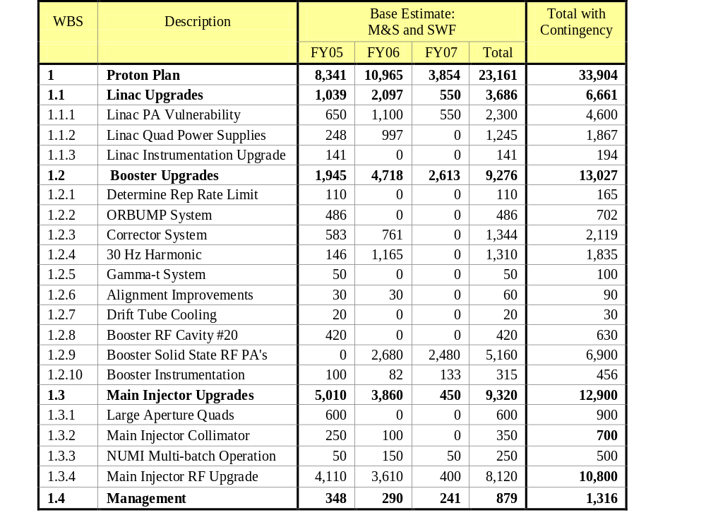
Cost Tables from Beams-Doc-1441 (b)
TABLE 3: Total cost (M&S and SWF) by fiscal year.
currently redefining scope to fit new budget guidance

Slide 9
Current Budget Guidance
After the cancellation of BTeV, we have the following budget guidance (M&S+SWF):
Most Likely Scenario
  Main Injector RF project and Booster Corrector System get delayed by one year, relative to the original plan
  Booster RF Solid State PA upgrade deferred indefinitely
 | FY05 | FY06 | FY07 | FY08 | Total
Present Guidance | 7327 | 7845 | 6915 | 6116 | 28203

Slide 10
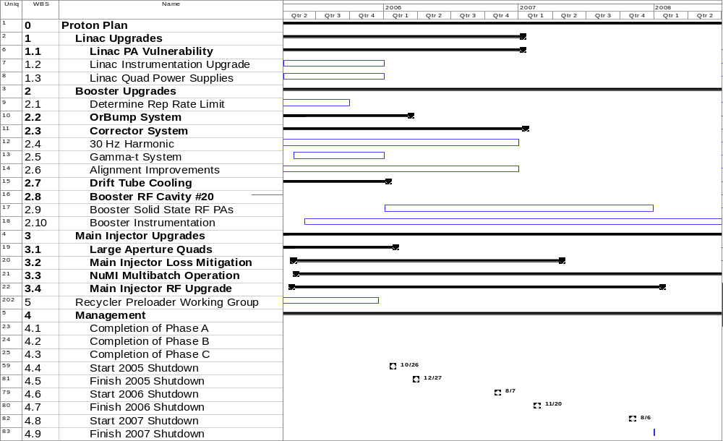
Present Plan
(draft - not fully rescoped)
New: study group formed

Slide 11
Resource-Loaded Schedule
Cost and Schedule Reporting
Building resource loaded schedule:
For several L3 projects the work is already ongoing (TD is building Orbump, large aperture quads…)
  Budget codes established and capturing costs
Scope under development for some L3 projects (eg. MI RF upgrade: prototype phase, then review and production phase)
  Developing strategy, milestones, and decision points
  Will include estimates with large contingency as place-holders where necessary
Will use the same cost and schedule reporting tools as the Run II Upgrades
Reporting via monthly PMG
Change control similar to Run II Upgrades

Slide 12
Status of Major Work
Linac (1)
  (1.1) 7835 Task force
    Working with vendor (Burle)
    Placed order for 12 extra spare tubes (two year supply) over the next two years
    Studying lifetime issues (filament current, etc)
    Formulating replacement plan
  (1.3) Low Energy Linac (LEL) quad power supplies
    Working on prototype, based on HEL supplies
Booster (2)
  (2.2) ORBUMP System
    Magnets - First magnet built and tested, proceeding with the rest
    Power Supply - Procuring and assembling
  (2.3) Corrector System
    Conceptual design complete for the corrector magnets, working on detailed design
    Working on power supply specs
  (2.4) 30 Hz Harmonic in Booster cycle
    Work Proceeding on Prototype

Slide 13
Status of Major Work (cont’d)
(3) Main Injector
  (note that the BLM/BPM upgrades are under the Run II)
  (3.1) Large Aperture Quads
    In fabrication. Will be ready for 05 shutdown
  (3.2) Loss mitigation/collimator system
    Working group formed
    Identifying collimator candidates for MI-8
    Starting ring collimator system design based on Booster system
  (3.3) Multi-batch operation
    Demonstrated mixed mode (2+5) operation w/ 5 batches of 2E12 to NuMI (goal For FY05 is 5 batches of 5E12)
    Developing schemes for slip-stacking and barrier stacking
  (3.4) Main Injector RF Upgrade

Slide 14
Main Injector Loading
Initial NuMI operation (“2+5”):
  Two batches are slip stacked for antiproton production
  Five more batches loaded for NuMI
  All are accelerated together
Ultimate NuMI operation (“2+9”):
  Five batches will be loaded into the Main Injector, leaving one empty slot
  Six more batches will be loaded and slipped with the first to make two for antiproton production and 9 for NuMI
  This will exceed the capacity of the current RF system

Slide 15
Main Injector RF
The present MI RF system:
  Number of cavities: 18
  Total Power Available: 175 kW/cavity (single PA)
  Total Power dissipated: 58.6 kW/cavity
  Power available for acceleration: 116.4 kW/cavity
  Maximum acceleration rate: 200 GeV/s
In the absence of beam loading compensation, an RF system is stable until the energy expended in accelerating the beam is equal to the energy dissipated in the cavity.
Feed forward loops can increase this stability threshold
For the present system
  Maximum guaranteed stable intensity: 3.3E13 protons
  With feed-forward 4E13 is likely
  Power limited intensity: 6.5E13 protons

Slide 16
Options
By adding an additional 28.9 kW passive load to each cavity, we could ensure 87.5 kW of power for stable acceleration
  Limit ~ 4.9E13 protons/load
  Cost scale ~$2M
Each cavity has an additional port for a second PA, allowing an additional 350 kW of total power
  Limit ~ 9.8E13 protons/load in the most conservative case (175 kW power dissipation)
  Possibly higher with feedback loops
  Cost scale ~$12M

Slide 17
Main Injector RF in FY05 (3.4)
Build prototype cavity from existing spare
  Passive load
    Existing port or cut new one?
  Second PA
    Requires new modulator, other parts exist
Carry out a series of studies in the Main Injector
  Determine effectiveness of feed-forward loops
  Determine optimal passive load and predict intensity limit for one- and two PA scenarios
Refine cost estimate for passive load and PA upgrades
Use this information to develop and review long range plan (beginning 2006)

Slide 18
Proton Projections
Phases of Operation
  Phase I (now)
    Booster lattice distortions ameliorated
    Booster limited to 7.5Hz total repetition rate
    Main Injector limited to 4E13 protons (2+5 operation)
  Phase II (after 2005 shutdown)
    Injection bump (ORBUMP) replaced
    Drift tube cooling in Booster RF cooling finished
    Booster capable of 8-9Hz operation
    MI still limited to 2+5 operation
  Phase III (after 2007 shutdown)
    MI RF upgrade complete
    2+9 operation to NuMI

Slide 19
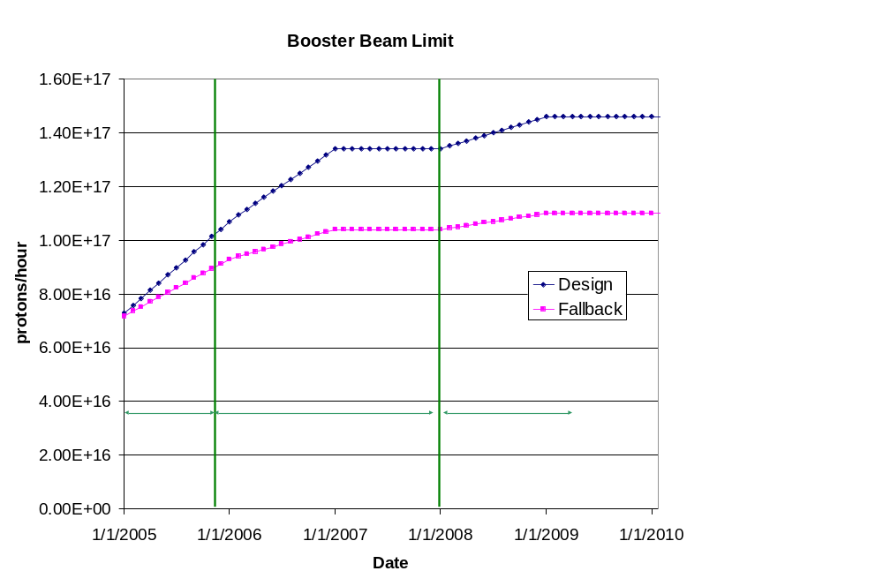
Predicted Peak Proton Intensity Limits
Demonstrated >8E16, typical ~7E16
See document for details

Slide 20
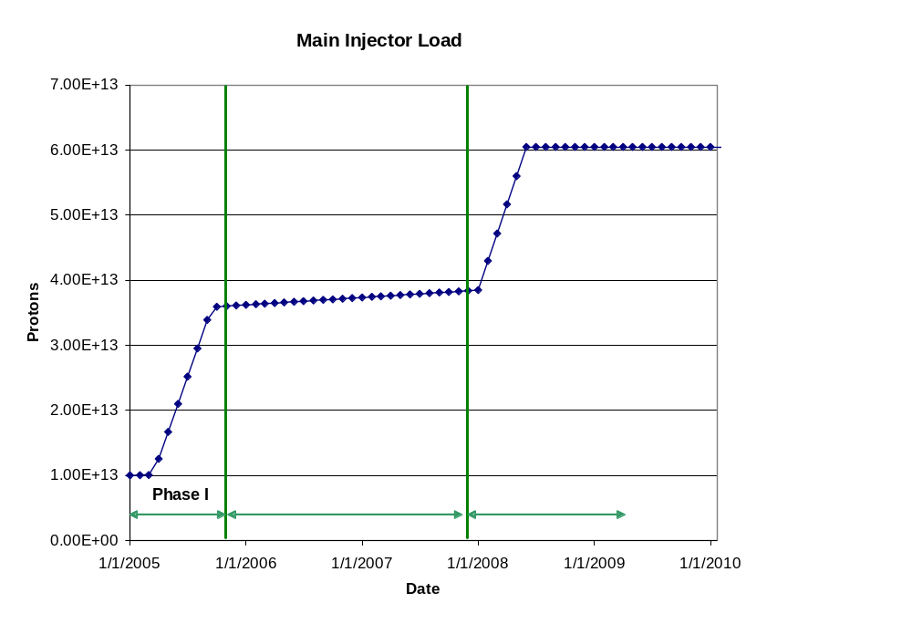
Main Injector Loading
“2+9”
“2+5”
MI RF Upgrade

Slide 21
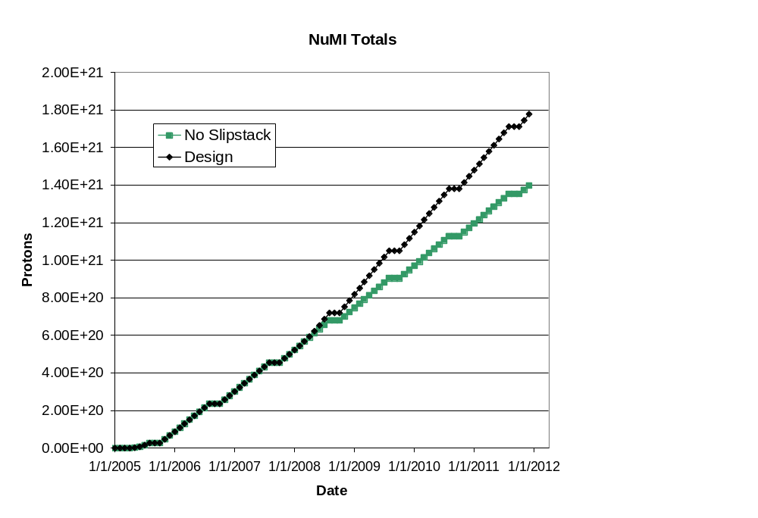
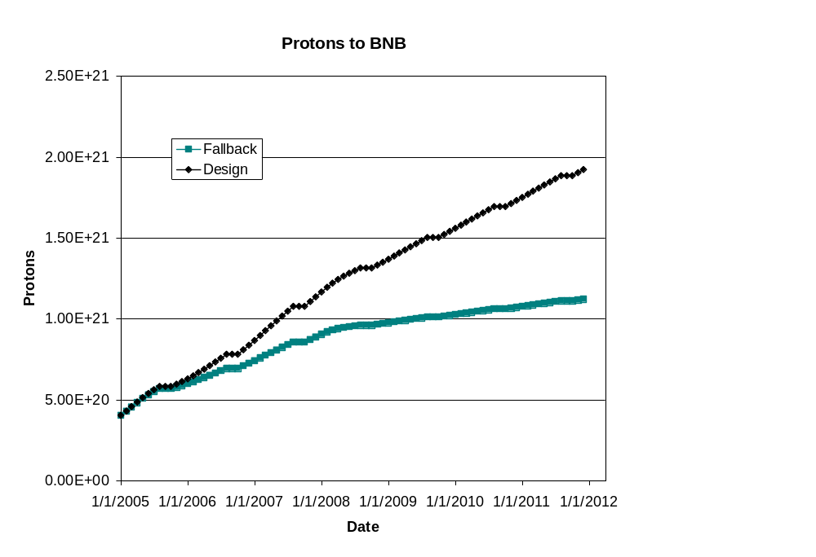
Long Term Projections
(~“delayed” scenario in document)
(for FY05 projections see McGinnis Talk)
Note! Does NOT reflect NuMI’s recent troubles!
This turn-on is slower than in document
NuMI fallback = slip-stacking fails
BNB fallback = poor performance of Booster aperture upgrades
BNB only runs during shot setup

Slide 22
“Design” PoT from the document
 | Booster Batch Size | Main Injector Load | Cycle Time | MI Intensity | Booster Rate* | Total Proton Rate | Annual Rate at end of Phase
 |  | (AP + NuMI) | (sec) | (protons) | (Hz) | (p/hr) | NuMI | BNB
Actual Operation
July, 04 | 5.0E+12 | 1+0 | 2.0 | 0.5E+13 | 5.1 | 0.8E+17 | 0 | 3.3E+20
Proton Plan
Phase I | 5.10E+12 | 2+1→2+5 | 2.0 | 3.6E+13 | 6.3 | 1.0E+17 | 2.0E+20 | 1.5E+20
Phase II | 5.3E+12 | 2+5 | 2.0 | 3.7E+13 | 7.5 | 1.2E+17 | 2.2E+20 | 2.8E+20
Phase III | 5.50E+12 | 2+9 | 2.2 | 6.0E+13 | 8.3 | 1.5E+17 | 3.4E+20 | 2.2E+20
Beyond Scope of Present Plan
11 Hz | 5.50E+12 | 2+9 | 2.2 | 6.1E+13 | 11.0 | 2.0E+17 | 3.4E+20 | 5.0E+20

Slide 23
Summary
The Proton Plan encompasses accelerator improvements to maximize protons to NuMI and the 8 GeV line over the next 10 years
The implementation of the Plan will provide
  ~7E16 p/hr to NuMI (~3E20 p/yr)
  Up to ~4E16 p/hr (1-2E20 p/yr) for the 8 GeV line
We are studying concepts for further improvements in the post collider era (for example using the Recycler as a preloader)
A Resource-loaded schedule and cost and schedule tracking system are in development

