Slide 1
Proton Plan Status
March Report
Eric Prebys
Jeff Sims

Slide 2
Agenda
Operations Report – E. Prebys
Technical Progress – E. Prebys
Project Status and Cost Report – J. Sims

Slide 3
Operations Report

Slide 4
Proton Delivery
NuMI is back in operation!!
  Unable to reproduce leak when target was removed
  Leak reappeared when target reinstalled, but Helium overpressure system seems to be working.
Will still concentrate primarily on total proton delivery
Note: Paul Derwent has been working on automated reporting mechanism for these numbers similar to Run II, but I haven’t used it yet for this report (my fault).

Slide 5
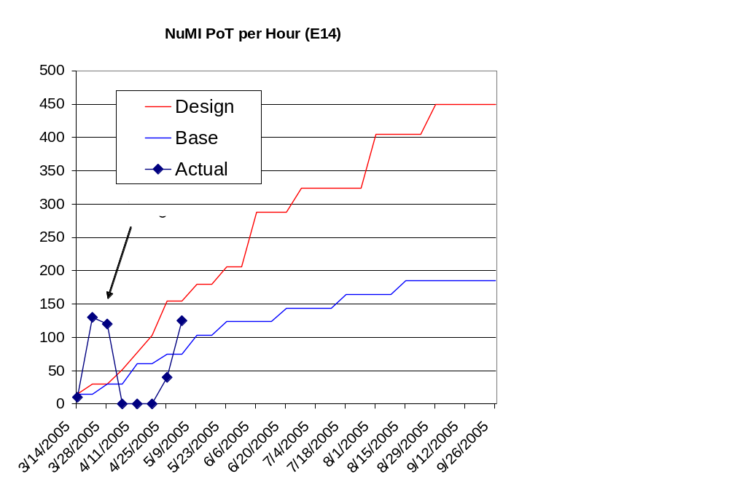
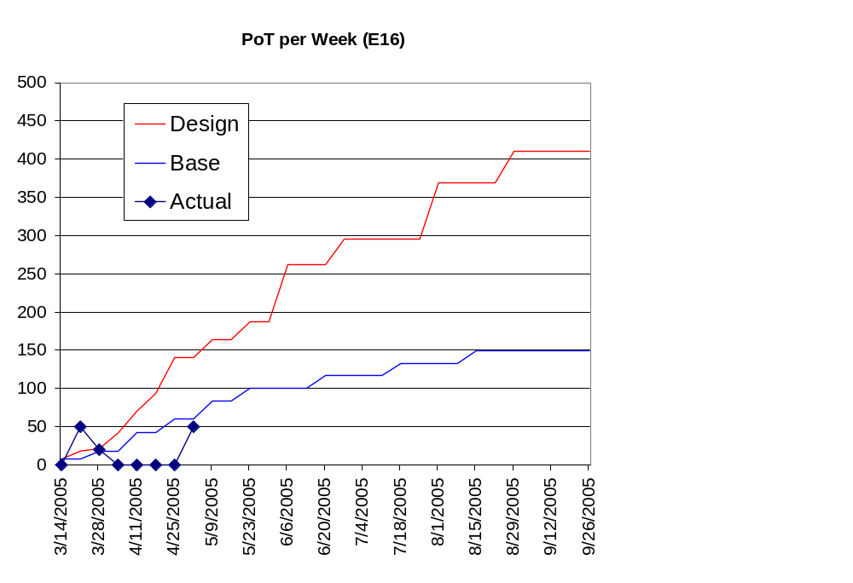
NuMI Back!

Slide 6
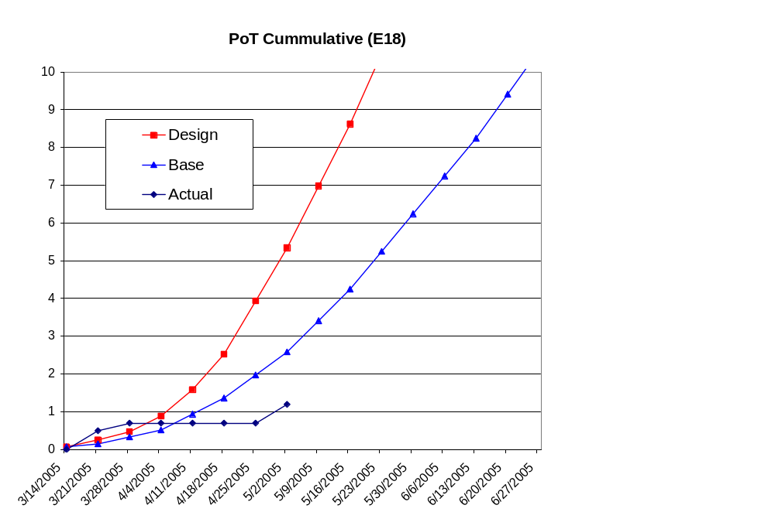
Trying to Catch up with Cumulative Totals

Slide 7
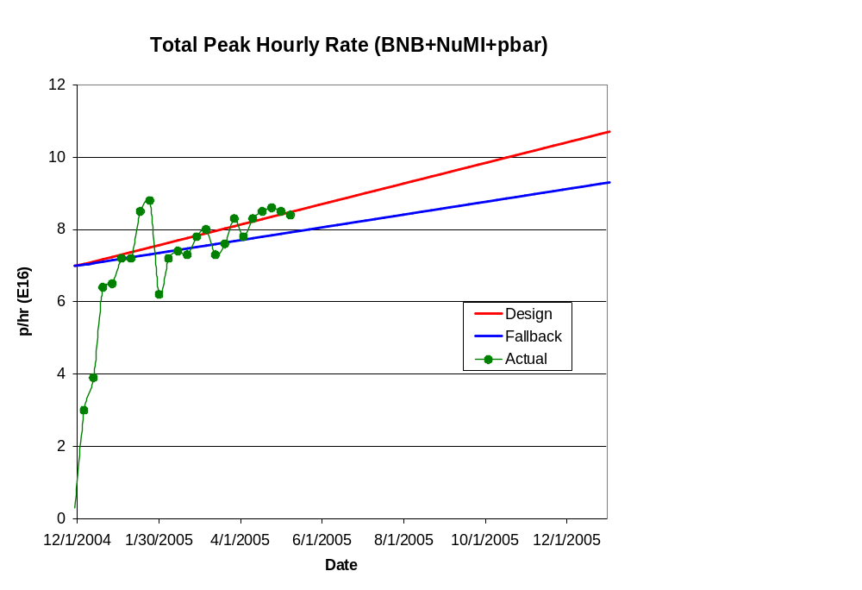
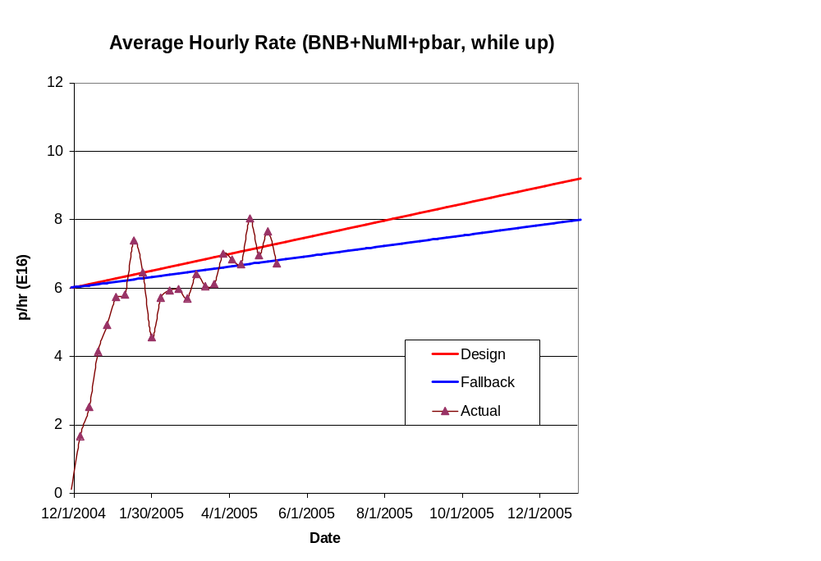
Hourly Proton Rate

Slide 8
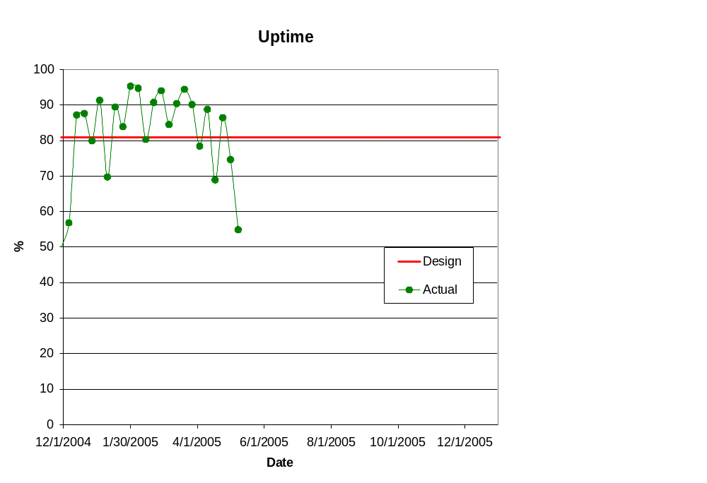
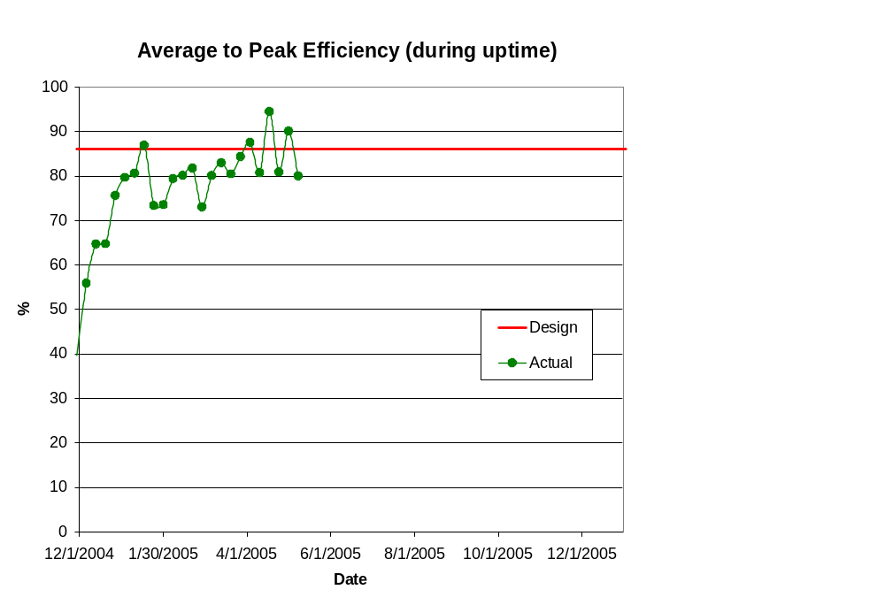
Efficiencies

Slide 9
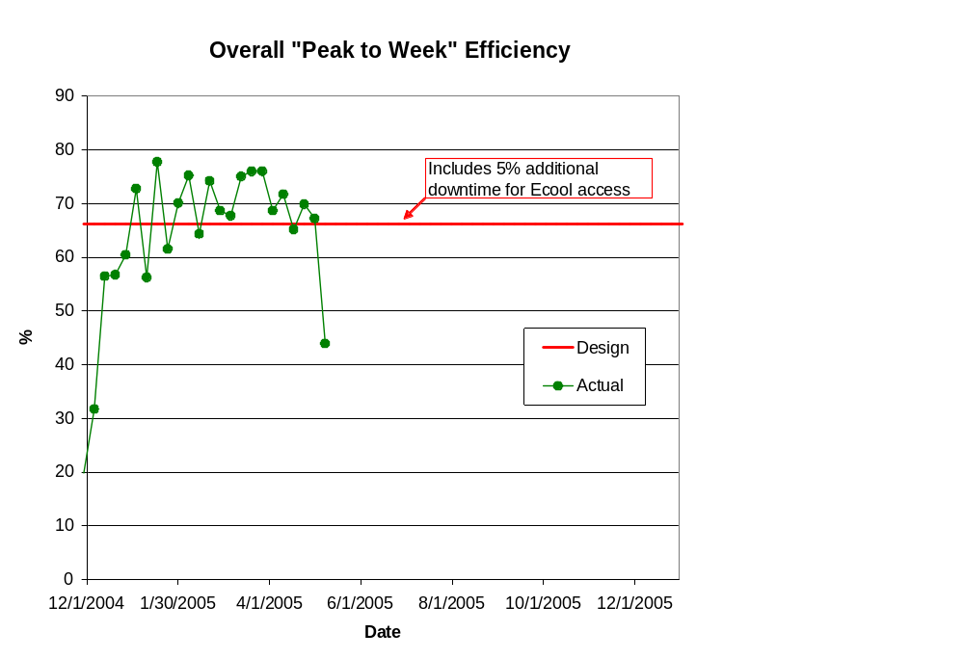
Overall “Peak to Week” Efficiency

Slide 10
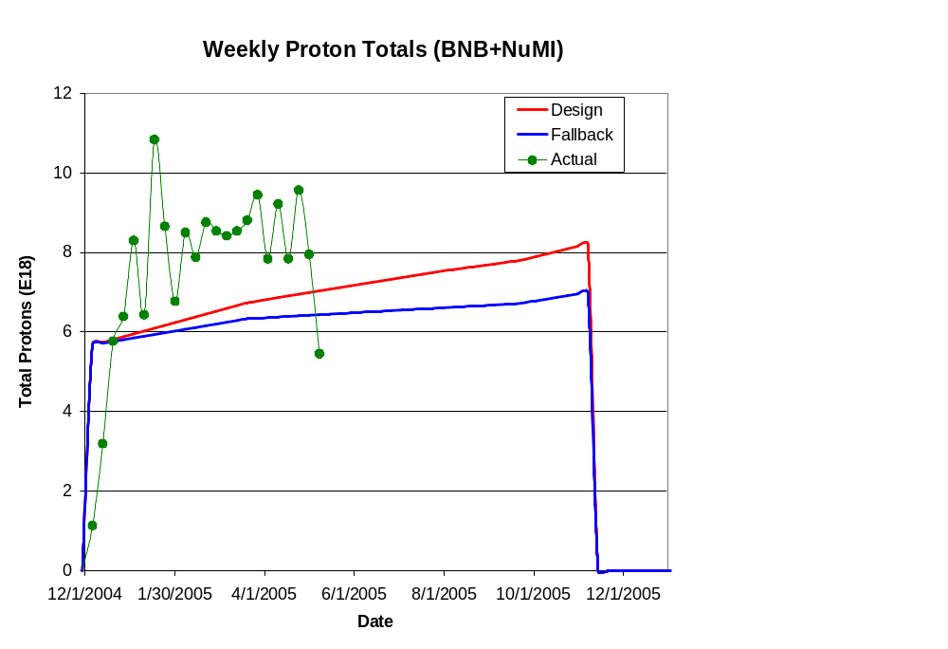
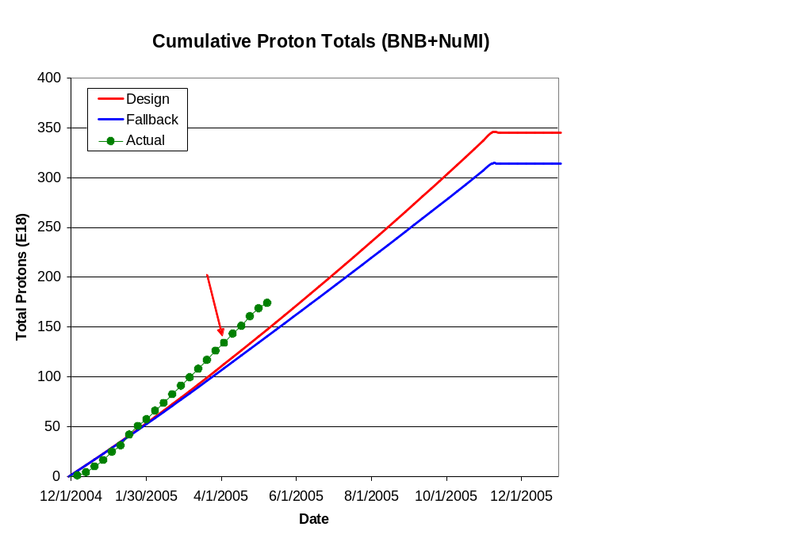
Integrated Delivery (BNB)

Slide 11
Technical Progress

Slide 12
Scope Changes Since Last PMG
Criteria to be in plan (one of following):
  Critical path to plan goals.
  Expensive (>$200K)
  Requires significant coordination across departments
Added:
  400 MeV Line rearrangement
    Part of ORBUMP replacement (discussed shortly)
Delayed:
  New booster notcher
    Delayed to 2006 due to manpower considerations

Slide 13
Progress
Baseline plan
  Great progress made in assigning resources and managers
  Aim for a baseline review next month (?)
Technical Progress
  Linac
  1.01.01 PA Vulnerability –
    7835 tubes have been ordered
    Committee proceeding with post-Burle option plans
  1.01.02 Quad PS –
    Prototype tests proceeding
    Matching choke being fabricated in TD
    Plan to refit tank 1 this year.
  Booster
  1.02.02 Orbump –
    Two magnets built, third being assembled
    Modification made to current posts to allow for water cooling (after problem during test)
    New injection scheme (discussed shortly) involves major girder and stripline redesign, but much simpler.
    Power supply proceeding.
  1.02.02.04 400 MeV Line Reconfiguration (NEW SCOPE)
    Required by new injection scheme
    Working with Mechanical scope to work out details of work.

Slide 14
Progress
  Booster
  1.02.03 Correctors –
    Prototype and design work continuing
    Procurement for prototype starting.
  1.02.11 Booster Dump Relocation
    Working with mechanical support, FESS, and rad. safety on details of project
      Major rigging and stand fabrication
      New penetrations from BTW to MI-8
      Interlock issues
        Want to be able to run Booster with MI in access.

Slide 15
Progress
  Main Injector
  1.03.01 Large Aperture Quads –
    Procurement 93% complete
    First unit in fabrication (45% complete)
  1.03.02 Collimation –
    Logging survey meter requisitioned to help with systematic radiation measurements
    Design of MI-8 collimator proceeding
      Hope for review end of month.
  1.03.03 NuMI MultiBatch Operations –
    Barrier Bucket Procurement
    Multibatch studies back on track now that NuMI target back in place.
  1.03.04 RF Upgrade –
    Discussed shortly
Studies
  1.05 Proton Study Group–
    Meeting furiously to review post-collider options
    Draft report to Roger June 1

Slide 16
Main Injector RF (1.03.04)
The Main Injector Upgrade path remains the single largest uncertainty in the Proton Plan
  Still not certain whether any upgrade is needed for Stage I proton plan (almost half of budget)
Consensus is now that increment 2 PA upgrade is beneficial, so large upgrade plan will be rewritten as a series of smaller AIP’s, but...
Nothing will be done until we can make more definite statements about the existing system.
  Continue with prototype tests
  Organize a workshop this summer with external input.

Slide 17
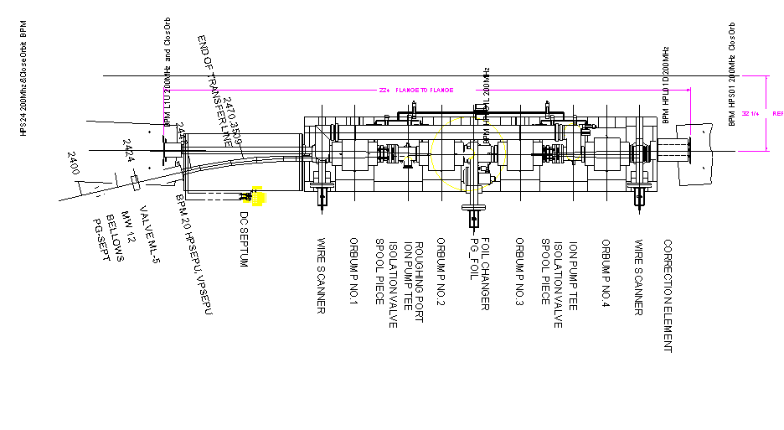
New ORBUMP Injection Scheme
Existing Scheme
4 Magnet dogleg
DC “septum”

Slide 18
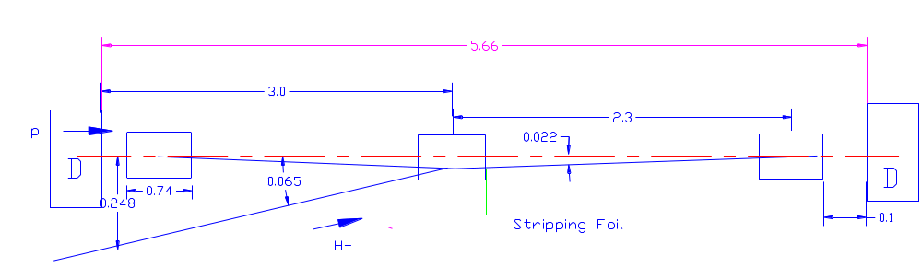
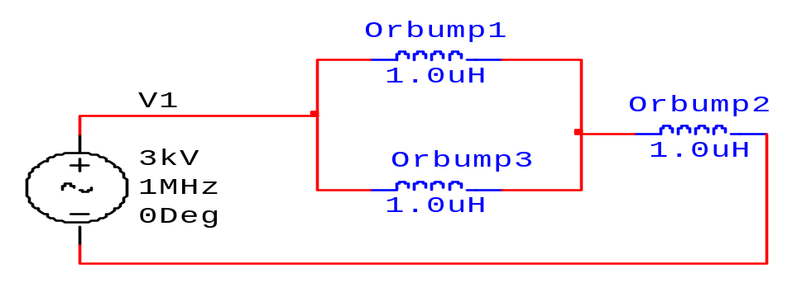
New ORBUMP Scheme (M. Popovic)
3 Magnet dogleg
Inject directly into center magnet -> DC septum goes away!!
Stripline circuit

Slide 19
Advantages of New Scheme
Reduced power from power supply:
  Central magnet runs at ~current of all four original scheme
  Outer magnets run at half this current
  50% reduction in current
  25% reduction in total voltage
Reduced edge focusing effects
  ~1/4 of existing design
Eliminate DC septum
  Aperture restriction (VERY HOT)
  Hysteresis issues
Simplify girder
  Additional instrumentation??

Slide 20
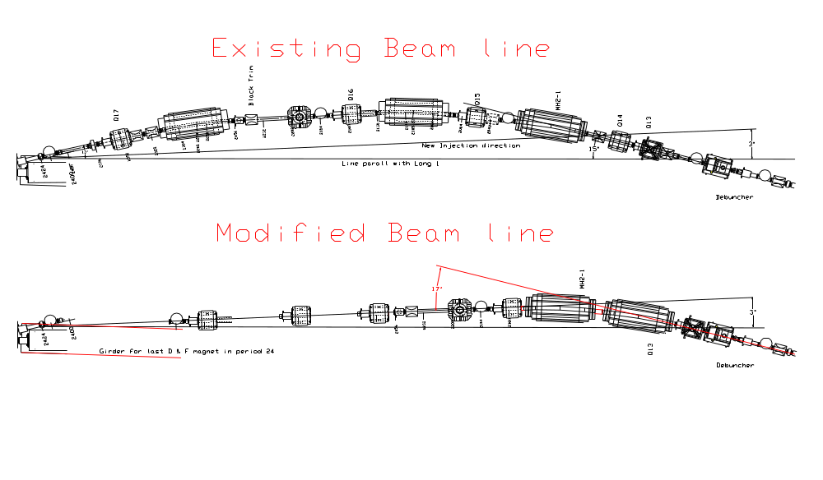
Consequences for 400 MeV line
Beam Direction
Same up to debuncher
ORBUMP
ORBUMP
No new beamline elements
  DCSEP and one HBEND removed
  Remaining elements rearranged
Minimal stand fabrication

Slide 21
Consequences to Plan
ORBUMP project not significantly effected
  Only need three magnets -> now we’ll have three spares
  Girder and stripline were not yet designed anyway
    New design simpler
  Trivial mods to PFN in power supply
400 MeV line project new
  Optical model looks OK
    Working on beam sheet (F. Garcia)
  Working with mechanical support for details of line rearrangement (Rob Reilly)
    One new stand
    Misc. vacuum parts
    Had to remove many elements anyway to install new ORBUMP girder

