Slide 1
Proton Plan Status
June Report
Eric Prebys

Slide 2
Agenda
Operations Report – E. Prebys
Technical Progress – E. Prebys
Booster Corrector AIP Status – C. Drennan
Project Status and Cost Report – J. Sims
Plan for Baselining – B. Baller

Slide 3
Operations Report

Slide 4
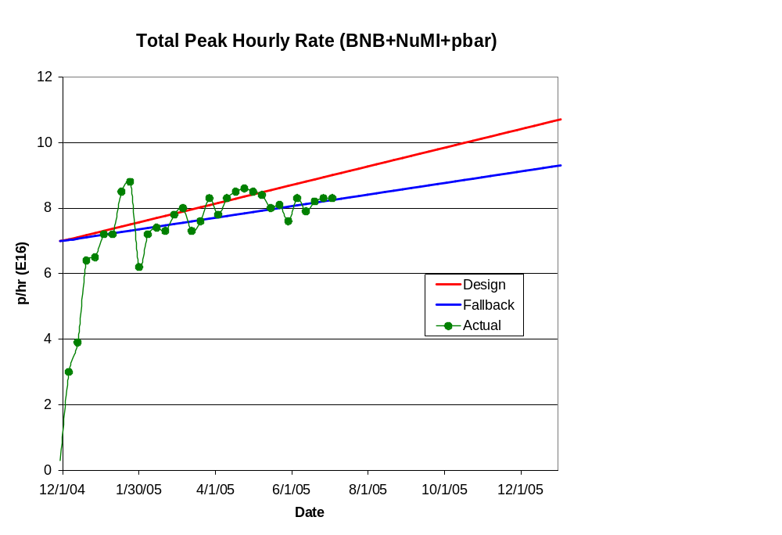
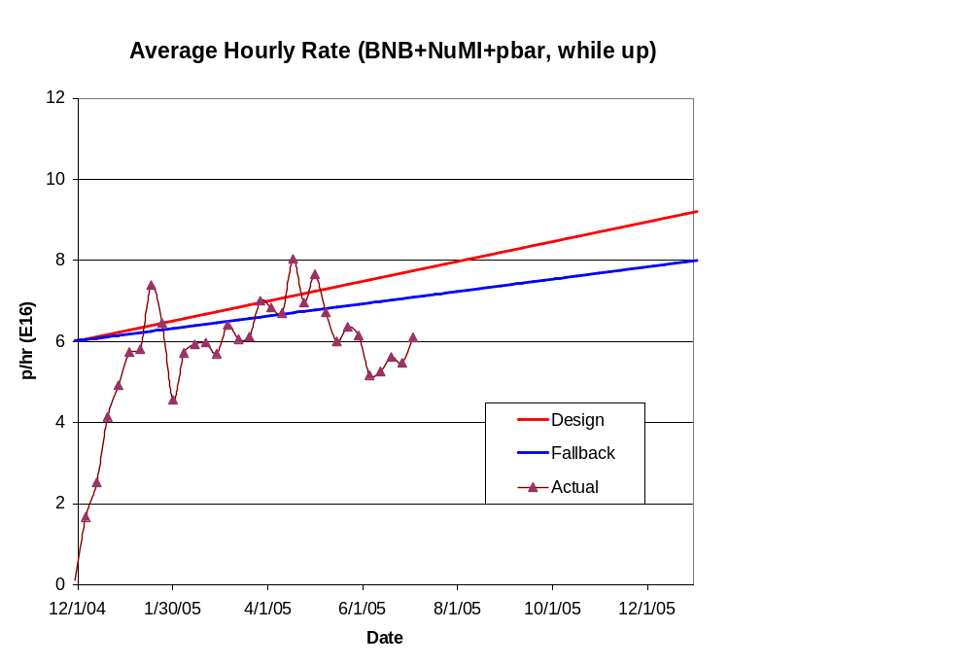
Total Hourly Proton Rate
Emphasis on slip stacking problems

Slide 5
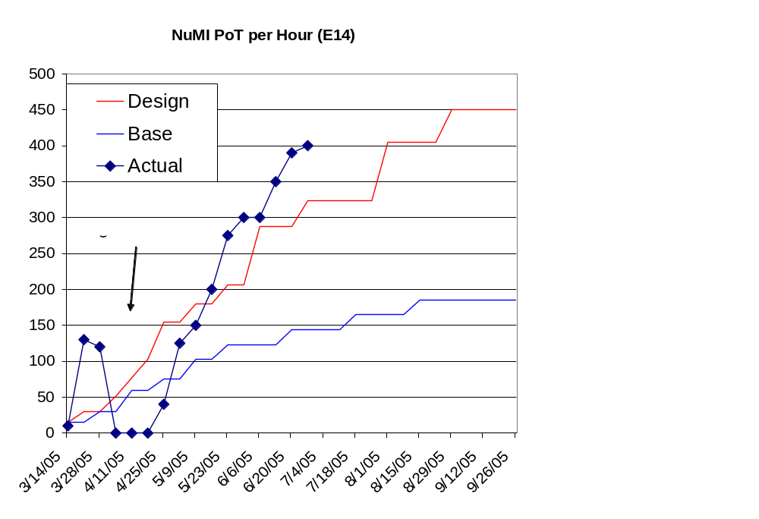
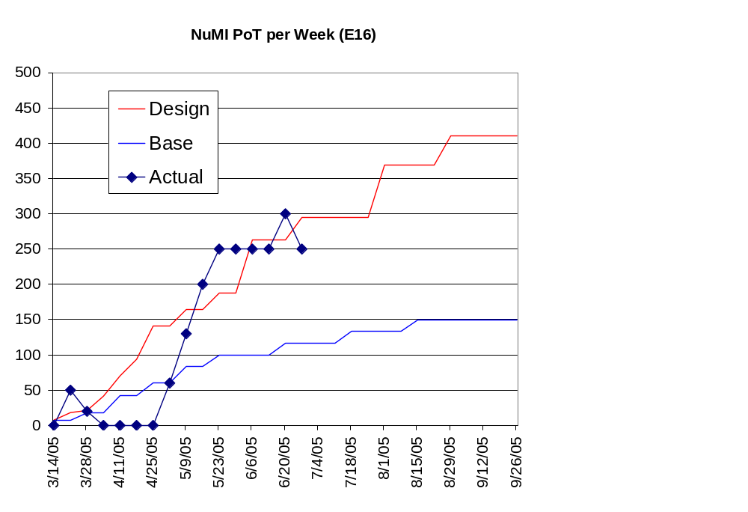
NuMI Proton Delivery

Slide 6
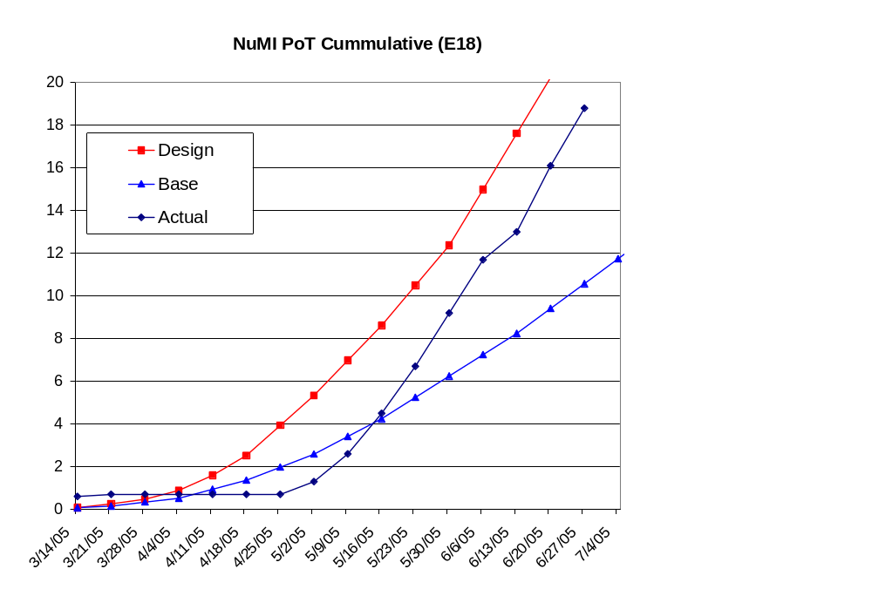
NuMI Integrated (almost caught up)

Slide 7
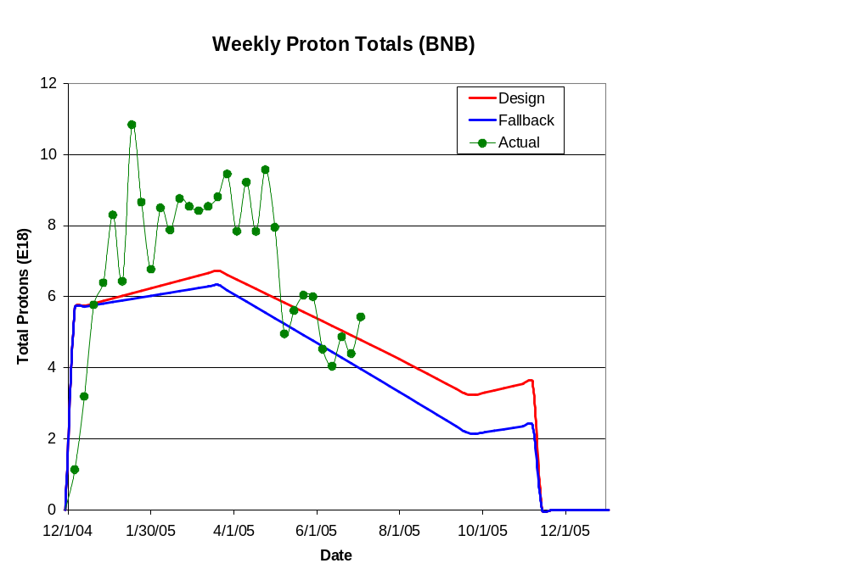
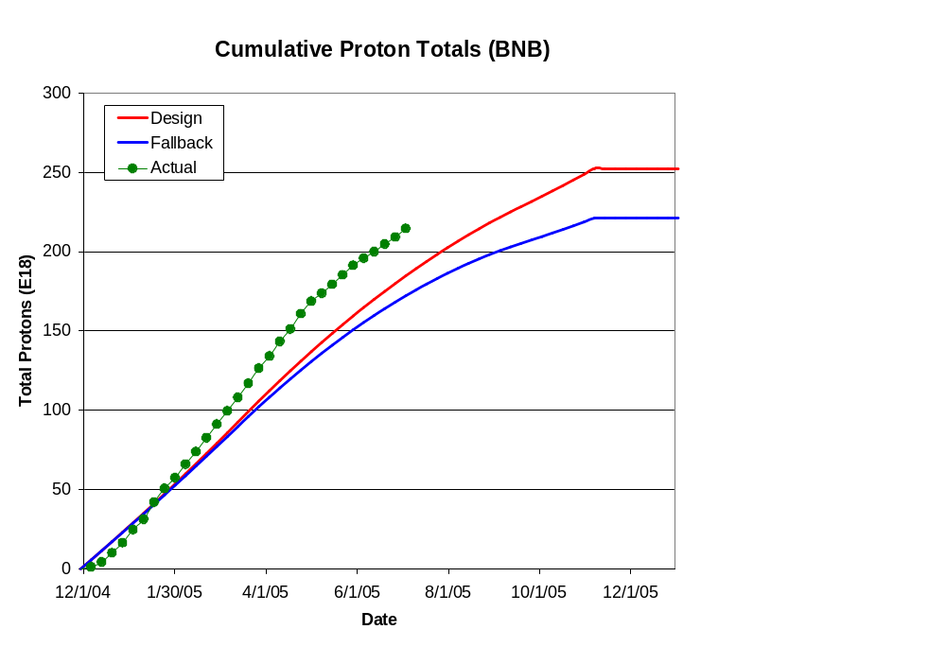
MiniBooNE (BNB) Delivery

Slide 8
Technical Progress

Slide 9
Scope Changes Since Last PMG
Modified:
  1.1.2 (Quad power supplies)
    Significantly reduced in scope
    Keep original supplies and upgrade controls electronics
    $1M+ -> ~$200K
  1.2.1 (Determine rep rate limits)
    Modified to include RF reliability concerns
  1.3.4 (MI RF Upgrade)
    Significantly reduced in scope
    (more in a bit)
Added:
  1.2.12 (Booster RF Improvements)
    Systematic plan (based on 1.2.1) to refurbish Booster RF modulators
Descoped:
  1.2.6 (Booster alignment)
    Decided to treat as part of normal operations
  1.2.8 (Cavity 20)
    Manpower limitations. Limited success of cavity 19

Slide 10
Progress
Baseline plan
  Aim for a director’s baseline review 7/21
  B. Baller will give more details
Technical Progress
  Linac
  1.01.01 PA Vulnerability –
    Committee report complete
  Booster
  1.02.01 Determine rep. rate limit
    Good understanding of what limits repetition rate and reliability
    Generating report
    Suggesting a plan of action (1.02.12)
  1.02.02 Orbump (+ 400 MeV line) –
    New injection scheme passed review!
    Three magnets built
    Beamline and girder design more or less complete
    Power supply passed review
    Will be ready for shutdown

Slide 11
Progress
  Booster
  1.02.03 Correctors –
    Design nearly complete
    See C. Drennan’s talk
  1.02.05 Gamma-t system
    Ongoing studies look encouraging
    Made decision to scrap existing magnets when we install the new correctors
    If system is useful, will build (12) new magnets between now and then)
  1.02.11 Booster Dump Relocation
    Review going on in WH12NW as we speak, HOWEVER
    Considering rather significant change to kicker location
    Will be ready for shutdown
  1.02.12 Booster RF Improvements
    NEW SCOPE
    Significant refurbishment plan for Booster modulators
    Waiting for recommendations of 1.02.01

Slide 12
Progress
  Main Injector
  1.03.01 Large Aperture Quads –
    On track for shutdown
  1.03.02 Collimation –
    MI-8 Collimator design complete and reviewed
    Will go in in shutdown
    Working on conceptual MI ring collimation
  1.03.03 NuMI MultiBatch Operations –
    Regularly deliver 5 batches at (Total 2.1E13 protons) to NuMI target
    Aim to start slipstacking earlier than anticipated
  1.03.04 RF Upgrade –
    Discussed shortly
Studies
  1.05 Proton Study Group–
    Preliminary report delivered to PAC on recycler retasking
    Overall report delayed by some more grandiose proposals than we anticipated.
    Hope to have a final report by 8/1

Slide 13
Main Injector RF (1.03.04)
Great progress has been made in understanding the limitations of the existing feed forward system.
  Calculations
  Beam studies
News is good
  The preliminary result is that the capacity of the RF system is >5.5E13 protons with no significant RF upgrade
Working on specifications for going to 6E13 in the most conservative scenario (i.e. upgrade some fraction of cavities to 2 PA’s)
This will free up a significant amount of money for other activities (e.g. Booster RF modulator refurbishment)
Prototype tests proceed, but have been delayed due to badly overcommitted RF group

Slide 14
Near Term Priorities
Prepare for shutdown!!!
  400 MeV Line+ORBUMP
  Booster dump relocation
  MI large aperture quads
Prepare for baseline review
  Working on Design Handbook
  Settling on scope of baseline (B. Baller’s talk)

