Slide 1
Proton Plan Status
September Report
Eric Prebys

Slide 2
Agenda
Operations Report – E. Prebys
Technical Progress – E. Prebys
Reaction to Director’s Review - Prebys
Status of Baseline – J. Sims
Stage 2 – M. Syphers

Slide 3
Operations Report

Slide 4
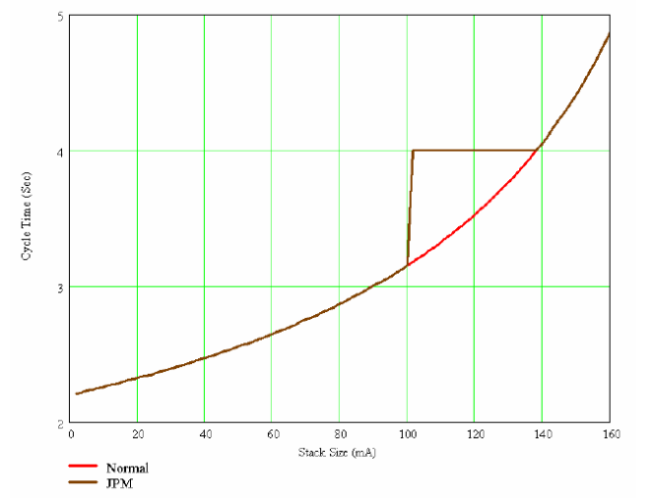
Operational Issues (NuMI)
Need to balance needs of stacking with needs of NuMI*
  pBar accumulation is optimized by increasing Main Injector cycle time (from 2.2 to almost 5 seconds) as the stack grows to accommodate stack tail cooling in the accumulator.
  The NuMI proton rate is inversely proportional to this cycle time.
A number of solutions were considered
  Status quo (pBar driven)
  Fixed 2.2 second rep rate with reduced proton intensity to pBar
  Fixed 2.2 second rep rate with reduced ARF1 bucket size
  (Jim Morgan) When the stack
  reaches 100 mA, increase pBar
  cycle time to 4 seconds and insert
  a NuMI only cycle in between.
See D. McGinnis, BEAMS-DOC-1941-v1 for detailed analysis

Slide 5
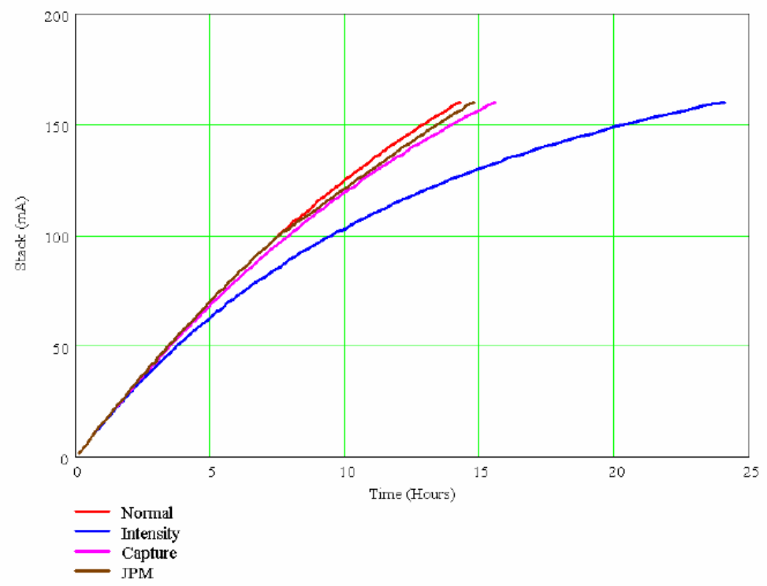
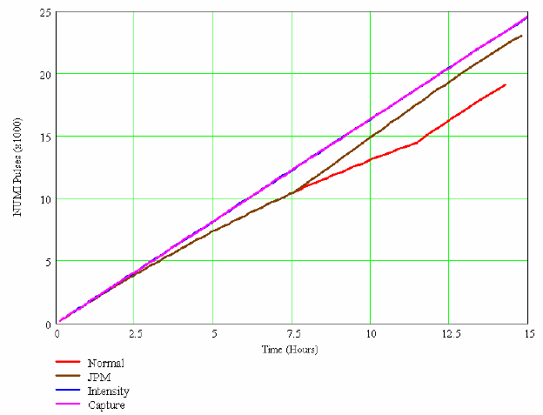
NuMI/pBar Optimization
“Normal”
Crossover
ARF1
Reduced protons
Stack
NuMI
Conclusion: crossover method best compromise.

Slide 6
Operational Issues (MiniBooNE)
Because of emphasis on stacking and NuMI turn-on, operations had adopted a policy of controlling MiniBooNE protons by lowering batch size, rather than rep. rate.
  Resulted in undue strain on Booster and horn
  Worse tuning overall
Sent message to all operators specifying
  MiniBooNE batches should ideally be the same as NuMI, and at most one turn (.5E12) lower.
  Both should be tuned as high as possible
  MiniBooNE rate should be set as high as possible by adjusting their rep. rate in the TLG
  Reminded operators that MiniBooNE intensity is extremely sensitive to how close we run the Booster to its limits (10% can be a factor of two to MB).
This had a very positive impact on MiniBooNE beam delivery

Slide 7
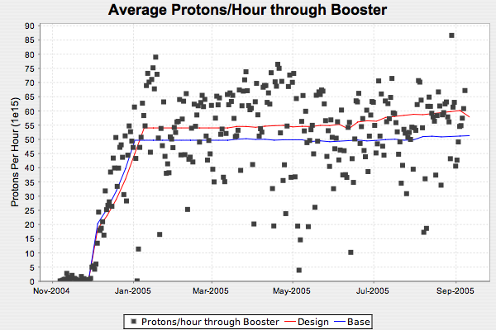
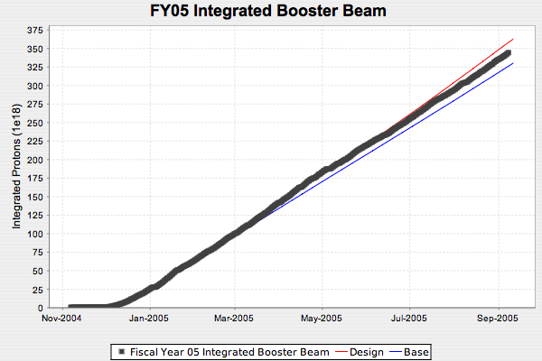
Total Hourly Proton Rate*
“Run II Style” tracking plots available at http://pfdg5.fnal.gov/~derwent/protons/ProtonPlots.html
(courtesy Paul Derwent)

Slide 8
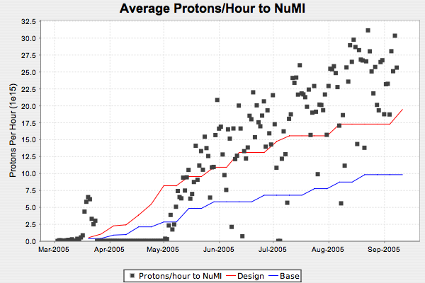
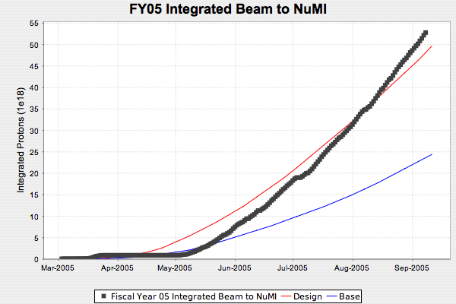
Beam to NuMI
Caught up from target problems!

Slide 9
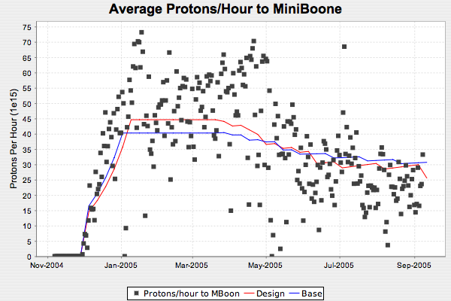
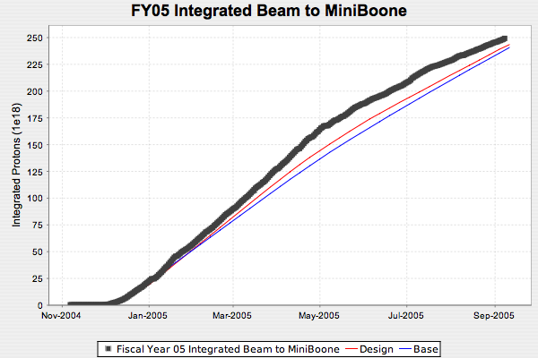
Beam to MiniBooNE

Slide 10
Technical Progress

Slide 11
Progress
Technical Progress
  Linac
  1.01.01 PA Vulnerability –
    Orders placed for 12 tubes
    First two to arrive next month
    Stage 2 (Thales test stand invenstigation) started
  Booster
  1.02.01 Determine rep. rate limit
    Much better understanding of rate limitiations
    Uncovered vulnerabilities in our power distribution
    Implementing initial suggestion (1.02.12)
  1.02.02 Orbump (+ 400 MeV line) –
    Four magnets “complete” (need three)
    Taking advantage of delayed shutdown to optimize shim design (cancel quadrupole moment)
    Girder contract out
    Beamline design complete
    Would have been ready for Oct 31 shutdown, but still a bit relieved.

Slide 12
Progress
  Booster
  1.02.03 Correctors –
    Modified design slightly to accommodate recommendations of internal review (more powerful quads)
    Proceeding with full prototype
    Schedule for “Fall 2007” shutdown, but probably cannot make Summer 2007
  1.02.05 Gamma-t system
    Ongoing studies look encouraging
    Calculations and models showed potential benefit for Gamma-t + 30 Hz
  1.02.06 30 Hz
    Decision bundled with Gamma-t
    Delayed shutdown may delay final decision on both
  1.02.11 Booster Dump Relocation
    Design complete
    Went with “alternate” design (kickers where shield wall is now)
    Finalizing beam dump limit numbers with rad safety.
    Would have been ready for Oct. 31 shutdown.
  1.02.13 Booster RF/ Rep. rate Improvements
    Purchasing 15 Hz transformers to address a vulnerability identified in 1.02.01

Slide 13
Progress
  Main Injector
  1.03.01 Large Aperture Quads –
    Delayed shutdown means all quads will be complete
    Whether all get installed will depend on time/manpower considerations.
  1.03.02 Collimation –
    MI-8 Collimator construction moving ahead.
    Will go in in shutdown
    Working on conceptual MI ring collimation
  1.03.03 NuMI MultiBatch Operations –
    Regularly deliver 5 batches at (Total 2.1E13 protons) to NuMI target
    Aim to start slipstacking mid-2006
Studies
  1.05 Proton Study Group–
    No real progress
    Now that reviews are over, should start up in earnest.

Slide 14
Director’s Review

Slide 15
General
A Director’s Review took place August 23-25th
  Ed Temple chaired
In general the review went pretty well:
  Very supportive of the Run II style “campaign” approach, and our use of the Run II expertise.
  Were impressed by the amount of work that had been done over the last year.
  We were aware that significant parts of the plan were not ready to be baselined, but we (and the committee) realized that it will always be a “moving target”.
  Made it clear that in many ways we will be held to a higher standard than Run II.
  Final report available at:
http://www-accel-proj.fnal.gov/Proton_Plan/Reviews/Dir_Rev_8_23/Closeout_Report_Final_08_05.pdf
(on Proton Plan public webpage)
Most significant criticisms:
  Design handbook far from complete.
  (related) The need for a table of parameters, along with the specific relationship to individual tasks.
    Our highest priority right now, in terms of planning
  Wanted some key decision points spelled out more clearly in the plan (e.g. slip stacking backup plans)

Slide 16
(Selected) Recommendations and Responses
Linac
  Consider stationing an RF engineer remotely at Burle to help ensure successful and timely production of 7835 tubes.
    I thank everyone for their diplomacy and restraint when this was presented.
  Aggressively pursue testing of new Burle tubes as they arrive at FNAL
    Will probably require 1-2 electrical techs.
  Pursue in parallel the LANL/Thales option right now.
    Stage 2 committee working up plan.

Slide 17
Recommendations and Responses (cont’d)
Booster:
  Improve modeling of injection
    Will be easier and more accurate with new injection girder
  Examine possibility of grouping corrector elements for some multipoles
    We will look into this, but it is a fairly modest cost savings on the scale of things
    We will use the fully powered version for our cost estimates
    Will make a final decision some time next year
  (to lab management) Proceed with corrector upgrade
  Maintain R&D into gamm-t/30 Hz (reversed internal review recommendation), but specify how decision is to be made
    We’re working on this as part of are “parameter list” initiative
  Directly address slip stacking beam physics issues (combined Booster/MI recommendation)
    For the moment, this is being addressed by pBar RRT
    If significant projects are indicated (e.g. Booster RF feed forward system), we will incorporate it into the plan with change control.
  Install 19th cavity in Booster ASAP and consider restoring 20th cavity to the plan
    Strongly agree
    19 not “officially” part of the plan
  Evaluate cost/benefit of solid state RF system and make a decision soon.
    Working to do this

Slide 18
Recommendations and Responses (cont’d)
Main Injector
  Improve beam modeling (paraphrases several specific recommendations)
    We agree. Tim Berenc has been assigned to this more or less 100% for the near future.
  Proceed with MI-8 Collimation system
  Increase effort on loss characterization and MI ring collimation design
Management
  Numerous recommendations, mostly already implemented
  Try to fill org. chart with non-placeholder names
    Being done
  Consider giving Project manager more control of contingency than in the PMP below a certain threshold
    Question for directorate.

