Slide 1
Proton Plan Status
September Report
Eric Prebys

Slide 2
Agenda
Operations Report – Prebys
Technical Progress – Prebys
Presentation of Proton Plan Baseline - Sims
Cost/Schedule Report – Sims

Slide 3
Operations Report

Slide 4
Operational Issues (NuMI)
Implemented interleaved “NuMI only” cycles into standard operation
  Discussed at last PMG
Have gone from 5->6 NuMI batches on NuMI only cycles
  ~5 batches at 2 second rep. rate, as in plan
Significant improvement in beam loss on high intensity cogged cycles
Demonstrated 5E12 booster batches to NuMI
  Just before target problems
Bottom line:
  NuMI is pretty much at their goal, until slip stacking (some time after shutdown)

Slide 5
Operational Issues (MiniBooNE)
Working with operations to formalize Booster tuning procedure to maximize and regularize Booster total output.
Agreed on MiniBooNE beam monitoring procedure
  i.e. when to call control room
Increase MiniBooNE batch size
  First time extended period >5E12 protons/batch

Slide 6
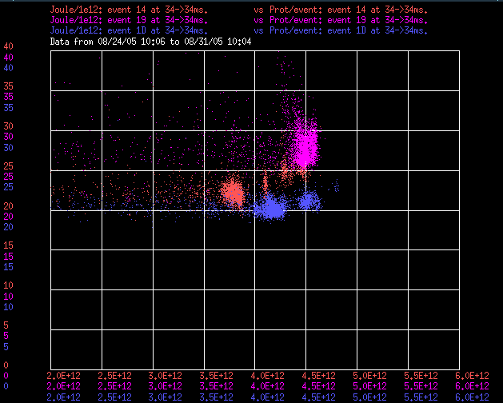
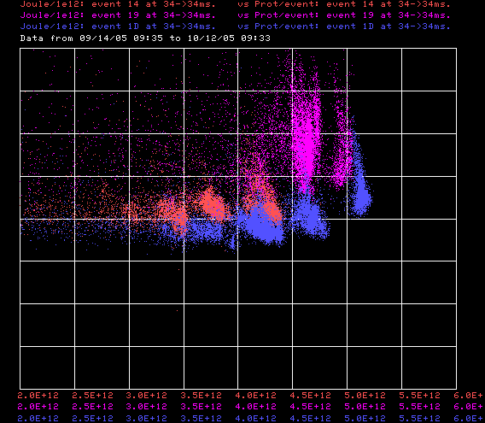
Total Energy Loss Improvement
Cogged Cycles (NuMI/Stack)
5E12
5E12
9/9/05
Now
Normalized Energy Loss (kJ/E12)
Batch Size
Batch Size
Uncogged Cycles (MB)

Slide 7
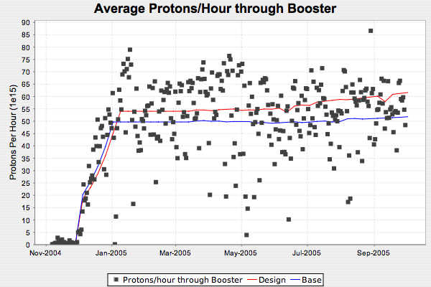
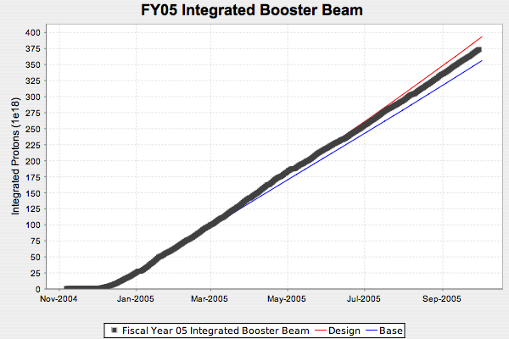
FY05 Final (Total Beam)
3.75E20*
*Total protons in 30 years prior to MB turn on ~5E20

Slide 8
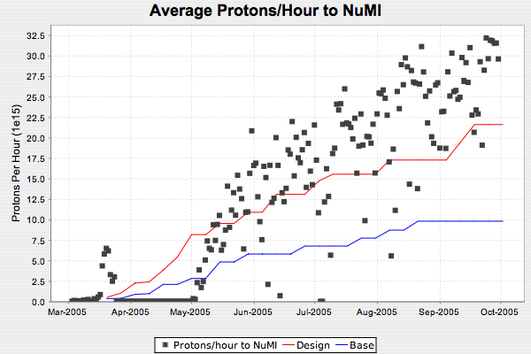
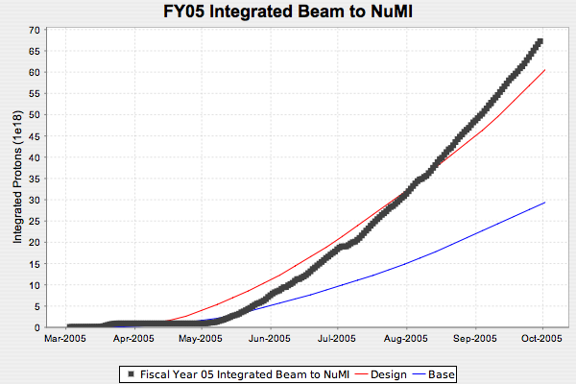
FY05 (NuMI)
Caught up from target problems!
.67E20

Slide 9
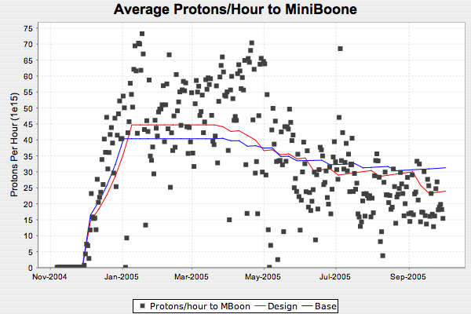
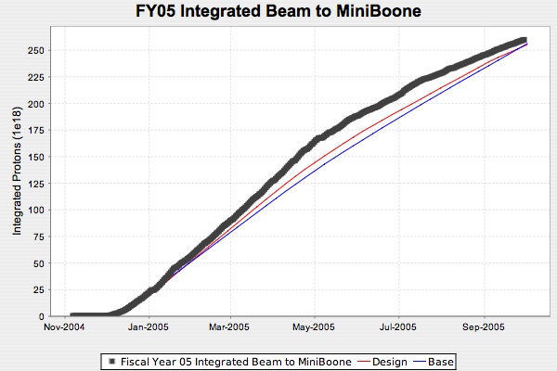
FY05 (MiniBooNE)
2.6E20

Slide 10
Projections for FY06
NuMI
  Design
    Gradual increase in batch intensity to ~constant 5E12
    Begin to implement slip stacking of 1 year following next shutdown
  Base
    Run like we are not
MiniBooNE
  Design
    “Design” proton capacity projections from Proton Plan document.
    NuMI at design.
  Base
    “Fallback proton capacity projections from Proton Plan
    NuMI at Base
Shutdown
  Assume beam off for full 14 weeks starting Feb. 6
    Conservative, not entirely consistent with Plan
    Projections go up if injector complex stays up.

Slide 11
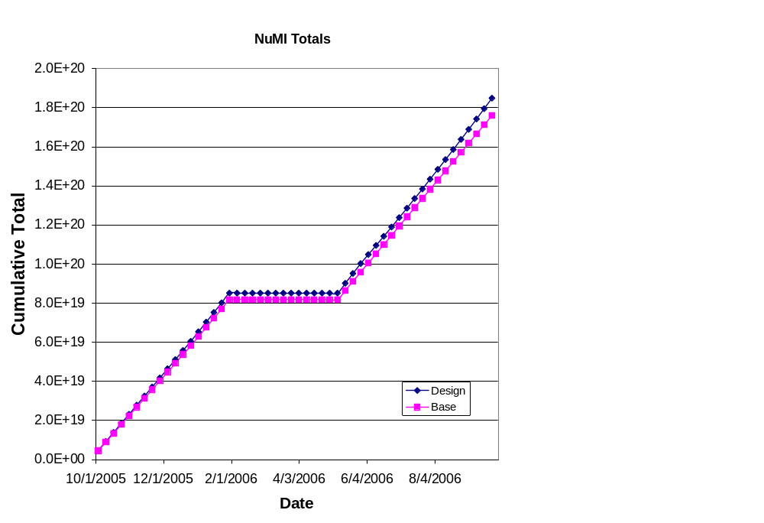
NuMI Projections
Too close?

Slide 12
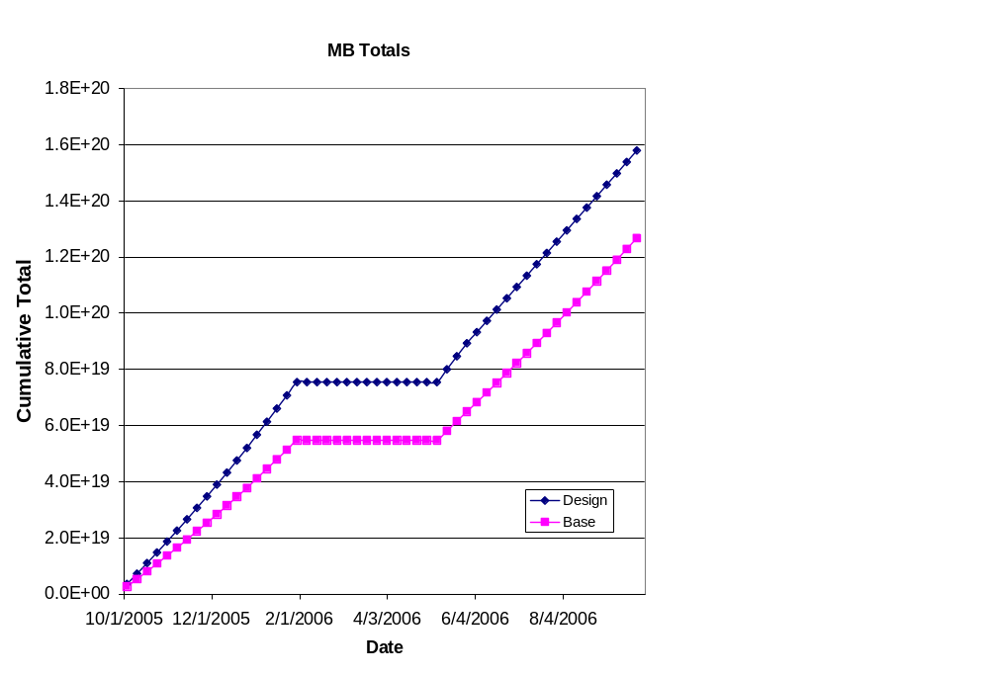
MiniBooNE Projections

Slide 13
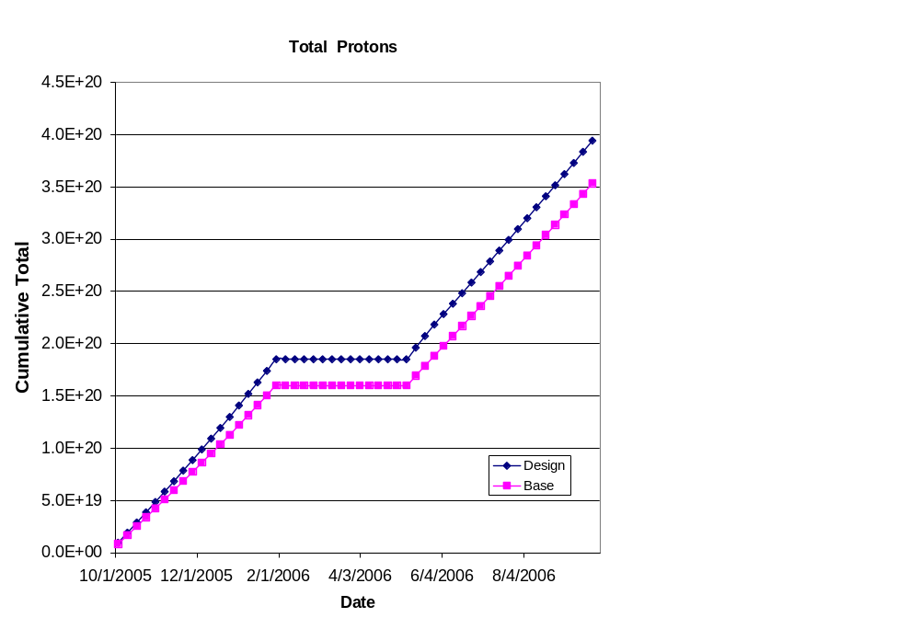
Total Protons

Slide 14
Technical Progress

Slide 15
General Comments
Shutdown date still not final
We can easily move the shutdown tasks themselves to accommodate new shutdown.
Have not taken into account the affect of the lower priority resulting from delayed shutdown
  Schedule will show huge float
  It will look like we’re falling behind
  Not worth chasing a moving target.

Slide 16
Shutdown Preparation
In general, we are in very good shape for the shutdown.
Nevertheless, these are big jobs that require a lot of coordination
We’ve appointed Rich Andrews “Shutdown Coordinator” for the Proton Plan
  Primarily an oversight position.
  Job will be to communicate with Level 2 and 3 managers, as well as support departments to identify problems and help to solve them.

Slide 17
Progress
Technical Progress
  Linac
  1.01.01 PA Vulnerability –
    First 2 of 12 new tubes scheduled to be delivered this month.
  1.01.02 Quad Power Supplies
    First of seven replacement cards designed
    Starting on second
  1.01.04 LLRF Upgrade
    Working out performance benefit in an effort to increase priority.
  Booster
  1.02.01 Determine rep. rate limit
  1.02.02 Orbump (+ 400 MeV line) –
    Finally settled on “no shim” design
    5 magnets complete except for endplates and insulators
    First two ready for testing in 1 to 2 weeks
    Girder back from vendor
    400 MeV design complete
    World’s most detailed ALARA under way.

Slide 18
Progress
  Booster
  1.02.03 Correctors –
    Design nearing completion for prototype
    Working out test and QA procedure
    Final specs will go to EE support within a week or two
    Broken into two installations
      Long (verticals) in 2007
      Short (horizontals) in 2008
  1.02.11 Booster Dump Relocation
    Delay caused by need move PS location in Booster West Tower
    Largest single project in the shutdown
    Still in good shape
    Working to reconcile our labor estimates with Dave Augustine.
  1.02.13 Booster RF/ Rep. rate Improvements
    15 Hz transformers have been given increased priority in purchasing to have them ready for installation it the shutdown.

Slide 19
Progress
  Main Injector
  1.03.01 Large Aperture Quads –
    Planning to install all 7 during shutdown
  1.03.02 Collimation –
    MI-8 Design being finalized
    Long lead times ordered
    Will go in in shutdown
    Working on conceptual MI ring collimation
  1.03.03 NuMI MultiBatch Operations –
    Regularly deliver 5 or 6 batches Total (>2.8E13)protons to NuMI target
    Doing prep work to do in tunnel improvements to MI-10 kicker to allow for slip stack operations after shutdown.
    Added badly needed RF expertise for MI modeling (Tim Barenc)

