Slide 1
Proton Plan Status
September Report
Eric Prebys

Slide 2
Agenda
Operations Report/Technical Progress – Prebys
Cost/Schedule Report – Sims

Slide 3
Operations Report

Slide 4
Operational Issues
NuMI
  Increased Recycler Usage has shortened average cycle time
    Much closer to design model
  Experiment has suffered from some problems
    I won’t discuss them here in any detail
MiniBooNE
  MiniBooNE has benefited from NuMI’s misfortunes
  Other than that, same old, same old.

Slide 5
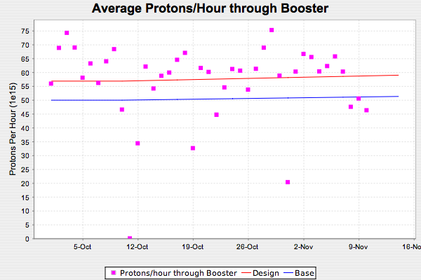
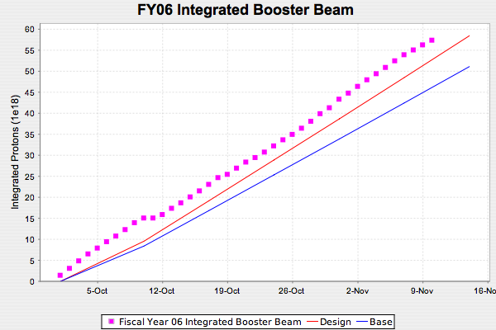
FY06 Total Booster Output
Off to a good start

Slide 6
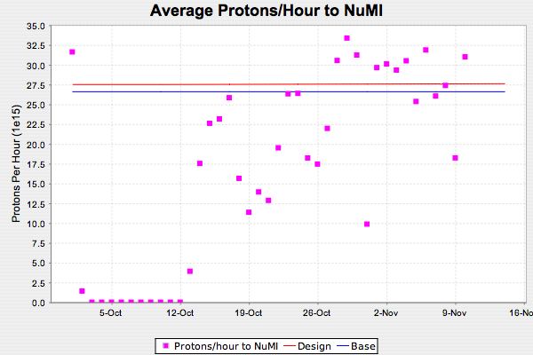
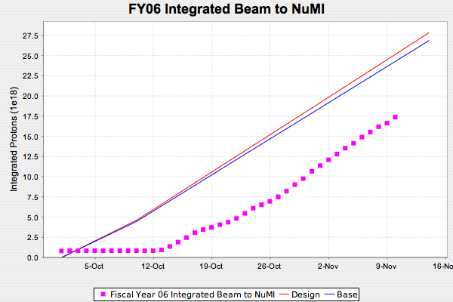
NuMI FY06
Pretty much where we’re going to be until slip stacking
Horn ground fault problems

Slide 7
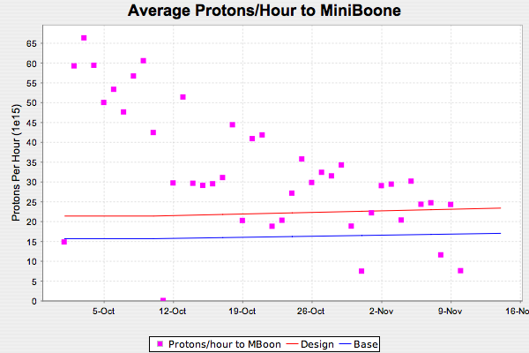
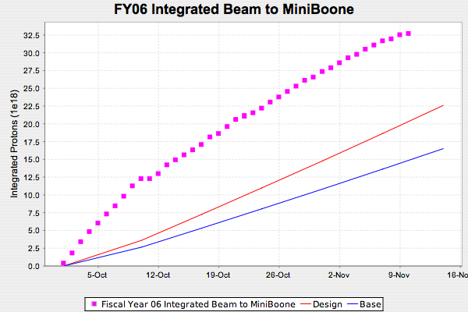
MiniBooNE FY06
MiniBooNE Benefits from NuMI’s horn problems

Slide 8
Technical Progress

Slide 9
Progress
Technical Progress
  Linac
  1.01.01 PA Vulnerability –
    First new tube delivered, awaiting our testing
    Second October tube failed at Burle
    Promise three in November
  1.01.02 Quad Power Supplies
    Design of second of seven replacement cards proceeding.
  1.01.04 LLRF Upgrade
    Larry Allan’s tests show final has enough gain to allow his control scheme to work
    Ralph Pasquinelli has identified manpower to work on project
  Booster
  1.02.01 Determine rep. rate limit
    Team concludes that after 2006 shutdown, we’ll be OK to 9Hz
    Working with outside contractor to determine exact needs for 15Hz (not in plan)
  1.02.02 Orbump (+ 400 MeV line) –
    All six magnets complete
    Beginning testing
    Stripline fabrication begun
    Working to finalize shutdown plans.

Slide 10
Progress
  Booster
  1.02.03 Correctors –
    Majority of bids back for prototype
      Goal to have protoype by May 1.
    Inductance spec to EE support
    Working on prototype measurement and QA procedure
    Working with Mechanical support and operations to try to get preparatory water work done in the tunnel this shutdown
      Looks reasonable
  1.02.11 Booster Dump Relocation
    Design complete except for final dump location and shielding
      Might require extra magnet
    Coordinating effort planning with ORBUMP project
  1.02.13 Booster RF/ Rep. rate Improvements
    Order has gone out for 15 Hz transformers
    Placed on “A” list for shutdown

Slide 11
Progress
  Main Injector
  1.03.01 Large Aperture Quads –
    Still planning to install all 7 during shutdown
  1.03.02 Collimation –
    MI-8 collimation still on track for shutdown
    Working on conceptual MI ring collimation
  1.03.03 NuMI MultiBatch Operations –
    2+5 operation more or less at design levels
    Effort increasing to allow tunnel prep. Work for MI-10 kicker during shutdown
      Critical path for slip stacking
  1.03.04 Main Injector
    Tim Barenc has a model of the Main Injector RF system and is working to refine it
      Will address majority of review questions

Slide 12
Restructuring Plan
WBS 1.5, which is currently “studies” to investigate Recycler preloading after the collider program is being expanded, nominally under the direction of Mike Syphers
New scope will include:
  Current 1.5 scope (recycler retasking)
  Investigating Main Injector RF and accelerator physics issues for intensities beyond Stage I
    E.g. Proton Driver, Alternate Proton Source, etc
  Investigating NuMI beamline and target issues at these intensities
Alberto Marchionni will head

Slide 13
Heads up
We plan to introduce Booster solid state upgrade into the plan as a major CR in the fairly near future
  Jeff Sims will also discuss

