Slide 1
Proton Plan Status
September Report
Eric Prebys

Slide 2
Agenda
Operations Report/Technical Progress – Baller
Cost/Schedule Report – Sims
Stage II Report - Syphers

Slide 3
Operations Report

Slide 4
Operational Issues
NuMI had an extended down period for the Tritium problem
MiniBooNE, as usual, benefitted
Both experiments ran well over the holidays

Slide 5
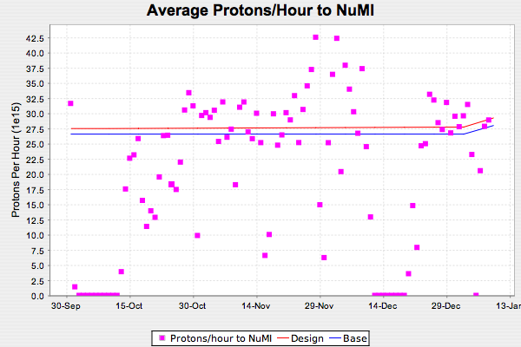
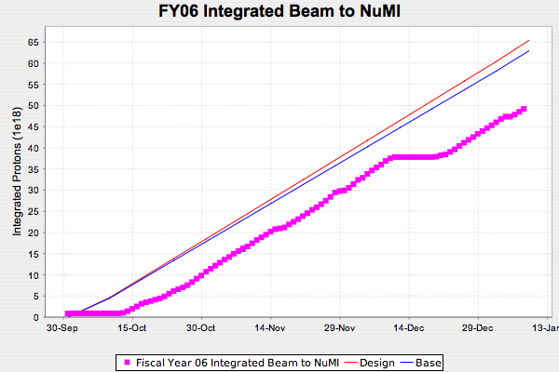
NuMI FY06

Slide 6
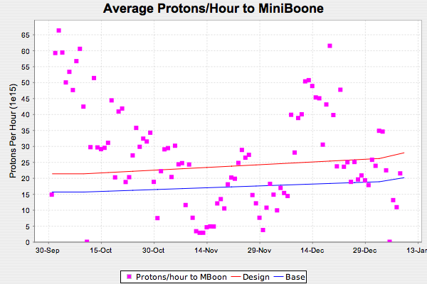
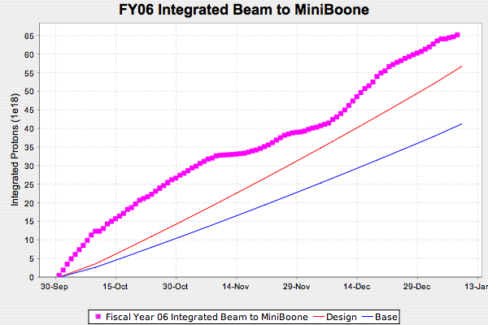
MiniBooNE FY06
Getting a bit better

Slide 7
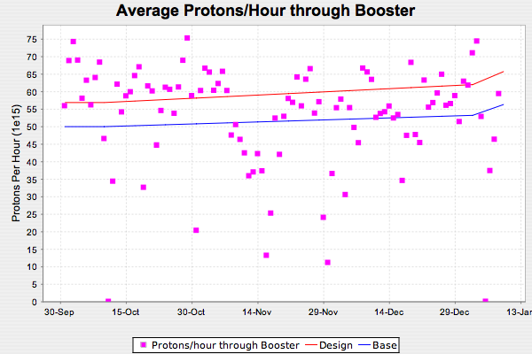
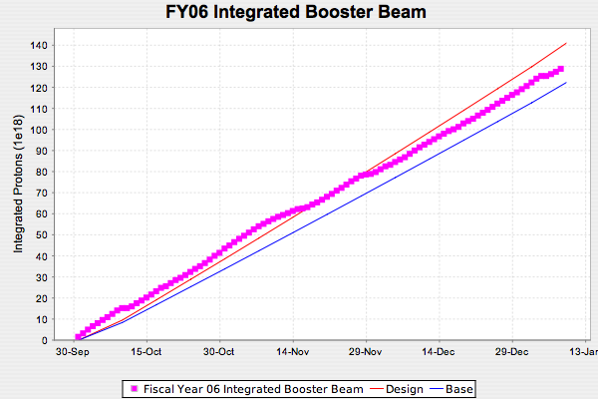
FY06 Total Booster Output
Falling a bit behind

Slide 8
Technical Progress

Slide 9
Progress
Technical Progress
  Linac
  1.01.01 PA Vulnerability –
    Seven out of twelve new tubes (plus seven ordinary spares)
    On schedule
  1.01.02 Quad Power Supplies
    First of eight cards prototyped and ready to go out for production.
  1.01.04 LLRF Upgrade
    Task force meeting regularly to plan characterization measurements.
  Booster
  1.02.01 Determine rep. rate limit
    Still trying to nail down all the numbers for 15 Hz
  1.02.02 Orbump (+ 400 MeV line) –
    All six magnets complete
    Three tested
    Will test all six and determine which to use
    Stripline assembly begun
    Misc. girder assembly ongoing
    On track for shutdown

Slide 10
Progress
  Booster
  1.02.03 Correctors –
    Two coils potted and ready for thermal test
    Three more coils wound and wrapped, ready for potting
    Lamination die ready Feb. 2.
  1.02.04/05 30 Hz/Gamma-t –
    Necessary modeling tools complete
    Working to focus effort
    Decision probably delayed until February
  1.02.11 Booster Dump Relocation
    Design complete
    Fabrication proceeding
    Everything else on track for shutdown.
  1.02.13 Booster RF/ Rep. rate Improvements
    Adding CR-4 to cover air switch gear to individually control transformers
    FESS will coordinate with overall installation
    On track for shutdown

Slide 11
Progress
  Main Injector
  1.03.01 Large Aperture Quads –
    Still planning to install all 7 during shutdown
  1.03.02 Collimation –
    Steel structure more or less complete
    Installing marble sides
    Good shape for shutdown
  1.03.03 NuMI MultiBatch Operations –
    Intensity pretty much where it’s going to be until we start slip stacking
    Studies continue
    Effort increased to insure MI-10 kicker mods will be done during shutdown.
    Modeling work continues

Slide 12
Progress (cont’d)
1.5 Stage II
  Draft report turned in to Roger Dixon
  See report from Mike Syphers

Slide 13
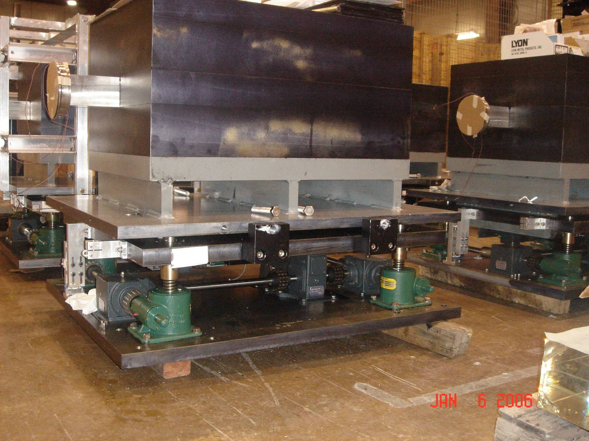
MI-8 Collimator

