Slide 1
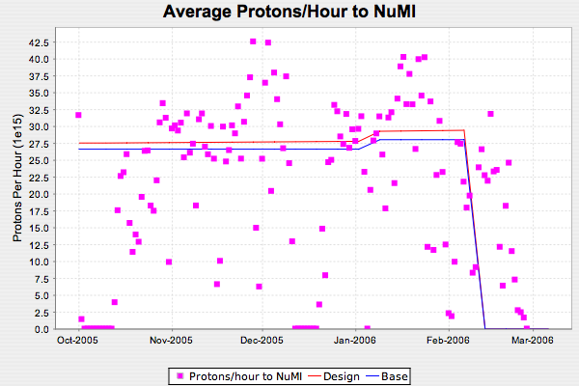
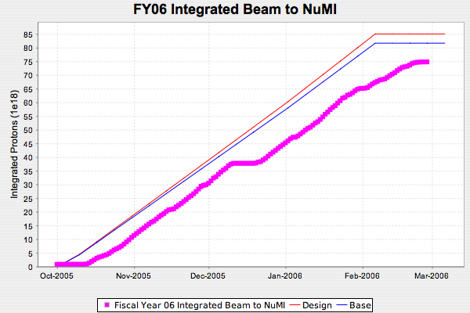
NuMI FY06

Slide 2
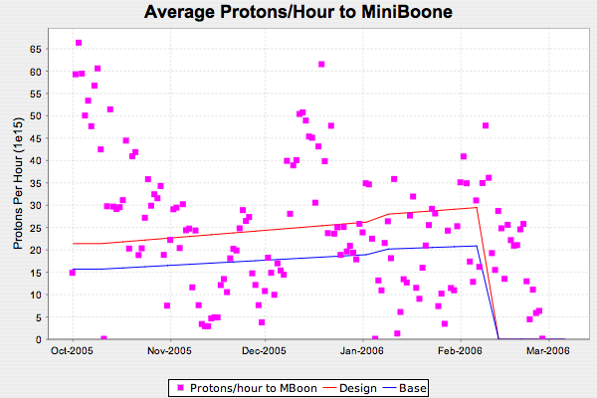
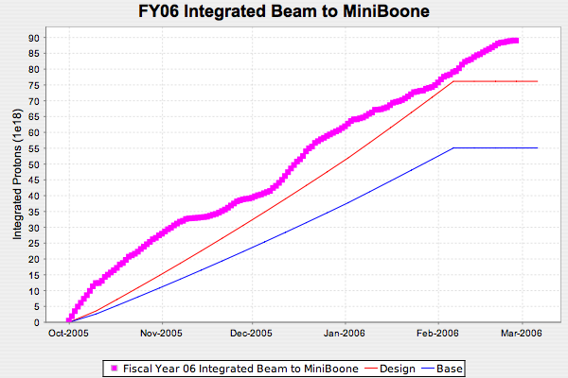
MiniBooNE FY06

Slide 3
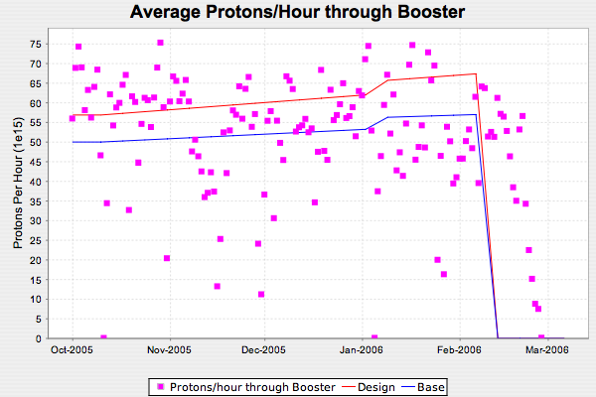
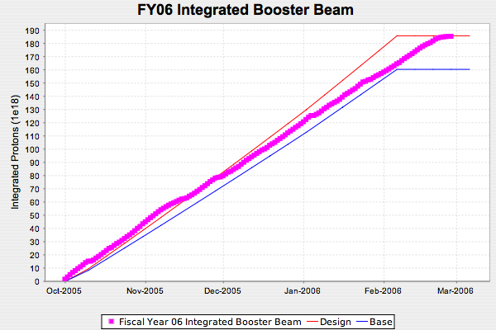
FY06 Total Booster Output

Slide 4
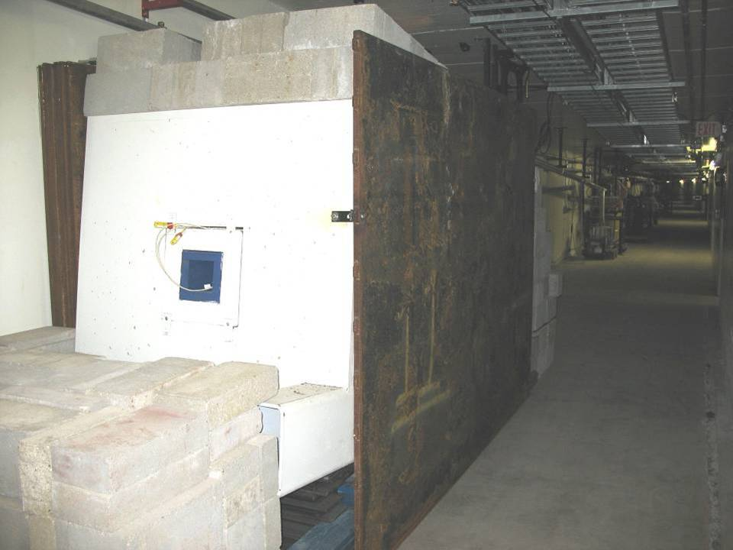
Relocated Booster Dump

Slide 5
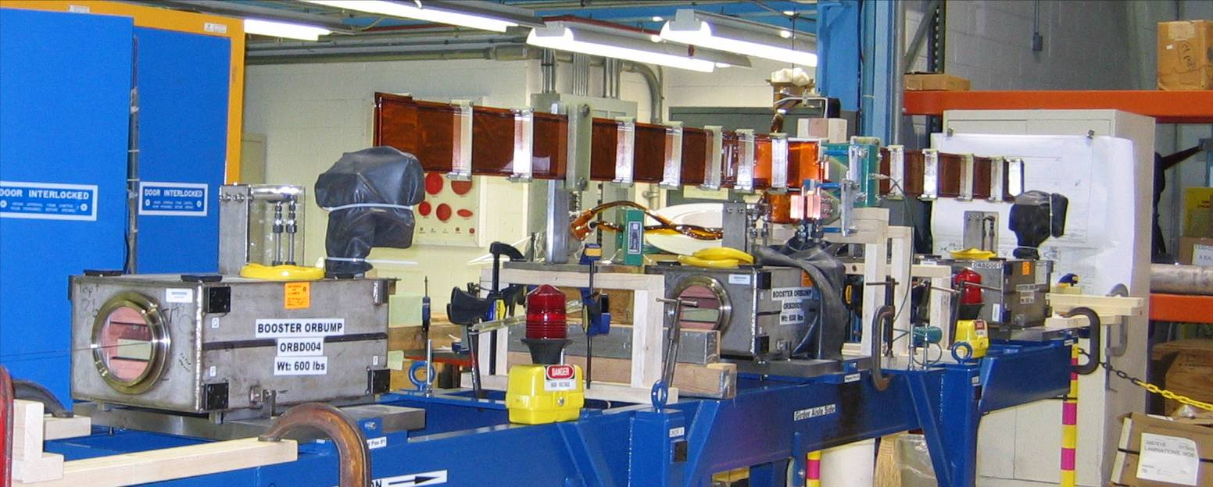
ORBUMP Girder
A series of magnetic measurements were carried out on the magnets on the ORBUMP girder.
Stripline now removed and vacuum components being installed.

