Slide 1
Proton Plan PMG – April 27, 2006
Agenda
  Shutdown/Technical Progress – Prebys
  Cost/Schedule Report – Sims
  MI RF - Berenc

Slide 2
Operations Report: OFF

Slide 3
Shutdown Status
Booster Projects (Proton Plan)
  ORBUMP/400 MeV Line
    All components installed and (mostly) connected
    Pumping down
    Testing wires, polarities, etc
    ORBUMP supply being connected to 480 and controls
  MI-8 Dump:
    All components installed (kickers installed yesterday)
    Pumping down
    All cables pulled
    Connecting (24) cables to septum and miscellaneous other cables
  Corrector water prep:
    Done. Being pressure tested.
  RF Drift tube cooling:
    Nearly complete

Slide 4
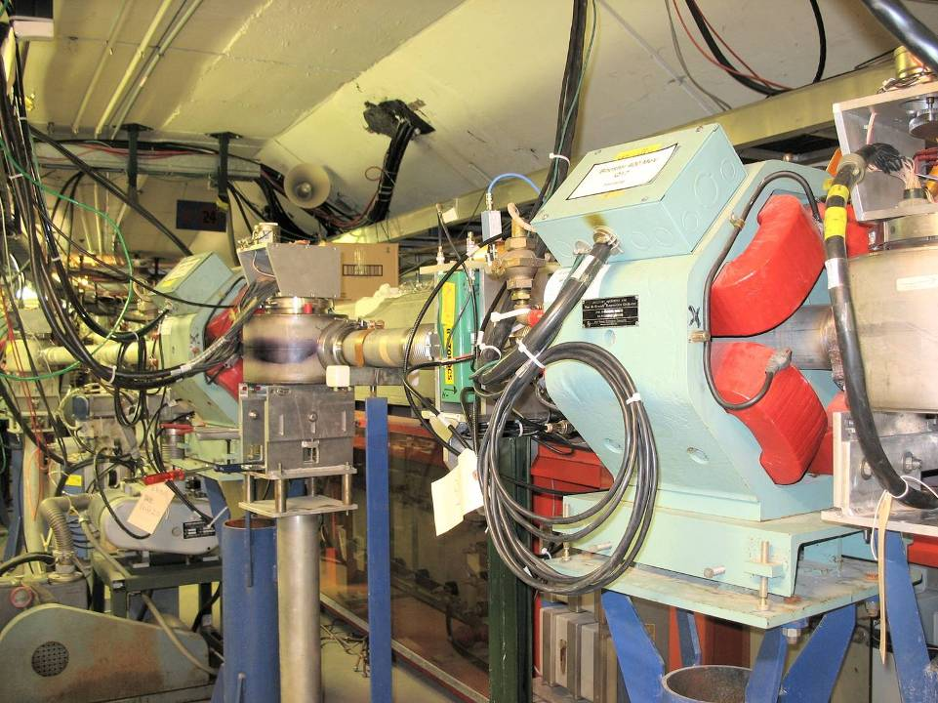
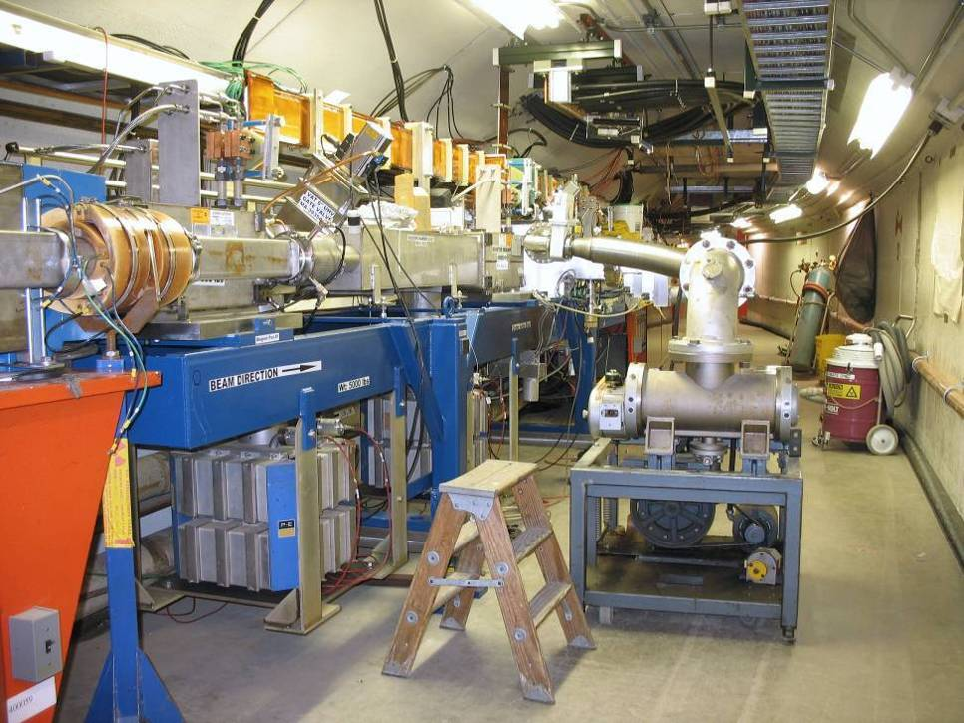
ORBUMP/400 MeV Project
Re-routed 400 MeV Line
Injection Girder

Slide 5
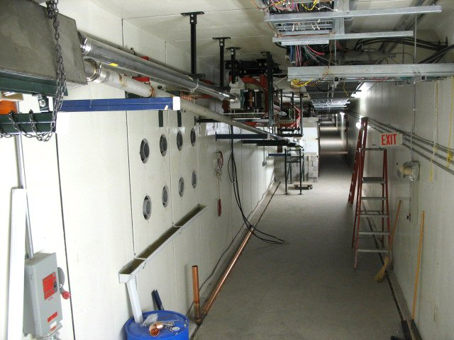
MI-8 Dump Line
Relocated Septum
Dump
New Dump Line

Slide 6
Booster Projects (non-Proton Plan)
RF
  Recover from water overpressure disaster
  Assorted preventive maintenance
  “Middle of May”
Sump re-routing
  Motivated by Tritium problem
  Prevent Booster sump water from being released off-site
  Should be complete next week

Slide 7
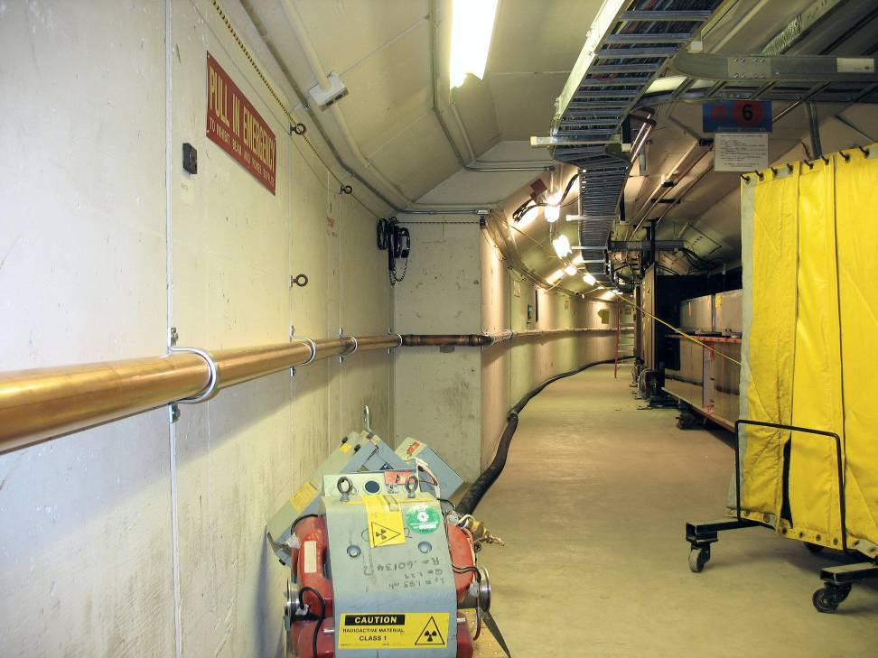
Sump Re-routing

Slide 8
Booster Startup
Rich Andrews working out “punch list” details for end of work and official turn-on time.
All installations should be done next week.
Ready to start injecting beam sometime week of May 8.
If RF system not ready, can do DC measurements for at least several days.
  Partial RF system would be useful for BPMs (discussing with RF group)
Hashing out commissioning plan in our Friday meetings (C. Ankenbrandt coordinating)

Slide 9
Main Inector Projects
Large Aperture Quads
  6 of 7 installed
    Three under vacuum
    Two being baked
    One open
    Last one will be installed next week
MI-10 Kicker
  Skid moved to MI-8, being connected
  Loads and piping installed in tunnel
  Final pressure test/completion ~next week
MI-8 Collimator
  Installed and under vacuum
  All cable pulls done
  Only final alignment remaining
Schedule
  All tunnel work complete by ~May 15
  Cannot do final magnet power test until Kautz power available (~5/22)

Slide 10
Non-shutdown Technical Status
Linac (1.1)
  (1.1.1) Reliability
    All 12 7825’s delivered!!! (one has to go back)
  (1.1.4) LEL LLRF (Improve phase and amplitude stability)
    Took advantage of shutdown for lots of important characterization measurements of LEL
(1.2) Booster
  (1.2.3) New Corrector System
    Enough cores and coils for first prototype
    About to begin assembly
    Still planning to begin testing in May
    Lots of work on cost and scheduling
  (1.2.4) 30 Hz Harmonic
    Held review 2/26/02
    Determined not worth money
    Working on CR. Might move money to other projects
(1.3) Main Injector
  (1.3.2) MI Collimation Systems
    Conceptual design of ring collimation scheme nearly complete
    Scheduling review for early June
  (1.3.4) MI RF Upgrade
    See Berenc talk

Slide 11
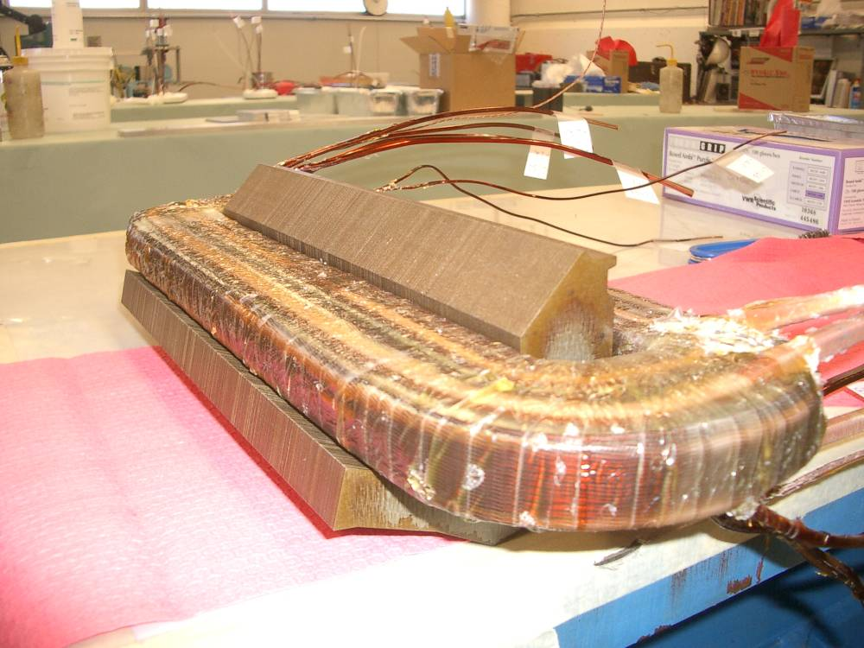
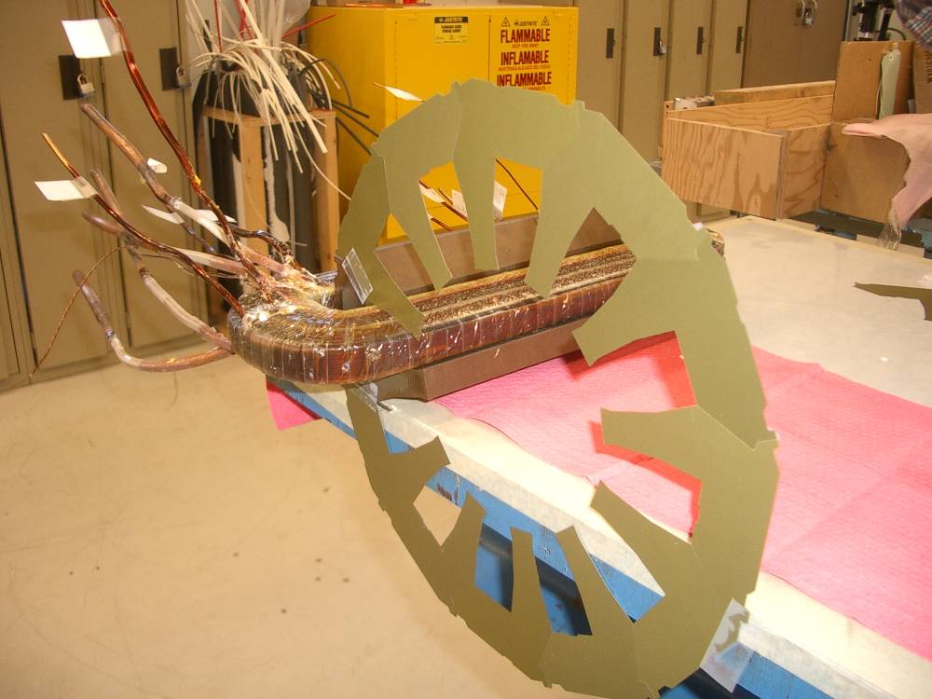
Corrector Prototype Progress (slightly out of date pictures)
Coil w/core
Need 12 of each (two types of coil)
  Have enough for prototype
Stacking scheme
Currently test-stacking real cores

Slide 12
30 Hz/Gamma-t Project (1.2.4/1.2/5)
As per Director’s Review, evaluated potential of 30 Hz harmonic upgrade and gamma-t upgrade together.
Held review 2/26
  Largely based on modeling of Jim Maclachlan
  Considered .3 unit gamma-t jump without 30 Hz harmonic and with two different 30 Hz scenarios
Conclusions
  The gamma-t jump system has the potential to allow the Booster to accelarate >6E12 protons per batch with very good longitudinal performance
  The 30 Hz harmonic has a very small effect on performance and does not warrant the cost and effort of the project
Currently writing up summary of review
  A couple of modeling issues Jim still had to address
Working on CR to descope 30 Hz from Plan
Assuming we will move ahead with new gamma-t magnets to be installed concurrently with the short straight correctors (~summer 2008)

