Slide 1
Proton Plan Status
April Report
Eric Prebys

Slide 2
Agenda
Shutdown/Startup – Prebys
Technical Status - Prebys
Cost/Schedule Report – Sims
Corrector Project - Drennan

Slide 3
Shutdown and Startup

Slide 4
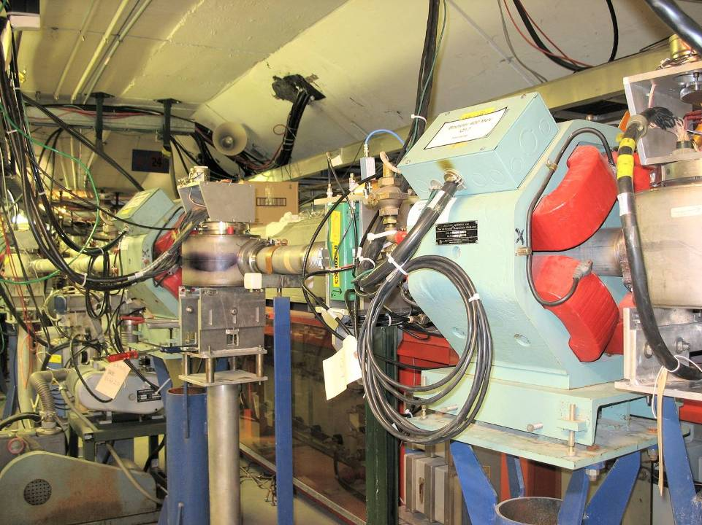
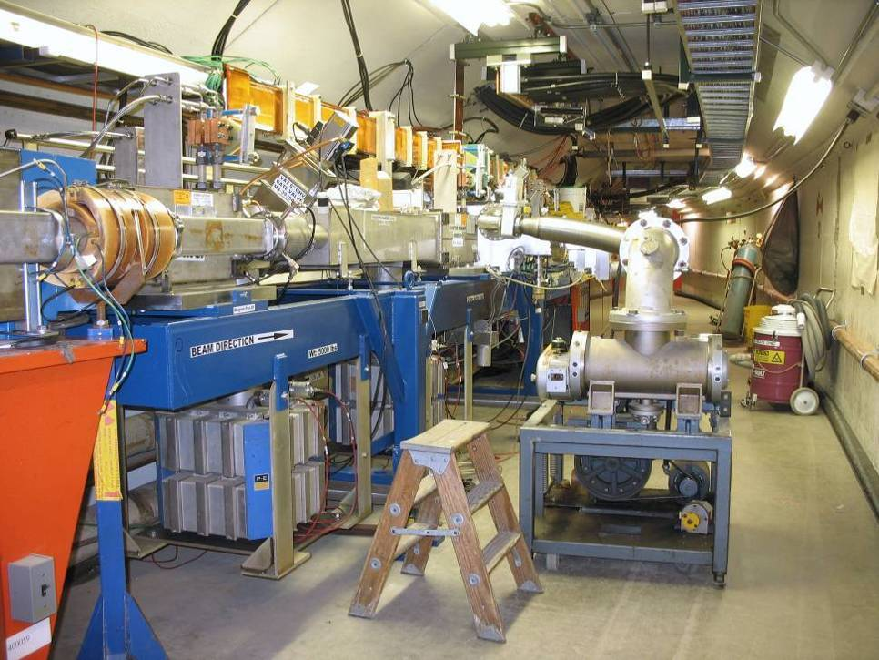
Review of Major Shutdown Work
Re-routed 400 MeV Line
Injection Girder

Slide 5
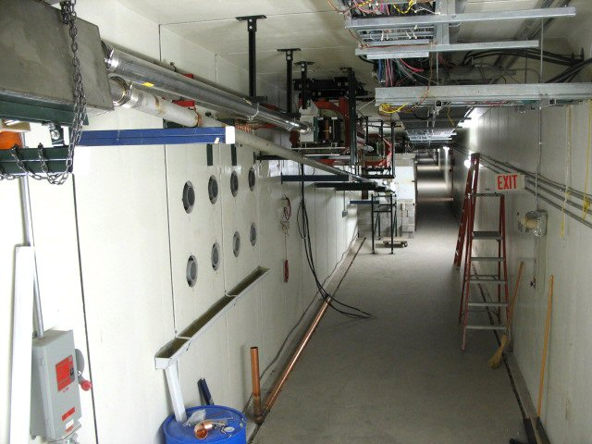
MI-8 Dump Line
Relocated Septum
Dump
New Dump Line

Slide 6
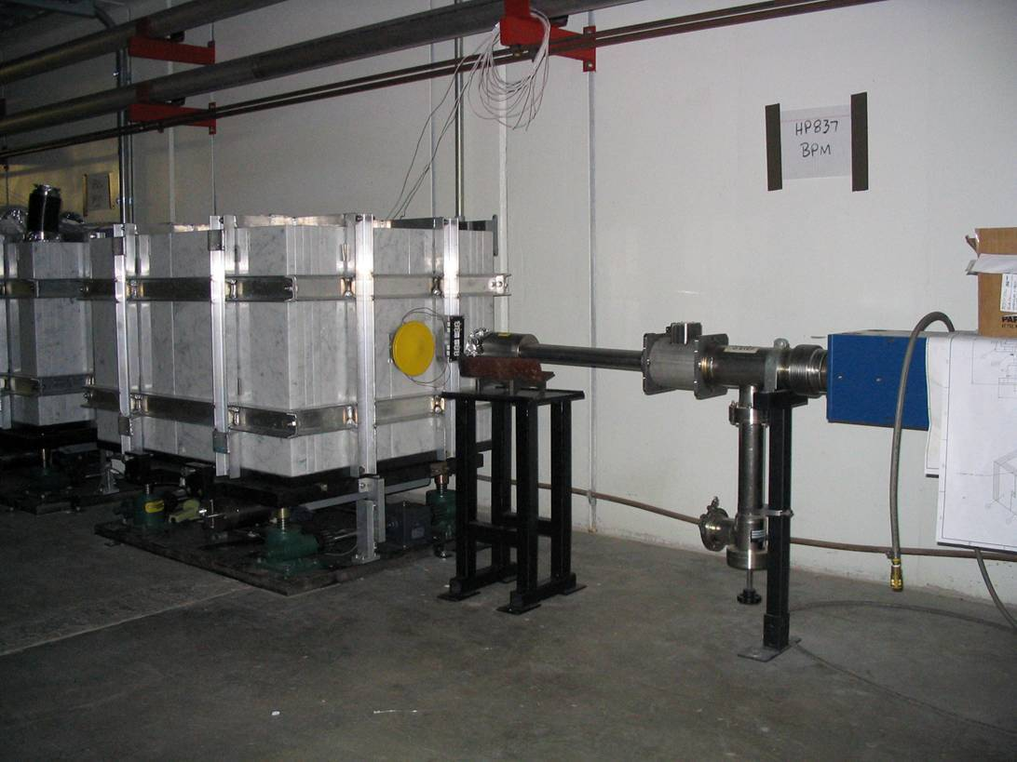
MI-8 Collimator
Note marble cladding

Slide 7
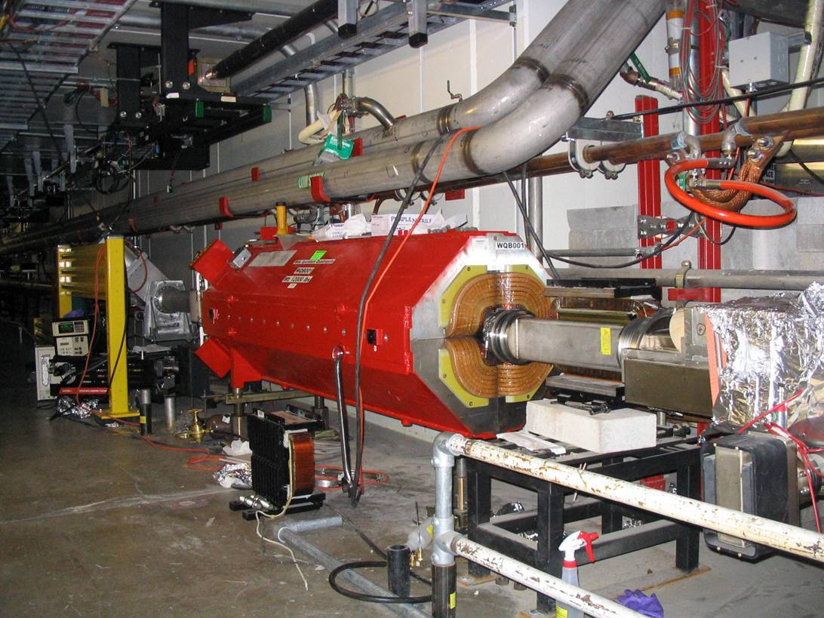
Main injector large aperture quads (7)

Slide 8
Other Proton Plan Shutdown Projects
Booster 13.8V transformer and switch gear upgrade:
  Recommended for reliable 9Hz operation
  New system will go to 15 Hz
Water routing for eventual corrector upgrade
RF cavity drift tube cooling complete
MI-10 kicker upgraded with new load and cooling to handle high rep. rates needed for NuMI slip stacking.
Lots of useful low level RF measurements in the Linac.

Slide 9
Major non-Proton Plan Work
Booster Sump rerouting
RF
  Significant maintenance work, including recovery from “water incident”
  A/B switch installed so cavity 19th cavity can be used as a proper spare.
    Time with at least 18 working cavities should go from ~80% to >95%.
400 MeV Line power supply upgrade:
  Replace unreliable Power 10 supplies with more robust Lambda supplies (good idea)
  Replace custom CAMAC controller with Allen-Bradley PLC (jury still out)

Slide 10
Acknowledgements
This shutdown ran like clockwork thanks to the work of countless people in the Proton Source, Main Injector, Project Support, Mechanical Support, and EE Support Departments, as well as Technical Division and the AMG.
We’d also like to thank Safety for working with us to insure that we had everything in order for an efficient sign-off.
As usual, Operations has played a big role in our smooth turn on.

Slide 11
Booster Startup Summary
The good news:
  It appears we didn’t do anything stupid
Timeline (note, we worked around daytime tunnel work):
  Friday 5/12
    19:00 - First attempt at 400 MeV beam
    21:00 - Beam to injection toroid
  Saturday 5/13
    02:00 – Beam through ORBUMP into Booster
    05:00 – Beam around Booster
  Sunday 5/14
    02:00 – DC beam for up to 33 ms
  Tuesday 5/16
    ~19:00 – Accelerate beam and extract. Get beam to new septum on first extraction attempt. Fail to hit new dump target in several hours
  Wednesday 5/17
    15:00 – After correcting for a miscalculation in the required septum current, establish beam to new dump!
  Currently
    Tuning and optimizing
    Demonstrated 3E12 proton batches with reasonable efficiency

Slide 12
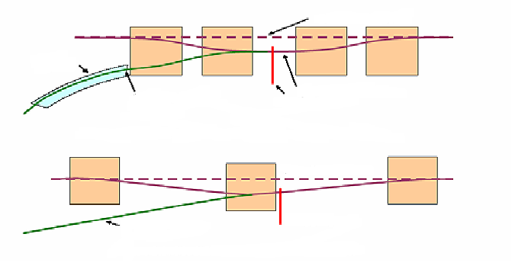
Understanding ORBUMP
Saturation of the central magnet:
  Causes a net integrated dipole moment (like a one bump).
  Measurements were inconsistent, but it’s on the order of 1%, which could cause a 4 mm closed orbit distortion as ORBUMP slews down.
  Doing measurements with various current shunts on end magnets to calculate the optimum shunt to cancel effect.
End to end mismatch:
  Causes a lateral displacement (like a single dogleg)
  Measured to be .4% with an imbalance toroid.
  This should cause a maximum of 0.6 mm closed orbit distortion.
  Can cancel it by modifying stripline to increase inductance.

Slide 13
MI Startup Summary
Monday 5/22
  1630 – Circulating Beam in MI on first shot!
Tuesday 5/23
  1400 – Beam to 120 GeV flat top
    Discovered problem with regulation of new quads, since fixed.
Wednesday 5/24
  2200 – Beam to 150 GeV
Currently
  Tuning MI-8 line and MI
  MI-10 kicker upgrades seem to have worked.

Slide 14
Technical Status

Slide 15
Major Elements
Linac (1.1)
  (1.1.1) Reliability
    Bad 7835 (of the 12) returned for checkout.
  (1.1.4) LEL LLRF (Improve phase and amplitude stability)
    Shutdown characterization studies complete
(1.2) Booster
  (1.2.3) New Corrector System
    (See Drennan’s talk)
  (1.2.4) 30 Hz Harmonic
    Waiting to de-scope
(1.3) Main Injector
  (1.3.2) MI Collimation Systems
    MI-8 collimator completed in the shutdown
    Will review ring collimation scheme in June
  (1.3.4) MI RF Upgrade
    Studies continue

Slide 16
Revised Projections
We are working to revise projection in preparation for the next Director’s Review
The biggest correction is for the benefit from NuMI slip stacking:
  Originally assumed that we began to implement slip stacking gradually over a year following this shutdown
  Now assume we do studies over the next year, but don’t get any benefit from slip stacking until after collimation and/or RF improvements in the 2007 shutdown, but then it only takes three months to ramp up.
These new projections were presented at the AAC review.

Slide 17
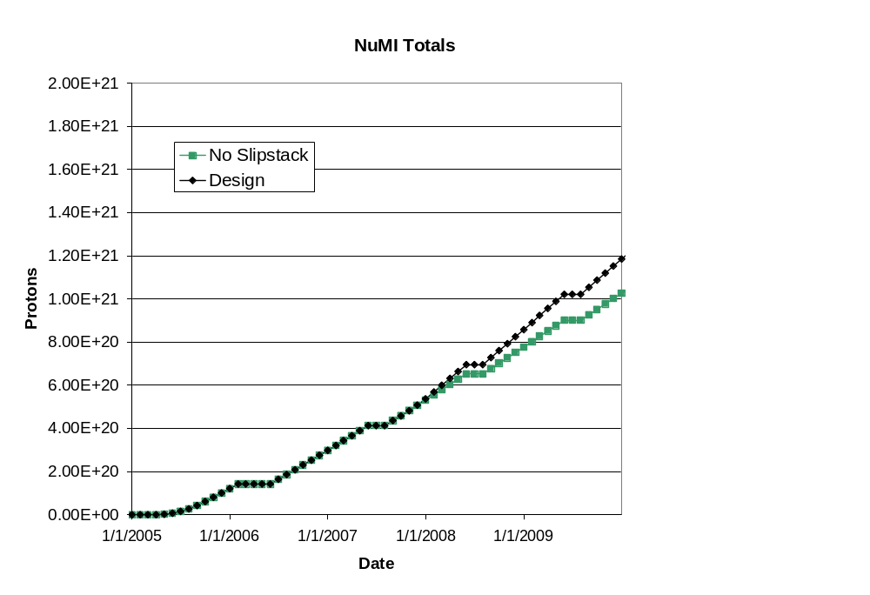
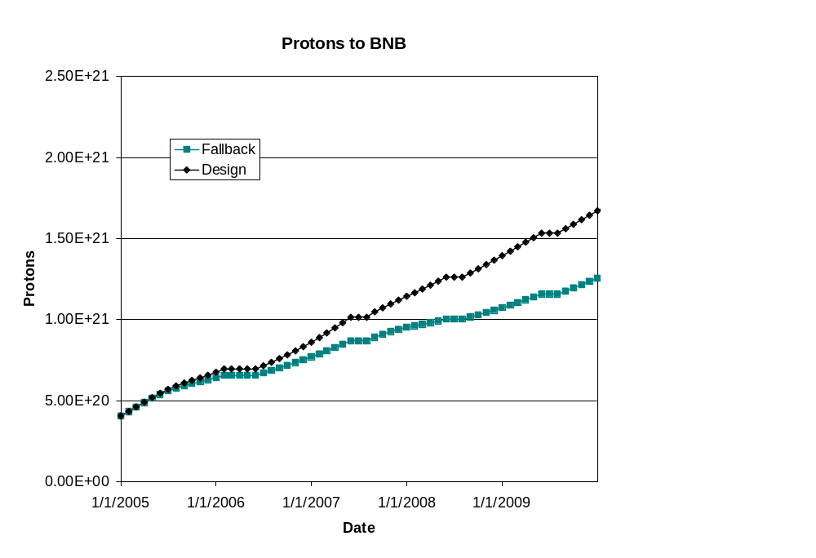
Long Term Projections
These projections do not take in to account effects of collider turning off or possible improvements thereafter.

