Slide 1
Proton Plan Status
May Report
Eric Prebys

Slide 2
Agenda
Operations – Prebys
Technical Status - Prebys
Cost/Schedule Report – Sims

Slide 3
Operations

Slide 4
Operational Issues
General
  As far as we can tell, there are no problems related to the major shutdown activities in the Booster and the Main Injector
MiniBooNE
  Problem with sparking connection in power supply
    Fixed after ~2 days
NuMI
  None

Slide 5
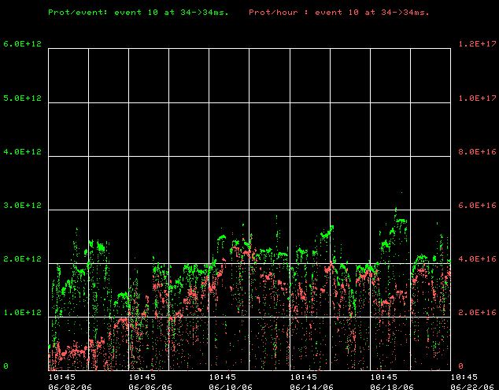
Not so good news: slow out of the gate
Where we’d like to be
Protons/hr
Protons/batch

Slide 6
Slow startup
Reason: Caution
    Want to take advantage of our new system to make the orbits as smooth as possible before pushing intensities
    Waiting to use collimators until we are confident in our orbit
      Note: hitting these hourly rates without collimators if actually pretty impressive!
Plan
  Starting to introduce collimators now.
    Will run with collimators at least when we’re not tuning
  Beginning to push batch intensity
    We don’t forsee any major problem with this.

Slide 7
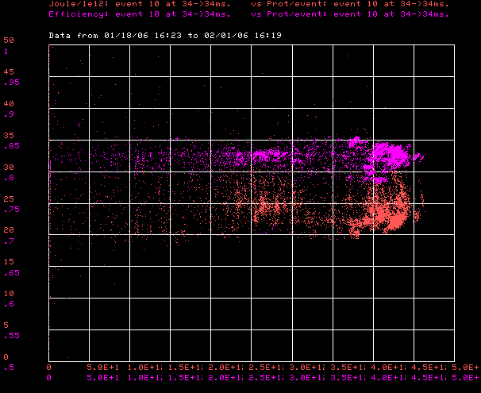
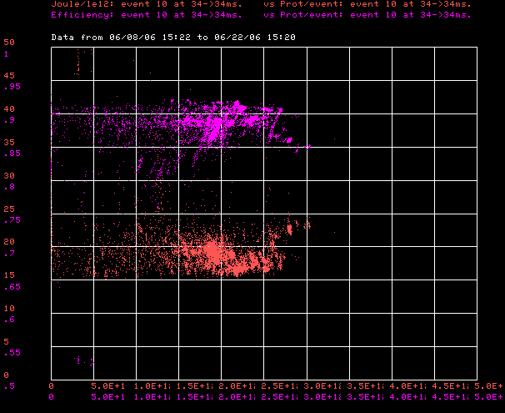
Good News: Improved Efficiencies!!!
January
Now
Efficiency (High is good)
85%
20 J/E12
Normalized Energy Loss
(low is good)
0.
2.5E12
5E12
0.
2.5E12
5E12
Batch size ->

Slide 8
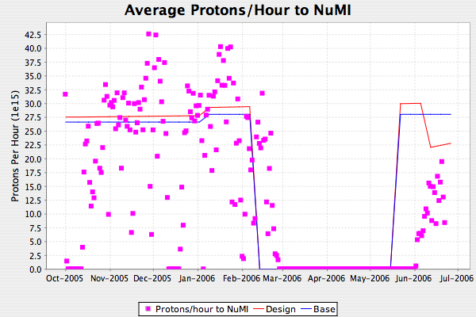
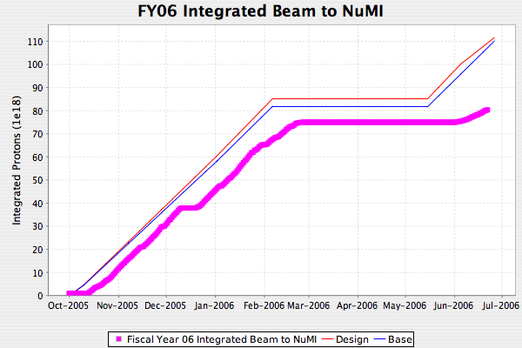
NuMI FY06

Slide 9
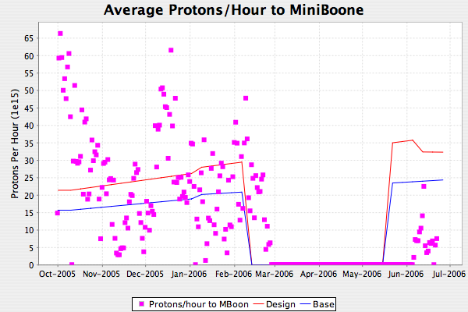
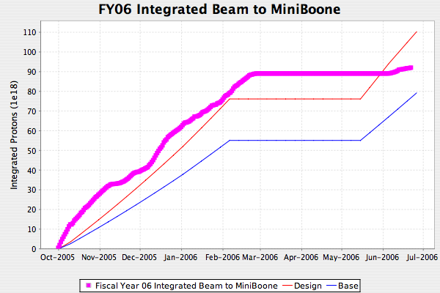
MiniBooNE FY06

Slide 10
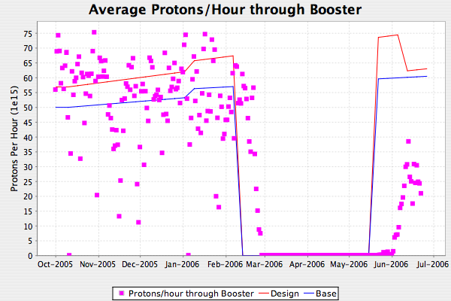
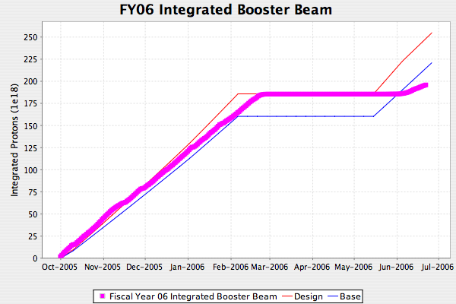
FY06 Total Booster Output
Falling a bit behind

Slide 11
Technical Status

Slide 12
Significant Activity Since Last PMG
Linac (1.1)
  (1.1.1) Reliability
    All 12 new tubes + 8 regular spares!
    Only 5 tested
    Disagreement about one new tube
      Burle says ion pump OK, we say it’s not
      We’ve got it back and will try it withouth ion pump (like we ran for 30 years)
(1.2) Booster
  (1.2.3) New Corrector System
    First prototype complete (see pictures) and testing beginning
    Video for RFI complete
    AIP paperwork nearly complete
  (1.2.5) gamma-t
    More studies in the last month than the last 5 years
    Beginning to work on design for new magnets
  (1.2.9) SS RF Upgrade
    Holding while deciding whether to pursue this as part of the Proton Plan or bundle it with SNuMI as part of a MI dual PA RF upgrade (decision soon?)
(1.3) Main Injector
  (1.3.2) MI Collimation Systems
    Paperwork nearly ready to use MI-8 collimator
    Review of ring collimation scheduled for next Friday.

Slide 13
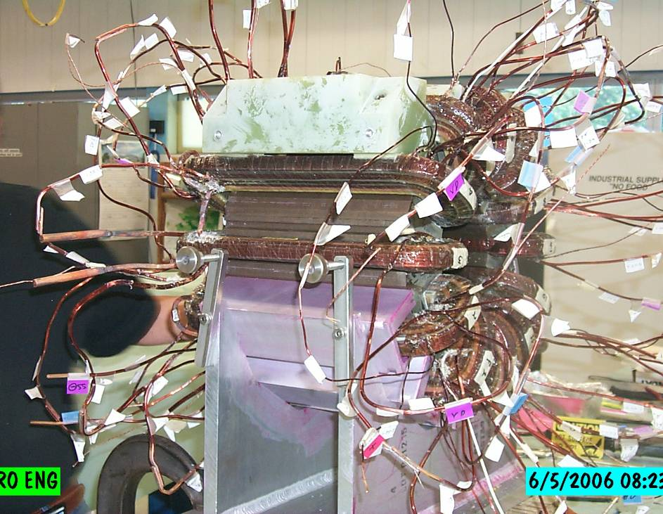
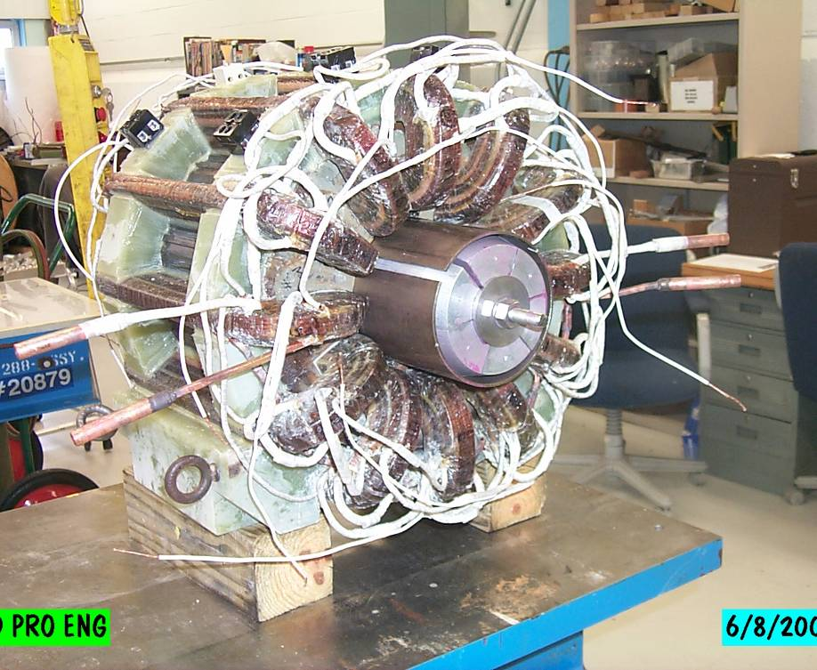
Corrector Prototype
Bad hair day
Ready for testing

Slide 14
Preparing for Director’s Review
Date set (August 15-16)
Focusing on Design Handbook
  Goal is to bring design handbook up to date and use it as basis for review talks
  Handbook with include “parameter tables” which were requested at the last review
  Handbook will be kept current as subprojects are completed
Will try to hammer out agenda at our next proton plan meeting.

