Slide 1
Proton Plan Status
June Report
Eric Prebys

Slide 2
Agenda
Operations – Prebys
Technical Status/Director’s Review - Prebys
Cost/Schedule Report – Prebys (for Sims)

Slide 3
Operations

Slide 4
Operational Issues
Booster
  Booster turn-on has been slower than anticipated
  Tuning for larger batch sizes
  Approaching anticipated intensities
NuMI
  NuMI horn bead problem has caused significant down time
  Essentially no possibility of reaching either the design or base curve for the FY
MiniBooNE
  “Malum quidem nullum esse sine aliquo bono”*
*”There is surely no evil without something good”

Slide 5
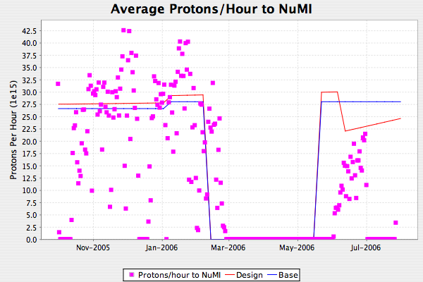
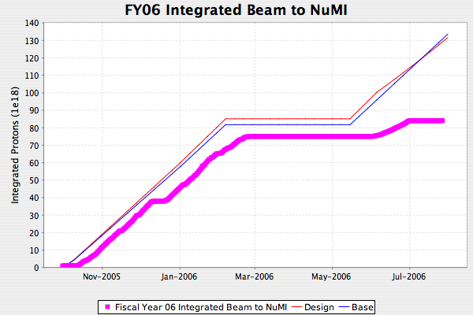
NuMI FY06

Slide 6
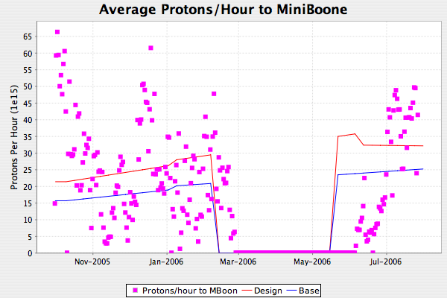
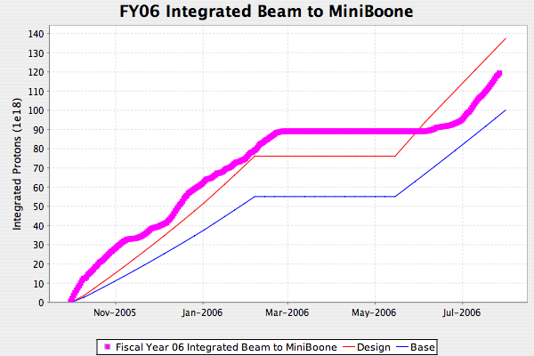
MiniBooNE FY06

Slide 7
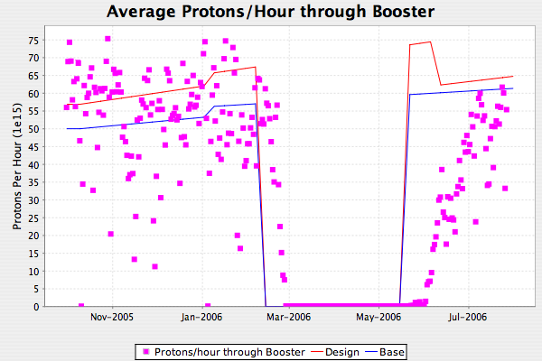
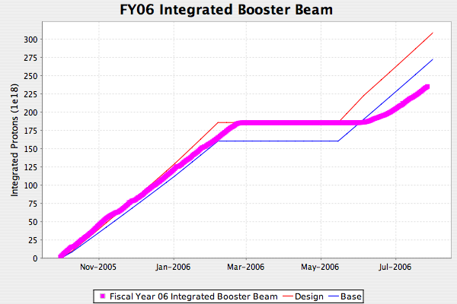
Total Protons

Slide 8
Technical Status/Director’s Review

Slide 9
Significant Activity Since Last PMG
Linac (1.1)
  (1.1.2) Quad Power Supply
    PO out for second replacement card
  (1.1.4) Linac LLRF
    Many important measurements made during the shutdown
    Modeling nearly complete
(1.2) Booster
  (1.2.1) Determine booster rep. rate
    Ready to schedule high rate test of Booster (9-10 Hz).
  (1.2.3) New Corrector System
    Tests of prototype proceeding
    No obvious problems
    Improvements to stacking fixture to improve core alignment
  (1.2.5) gamma-t
    Studies have uncovered some unusual behavior at transition, which is being investigated
  (1.2.9) SS RF Upgrade
    Decision made to descope from Proton Plan and treat as a maintenance replacement out of operating funds.

Slide 10
Activity (cont’d)
(1.3) Main Injector
  (1.3.2) MI Collimation Systems
    Paperwork nearly ready to use MI-8 collimator
    Conceptual review of ring collimation scheme took place 6/29 (V. Shiltsev, chair)
      Impressed by modeling effort
      Recommended proceed with two stage scheme over single stage w/ dispersion modification.

Slide 11
Preparing for Director’s Review
Tentative review agenda set
  Still might tweak some times after practice talks
Review highlights
  Shutdown projects
  Booster corrector system
  Main Injector modeling
  Projections
Preparing for the review has become the focus of our Proton Plan meeting
  Increased meetings to weekly from bi-weekly
  Finalizing parameter list (requested at last review)
  Updating responses from last year’s recommendations.
  Will have first practice talks next week
    Prebys
    Berenc
    Drennan

Slide 12
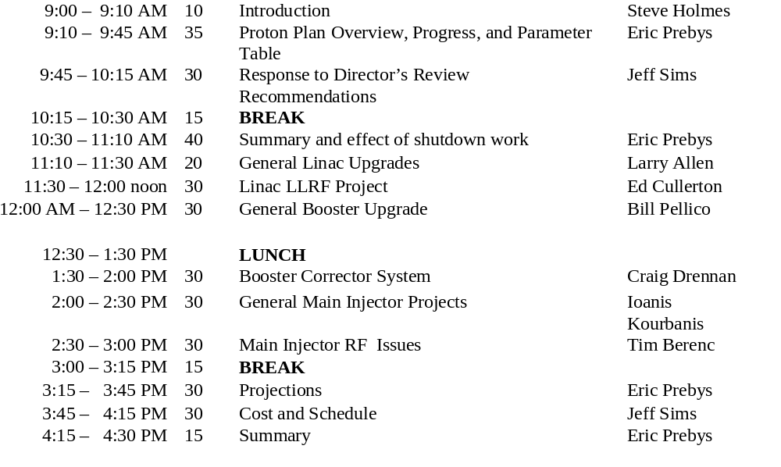
Review Agenda

Slide 13
Proton Projection Revisions
Batch size
  Old scheme used one batch size with low “efficiency” for slip stacked batches
    Accurate but confusing
  New scheme will have two explicit batch sizes
Uptime
  Biggest factor in NuMI beam delivery
  Old scheme had only small variation between design and base
  New scheme:
    NuMI “base” will be uptime from turn-on through shutdown
    BNB will budget 1 unscheduled horn replacement every two years
Post shutdown turn-on
  Historically tried to cover this by using a projection shutdown longer than actual shutdown
    Real shutdown always extended to same length
    Still looks bad
  New scheme:
    Post shutdown exponential ramp up with (tau ~2 weeks)
Peaks vs. averages
  Either way elicits strong reactions from people
  Will include both with clear explanation
Bottom line:
  Only the post-shutdown turn-on will affect design curve (slightly)
  Lower uptime will reduce the base curve.

