Slide 1
Proton Plan Status
September and October Report
Eric Prebys

Slide 2
Agenda
Operations – Prebys
Technical Status/Corrector Review - Prebys
Cost/Schedule Report – Baller

Slide 3
Operations

Slide 4
Operational Issues
Good News
  When things are running we seem to be meeting our goals
  Switched to 2+5 ALL to NuMI during shot setup
    Record NuMI intensity: 299 kW
Bad News
  “mouse incident” on October 10 caused a problem with LEL RF2, and possibly contributed to a string of source problems, resulting in a couple of days down time and a week of non-optimal performance.
  F-sector access to repair TeV leak held off all beam for several days.

Slide 5
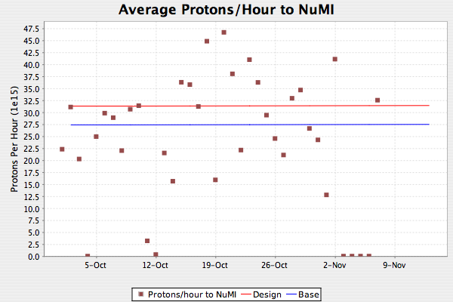
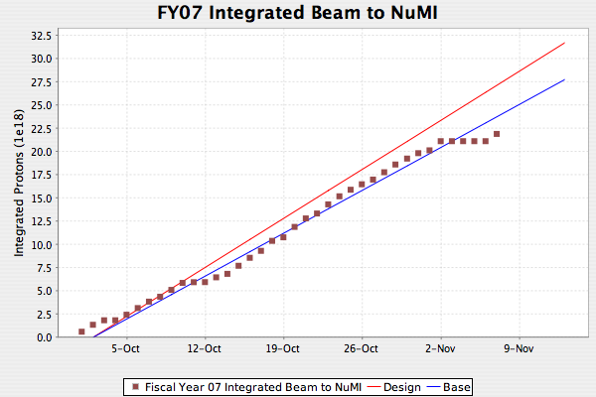
NuMI
Mouse incident
TeV leak

Slide 6
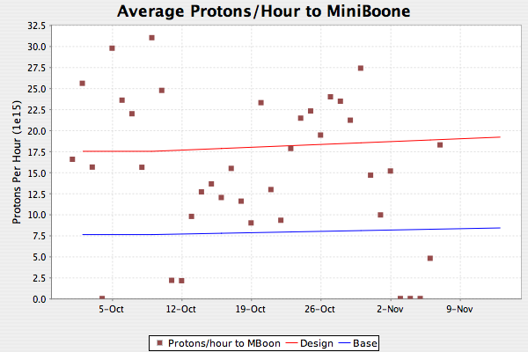
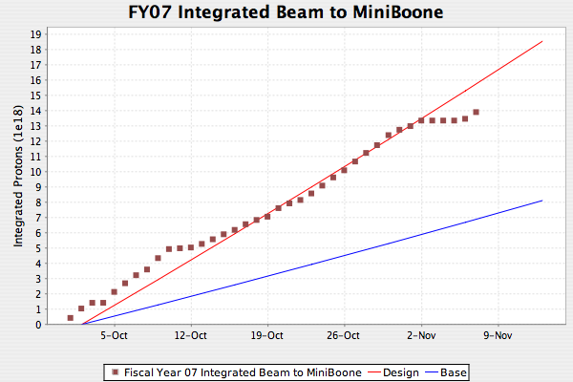
MiniBooNE

Slide 7
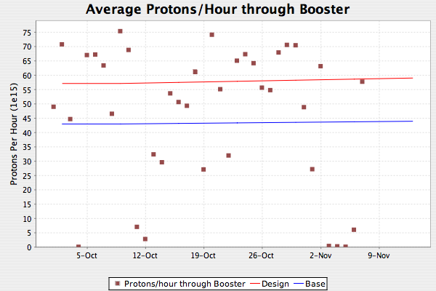
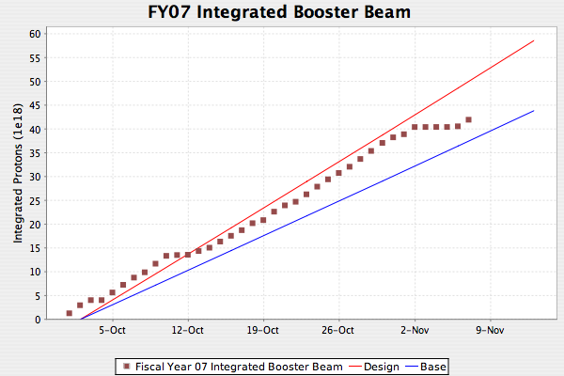
Total Booster Output

Slide 8
Technical Status

Slide 9
Significant Activity Since Last PMG
(1.2) Booster
  (1.2.3) New Corrector System
    Review held Oct 10th (more later)
    Review scheduled for Oct 10th
  (1.2.5) gamma-t
    Studies continue
    Reached 4.5E12 per batch with acceptable losses
      Preparing for slip stacking test
  (1.2.12) Booster notch chopper
    Working on design
    Trying to schedule review (some time in early December?)

Slide 10
Activity (cont’d)
(1.3) Main Injector
  (1.3.2) MI Collimation Systems
    MI-8:
      Final paperwork to 7th floor
      Expect approval to test soon
    Ring:
      Finalizing design
      Prototype primary collimator and test secondary installed in recent down time.
  (1.3.4) MI RF
    Scope of RF upgrades complete
    CR in the works to add comb filter
    Detailed design proceeding

Slide 11
Corrector Review
October 10, 2006

Slide 12
Booster Corrector Review (10/10/06)
Committee
  Mike Syphers, beam physics (chair)
  Tom Nicol, technical division
  Howie Pfeffer, EE support
  O’Sheg Oshinowo, AMG
  Absent: Mike Frett was supposed to represent Mech. Supp., but was called away by the TeV magnet problems
Covered
  Specifications
  Magnet design
  Prototype tests
  Procurement and production
  Power supplies
  Installation
Not covered
  BPM’s
  Controls

Slide 13
Complication at Review
Prototype tests seemed to show slower than expected slew rates.
  Several did not meet our specs
A number of review comments were related to this.
After the review, it was discovered that the problem was a bandwidth limit in the measurement.
Working on follow-up errata on this issue
  Bottom line: it now appears that the slew rates will meet our specs

Slide 14
Other Conclusions
A new corrector system is long overdue, and the specs and design appear well motivated.
No obvious problems with magnet design, power supplies, or installation plan.
  Once you eliminate the slew rate problems
Need more simulation of the beam physics considerations driving field quality requirements.
Strongly recommending building one or more additional prototypes, preferrably putting at least one in the beam.
  We’re looking into this.
Aggressive schedule very worrisome.
Recommend a second review to
  address remaining issues and to
  cover the controls issues and BPM’s
  Discussed fully fleshed out installation plan

