Slide 1
Proton Plan Status
November and December
Eric Prebys

Slide 2
Agenda
Operations – Prebys
Technical Status/Shutdown Preparations – Prebys
SNuMI/Nova/Proton Plan Restructuring - Prebys
Cost/Schedule Report – Baller

Slide 3
Operations

Slide 4
Operational Highlights
Excellent Running over Thanksgiving and Christmas
  MiniBooNE well above red curve
  NuMI at roughly red curve for weekly and approaching blue curve for integrated
    And this is with the erroneous 2 second curves!
  Total protons ~at red curve for both
More recently
  MiniBooNE’s falling steel plate problem has shut them off for ~a couple months
    Not really a Proton Plan problem, but makes the numbers look bad

Slide 5
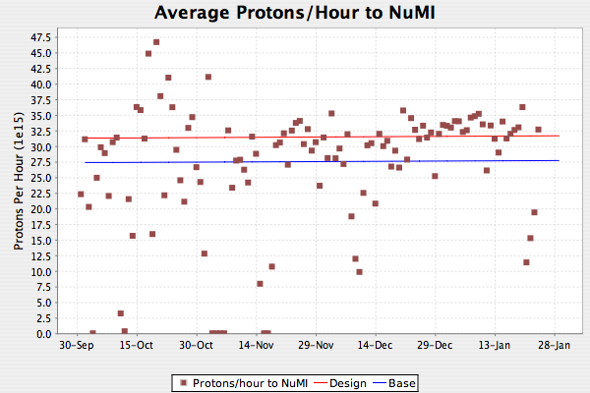
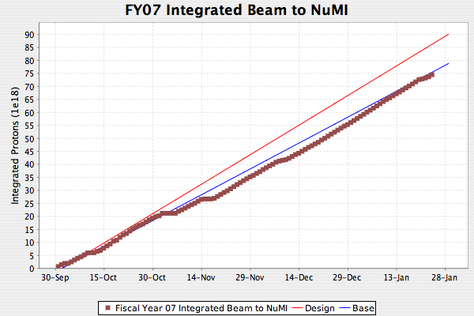
NuMI
Note: these plots assumed 2 second cycle time rather than the 2.4 seconds that has been the reality

Slide 6

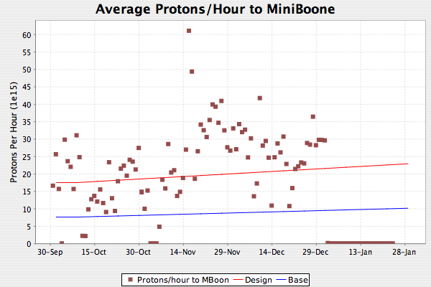
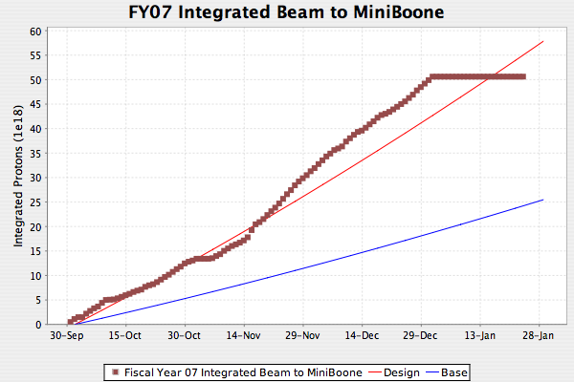
MiniBooNE
Rusty steel chain
Sword of Damocles

Slide 7
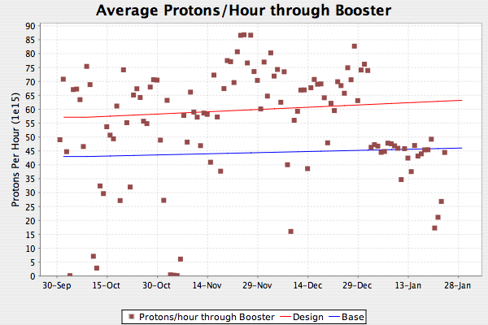
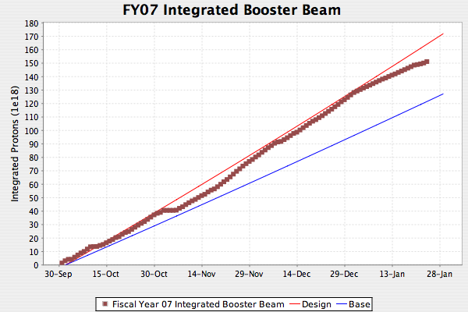
Total Booster Output

Slide 8
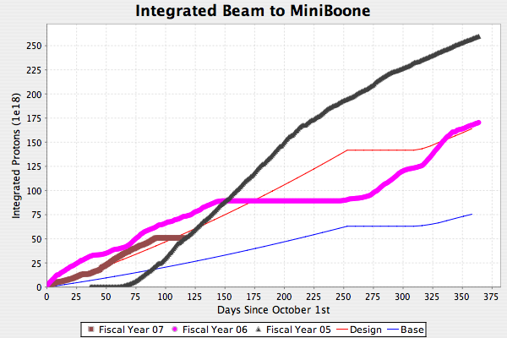
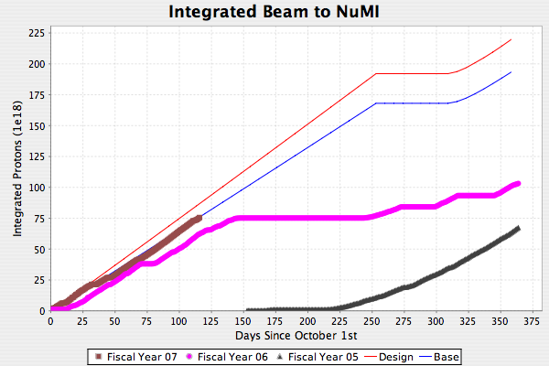
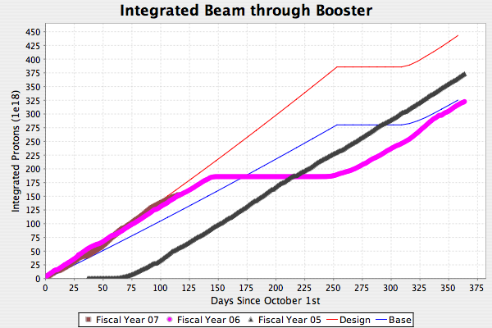
New Tracking Plots
Thanks to Paul Derwent
Available at AD->”9:00AM”
->”Proton Plots” webpage
Useful to see how we’re doing

Slide 9
Technical Status

Slide 10
Significant Activity Since Last PMG
(1.1) Linac
  (1.2.2) Quad Power Supply Upgrade
    All P8 cards replaced
    Three prototype P1 cards in service
      Ready for procurement
    Design complete for P2 and P4 cards
      Preparing to build prototypes
  (1.2.4) Linac LLRF Upgrade
    Lots of progress
    Conceptual design review last week
    Ready to build test bench at LRF2
    Working to hammer out CR for proper budget and schedule
      What’s there is largely a placeholder

Slide 11
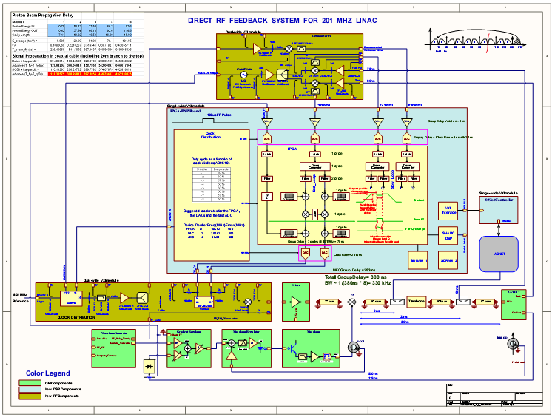

Slide 12
Booster Activity
(1.2) Booster
  (1.2.3) New Corrector System (Lots of progress!!)
    Magnets
      All tests of first prototype look good
      Second prototype nearing completion
        After testing, this will go into the Booster
      Production of coils and cores begun and quality looks good
      Should start arriving next week
      Hammering out QA procedure
    Power supplies and cabling
      40A design complete. Procurement ~next week
      60A design nearly complete
      Cable order ready to go out
    Controls
      Working primarily to adapt existing control software to handle new corrector system
        “First, do no harm”

Slide 13
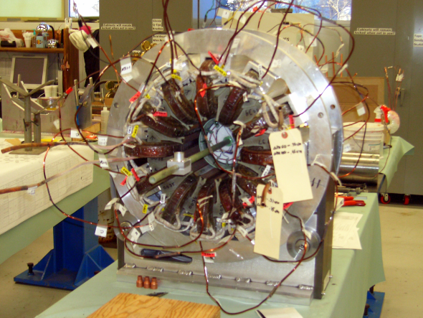
Second Corrector Prototype
Potting fixture
Hall probe array (polarity check)

Slide 14
Booster (cont’d)
  (1.2.5) gamma-t
    Studies continue
    Slip Stacking test looks encouraging
    Engineering continues, but will delay any production until the next fiscal year.
  (1.2.12) Booster notch chopper
    Prototype test bed assembled in Booster staging area and tests under way
      Picture to follow
    Looks good, but cannot make shutdown
      Working on CR to shift schedule to be ready for 2008 shutdown

Slide 15
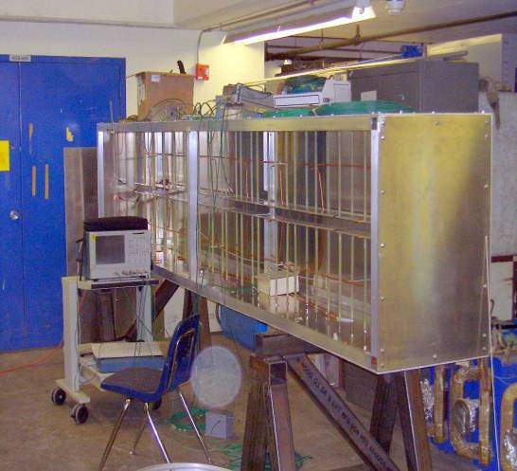
Notcher Prototype Test Bed
~4m long x 2¼” high
Real notcher will need ~40 kV
Plates segmented
Will be phased in such a way as to beta match the beam
Serves as a model for a possible (pseudo-) electrostatic extraction kicker in the future.

Slide 16
Booster (cont’d)
  (1.2.13) Booster RF Reliability Improvements
    Idendified a general problem with water availability
      Identified while discussing SNuMI
      Possibly already an issue
      Definitely an issue at higher rep. rate
      Contracting Mike May to work with water group (Matt Cooper), and they’ve come up with a plan
      Working on CR, but probably a few 10’s of $K this shutdown and ~$100K next shutdown.

Slide 17
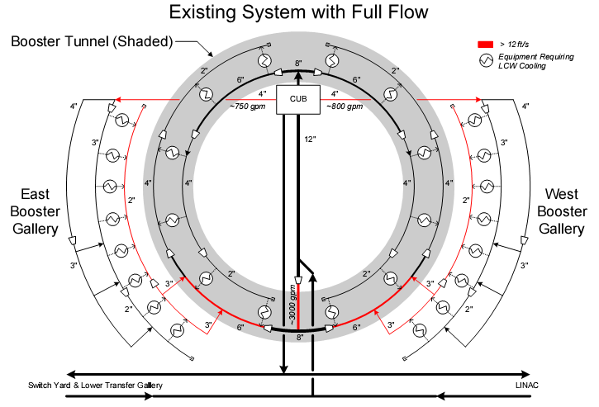

Slide 18
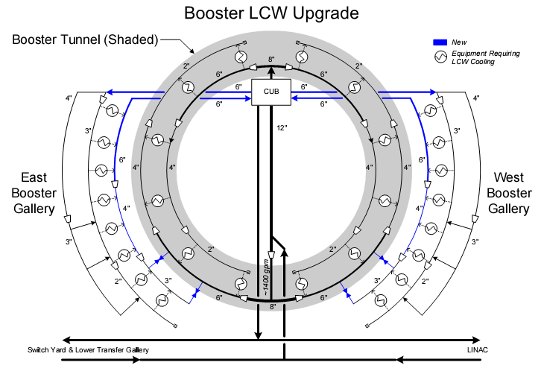

Slide 19
Main Injector Activity
(1.3) Main Injector
  (1.3.2) MI Collimation Systems
    MI-8:
      Commissioning studies very successful
        See BEAMS-DOC-2618
      Nearly ready to put in operationally
        Need to improve positional stability of extracted Booster beam
    Ring:
      Design COMPLETE
        All steel (no Copper)
        Located around Ecool (Q301 Q303 Q307 Q308)
      Internal review coming up, after which procurement will start

Slide 20
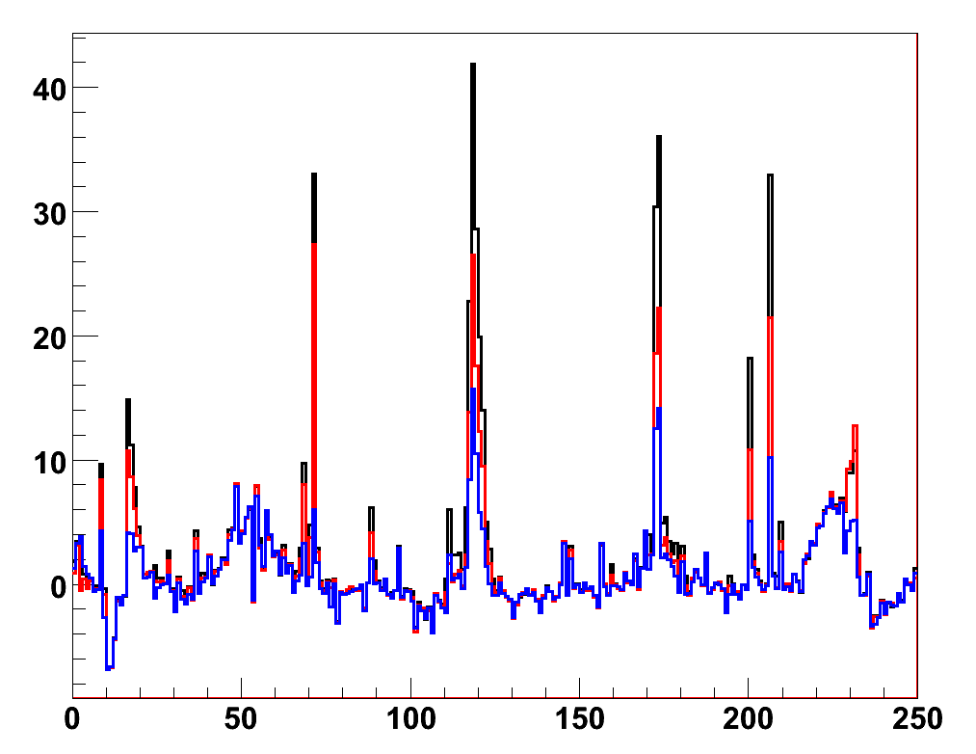
MI-8 Collimation Studies
No Collimators
H Collimators
H&V Collimators
Loss (R/s)
BLM #

Slide 21
Main Injector (cont’d)
  (1.3.3) Multi-batch slip stacking
    11 batch slip stacking studies continue
    Considering partial slip stacking solution to increase beam to NuMI in the short term
  (1.3.4) MI RF
    Work proceeding
    Important to stay on schedule for the shutdown

Slide 22
Shutdown Preparations
Three Significant projects for the shutdown
  New Long Straight Booster Correctors (1.2.3)
    Project proceeding well
    No possibility of making a June shutdown (it was always marginal)
    July tight, but probably doable
    Magnets and power supplies in good shape
    If controls effort fall behind, there are a number of workable stopgap solutions.
  Main Injector collimation (1.3.2)
    Design complete
    Procurement should begin shortly
    Collimators very similar to Booster and MI-8 systems
      Becoming experts at building and installing them
    Added complication from moving MI bus and shielding for Recycler operation
      More at next PMG
  MI RF Upgrade (1.3.4)
    Quietly proceeding on schedule
      Easy to forget how important it is
    Looks good, but very important that Tim gets the resources he needs.

Slide 23
Project/Campaign Restructuring

Slide 24
What’s in a Name?
Scenarios (current name shown in green):
  “Stage 1”: MINOS era (concurrent with Run II), aka: “business as usual”, Proton Plan, Proton Plan 1, Proton Plan
    Ramp up to deliver slip stacked protons to both NuMI and antiproton production
    Continue to deliver protons to the 8 GeV line at some level
    Goal:
      ~380 kW to NuMI
      1-2E20 protons to 8 GeV line
    Status: in progress
  “Stage 2”: Nova era (after collider program), aka: SNuMI I, Proton Plan 2, “part of Nova”
    Use Recycler as a pre-loader to the Main Injector to eliminate loading time
    Becoming a formal plan.
    Goal
      ~700 kW to NuMI line
    Status: “probable”
  “Stage 3’ ”: enhanced NoVA++, aka: Obietron, McGinnis-o-tron, SNuMI II, SNuMI
    Use Antiproton Accumulator Ring to momentum stack protons
    Boxcar stack these protons into Recycler
    Load into Main Injector
    Goal
      ~1.2 MW to NuMI line
    Status: “wait and see what happens with ILC”.
  “Stage 3”: 8 GeV Linac, aka: Proton Driver, Foster’s folly, “HINS”
    Always a possibility, but not part of our baseline thinking at the moment.
    Status: only if the ILC is not built, or not built for a very long time.

Slide 25
Orders from Above
It was decided in Washington the NoVA project would be combined with the accelerator activities required to make it a success
  Not so crazy when you think about it
  NoVA now “assimilates” the effort to retask the recycler as a MI preloader (most recently called “SNuMI”).
  NoVA goes from $200M->$240M
By the end of the Proton Plan, the Booster/Linac will be “good enough” to support NoVA alone
  All Booster activity dropped from NoVA/SNuMI
  Moved to Proton Plan
    Only included 15 Hz hardware upgrades needed for things beyond, or in addition to, NoVA
The good news:
  Booster and Linac people will not have to go to NoVA/SNuMI reviews
Bad news:
  This rearrangement has left some activity orphaned.

Slide 26
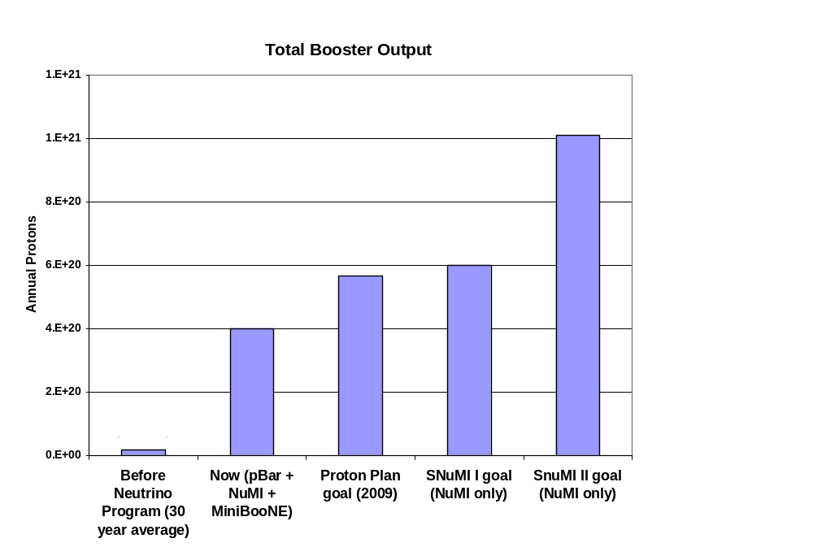
Rationale
Present

Slide 27
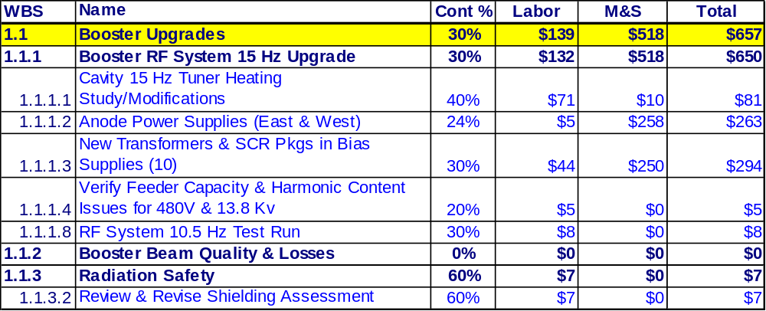
Orphaned Scope
The cost is driven by the upgrades that are required to increase the average repetition rate of the Booster RF system
  Tuner cooling
  Bias supply improvement
  Anode supply refurbishment

Slide 28
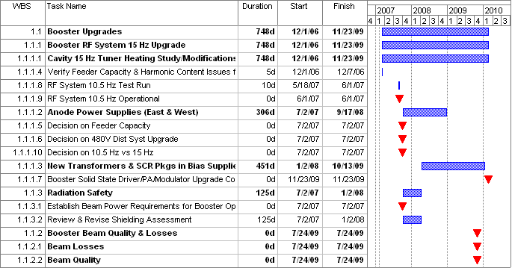
Nominal Schedule
Still important
Must fit into Proton Plan somehow
Still working out details of CR’s (move as much to FY08 as possible)

