Slide 1
Proton Plan Status
January
Eric Prebys

Slide 2
Agenda
Operations – Prebys
Technical Status/Shutdown Preparations – Prebys
Cost/Schedule Report – Baller
Shutdown Teaser – Bob Mau

Slide 3
Operations

Slide 4
Operational Highlights
Excellent performance for NuMI and PBar beam
  With the exception of a leaky NuMI magnet
  Very good efficiencies for cogged cycles
  Too bad MiniBooNE isn’t here to enjoy it!

Slide 5
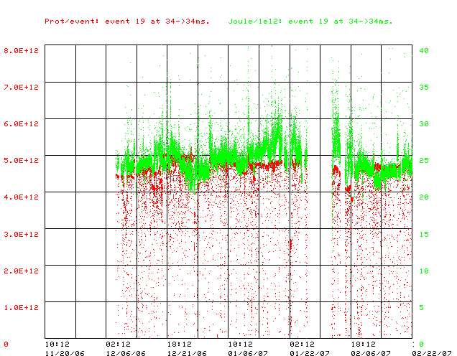
Energy Loss on NuMI cycles
Energy Loss (J/E12)
Protons/batch

Slide 6
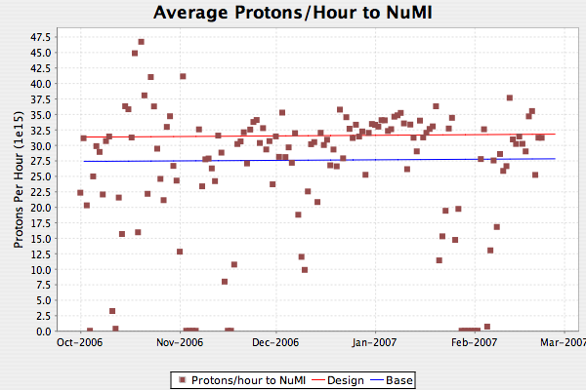
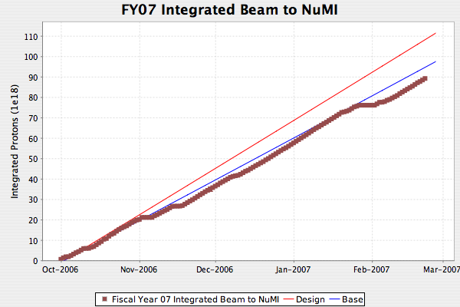
NuMI
Dotted lines are 2.4 second rep rate

Slide 7
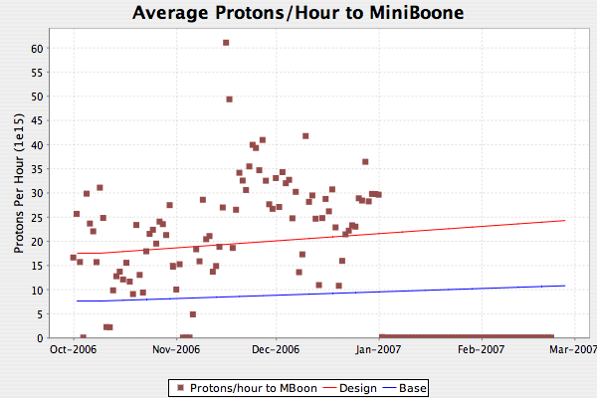
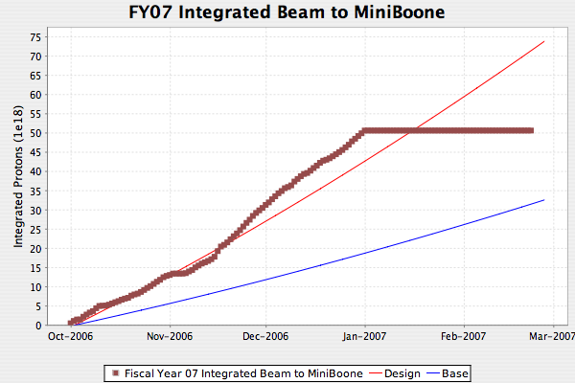
MiniBooNE
What can I say?

Slide 8
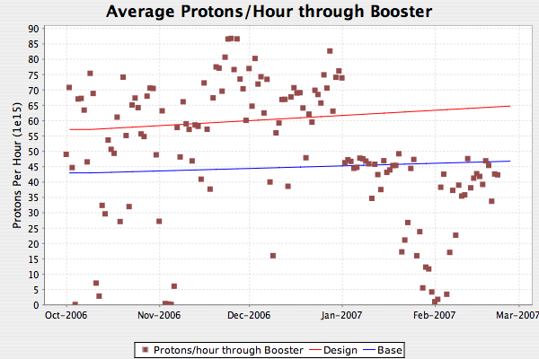
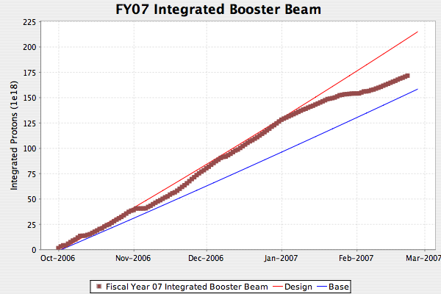
Total Booster Output
Mostly reflects loss of MiniBooNE

Slide 9
Technical Status

Slide 10
Significant Activity Since Last PMG
(1.1) Linac
  (1.2.2) Quad Power Supply Upgrade
    All P8 cards replaced
    Three prototype P1 cards in service
      Being evaluated
      Ready for procurement
    Design of three others complete
      Waiting fir results of P1 test
  (1.2.4) Linac LLRF Upgrade
    Passed design review
    Beginning to set up test system
    Affected by delay of ILC FPGA module
      Will use prototype board for test system
    Will still be in during shutdown IF the ILC prototype works reasonably well
      Also affects MI RF project
    Also, will need time in the near future to adjust coupling of station 3 or 5
      Involves moving coax line
      ~1 shift to do + 1 shift to tune

Slide 11
Booster Activity
(1.2) Booster
  (1.2.3) New Corrector System (Lots of progress!!)
    Magnets
      Cores arriving from vendor ahead of schedule
        Look good!!
      Coils behind schedule
        Potting fixture had to be rebuilt
        Becoming worrisome
        Curing oven could be bottleneck
        Will know more next week
    Power supplies and cabling
      40A Ready for procurement
      60A Nearly ready for procurement
      Cable ordered
        Due March 31st
    Controls
      Moving ahead

Slide 12
Booster (cont’d)
  (1.2.13) Booster RF Reliability Improvements
    Hoped to have a full cost and schedule estimate for water upgrade by this PMG
    Mike May identified required modification to manifold system for modulator water distribution.
    Working in scope change.

Slide 13
Main Injector Activity
(1.3) Main Injector
  (1.3.2) MI Collimation Systems
    MI-8:
      Now used operationally
    Ring:
      Drawings complete (for collimators)
      Should go out next week
      Working on bus rerouting scheme

Slide 14
Main Injector (cont’d)
  (1.3.3) Multi-batch slip stacking
    Lot’s of progress in 11 batch slip stacking (see following slides)
  (1.3.4) MI RF
    On track, but tight
    Affected by delay of ILC LLRF FPGA module
    Considering back up plan using prototype boards

Slide 15
Proton Plan Goal (slides from Kiyomi Seiya’s AEM talk)
Intensity: 11 x 4.3E12 @ injection 4.5E13 ppp @ extraction
Total beam power: 400kW 80kW → Pbar 320kW→ Numi
Total beam loss: < 5%
Mixed mode
Pbar
Numi multi-batch
Numi ONLY
Numi multi-batch
Bucket #
0
84
588

Slide 16
Present Status
Fit MI ramp to 2.2 sec
Verify 11 batch slip stacking scheme
Send 11 batch to Numi target with int. of ~3.0E13
Current operation
7 batches
Multi batch
Slip stacking
11 batches
Bucket #
0
84
588

Slide 17
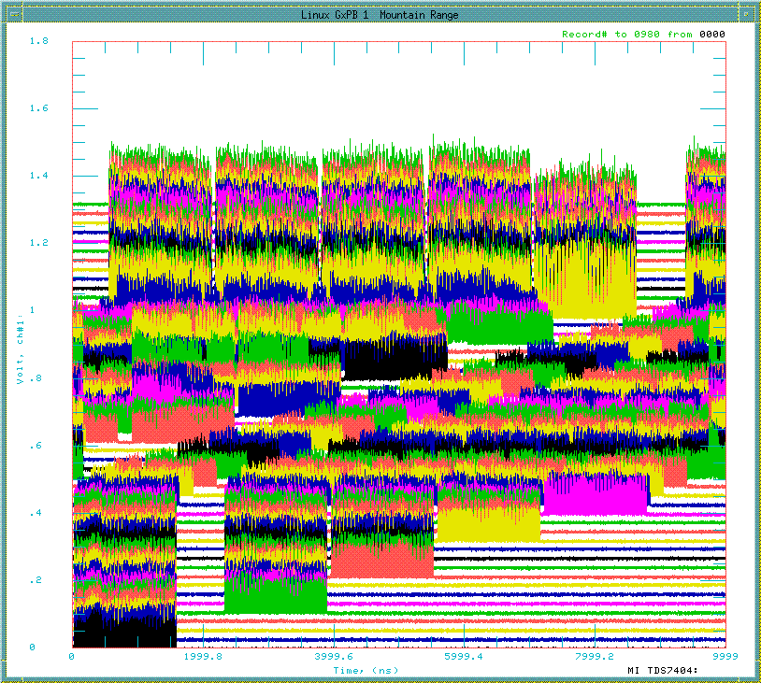
Slip stacking on Mixed mode cycle
Numi (9)
Pbar (2)
11μsec (1 revolution)

Slide 18
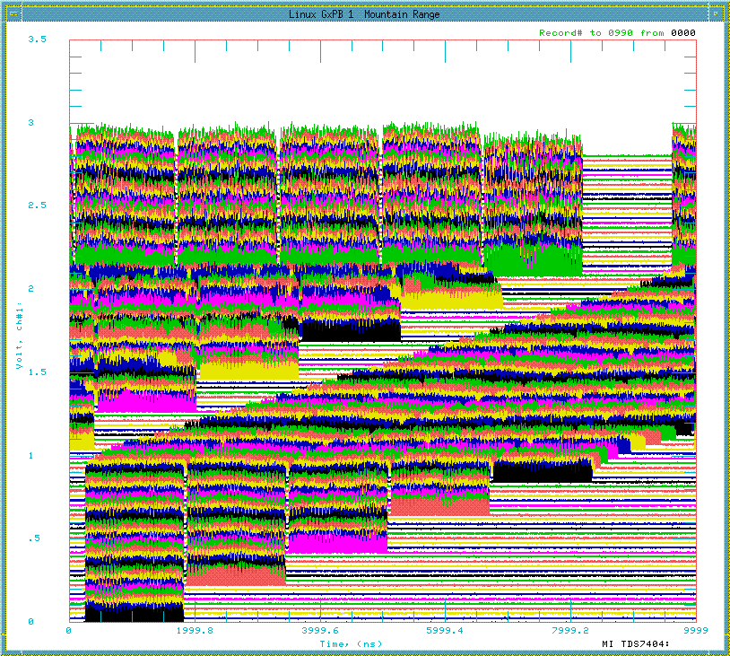
Slip stacking on Numi Only cycle
Numi (11)
11μsec (1 revolution)

Slide 19
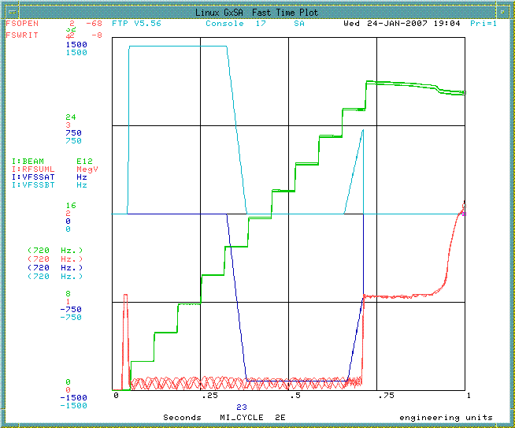
Intensity and frequency curves
Frequency A
1425Hz
Frequency B
Intensity
RF voltage

Slide 20
Status
Records:
  11 Batch (MI) Record:
    3.7E13 to MI dump
    90% efficiency
    No reason we can’t send this to NuMI (will try today)
  NuMI record
    3.5E13
    85% efficiency
Issues:
  Dampers don’t work because of the multiple frequencies during slip stacking
    Damper group working on two board solution
  Approaching limits of MI RF system
  Will need collimation to run operationally

Slide 21
Shutdown Preparations
See Bob’s talk for details
Beginning to make concrete plans
  Coordinator: Rich Andrews
  Floor Manager: Fernanda Garcia (backups: Todd Sullivan and Jim Lackey)
  Individual bosses assigned.
  Will begin to meet with AMG in the very near future
Complication:
  MTA beamline will be a significant project competing for resources and Fernanda’s time
Date?
  June off table
  July possible, but tight
  More comfortable with August 1

