Slide 1
Proton Plan Status
February
Eric Prebys

Slide 2
Agenda
Shutdown Preparations and Schedule – Prebys/Mau
Operations – Prebys
Technical Progress - Prebys
Cost/Schedule Report – Baller
Covered under shutdown prep.

Slide 3
Proton Plan Shutdown Projects
Linac
  Low Level RF Upgrade
  Complications
    NTF Running
    MTA beamline (not part of Proton Plan)
Booster
  Long straight correctors
    Huge project
  Water supply upgrade
Main Injector
  Ring Collimation System
    Two primary and four secondary collimators
    Requires rerouting of power bus and water
  RF upgrade
    Transformer upgrade
    Comb filter

Slide 4
Linac LLRF Status
Have design
Waiting on FPGA Board prototype
Will not drive shutdown

Slide 5
Booster Corrector Status
Magnets:
  Two Prototypes built and tested
    Look good
    Second prototype will be put in Booster tunnel ~April
  Vendor Deliveries
    Cores: over half delivered
    Coils: lots of start up problems, but now first couple of magnets’ worth delivered
  Assembly
    Beginning assembly of first magnet from vendor-supplied components
Power supplies
  5 (4x40A + 1x65A) of the six power supply types in procurement
  Remaining PS (2.5A skew quad) straightforward

Slide 6
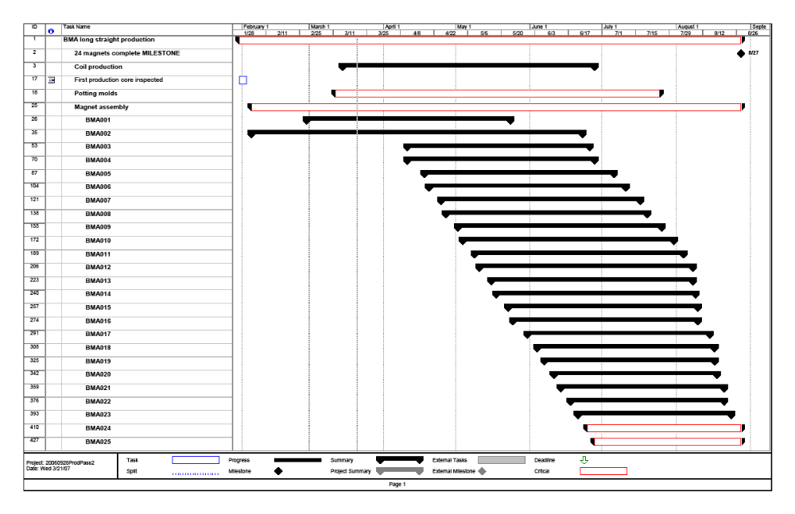
Corrector Schedule

Slide 7
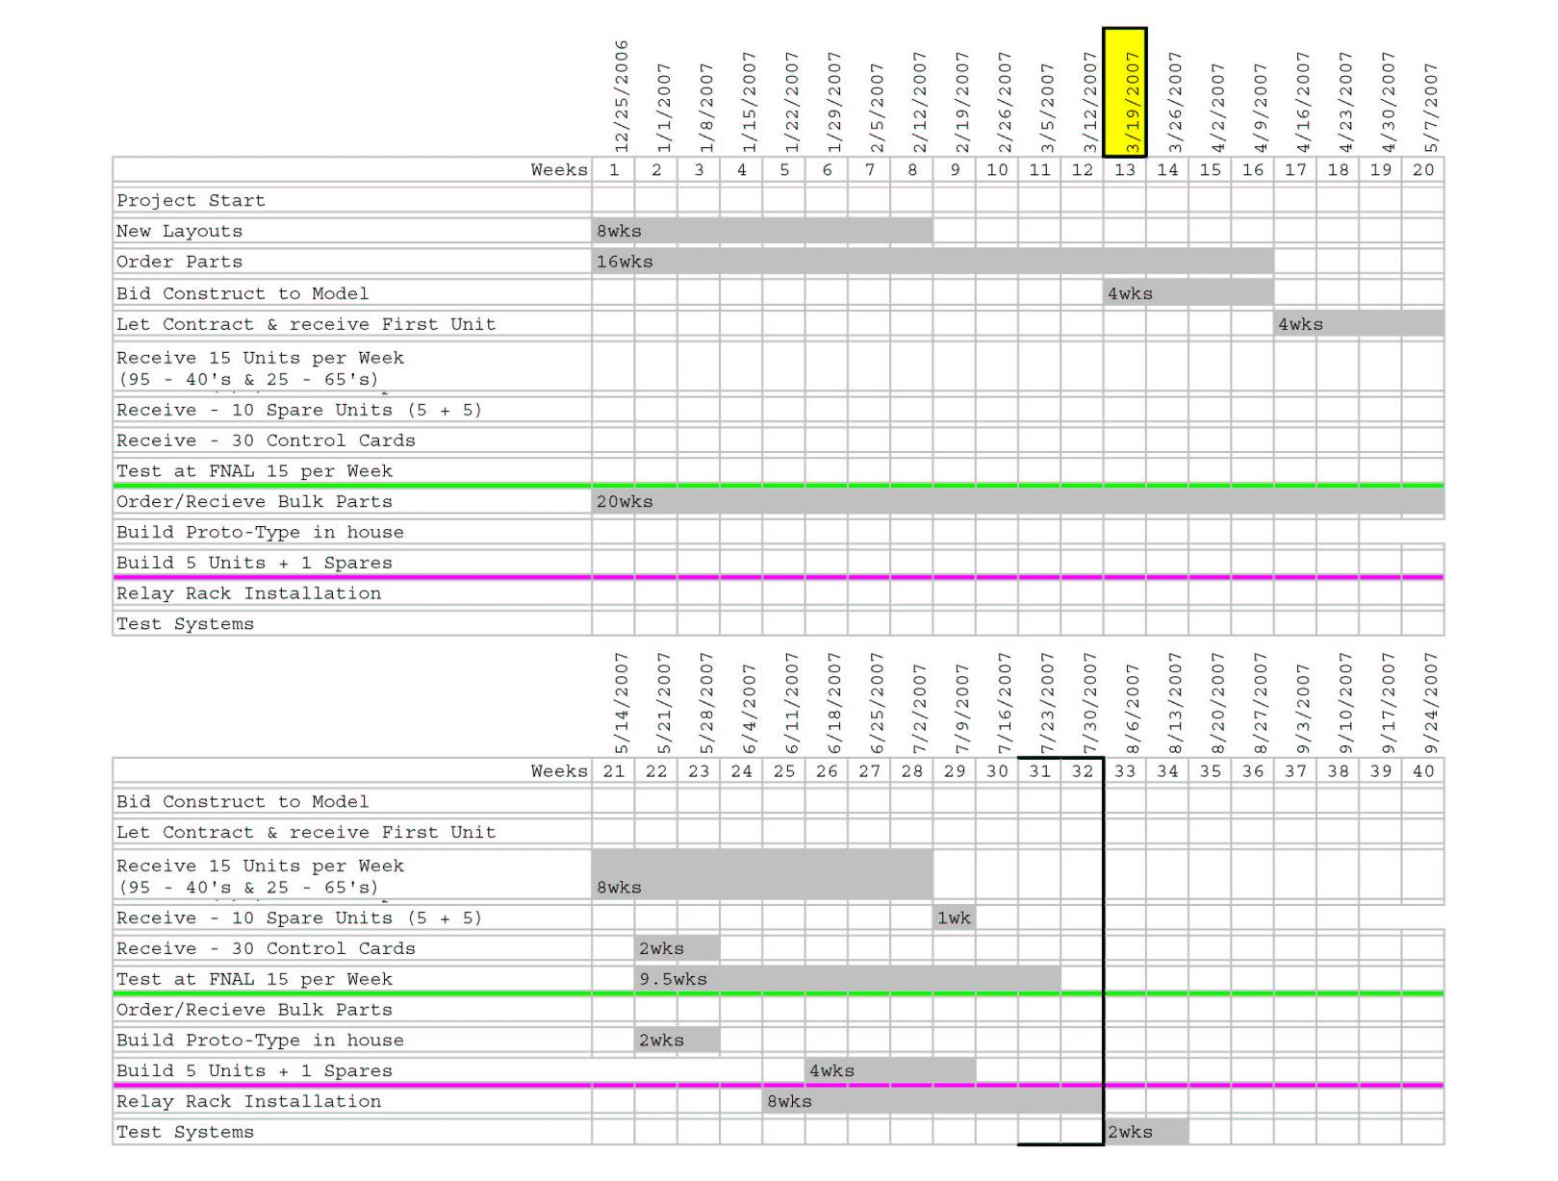
Power Supply Schedule

Slide 8
Booster Water Upgrade
Current system will not handle 15 Hz operation
  Already operating outside of specificiations
Beginning staged upgrade this shutdown
  Will upgrade West gallery return from 2” to 4” and 6”.
  New manifolding.
  Will still tie into existing return via tunnel
Estimate 4-6 weeks.
Preparing fixed price contract bid package.
We will not allow this project to drive shutdown.

Slide 9
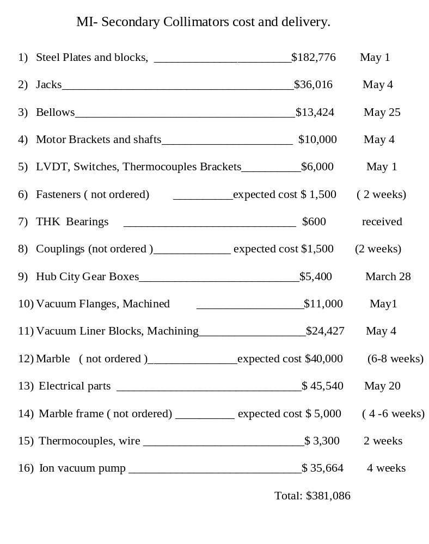
Main Injector Collimator Status

Slide 10
MI RF Upgrade Projects
Solid state power supplies
  Ordered: ~4-8 weeks delivery
  Installation will take about 10 days
Install spare anode transformer at MI Center
Will modify all three anode power supply transformer slabs for new transformers, compatible with NOvA operation.
Procuring new transformer for south anode power supply
  Will not be ready for shutdown

Slide 11
Summary
Linac LLRF
  Could be ready for July 1 shutdown
  Can be installed arount NTF schedule (total of ~2 days/station x 5)
  Will not be allowed to drive shutdown
Booster
  Water
    Can be ready for July 1st shutown
    4-6 weeks installation
    Will not drive shutdown
  Correctors
    Can not be ready until an August 1st shutdown at the earliest
    8 weeks installation, assuming no interference
Main Injector
  Collimation
    Can be ready for a July 1st shutdown
    Currently 16 weeks installation.
    Hope to shorten to 12.
Start date driver
Length driver

Slide 12
Worries and Caveats
Correctors
  Production of cores and coils is proceeding, but we have not yet built a production magnet from vendor-supplied parts.
  We do not yet have a single vendor-supplied power supply
  Installation schedule does not yet allow for interference with other projects, resource leveling, and does not include commissioning time (would ideally like two full weeks dedicated time).
Main Injector Collimators
  Utility rerouting scheme still very preliminary
  No detailed installation plan
    Present time estimate (conservative) WAG

Slide 13
Operations

Slide 14
Operational Highlights
MiniBooNE
  Still off
  All plates lowered without incident
  Waiting for stainless steel rods to lift back into out position
  Scheduled to come back on ~mid April.
NuMI
  No significant down time since last PMG
    Overall uptime since Feb. 1 = 94%!!
      Design: 80%
      Base: 70%
    Helps compensate for unrealistic cycle time
  Continue to push batch intensity
  Slip stacking studies continue
    Reached 4.05E13 protons to NuMI in tests
  Continue to work to reduce cycle time from 2.4->2.2 seconds

Slide 15
Review: NuMI Cycle Time Issues
Because pBar and NuMI batches are accelerated together, the NuMI cycle time is locked to the pBar production cycle time.
Original assumption:
  NuMI and pBar would run at 2 second cycle times during 2+5 operation (limited by minimum pBar rep. rate)
  Cycle time would change to 2.2 seconds for 2+9 operation (limited by MI loading time)
In fact:
  pBar has problems running below 2.4 seconds, significantly reducing beam to NuMI
  The effect was originally largely cancelled by NuMI only cycles (during shot setup and “interleaved” mode when the accumulator had large stacks)
  Now with fast transfers to Recycler, there are very limited NuMI-only cycles
Present status:
  Working to optimize pBar for 2.2 cycle time
  Will lock complex to that time through end of collider program
  Not yet accounted for in this year’s projections

Slide 16
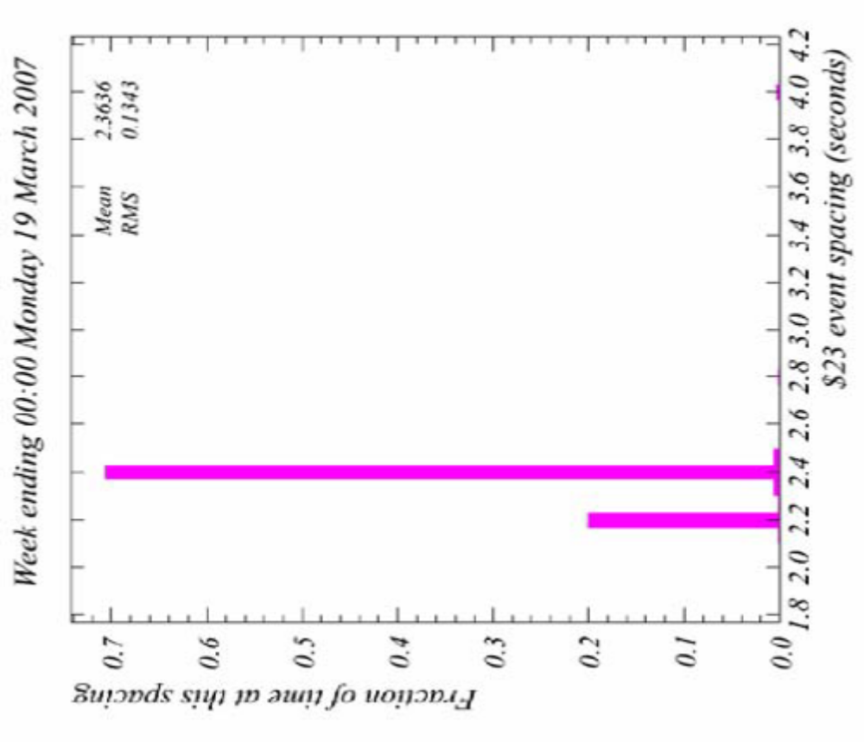
NuMI/pBar Cycle Time Progress

Slide 17
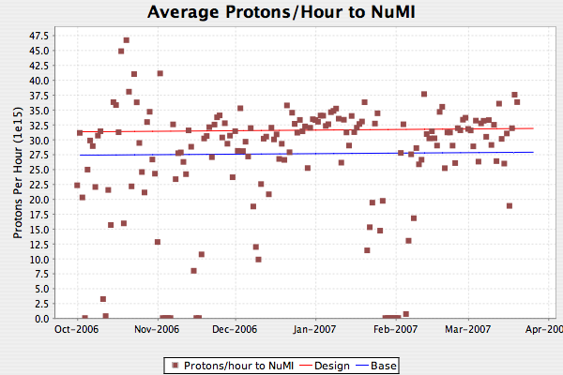
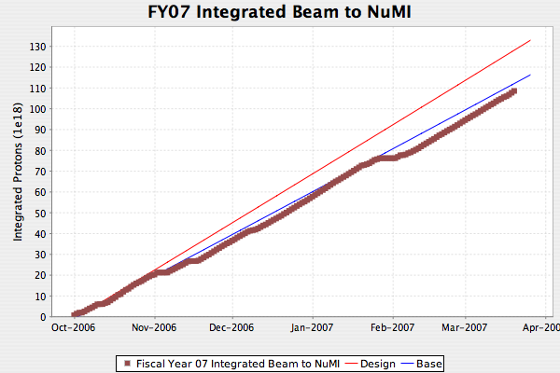
NuMI
Dotted lines are 2.4 second rep rate

Slide 18
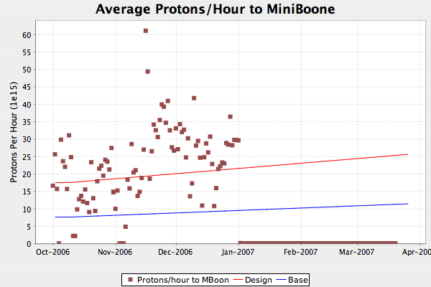
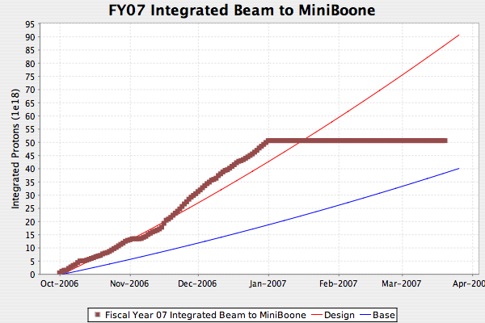
MiniBooNE
MiniBooNE still off
Will cross blue line ~May 1
Scheduled to come back on in mid-April

Slide 19
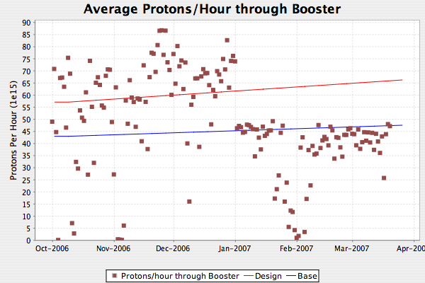
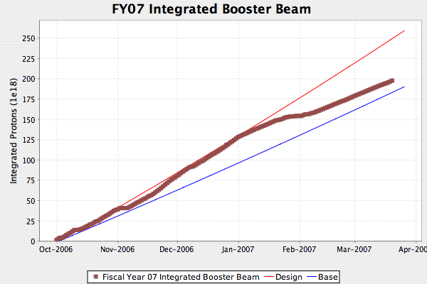
Total Booster Output
Mostly reflects loss of MiniBooNE

