Slide 1
Proton Plan Status
March
Eric Prebys

Slide 2
Agenda
Operations - Prebys
Technical Progress – Prebys
  Focus on shutdown preparation
Cost/Schedule Report – Baller
Shutdown - Mau

Slide 3
Operations

Slide 4
Operational Highlights
MiniBooNE
  Came back up on April 11
  Quickly ramped up to full intensity
NuMI
  Uptime 91.8% for March
  Pushing batch intensities
  Record MI intensity on slip stacked test cycles (more in a bit)

Slide 5
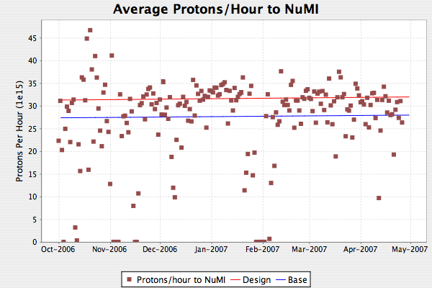
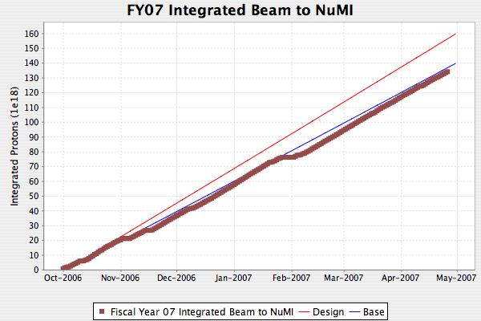
NuMI
Dotted lines are 2.4 second rep rate

Slide 6
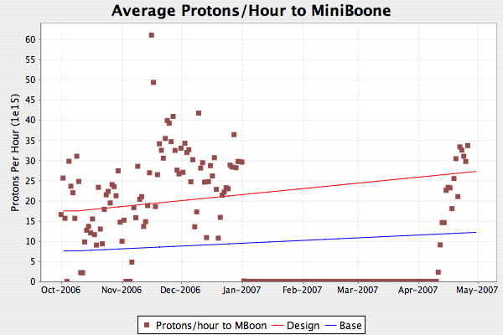
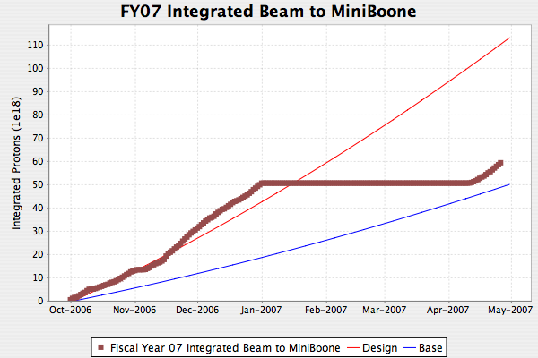
MiniBooNE
MiniBooNE back!
Quickly ramped back to full intensity.
Running smoothly

Slide 7
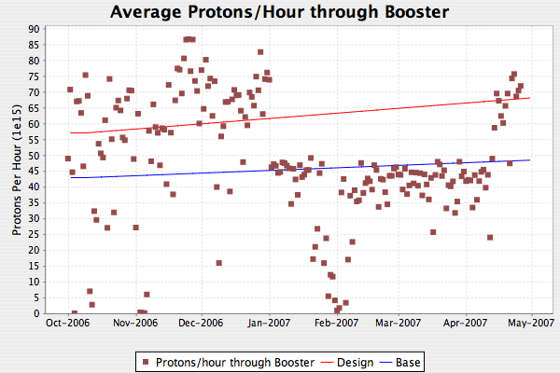
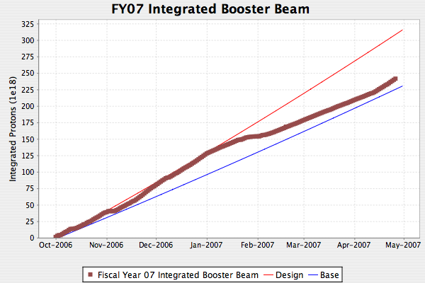
Total Booster Output
MiniBooNE back!

Slide 8
Technical Status

Slide 9
Significant Activity Since Last PMG
(1.1) Linac
  (1.2.2) Quad Power Supply Upgrade
    All P8 cards replaced
    P1 Cards on order
    Three more designed and being prototyped
  (1.2.4) Linac LLRF Upgrade
    Test stand 90% complete.
    First prototype FPGA board being stuffed
    Still on track for shutdown

Slide 10
Booster Activity
(1.2) Booster
  (1.2.3) New Corrector System (Lots of progress!!)
    Magnets
      Prototype (BMA001) potted and being prepared for test installation in tunnel (probably ~June 1)
        One coil to coil short. Not a problem for test, but a worry
      BMA002
        Water problem. Fixed, being reassembled
      BMA003
        Being tested. Return for potting at end of week
      BMA004
        Ready for MTF Monday
      BMA005
        Brazed, wired, ready for gluing. MTF next week
      BMA006+
        Held up by coil delivery (today??)

Slide 11
Correctors (cont’d)
Vendor delivery
  Cores:
    complete, last lot to be shipped
  Coils:
    Pile up of complete, potted coils at vendor
    Bottle-neck is cooling line brazing
    If they meet their new schedule, it should not hold up production.
  Cooling manifold
    First shipment leaks like hell
    Returned for remanufacture.
    Should still be OK for shutdown
Overall
  Shutdown still tight but doable

Slide 12
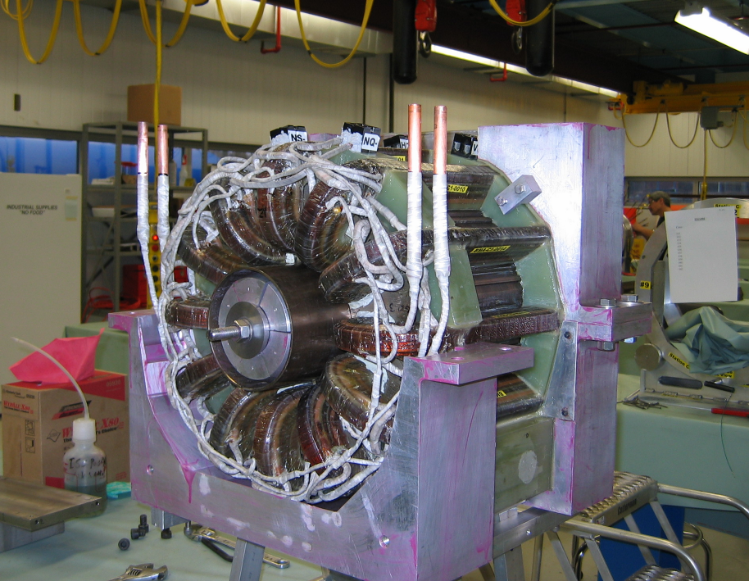
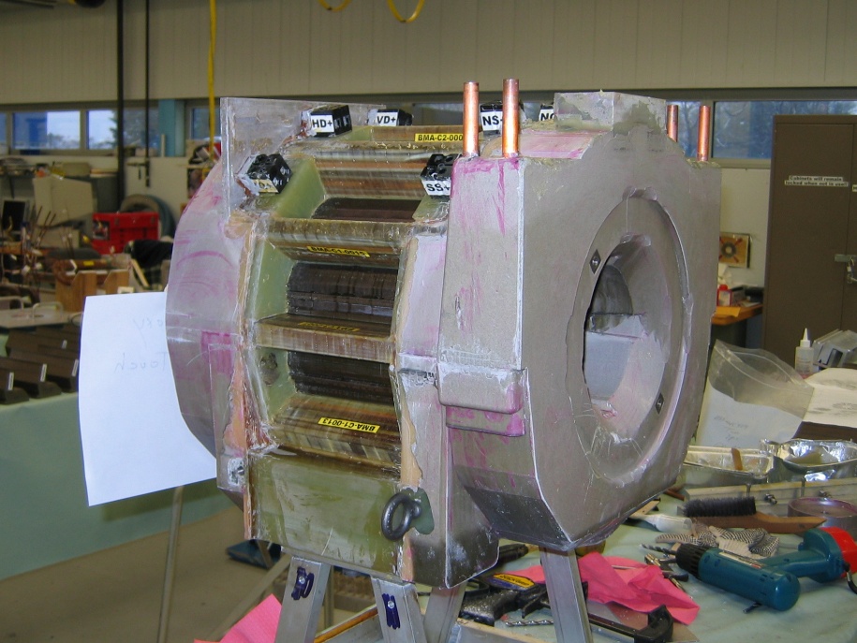
Potting

Slide 13
Booster (cont’d)
  (1.2.12) Booster notch chopper
    Now that the Booster is getting more efficient, losses due to bad notching are becoming more obvious, raising the priority of this project.

Slide 14
Main Injector Activity
(1.3) Main Injector
  (1.3.2) MI Collimation Systems
    MI-8:
      Now operational
      Issue with MiniBooNE position resolved. Can run both with no problem
    Ring:
      Collimator materials procured, and beginning to arrive
      Lots of progress on utility move plan
      Installation being coordinated by Dave Capista, as MI Shutdown Coordinator.

Slide 15
Main Injector (cont’d)
  (1.3.3) Multi-batch slip stacking
    Have demonstrated > Proton Plan design intensity
      4.6E13 at 120 GeV with 91% efficiency!!
      Design: 4.4E13 with 95% efficiency
  (1.3.4) MI RF
    Transformer order CANCELLED after vendor backed off on the specs.
    Will not have new transformer for the shutdown.
    Should not affect performance to NuMI, but has some implications for reliability

Slide 16
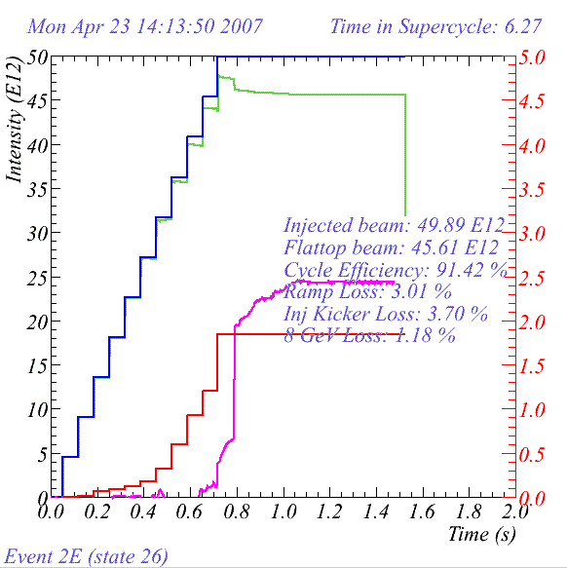
New Record!

