Slide 1
Proton Plan Status
April/May
Eric Prebys

Slide 2
Agenda
Operations - Prebys
Technical Progress – Prebys
  Focus on shutdown preparation
Cost/Schedule Report – Baller
Shutdown – Mau
Tranformers - Hays

Slide 3
Operations

Slide 4
Operational Highlights
MiniBooNE
  Great Running!
NuMI
  Great Running!

Slide 5
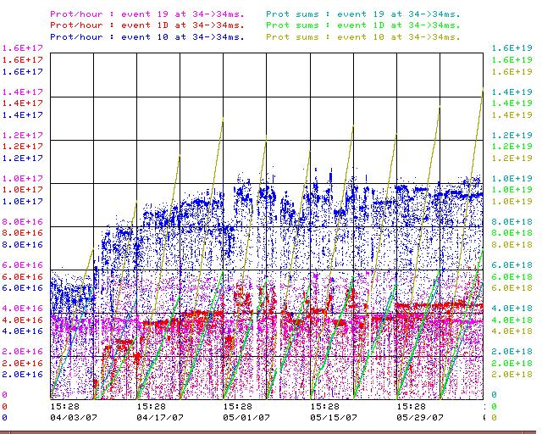
Proton Intensities
1E17 p/hr

Slide 6
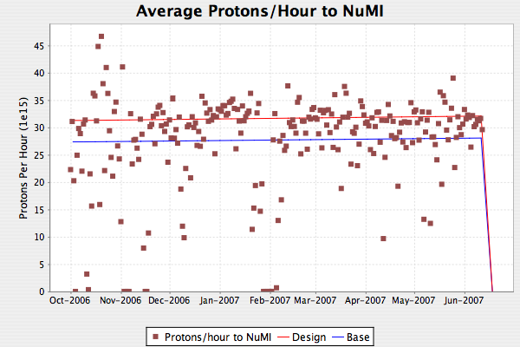
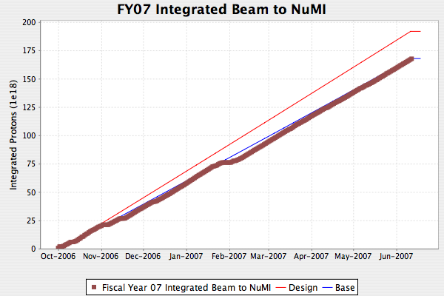
NuMI
Dotted lines are 2.4 second rep rate
On Base curve even with 20% error in rep. rate!
  90% up time since April 1st.

Slide 7
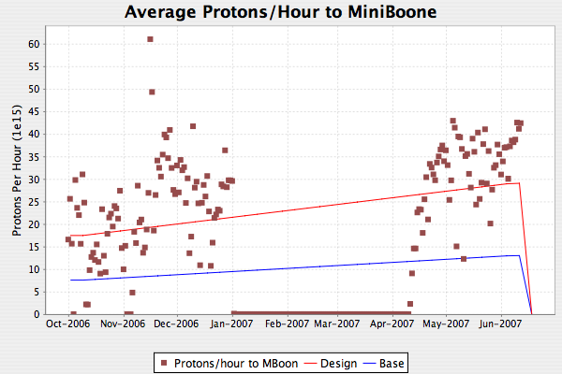
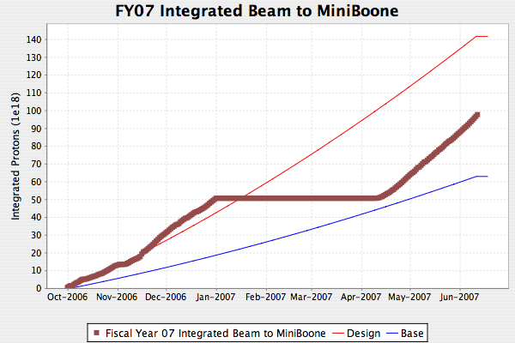
MiniBooNE
Well above design curve
Will probably make up for beam line down time before shutdown.

Slide 8
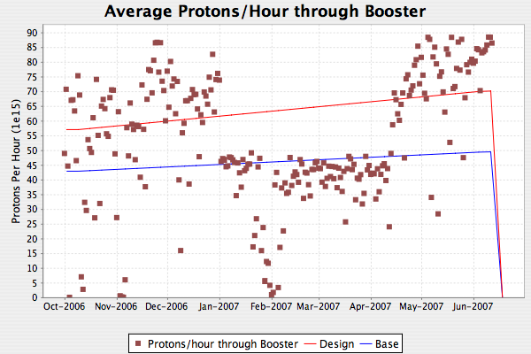
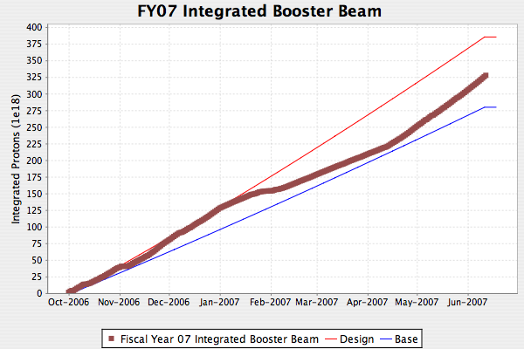
Total Booster Output
MiniBooNE back!

Slide 9
Technical Status

Slide 10
Significant Activity Since Last PMG
(1.1) Linac
  (1.2.2) Quad Power Supply Upgrade
    Continues adiabatically
  (1.2.4) Linac LLRF Upgrade
    Prototype FPGA board working and being used for tests
    Still on track for shutdown
(1.2) Booster
  Magnets, magnets, magnets

Slide 11
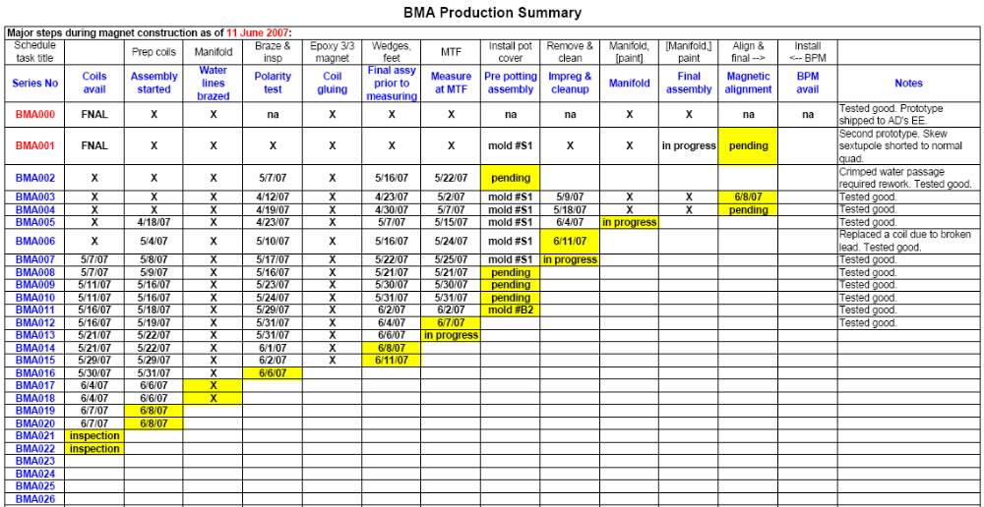
Magnet Production (as of Monday)
needed
Successful test of 8th magnet triggered next AIP

Slide 12
Production End Game
Magnets
  24th production coil set: ~next week
  24th production magnet to MTA: ~ July 4th
  24 magnets ready to install: ~end of July
BPM’s
  Contract out
  30 by July 20
  Three prototypes being built in-house. Ready ~next week.
Power Supplies
  Will have enough for our prototype test in early July
  Will have remainder in time for shutdown.
Mechanical supports
  Out for fabrication.
  Should begin arriving next week
Control cards, HRM’s, etc
  All in production and on schedule for shutdown

Slide 13
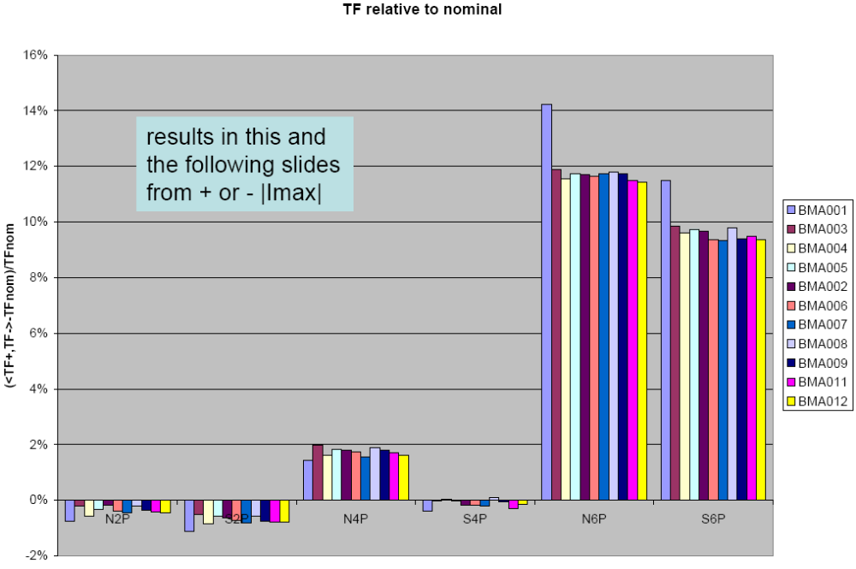
Magnetic Measurement (10 magnets)
Prototype

Slide 14
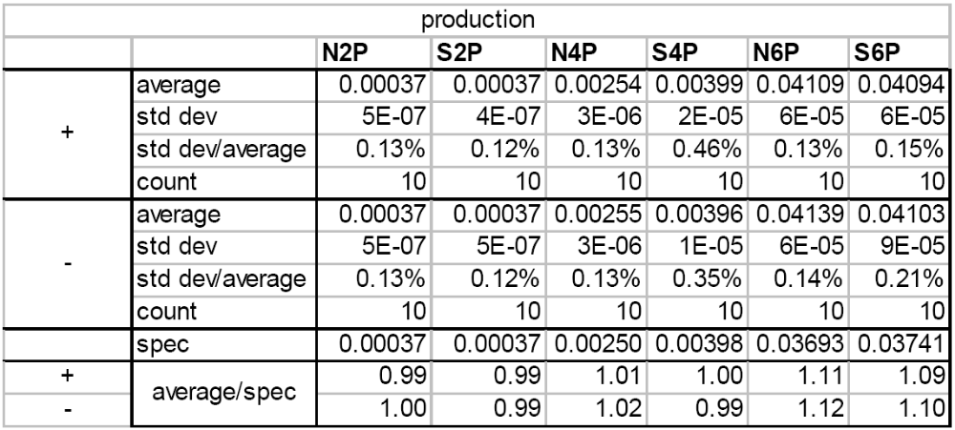
Magnetic Measurement Summary (10 magnets)

Slide 15
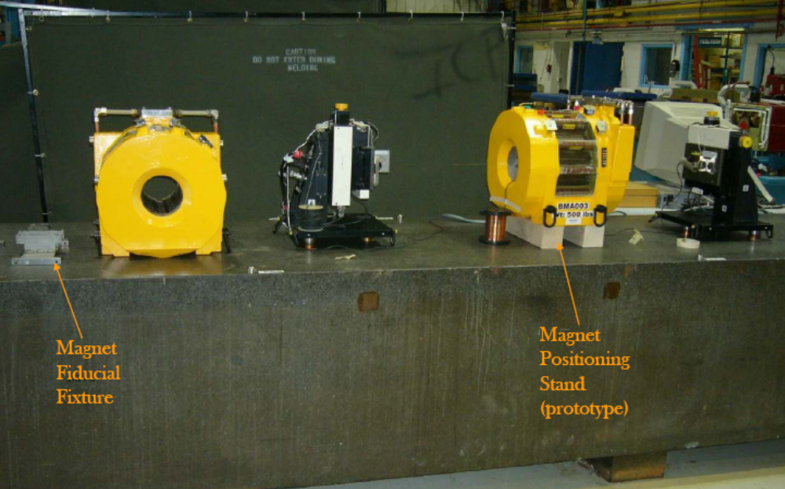
Alignment

Slide 16
Prototype Test
Plan to install one magnet in Long 4 in early July
  This will give us a chance to test the magnet and entire control chain in actual operation.
This magnet will be installed in addition to the existing magnet.
  Will be moved into correct location during shutdown.

Slide 17
Main Injector Activity
(1.3) Main Injector
  (1.3.2) MI Collimation Systems
    Ring:
      Designs complete
      Parts arriving for collimators and LCW/bus modifications
      Should begin a test assembly of secondary collimator next week
      Still driving length of shutdown (more from Bob)

Slide 18
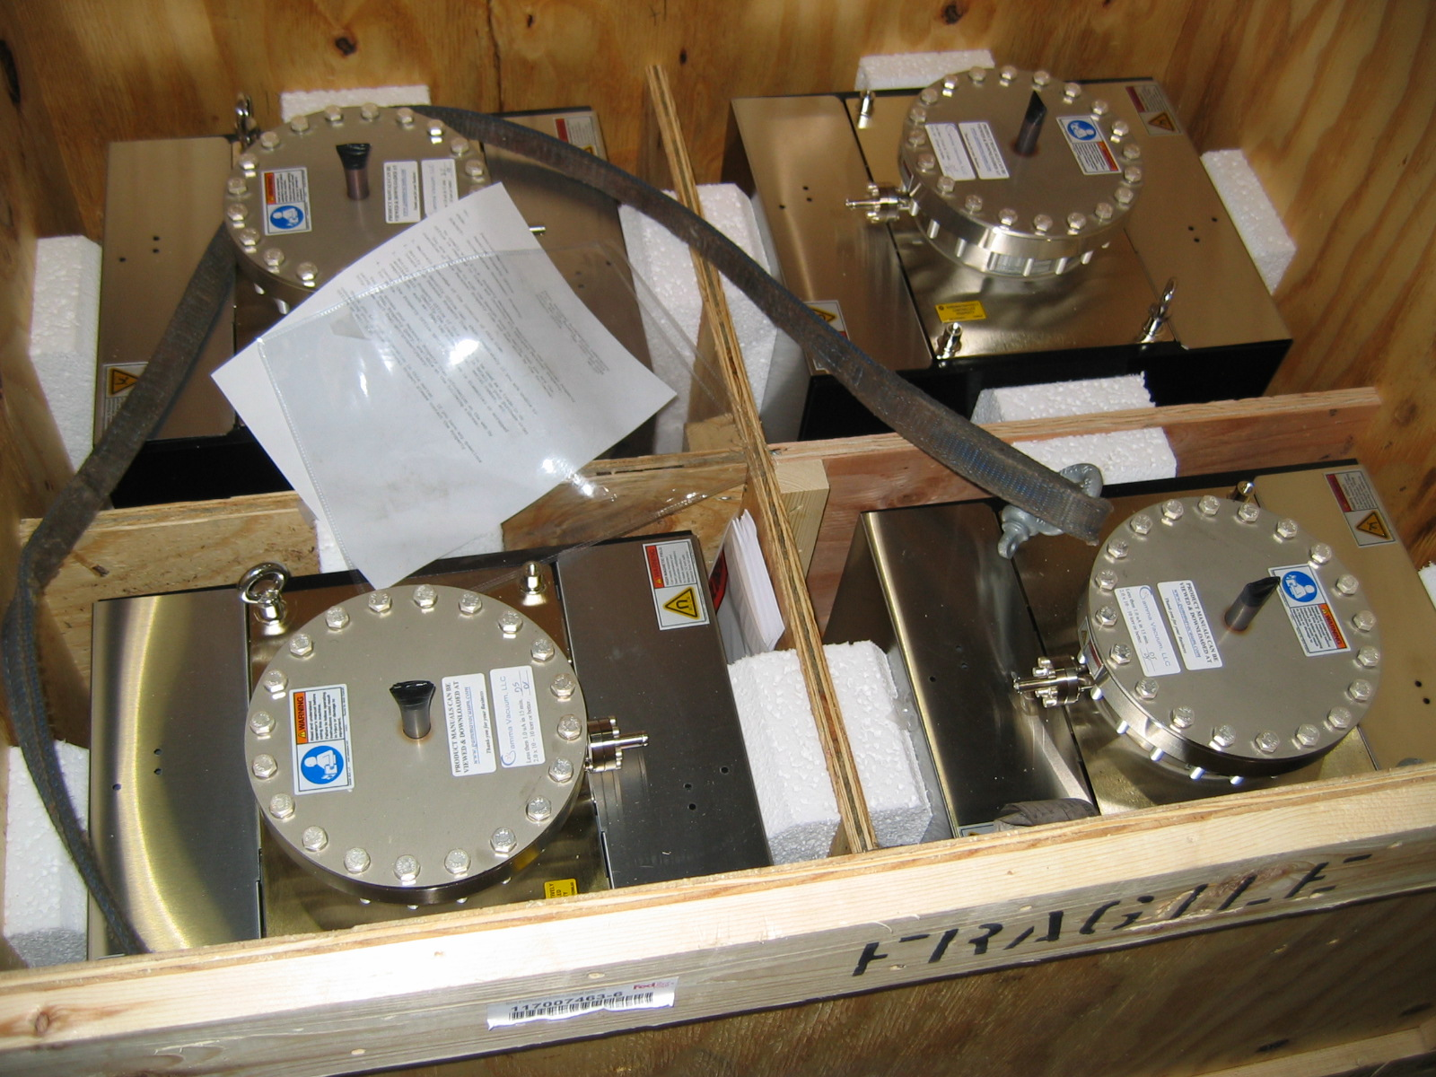
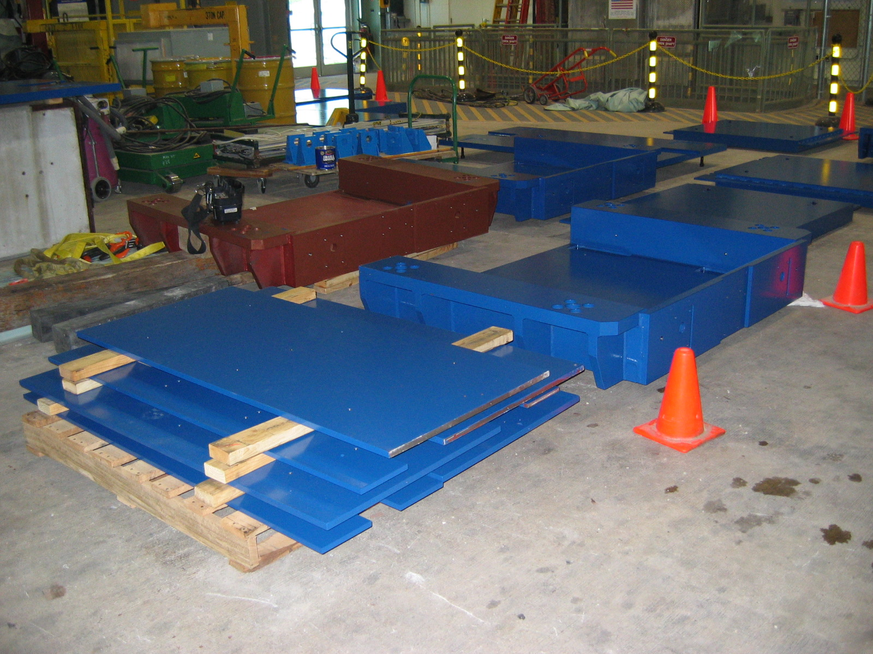
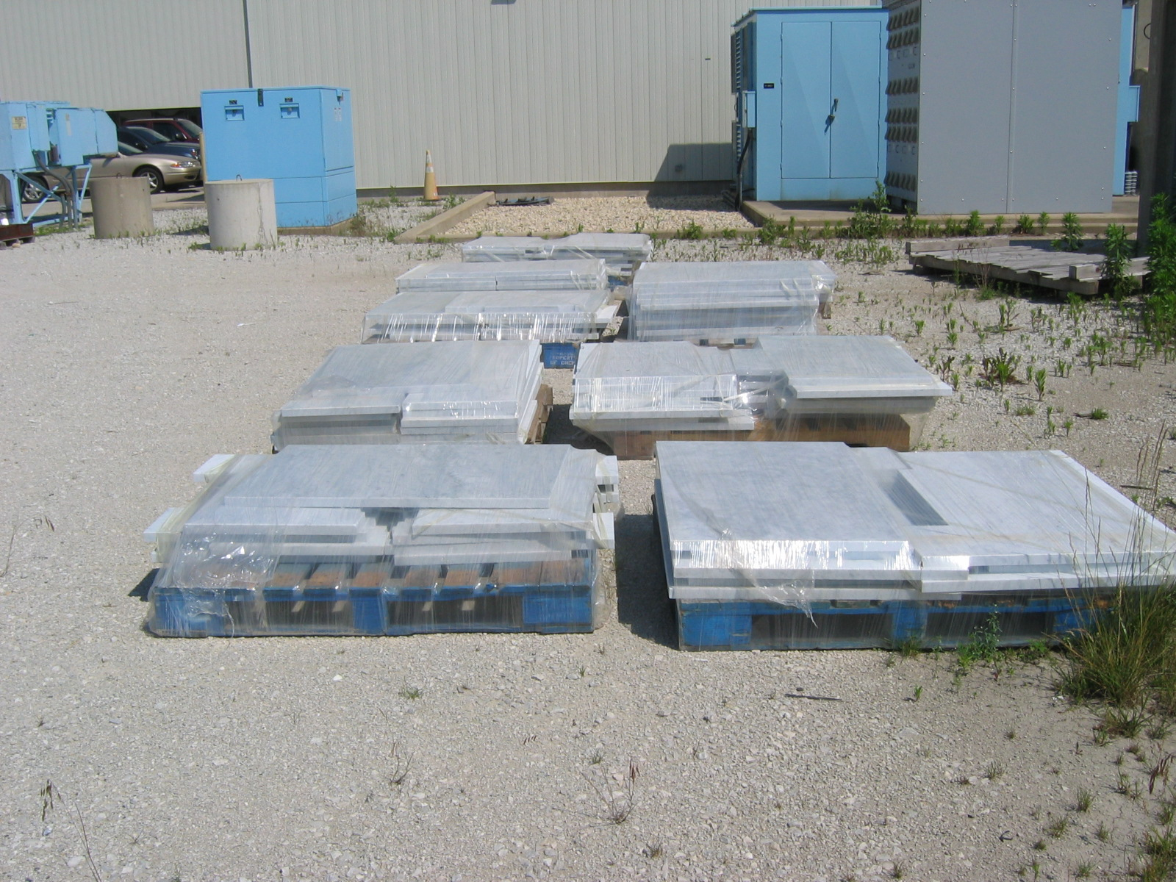
Collimator Parts

Slide 19
Main Injector (cont’d)
  (1.3.3) Multi-batch slip stacking
    Tested operational (pBar+NuMI) slip stacking
      2x8 turns = 6.1E12 to pBar
      9x6 turns = 2.3E13 to NuMI
    Limited by out of bucket beam hitting MI-52 kicker
    Should be improved with better tuning and damper improvements.
    Plan to run in operational mode for at least a few days some time before shutdown to perfect technique, so we can ramp up quickly after shutdown.
  (1.3.4) MI RF
    (see Hays talk about transformers)
    Tim Berenc leaving!
      Working to hand off to Chase and co.
      Hope to have a prototype comb filter working before he leaves.

