Slide 1
Proton Plan Status
June
Eric Prebys

Slide 2
Agenda
Shutdown Schedule – Mau
Operations - Prebys
Technical Progress – Prebys
  Focus on shutdown preparation
Cost/Schedule Report – Baller

Slide 3
Operations

Slide 4
Operational Highlights
NuMI
  Great until 2nd horn problem knocked them off the air
MiniBooNE/SciBooNE
  Will ~hit design goal for the fiscal year in spite of three month down time!

Slide 5
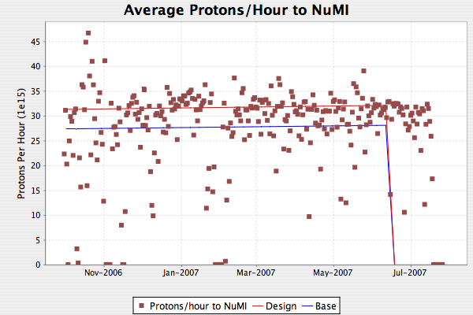
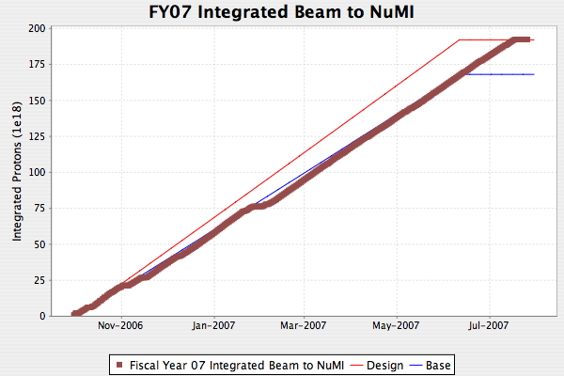
NuMI
Now this is a coincidence
Dotted lines are 2.4 second rep rate
Oops!

Slide 6
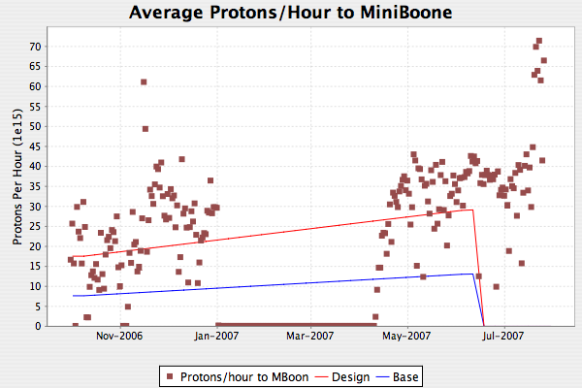
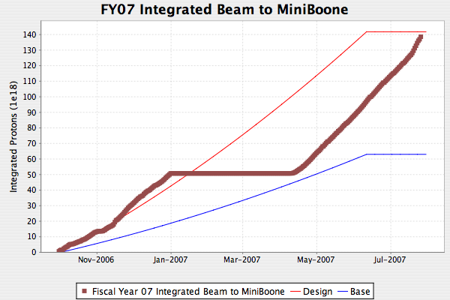
MiniBooNE/SciBooNE
No sense letting all the NuMI protons just sit there
Good running plus delayed shutdown => both beamlines ~hit their design goals for the fiscal year in spite of mistakes, unforeseen problems, etc.

Slide 7
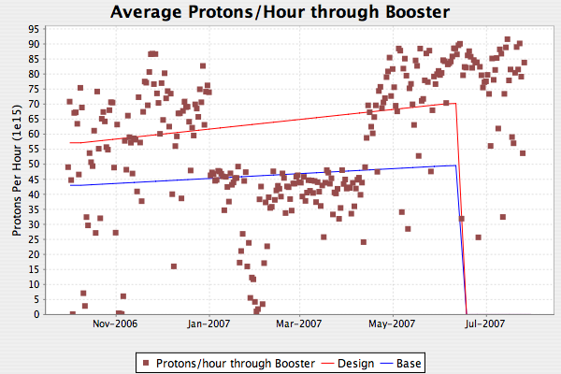
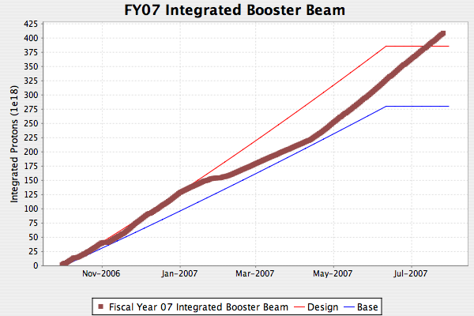
Total Booster Output
Operations smoothly switches NuMI’s protons to BNB

Slide 8
Technical Status

Slide 9
Significant Activity Since Last PMG
(1.1) Linac
  (1.2.2) Quad Power Supply Upgrade
    Continues adiabatically
  (1.2.4) Linac LLRF Upgrade
    Prototype FPGA board working and being used for tests
    Unlikely to finish job during shutdown
      Goal: Complete at least station 5 and all prep work (VXI crates, etc) for other stations.
      Adiabatically upgrade remaining stations as hardware appears.
(1.2) Booster
  Magnets, magnets, magnets

Slide 10
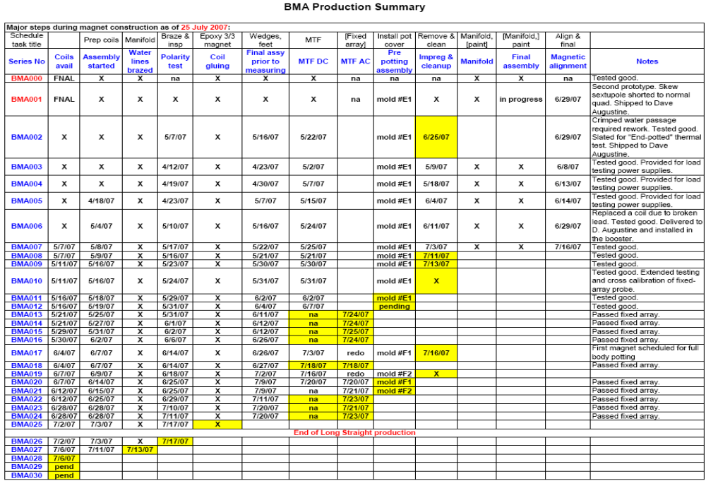
Magnet Production (as of yesterday)
bottleneck
complete

Slide 11
Latest Delivery Schedule
Date | Magnets Available
August 3 | 10
August 10 | 11
August 17 | 13
August 24 | 15
August 31 | 19
September 7 | 23
September 14 | 26
Will not delay installation
Does not free up technicians until well into the shutdown

Slide 12
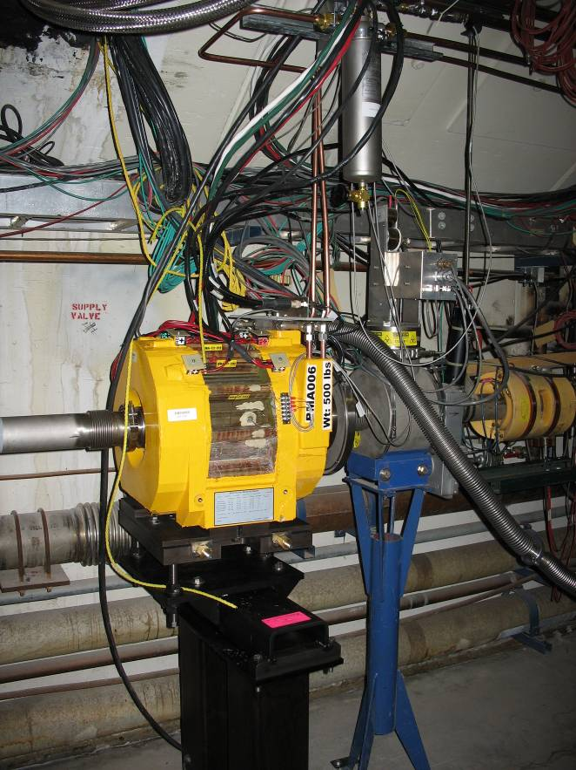
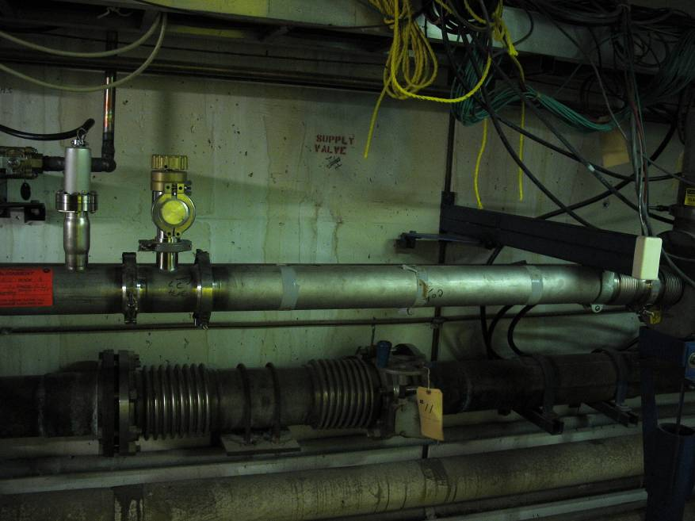
Prototype Installation
All power supplies and water connected
Pulsing (hard) on beam off cycles
Proceeding with beam tests

Slide 13
Main Injector Activity
(1.3) Main Injector
  (1.3.2) MI Collimation Systems
    Ring:
      All collimators assembled in MI-65
      Motion control tested
      Ready for shutdown

Slide 14
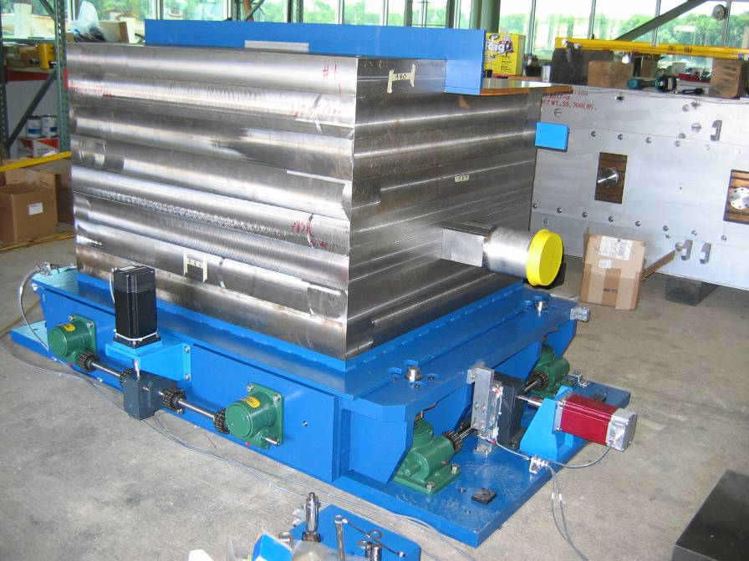
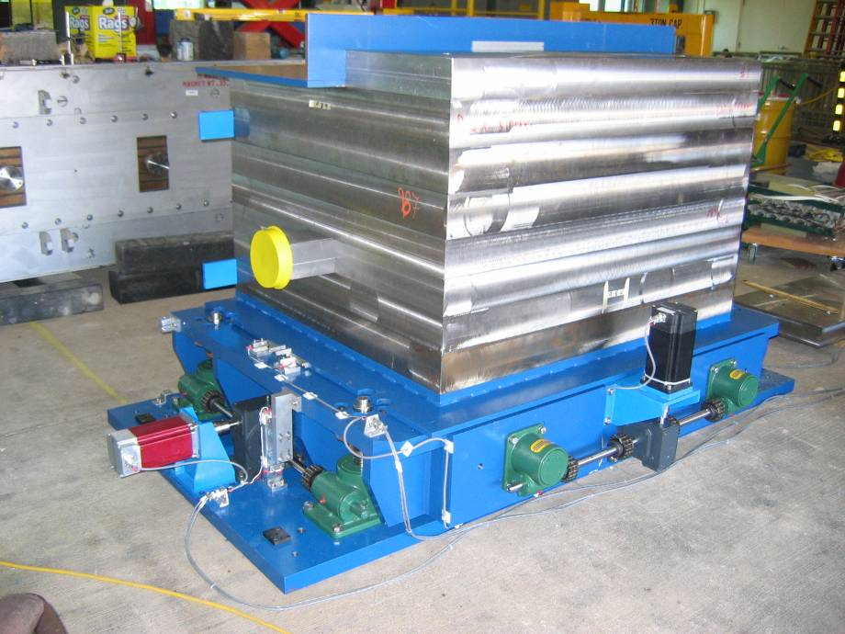
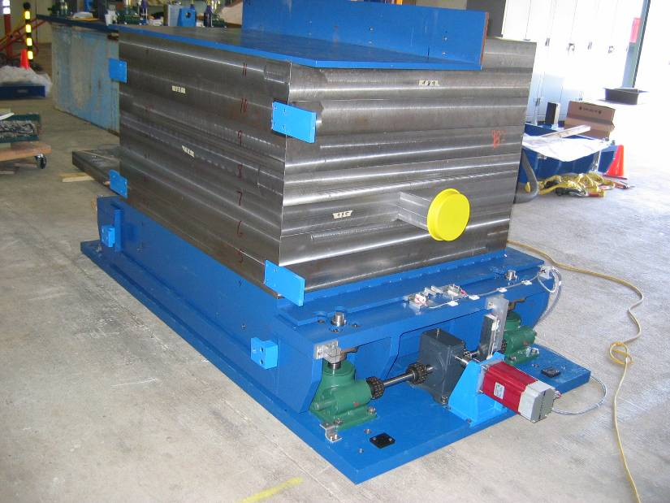
Assembled Collimator

Slide 15
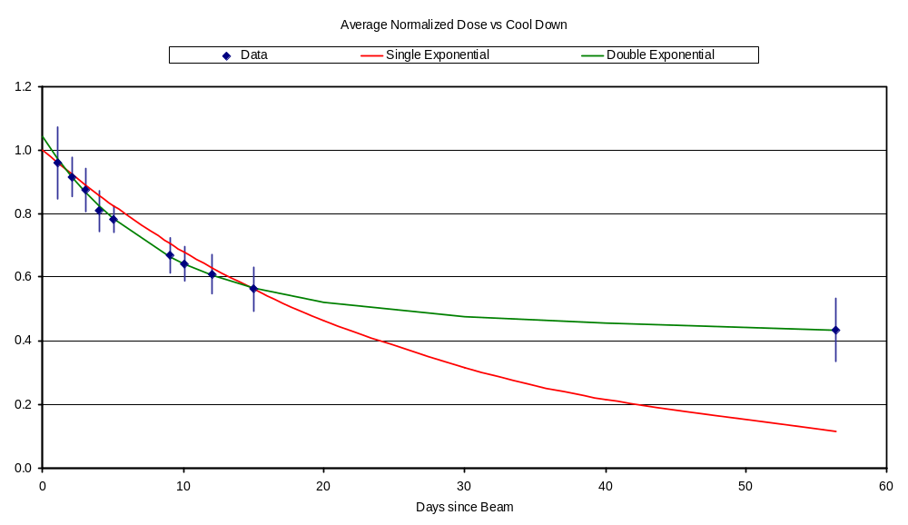
Cooldown?
One week
Current Estimate: 530 mRem/person!
Propose turning MiniBooNE/SciBooNE off one week before shutdown

