Slide 1
Proton Plan Status
Eric Prebys

Slide 2
Agenda
Linac and Booster Shutdown Status – Prebys
Main Injector Shutdown Status - Kourbanis
Overall Shutdown Schedule – Mau’s designee
Cost/Schedule Report – Baller

Slide 3
Technical Status

Slide 4
Proton Plan Shutdown Projects
(1.1) Linac
  (1.2.4) Linac LLRF Upgrade
    Goal: Complete at least station 5 and all prep work (VXI crates, etc) for other stations.
    Adjust coupling on stations 3 and 5
(1.2) Booster
  (1.2.3.2) Booster long straight correctors
    Original goal: Install 24 new correctors in long straight sections
    De-scoped goal: Install 12 new correctors in odd long straight sections
      Includes 1 and 3, the most difficult
(1.3) Main Injector
  1.3.2.3 Collimation System
    Goal: Install ring collimation system at MI-30

Slide 5
Linac Status
Proton Plan Work:
  Coupling adjustments to tank 3 and 5 done and tested
  All prep work for RF upgrade installed
    VXI crates in station 1-5
  ILC FPGA board delayed
    New LLRF wil NOT be on any stations for turn-on
    Will have to adiabatically schedule upgrade as time allows
      1-2 days for first station
      Less after that
  Beam to NTF tomorrow evening
Non Proton Plan work:
  Service ion sources and upgrade vacuum systems - DONE
  PM on LEL and water systems - DONE
  Install MTA beam line!
    Descoped to T&M work and “whatever we can get done” with vacuum system
    See next slide
Bottom line: Ready for Booster turn-on by 10/2

Slide 6
MTA Status
All T&M work done
  Shielding re-stacked properly
    Still need to shield beam pipe to MTA
  Magnets set
  All cables pulled and terminated
Further than we expected with vacuum work
  All spool pieces fabbed
  Most mounted
Waiting on final alignment
  Small problem with height of Q74 (linac quad)
  Waiting on alignment crew working on TeV low beta (?)
Bottom line:
  Will not be ready for beam MTA side not done
    MTA side not done
    Shielding not complete in pit
  Still hope to get Linac side under rough vacuum before end of shutdown
    After that, most work will not require Linac shutdown
Will not delay turn-on by definition

Slide 7
Booster Status
Proton Plan Work
  12 Correctors Installed
    Aligned
    Cabled
    Power supplies, controls, and database entries in place
    Waiting on Ox levels to come down before valving in.
  Booster under vacuum
    All ion pumps on
  Working on final application work for turn-on
    See later slide
Non-proton plan work:
  Change leaky Q800 – DONE
  Booster West Gallery water upgrade – DONE
  Booster water routed through pBar de-Ox system - DONE
  Install new large aperture kickers in L2 and L12
    Will be needed to fit new correctors in those periods
    Not completed due to curse on entire project.
  RF work
    PM and partial solid state upgrade – DONE
Bottom line: will be ready to turn on by 10/2

Slide 8
Magnet Production Status
Slowed during shutdown due to TD technician reassignment
Production Status
  15 Complete, with BPM installed
    100% yield after BMA001 (inter-coil short)
  +5 potted and cleaned an in final production and testing
  +16 with coils available in various stages of production
  All cores on hand

Slide 9
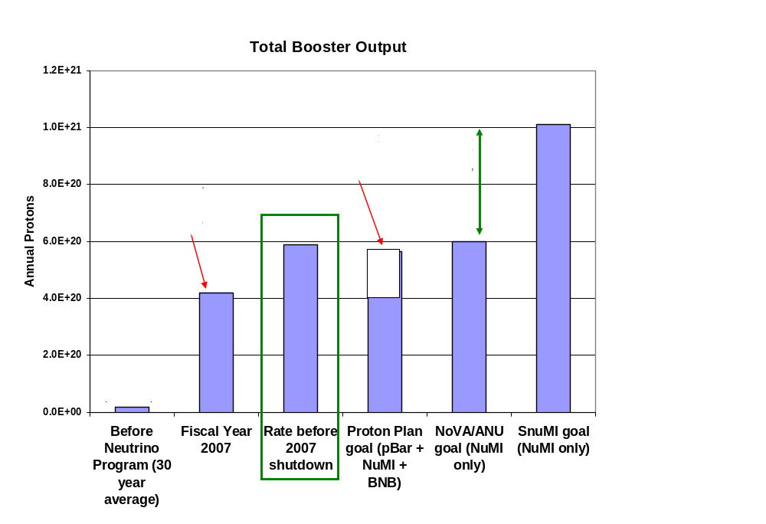
Start-up Philosophy: First, do no harm
2012

Slide 10
General Guidelines
Prior to the shutdown, the Booster was demonstrating ~all the proton capacity which it has promised through the start of high intensity NOvA operation in 2012.
Our overriding goal will be to return to this level of performance as quickly as possible.
  Want tuning to have the same “look and feel” as before.
Enhanced functionality of the new system (ramped HL correctors, distributed sextupoles) should not be used until we have demonstrated pre-shutdown performance without it
  i.e. we don’t want to use new features to compensate for tuning problems.

Slide 11
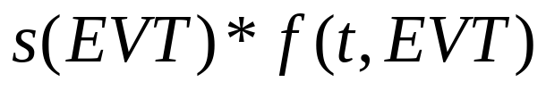
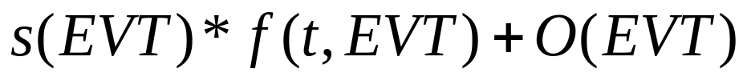
C465 (old) vs. C473 (new)
465
DAC
All dipole scale factors set to 1
For DC operation, turn “off” and write directly to DAC
Quad ramps control several in parallel, with individual DC offsets added in hardware
473
DAC
Will use scale factor to correct for transfer function
For DC operation, set ramp to null and use OFFSET
Quad control: load ramps in parallel and use offset registers for individual offsets

Slide 12
Pre-shutdown Corrector Operation for long straights
Vertical Dipoles (vertical high-beta)
  Controlled by individual C465 ramp cards
Horizontal Dipoles (vertical low-beta)
  DC levels
Quads (normal and skew)
  Controlled in groups of six by C465 ramp modules, which were globally set with identical curves
  Individual DC offsets added in hardware for harmonic compensation.
Sextupoles
  Not in corrector packages
  Chromaticity and harmonic compensation done by a small number of special purpose sextupoles, which will still be there.

Slide 13
Initial Operation of New Odd Long Sections
Vertical Dipoles
  Ramped as before
  Use C473 Scale factor for transfer function conversion
    Effectively redefine the “amp”
Horizontal Dipoles
  Run DC, using offset C473 Offset register
  Preloaded with scaled pre-shutdown values
    DC Offset does not see scale factor
Quads
  Run ramped portion globally with even ramped quads
    Use scale factor to compensate for different transfer function
  Use C473 offset register for DC term
    Done in hardware for even periods
    Will not see scale factor, so must modify harmonic applications.
Sextupoles
  Initially off
  Transfer SEXTL functionality to new correctors
  Later: apply harmonic correction

Slide 14
To do list
Database entries – Triplett (DONE)
Initial translation of old settings – Prebys (DONE)
Parameter pages/mults (B2,3,6,11,12,etc) – Triplett, Pellico (mostly DONE)
Ramp Applications (B14,15,16) – Waller (critical ones DONE)
Harmonic Corrector (B71) – Prebys (DONE by 10/3)
Closed Orbit (B87)
  Initial porting – Prebys (in progress)
  Upgrades for new ramps – Marsh (later)
Ramped 3-bumps (B82) – Prebys (DONE)
Aperture Scan (B75) – (later)

