Slide 1
Proton Plan Status
Dec-Jan
Eric Prebys

Slide 2
Agenda
Operations
Shutdown Issues

Slide 3
Operations

Slide 4
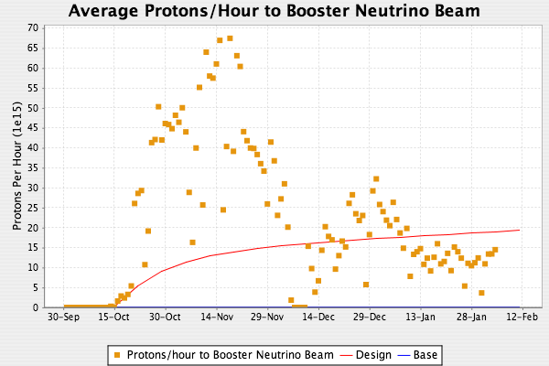
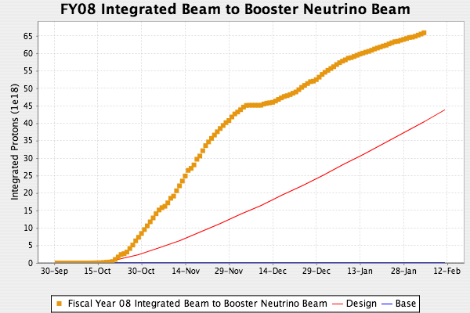
MiniBooNE/SciBooNE
NuMI back on
Hitting RF rate limit
  RF cycle counter mismatched with TLG cycle
Will try to increase by .5-1Hz
NuMI 2+9 operation

Slide 5
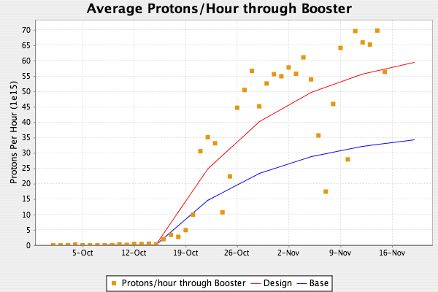
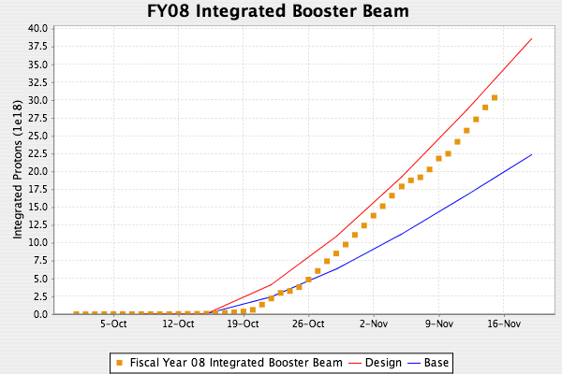
Total Booster Output
More realistic turn-on curve (Proton Plan revision for 2006 review)

Slide 6
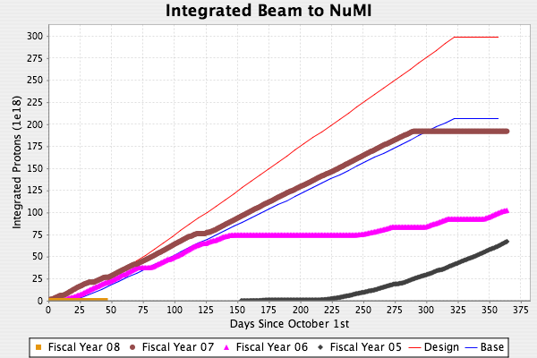
NuMI
Projections for FY08:
Did not correct for current problems

Slide 7
Corrector Production
All cores and coils complete and on hand
Production status
  Complete: 20 (12 in tunnel+8 more)
  Potted: 8
  Assembly begun: 10
Failed magnet found
  BMA022 (not counted): coil to coil short
  Only second one so far
On track to have all correctors complete by next shutdown

Slide 8
Descoping Gamma-t
We have decided to descope the gamma-t system, based on the following
  Studies were unable to demonstrate improved slip stacking operation using the gamma-t system
  We have demonstrated large batch sizes with good efficiency and longitudinal emittance without a gamma-t system
  The gamma-t system has a significant operational overhead.
  The gamma-t system would complicate the installation of the short straight correctors.
Gamma-t engineering accounts have been closed
CR will appear by next PMG.

