Slide 1
Proton Plan Status
Dec-Jan
Eric Prebys/Craig Drennan

Slide 2
Agenda
Operations
Shutdown Issues

Slide 3
Operations

Slide 4
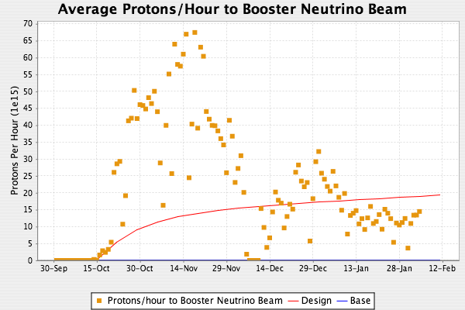
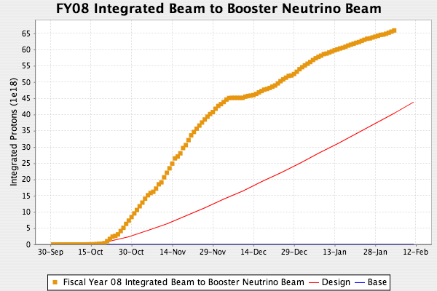
MiniBooNE/SciBooNE
NuMI back on
Hitting RF rate limit
  RF cycle counter mismatched with TLG cycle
Will try to increase by .5-1Hz
NuMI 2+9 operation

Slide 5
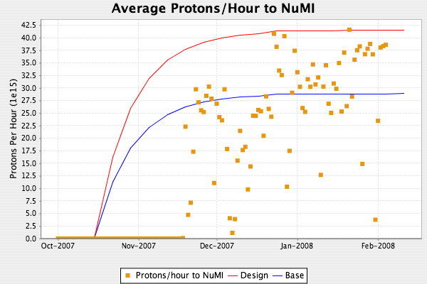
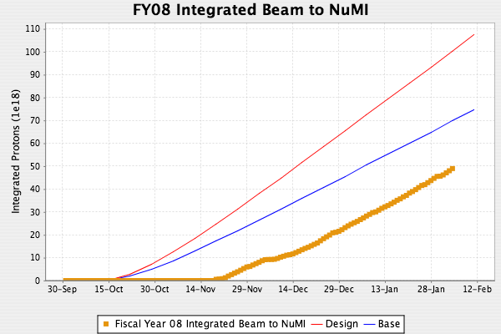
Beam to NuMI
2+9 slip stacked operation
(see Kourbanis talk)

Slide 6
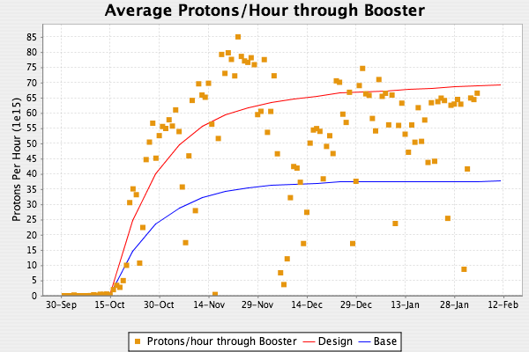
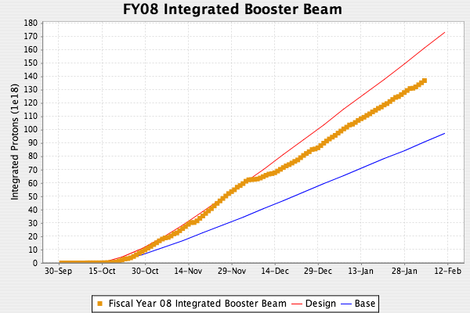
Total Booster Output

Slide 7
Technical Progress
Linac
  Pulsed Quad Power Supplies
    P1 and P8 installed (marked increase in reliability)
    Remaining cards in design
    Aim for completion in May (CR in progress)
  LLRF
    Production version of LLRF module in production
    Plan to have operation in station 5 in roughly 1 month
    Adiabatically install in stations 1-4 after that
Booster
  Correctors
    See shutdown preparation status
  Booster chopper/notcher
    Given up on distributed pulse design
    Going with three separately pulsed gaps in single long straight
    Working to begin evaluating impedance issues
    Will not be ready for 2008 shutdown (possibly spring)
Main injector
  See Kourbanis talk

Slide 8
Next Shutdown (Steve’s Questions)
When will correctors be ready?
  Have enough to complete long straights now
  Enough to complete job by last week of May
  All correctors, including ~12 spares by end of June
Other projects
  We will not have the Booster chopper ready for a 2008 shutdown
  Water and RF projects can proceed as money and manpower permit
Running until spring?
  No problem wrt correctors
  Possibly ready to install chopper in spring
Effect of 20% workforce reduction on length of shutdown
  Shutdown currently scheduled for 10 weeks
  Effect of reduced manpower depends on details
  Best we can do “generically” is to assume a linear effect, ie 20% reduction -> 20% longer

