Slide 1
Proton Plan Status
Feb/March 2008
Eric Prebys

Slide 2
Agenda
Operations/Technical – Prebys
Cost/Schedule – Domann
Shutdown ‘09
  Implications for Proton Plan – Prebys
  The Big Picture – Mau
  Duration and Start Date Considerations – Discussion
AOB

Slide 3
Operations

Slide 4
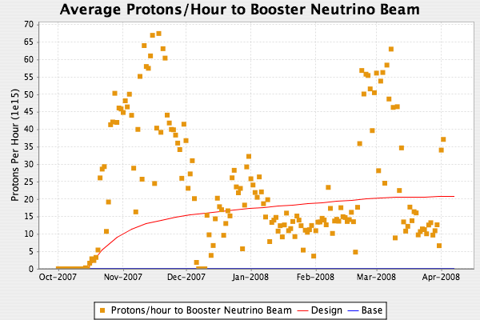
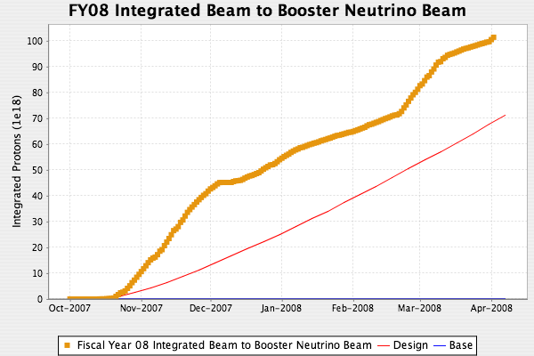
MiniBooNE/SciBooNE
NuMI back on
NuMI 2+9 operation

Slide 5
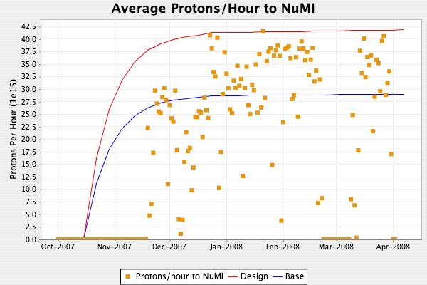
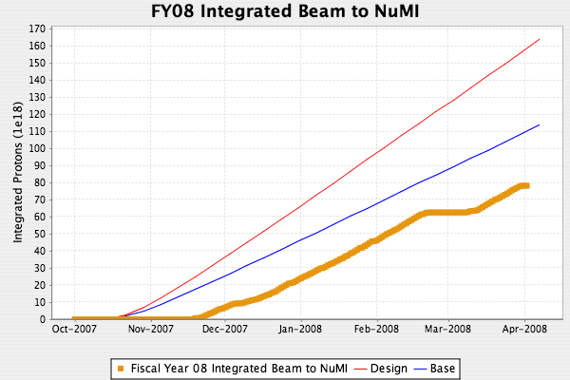
Beam to NuMI
2+9 slip stacked operation

Slide 6
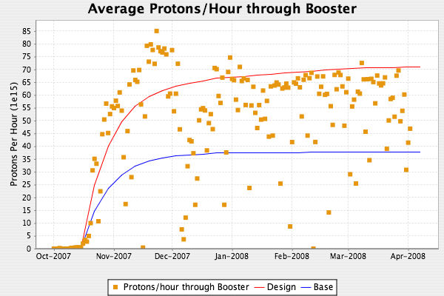
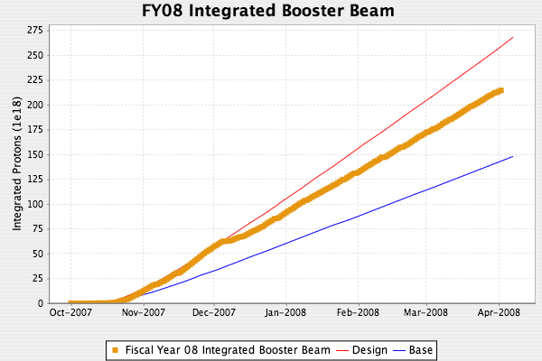
Total Booster Output
Running at ~8Hz instead of 9 Hz

Slide 7
Rate Issues
We have now completed all Proton Plan milestones that should allow the Booster to run at 9 Hz.
This is assumed in projections
We are currently limited to ~8 Hz by power loss in passive damping resistors in some the Booster RF cavities
John Reid has determined that the system is dumping too much fundamental into these loads, and is investigating.
Because this does not affect NuMI or Run II, and BNB is still well above the red curve, this is not being given much operational priority.

Slide 8
Technical Progress

Slide 9
Technical Progress: Linac
Pulsed Quad Power Supplies
  Design, fabrication and installation continue
  Working closely with EE support
  New estimated completion: Sept. 30
LLRF
  (see slides from T. Butler)

Slide 10
L.E. Linac LLRF Reference Line
New 201.25 MHz reference line, synchronized to 805 MHz reference
  We have finished installation of a 805 MHz reference line input for each new LLRF station
  We have tested and confirmed a new RF phase lock system between the new 805 MHz reference line and the old 201.25 MHz (805÷4) reference line
  RF Cables (3/8 Heliax) have been installed to run the new LLRF system on LRF5 for long term studies and LLRF commissioning.

Slide 11
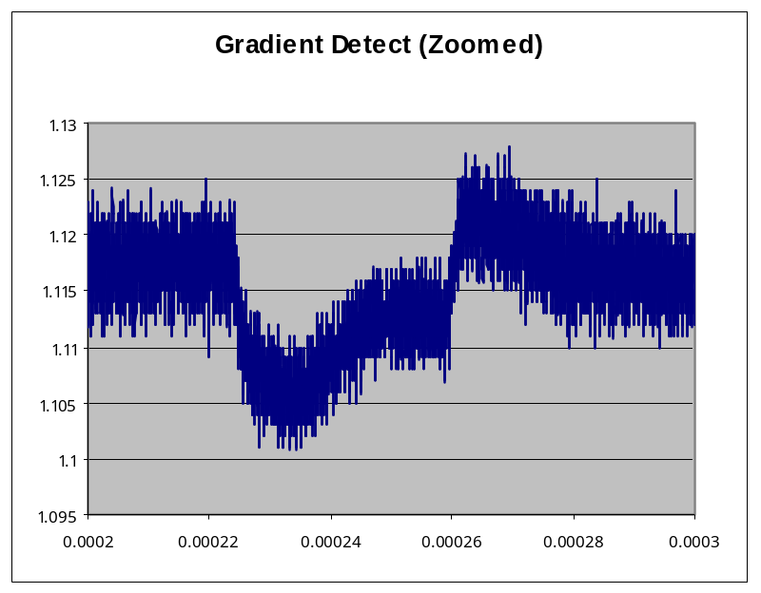
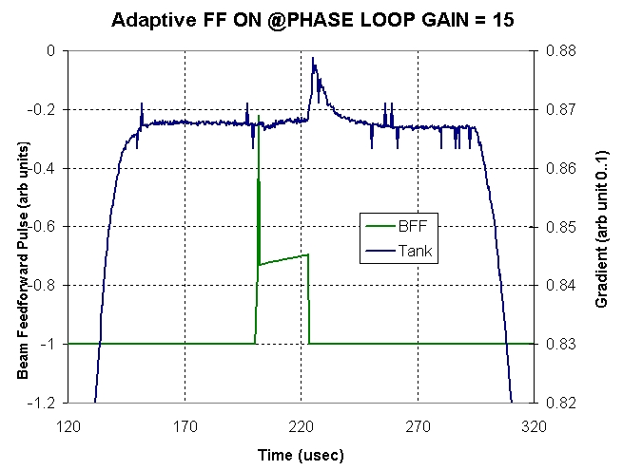
L.E. Linac LLRF Amplitude Regulation
Doing the last set of studies, the new LLRF system was able to decrease RF gradient beam amplitude variation from 1% to < 0.2% using a ‘feedforward’ pulse. This far exceeds the original design specs.
Future studies will involve testing ideas to reduce feed-forward aftereffect
1 % R F Gradient Variation (Old LLRF)
RF Gradient <0.1% Variation (New LLRF)
Gradient ‘Feedfoward’ Pulse

Slide 12
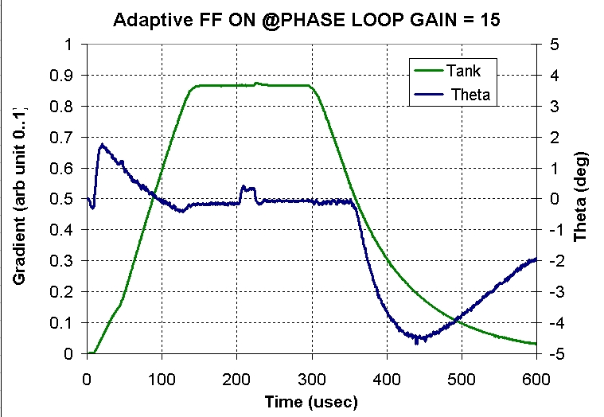
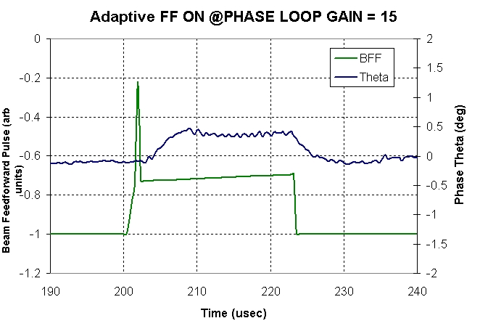
L.E. Linac LLRF Phase Regulation
After succeeding with the amplitude loop regulation, the current LLRF studies have now been focused on the phase feedback system. Using only RF feedback, the new LLRF system was able to surpass the original design goal of less than 0.4 degrees of phase stability
Future studies will involve using a phase ‘feedfoward’ pulse, similar to the amplitude feed forward pulse, to decrease the phase variation even further to << 0.4°
RF Gradient
Phase
Phase (Zoomed In)
0.2° Phase Stability

Slide 13
L.E. Linac LLRF Upgrade Future Plans
Test new phase ‘feedforward’ system, which might be used to increase phase stability during beam time even better than the original design specifications
Test ideas for reducing, or possibly eliminating, the ‘feedforward’ aftereffect by using the chopper off pulse, provided by Booster, to shutoff amplitude feed forward off before beam arrives to compensate for the time delay of the modulator amplifiers.
Implement through software the new frequency regulation system. The new LLRF system will replace the current mixer based system used to keep the cavity frequency constant, compensating for temperature variations and different cavity gradients.
Ultimate goals is to have a new VXI based LLRF system ready for operational commissioning, with hopes of running full time in LRF5 in the near future (~May 1)
Will them begin to adiabatically upgrade remaining stations

Slide 14
Technical Progress: Booster
Correctors
  See shutdown preparation status
Booster chopper/notcher
  Looking for help (ex ILC types?) to evaluate impedance issues
  Would not have been ready for 2008 shutdown
  Possibly ready for spring

Slide 15
Technical Progress: Main Injector
2+9 Slip stacking
  Operational
Collimators
  Operational! (see slides)
RF
  (See slides)

Slide 16
Main Injector Collimators
Main Injector Ring Collimators now fully operational
Use BLM system to identify loss categories
  Injection loss
    30% of total loss
    Collimators absorb 52% of this
  Uncaptured beam loss
    55% of total
    Collimators absorb 87% of this
  Extraction losses
    15% of total
    Collimators not effective
-> Collimators reduce uncontrolled loss by 63%
  Much of remaining loss localized
Continue to optimize

Slide 17
Main Injector RF
Upgrade of charging supplies
  Done
Transformers
  Replace the “old” one (of three) with new style
    order out
Comb filters
  Using same “ILC” boards as Linac LLRF
  Testing at test station in MI-60
  Hope to test on a real station this month
  Project: complete by Oct 1
  Benefit: 5E13 -> 5.5E13 total protons

Slide 18
Shutdown Implications

Slide 19
Corrector Packages
Production status (48 total needed)
  38 complete (incl. 12 installed)
  14 in production (ie, enough to complete installation)
  Still aim to have
    Enough for installation by end of May
    All done by end of June
Mechanical design
  Proceeding
  Might have been a bit tight for summer
  No problem for spring shutdown
Installation needs
  See Bob’s Talk
Implication of delayed installation
  NuMI: no impact
  BNB: possible slight improvement, but appears we can control losses to the point where BNB is rep. rate limited even without new correctors

Slide 20
Booster Chopper/notcher
Settled on conceptual design
  Three separate pulsed plates in one long section
Seeking help (ILC?) to evaluate impedance implications.
Might be ready by a spring shutdown if no big impedance problems found.
Installation needs
  Minor compared to correctors

Slide 21
Main Injector
RF Upgrade can be adiabatically installed, and does not need shutdown
Transformer needs “a couple of days”, so it would be better to do during a shutdown, but if the need arises, it can be done quickly outside of a shutdown (or during a short shutdown)

