Slide 1
Proton Plan
Eric Prebys, FNAL Accelerator Division

Slide 2
Proton Plan Charge
Develop a plan for a reasonable set of improvements and operational initiatives to maximize proton delivery to NuMI and the Booster Neutrino Beam (BNB)
Estimate the budget and timeline for these improvements.
Estimate proton delivery to both beam lines if the Plan proceeds on schedule.
Note:
  This project precedes other work that must be done to support the NoVA program
  This project precedes a proton driver or other significant improvements to the complex that are under discussion.

Slide 3
Staged Approach to Neutrino Program
This talk
Present Proton Plan:
  The implementation of slip stacking to NuMI in the Main Injector will gradually increase NuMI intensity to 4-5E13 protons to NuMI per 2.2 second cycle or about 3.5E20 p/yr. (~400 kW)
  This will increase by ~20% as protons currently used for pbar production become available.
  The Booster rep. rate and efficiently must increase to accommodate this, and it is hoped that there will be enough excess capacity to continue to operate the BNB at the 2E20 p/yr level throughout this period.
Beyond the Proton Plan (post-collider, “SNuMI” Nova era):
  Preload protons in the Recycler to reduce the Main Injector cycle time.
    ~700 kW
  Use the accumulator to momentum stack protons, prior to loading in the Recycler.
    ~1 MW
  Build a dedicated proton driver?
    ~2 MW

Slide 4
Some Numbers to Keep in Mind
At 120 GeV, 100 kW is roughly
  1E20 protons/year
  1 Booster Hz @5E12*
  2E16 peak proton intensity out of Booster
ABSOLUTE limit of this Proton Source:
  5E12 batches @ 15Hz
    ~1.5MW @ 120 GeV
    1.5E21 protons/year
    3E16 pph out of Booster
    This is about ~2x the present proton plan
*not including prepulses.! Add 2Hz/(MI cycle) for total rate

Slide 5
Limits to Proton Intensity
Total proton rate from Proton Source (Linac+Booster):
  Booster batch size
    ~4-5E12 protons/batch
  Booster repetition rate
    15 Hz instantaneous
    Prior to shutdown: 7.5Hz average (injection bump+RF)
  Beam loss
    Damage and/or activation of Booster components
    Above ground radiation
Total protons accelerated in Main Injector:
  Maximum main injector load
    Six “slots” for booster batches (3E13)
    Up to ~11 with slip stacking (4.5-5.5E13)
    Possible RF stability limitations (under study)
  Cycle time:
    1.4s + loading time (1/15s per booster batch)
Historically our biggest worry

Slide 6
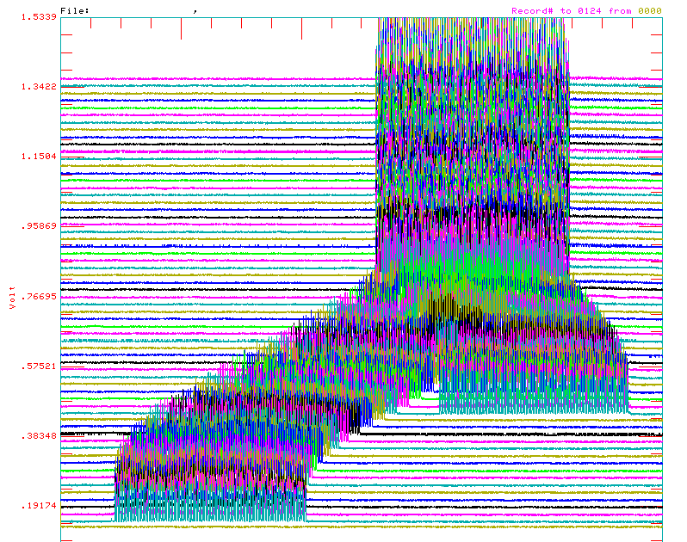
Review: Main Injector Loading
The Main Injector has six usable “slots”, into which Booster batches may be placed.
More batches may be loaded, using “slip stacking”, in which an initial batch in the Main Injector is accelerated such that a subsequent batch will be at a slightly different energy.
The two will then drift together and can be captured as a single batch (with at least twice the longitudinal emittance).

Slide 7
Main Injector Loading
Initial NuMI operation (“2+5”):
  Two batches slip stacked for antiproton production.
  Five more batches loaded for NuMI
  All will be accelerated together.
  This is the current standard operation.
Ultimate NuMI operation (“2+9”):
  Five batches will be loaded into the Main Injector, leaving one empty slot.
  Six more batches will be loaded and slipped with the first to make two for antiproton production and 9 for NuMI.

Slide 8
Proton Plan Developments Since Last Ops Review
AD Review, July 2005
Director’s Review, August 2005
“Baseline”, September 2005
Since baseline:
  Plan tracked with monthly PMG meetings
  Change control through formal change request (CR) procedure.
    So far, five complete CR’s with three more in process

Slide 9
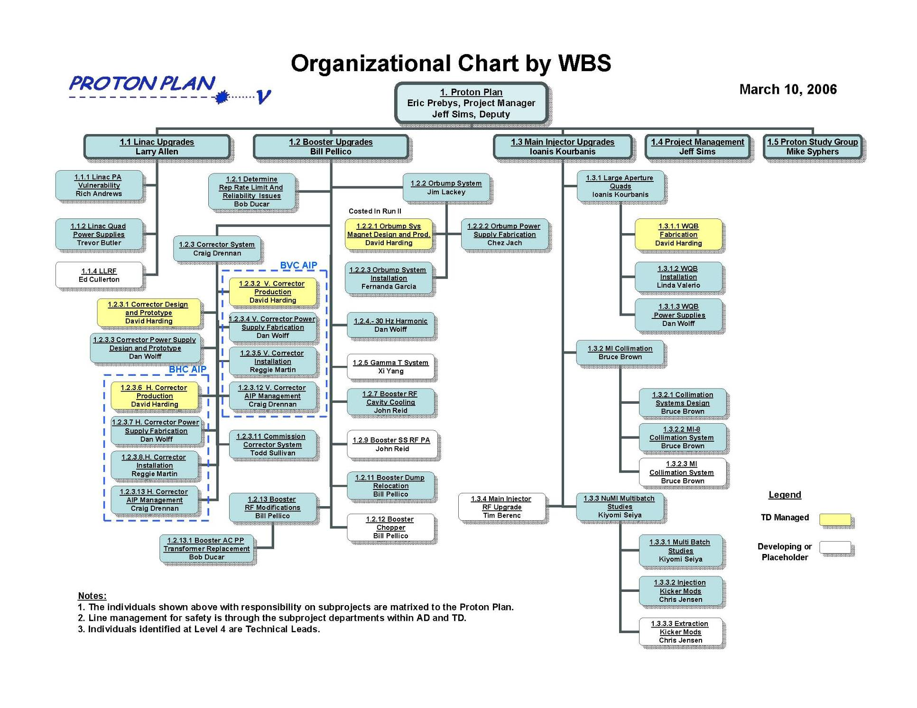

Slide 10
Plan Strategy
Increasing the proton delivery from the Booster to NuMI and MiniBooNE
  Increase maximum average Booster repetition rate.
  Increase acceptance by improving orbit control and beam quality.
Increasing the beam intensity in the Main Injector for NuMI
  Main Injector multi-batch operation.
  Slip stacking in Main Injector (requires injection kicker improvement and possibly some RF improvements).
Improving operational reliability and radiation limitations
  Linac pulsed quad supplies
  Booster RF upgrades, possibly significant
  Alleviate Low Energy Linac 200 MHz PA (“7835”) supply problem
Organized along the Run II model
  “campaign” rather than “project”

Slide 11
Summary: Significant Elements of Plan
Linac
  Stockpile two year supply of spare 200 MHz power amplifier tubes (7835’s), in the event of an interruption in supply
  Characterize and improve Low Energy Linac Low Level RF
Booster:
  Replace and reconfigure injection bump (ORBUMP) system.
  Relocate 8 GeV dump from Booster tunnel to MI-8 transfer line
  Make Booster robust to 9 Hz, and understand requirements to go to 15 Hz
  Design, build, and install new corrector system
Main Injector:
  Replace seven quadrupoles with increased aperture versions, to reduce injection and extraction losses.
  Operationally develop multi-batch and multi-batch slip stacked operation
  Design and install collimation system, both in the MI-8 line and in the MI ring
  Modify injection kicker to allow multi-batch slip stacked operation
  Characterize and perhaps make improvements to RF system, to support high intensity operation.
Red = to be completed this shutdown

Slide 12
Major Accomplishments This Year
Linac
  All 12 strategic spare 7835’s delivered!
    One must go back (bad ion pump)
  Design of pulsed quad supplies ongoing
  LEL LLRF studies well under way
Booster
  Operationally supported slip stacking for pBar production, NuMI, and MiniBooNE
    Required operational cogging
    Logitudinal properties improved with the intervention of Rapid Response Team (RRT)
  Worked in preparation for this shutdown (see next slides)
  Finalized specifications and prototype design for new Booster corrector system.
Main Injector
  Prepared for shutdown (see next slides)
  Initiated routine full 2+5 operation
    Rate maximum until slip stacking begins after shutdown
  Did studies related to full slip stacking
    Demonstrated accelerated 2+9 operation at low intensity

Slide 13
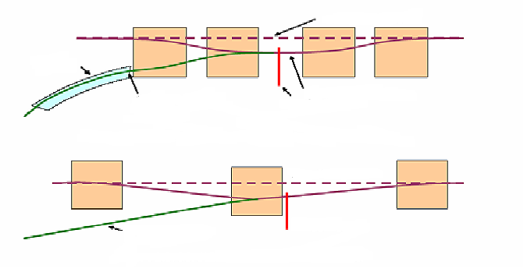
ORBMP/Injection
New Booster Injection - ORBMP Girder & PS
  A simplified 3 Bump injection scheme
      Septum Magnet not required
      Better Lattice Match
      Alignment of Circulating beam with Injected beam
  New ORBMP ps and magnets that can run at 15 Hz
      Present system limited to 7.5 Hz due to heating
Circulating Beam
Septa
Injected Beam
Present Injection Girder
Foil
Circulating Beam
Injected Beam
Foil
New Injection Girder
Provided by Jim Lackey and Fernanda Garcia

Slide 14
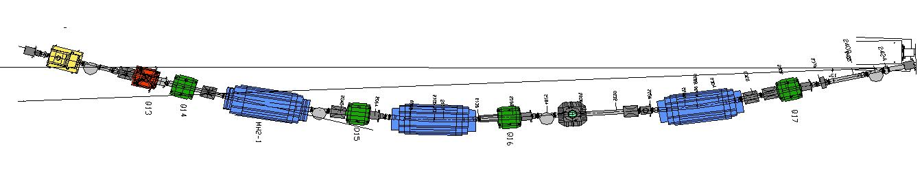
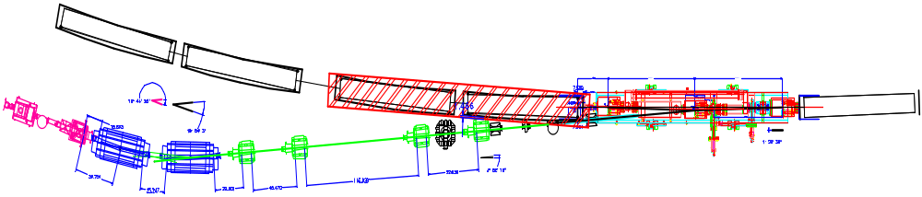
Injection Modifications
Current Scheme
New Scheme
ORBMP Girder
Booster
ORBMP MAGNETS
New 400 MeV Injection Layout
Provided by Jim Lackey and Fernanda Garcia

Slide 15
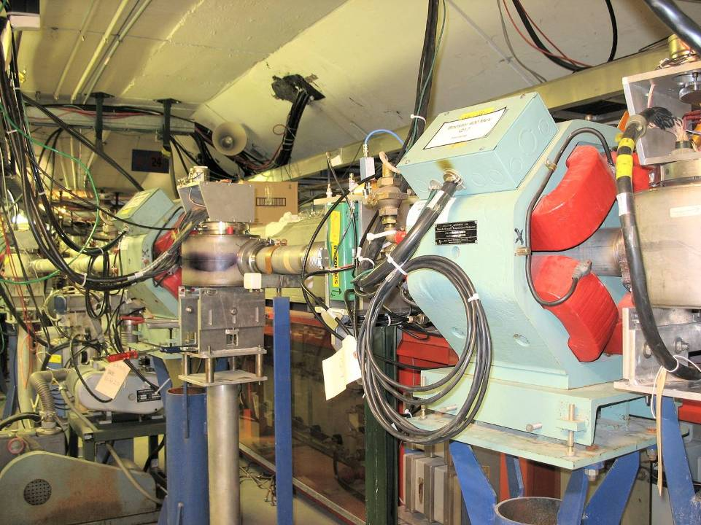
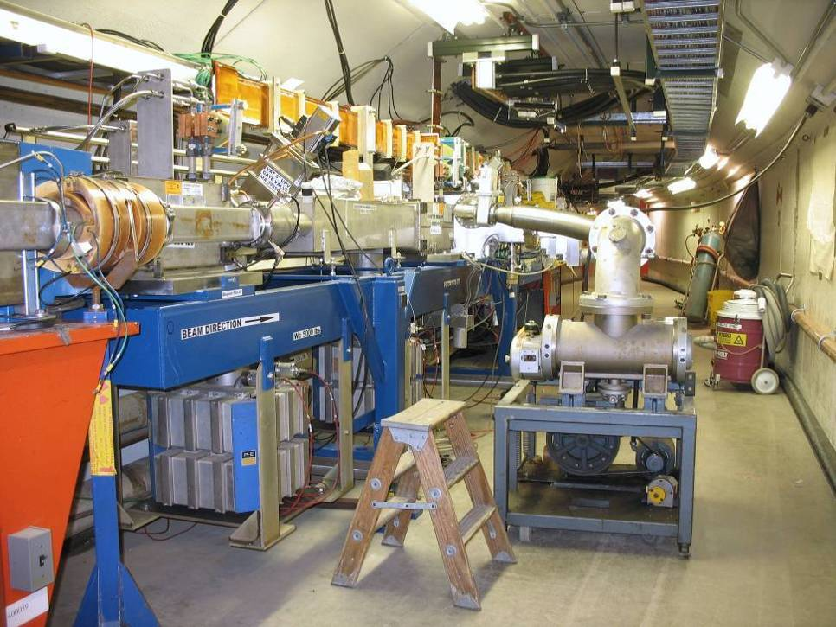
ORBUMP/400 MeV Project
Re-routed 400 MeV Line
Injection Girder

Slide 16
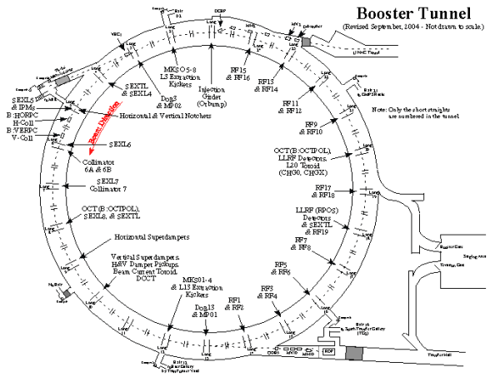
Booster Dump Relocation
L3 Extraction to MI
L13 Extraction Dump
This extraction region is being relocated to the MI-8 transfer line

Slide 17
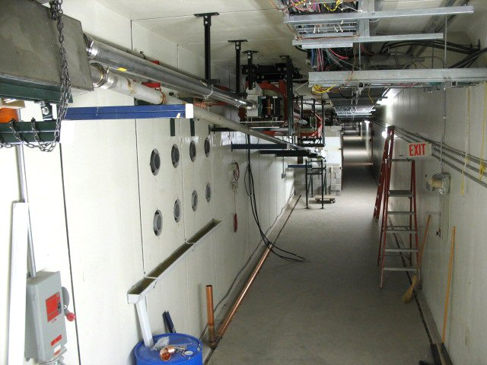
MI-8 Dump Line
Relocated Septum
Dump
New Dump Line

Slide 18
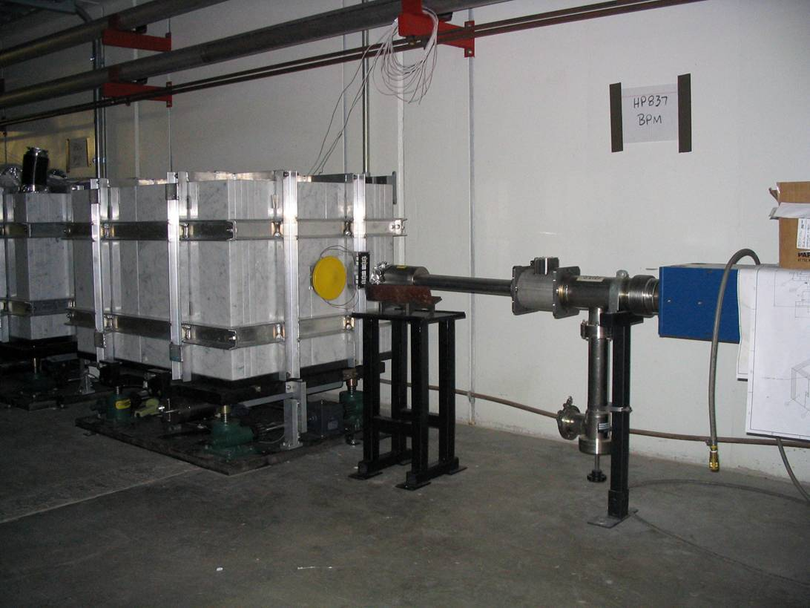
MI-8 Collimator
Note marble cladding

Slide 19
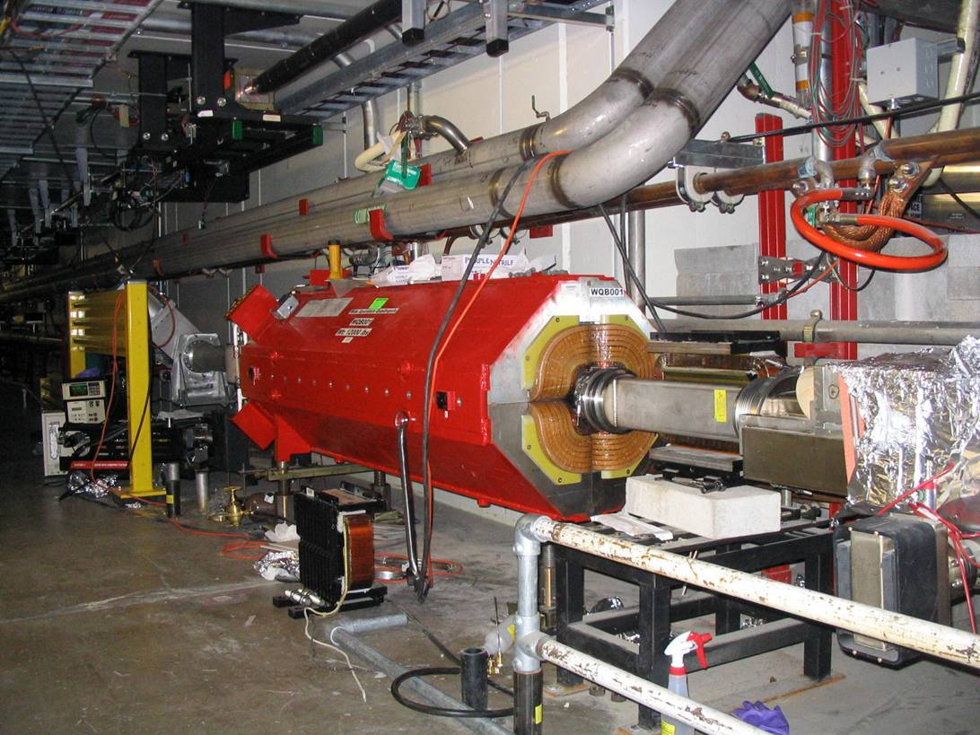
Main injector large aperture quads (7)

Slide 20
Shutdown Status
Linac
  Ready to go
Booster
  Down to “punch list”
  Expect DC beam ~5/12
  Commissioning week of 5/15
  Ready to deliver beam (at some level) 5/22
Main Injector
  All work to be completed ~5/15
  Beam commissioning when back on Kautz Rd power (5/22)

Slide 21
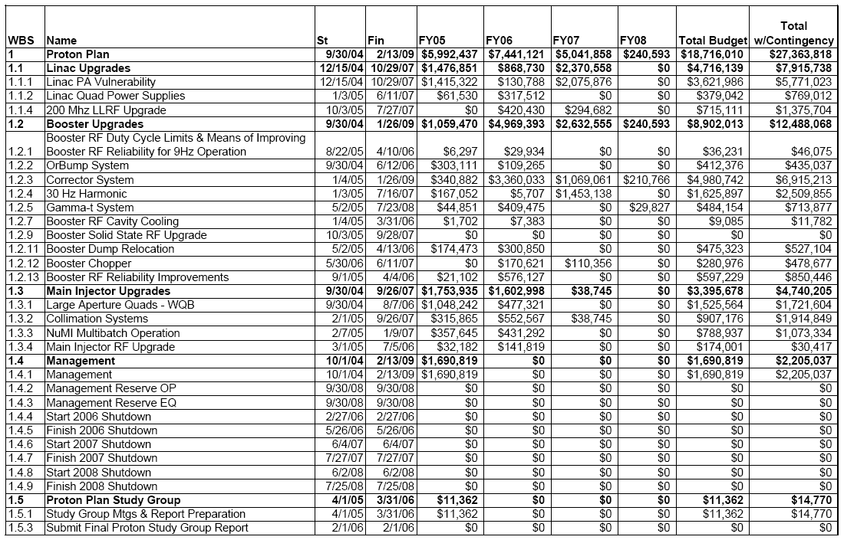
Level 3 Breakdown with Budget

Slide 22
Booster Corrector Upgrade
Existing System:
  Each of the 48 Subperiods contains
    H and V dipoles
    Normal and skew quads
  Chromaticity correcting sextupoles at discrete locations
  Not enough strength to control position and tune through cycle
  Not enough slew rate for transition
  Cannot cancel third order resonances
New system:
  Dipoles strong enough for +- 1cm position control through whole acceleration cycle
  Quads strong enough to select working point arbitrarily close to half or integer resonance through cycle
  Sextupole and skew sextupole at every sub-period
  Quads and sextupoles can go rail to rail in ~1 ms
Very complex project
  Even without the rest of the plan, this would be a project
  Organized as two AIP’s: long straights (2007) and short straights (2008)

Slide 23
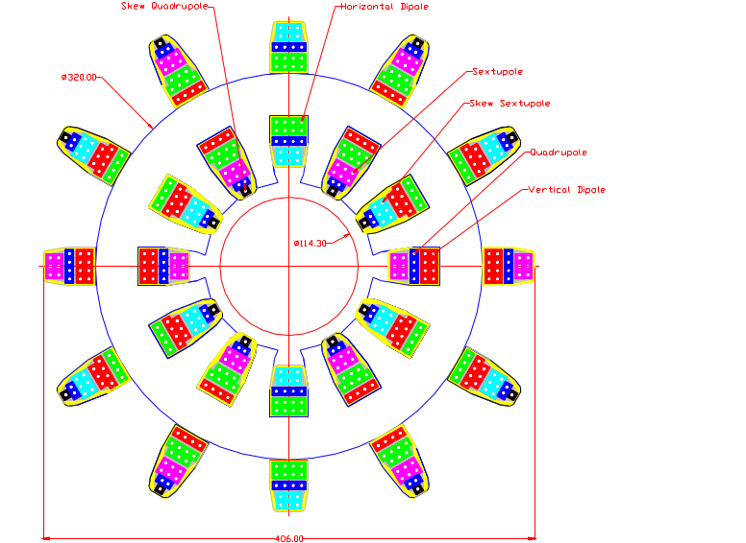
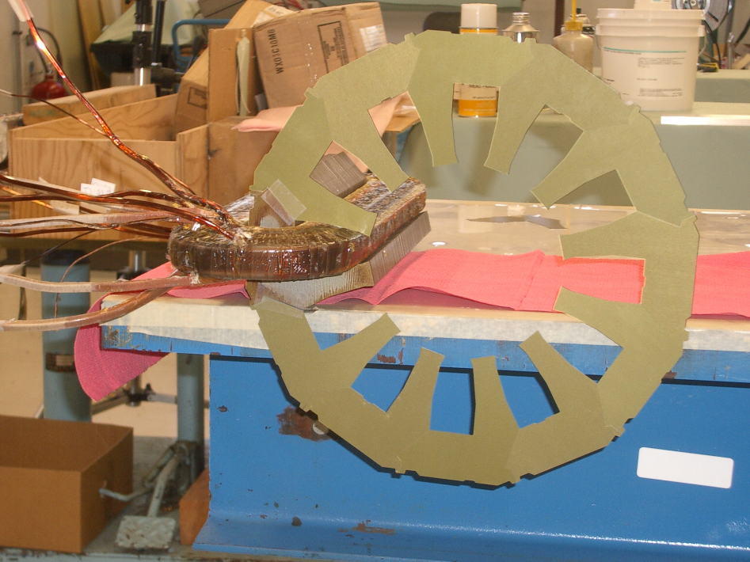
Booster Corrector Design: 12 Pole Magnet
Prototype in progress
  Coils and cores complete
  Assembly beginning
  Ready for test beginning of June

Slide 24
Main Injector Issues
Collimation System
  The Main Injector can have significant beam loss for slip stacked beam.
  A conceptual plan for collimation within the Main Injector ring has been developed.
  We will review it in June, with the idea of implementing it during the 2007 shutdown.
RF Beam Loading
  The existing RF system should have sufficient beam power to accelerate beam, but there might be stability issues and loading issues for slip stacking.
  We have a detailed program of studies going on now to investigate these issues and suggest mitigation, if necessary.
For these reasons, although slip stacking studies will begin soon after this shutdown, we do not assume any increase beam from slip stacking until after the 2007 shutdown.

Slide 25
Proton Projections
Assume traditional operational priority:
  Protons for pBar production
    Limited by ability to slip stack
    Limited by max cooling rate
  Protons for NuMI
    Limited by max Booster batch size
    Limited by max MI cycle rate
    Limited by max MI proton capacity
    (will be) limited by ability to slip stack NuMI protons in MI
  Protons for BNB (currently MiniBooNE)
    Determined by difference between Booster capacity and maximum MI loading.
    Currently limited by Booster losses, and will continue to be for some time.
    Ultimately limited by Booster rep. rate.
    Extremely sensitive to fluctuations in total Booster output

Slide 26
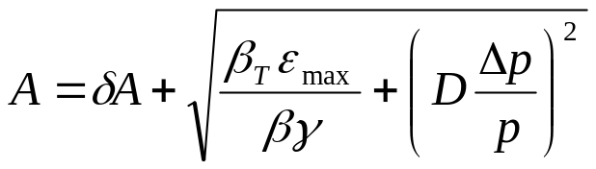
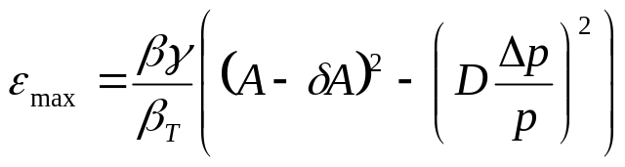
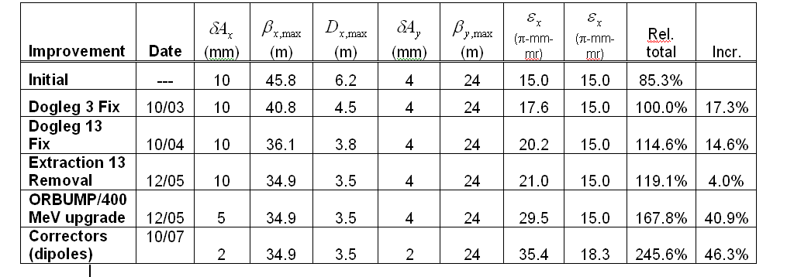
Evaluate Effect of Booster Improvements
Calculate effect of various improvements based on increased acceptance:
Use:
Effective aperture
reduction
Booster Dump Relocation
06/06
06/06
“Design” projection: 50% of calculated benefit after 1 year
“Baseline” projection: 25% of calculated benefit after 1 year

Slide 27
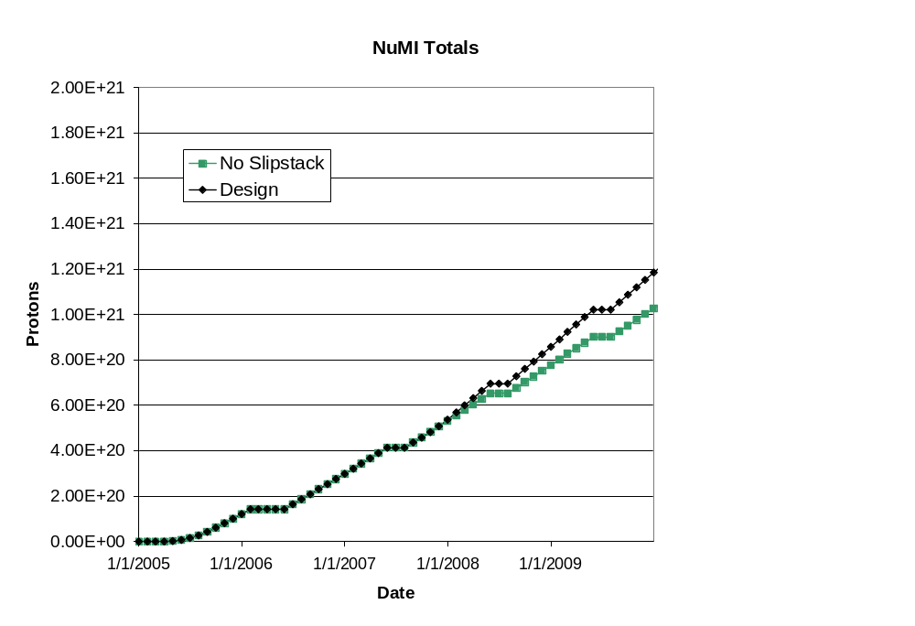
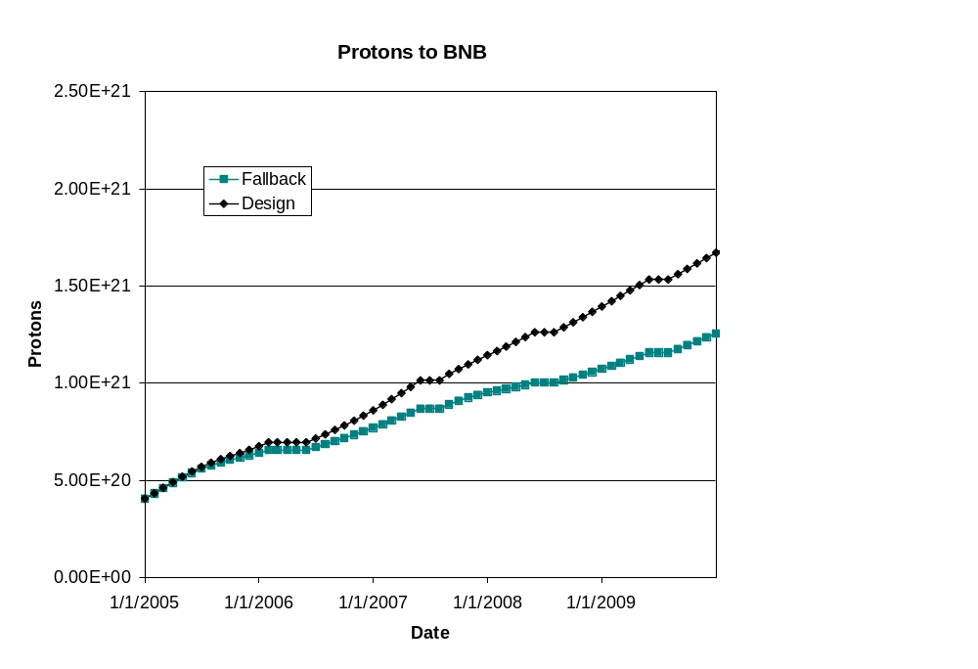
Long Term Projections
These projections do not take in to account effects of collider turning off or possible improvements thereafter.

Slide 28
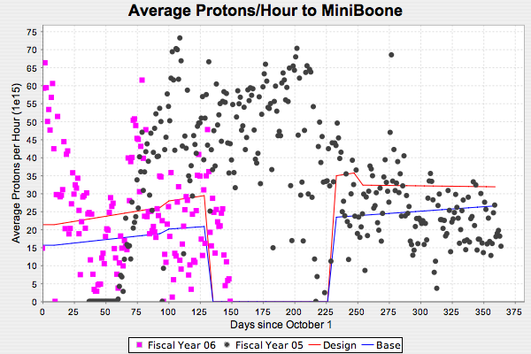
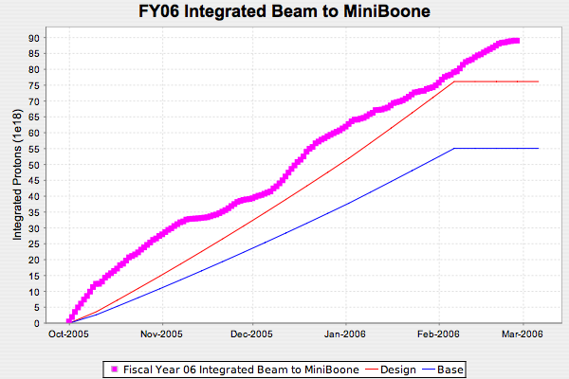
How have we done so far?
FY06 Protons to MiniBooNE

Slide 29
Operational Summary for MiniBooNE
We continued to deliver protons to the MiniBooNE experiment as NuMI ramped up through the year.
  This was still considered problematic as little as six months before the NuMI turn on
  It reflects a significant achievement by both the Proton Source personnel and Operations.
MiniBooNE benefited from periodic NuMI downtimes.
There were no significant operational issues for the MiniBooNE experiment since the last Ops review.

Slide 30
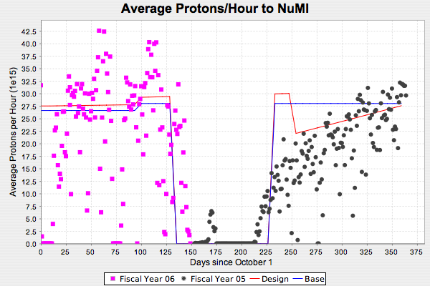
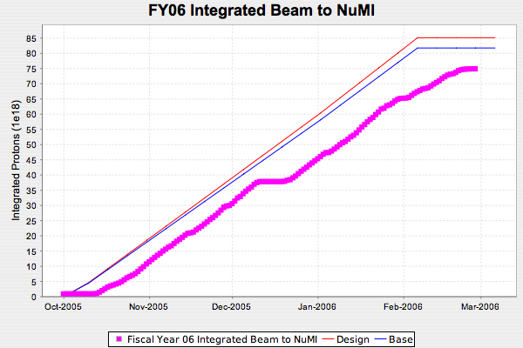
FY06 Protons to NuMI

Slide 31
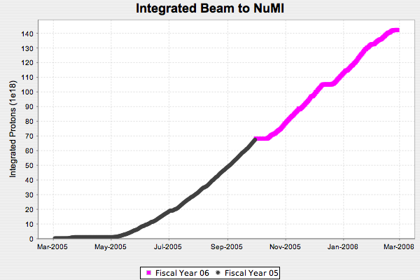
NuMI Operational Issues*
Install system to collect
tritiated water from
target pile air cooling
March 2005:
Project completion,
beam-line commissioning
Clear horn
ground fault
(foot shook loose)
Infant mortality
of target water line,
do “patch” on target system
Integrated
1.4 x 10²⁰ POT
(equivalent to 1MW-month
of continuous beam)
*slide courtesy Jim Hylen

Slide 32
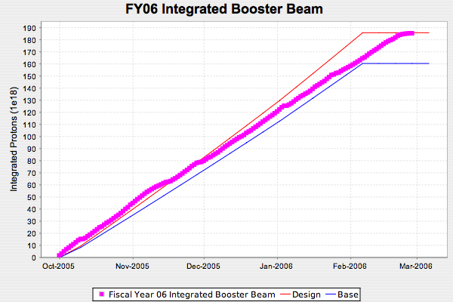
Total Protons Delivered

Slide 33
The Year in Review
Things which went well
  Operationally continuing to run MiniBooNE with NuMI
  Uptime better than anticipated
  Less access needed for ECool than planned
  Understanding the MI RF needs led to a drastically reduced scope of proposed MI RF work
Things which fell a bit short
  Peak Booster intensity has not risen as fast as expected
    Projected peaks of 1E17 pph by this time.
    In fact peaks of ~9E16 pph have been observed.
  Assorted problems with NuMI beam line

Slide 34
Summary
In the last year, the Proton Plan has gone from a concept to an official project, with monthly oversight and change control
We are successfully ramping up NuMI operation while continuing to deliver beam to MiniBooNE
As in Run II, an important part of the Plan is to make realistic proton delivery estimates, and we have done reasonably well.
A significant part of the plan has been completed this shutdown
The most important remaining parts are
  Booster corrector system
  Main Injector Collimation system

