Slide 1
Answer to Question
What is the analysis backing up the claim that the losses will be reduced with the new corrector system in the Booster? What are the expectations for performance with the new systems implemented?
  All analyses are calculations are based on the assumption that we keep the absolute total beam loss in the Booster more or less what it is now.
  Increased efficiency-> Reduced losses-> more beam

Slide 2
Techniques for calculating benefit of correctors
Lacking a detailed model for Booster beam loss, two approaches have been applied
  Assume gaussian beam profile and Booster physical aperture
    Method in McGinnis’ analysis
    Appropriate later in cycle
    Independently verifies observed COD
  Calculate fractional change in effective aperture represented by 95% emittance.
    Probably more accurate for hard scraping early in cycle
    Leads to a more conservative estimate
    Used in Proton Plan projections
  CAVEAT: Beam motion calculations are complicated by the injection bump mismatch and the existence of the second extraction region
    It should be possible to do far more accurate calculations within a few months of the current shutdown.

Slide 3
Corrector Performance
Assume that the new correctors, together with the new ORBUMP and improved alignement will reduce the COD from 1cm -> 2mm
Also assume that the local chromaticity correction will eliminate at ~10% emittance blowup caused by the existing system.
Remember that in all cases, the “design curve” is based on realizing 50% of the potential benefit of an improvement after 1 year of tuning.
  If I turn this around, this says I have only succeeded in reducing the COD to ~5 mm

Slide 4
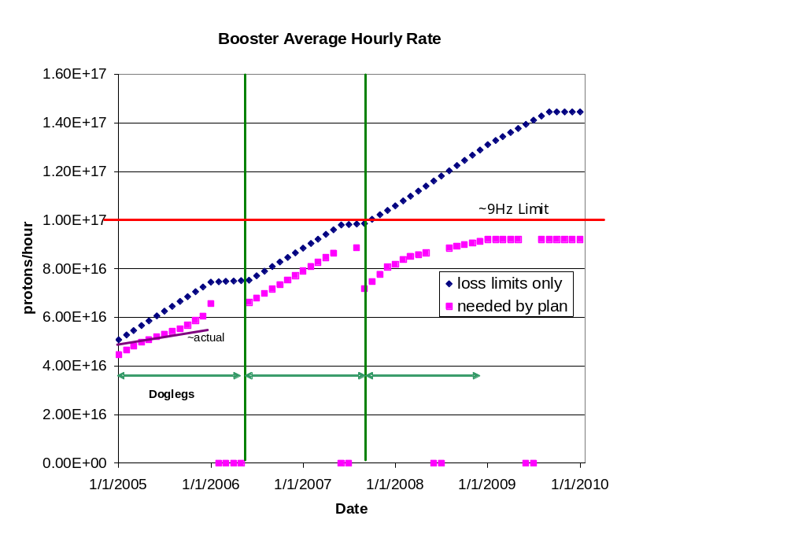
Effect of Improvements
Represents factor of 15-20 over typical rates prior to neutrino program

Slide 5
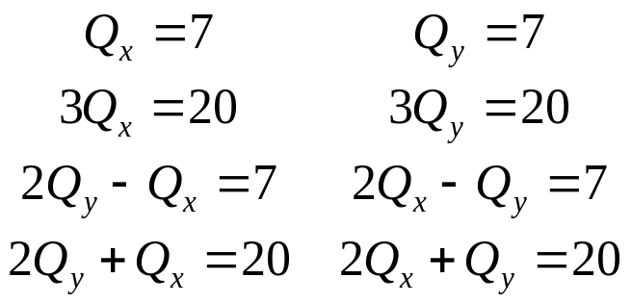
Corrector benefits not yet quantified
More effective use use collimation system
  Collimation system should reduce uncontrolled beam loss by factor of ~10
  In practice, more like a factor of 2-3, and this is what is used in projections.
  Uncontrolled beam motion likely largely to blame.
Better beam control at transition will allow use of gamma-t system
  New gamma-t magnets will be installed along with short straight correctors in 2008
  Not “officially” accounted for yet
Ability to correct third order resonances with sextupoles.
Correct with normal sextuples
Correct with skew sextuples

