Slide 1
Proton Plan (short version)
(BEAMS-DOC-1441)
Eric Prebys, FNAL Accelerator Division

Slide 2
Charge
Develop a plan for a reasonable set of improvements and operational initiatives to maximize proton delivery to NuMI and the Booster Neutrino Beam (BNB) over the next ten years or so.
Estimate the budget and timeline for these improvements.
Estimate proton delivery to both beam lines if the Plan proceeds on schedule.
Note: this plan is exclusive of the Proton Driver, which we assume will one day replace the existing Proton Source (Linac+Booster).

Slide 3
Acknowledgements
Proton Plan Team
  Jeff Spalding
  Bruce Baller
Significant contributors (in no particular order)
  Alberto Marchionni (MI)
  Ioannis Kourbanis (MI)
  Kiyomi Koba (MI)
  Bill Pellico (PS)
  Jim Lackey (PS)
  Larry Allen (PS)
  Elliott McCrory (PS)
  John Reid (RF)
  Dave Harding (TD)
  Dan Wolf (EE)
  Weiren Chou (Integration)
  Peter Garbincius (Management)
  Dave McGinnis (Management)
  + others

Slide 4
Review: What Limits Total Proton Intensity?
Maximum number of Protons the Booster can stably accelerate: 5E12
Maximum average Booster rep. Rate: currently 7.5 Hz, may have to go to 10 Hz for NuMI+ (full) MiniBooNE
(NUMI only) Maximum number of booster batches the Main Injector can hold: currently 6 in principle, possibly go to 11 with fancy loading schemes in the future
(NUMI only) Minimum Main Injector ramp cycle time (NUMI only): 1.4s+loading time (at least 1/15s*nbatches)
Losses in the Booster:
  Above ground radiation
  Damage and/or activation of tunnel components
Our biggest worry at the moment and probably forever

Slide 5
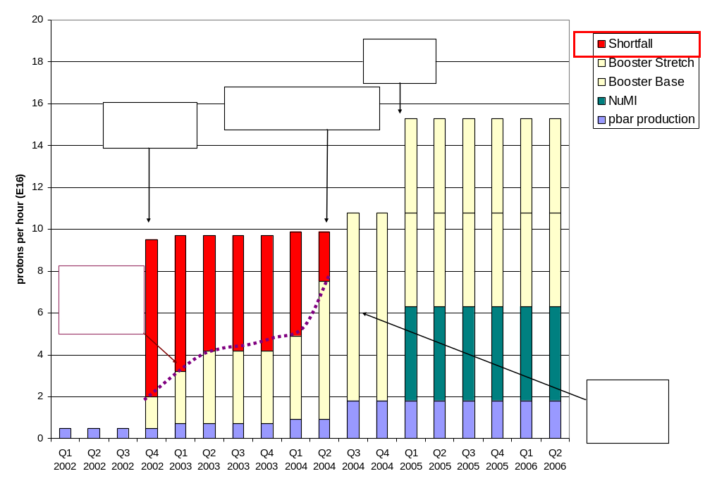
History: Proton Demand (pre-”plan”)
7.5 Hz
Have now exceeded initial NuMI needs!!!!

Slide 6
Plan Strategy
Increasing the proton delivery from the Booster to NuMI and MiniBooNE
  Increase maximum average Booster repetition rate.
  Increase acceptance by improving orbit control and beam quality.
Increasing the beam intensity in the Main Injector for NuMI
  Main Injector multi-batch operation.
  Slip stacking in Main Injector (requires RF upgrade).
Improving operational reliability and radiation limitations
  Linac quad supplies
  Booster and Linac Instrumentation
  Booster RF Upgrade
  Investigate 7835 Problem

Slide 7
Breakdown of Plan
WBS | Description
1 | Proton Plan
1.1 | Linac Upgrades
1.1.1 | Linac PA Vulnerability
1.1.2 | Linac Quad Power Supplies
1.1.3 | Linac Instrumentation Upgrade
1.2 | Booster Upgrades
1.2.1 | Determination of Rep Rate Limit
1.2.2 | ORBUMP System
1.2.3 | Corrector System
1.2.4 | 30 Hz Harmonic Upgrade
1.2.5 | Gamma-t System
1.2.6 | Alignment Improvements
1.2.7 | Drift Tube Cooling
1.2.8 | Booster RF Cavity #20
1.2.9 | Booster Solid State RF PA’s
1.2.10 | Booster Instrumentation Upgrade
1.3 | Main Injector Upgrades
1.3.1 | Large Aperture Quads
1.3.2 | Main Injector Collimator
1.3.3 | NuMI Multi-batch Operation
1.3.4 | Main Injector RF Upgrade
1.4 | Management

Slide 8
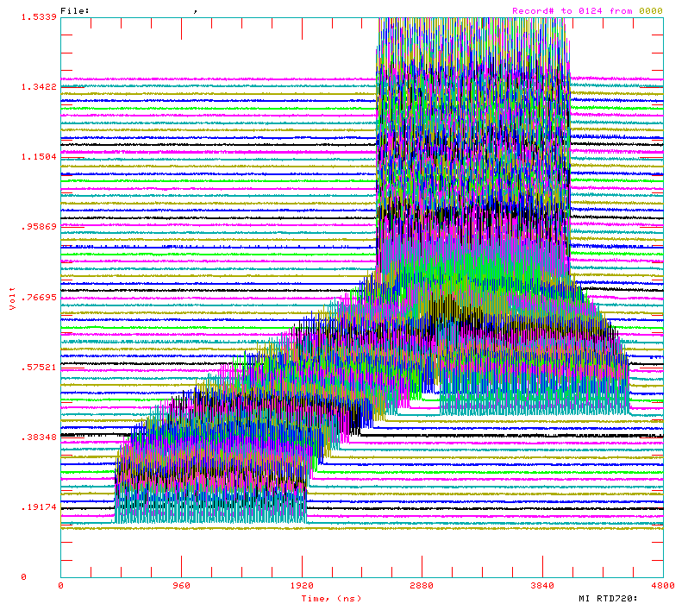
Main Injector Loading
The Main Injector has six usable “slots”, into which Booster batches may be placed.
More batches may be loaded, using “slip stacking”, in which batches are injected at slightly different energy, drift together, and are captures as one batch (with at least twice the longitudinal emittance).

Slide 9
Main Injector Loading (cont’d)
Initial NuMI operation (“2+5”):
  Two batches will be slip stacked for antiproton production.
  Five more batches will be loaded for NuMI
  All will be accelerated together.
Ultimate NuMI operation (“2+9”):
  Five batches will be loaded into the Main Injector, leaving one empty slot.
  Six more batches will be loaded and slipped with the first to make two for antiproton production and 9 for NuMI.
  This is beyond the capacity of the current RF system.

Slide 10
Main Injector RF Upgrade (3.4)
The existing RF system can accelerate about 4E13 protons
This is enough for 2+5 operation (~3.5E13 protons), but not enough for 2+9 (~5.5E13).
Each RF station has a port for a second PA.
The plan is to verify that this will provide enough power to accelerate 7E13 protons, then proceed with procurement to add a second PA.
This is the most expensive part of the plan and the most vital to NuMI operation.
It would require new modulators, which would make the old ones available for the Booster RF upgrade (2.9)
Plan
  Build prototype station this year to establish performance
  Proceed with procurement
  Investigate possible interim solution to increase capacity of existing system to ~4.9E13

Slide 11
Result of Funding “Reality Check”
Likely funding profile means
  Non critical items either deferred, moved back into department budgets, or eliminated.
  Major projects will likely be delayed
Key remaining elements
  Linac
    7835 task force: throw money at Burle to build up two years supply of spares in the next two years.
  Booster:
    New ORBUMP and ORBUMP PS (Install fall 05)
    New Corrector system (Install fall 06 or 07)
    30 Hz harmonic (prototype and then decide)

Slide 12
Remaining Items (cont’d)
  MI
    Complete large aperture quads (Install fall 05)
    Continue on RF upgrade (full upgrade fall 07 at the earliest)
    Investigate interim partial RF solutions
    Investigate alternate stacking scheme (barrier bucket, involves some hardware and studies)
    Investigate and mitigate beam loss (see next slide)

Slide 13
Beam Loss in MI
Preliminary measurements indicate that the Main Injector will have radiation problems similar to Booster.
To first order, nothing has been done about this.
Needed:
  Study and calculation
  Upgraded BLM system (in the works)
  Systematic monitoring (a La Kasper)
  Design and build collimation system
    MI-8 line
      simple. Use old spare from switchyard??
    In ring
      Similar to Booster
      Maybe identical??
Might be a good area for university involvement

Slide 14
Possible Additions to the Plan and Universities
Existing plan
  Booster LLRF/transverse damping
    Already tentatively using PostDoc from CalTech
  Eliminating Period 13 extraction and putting dump in MI-8 line.
    Hard to see how a University would get involved.
Longer term (sans BTeV):
  Re-task Recycler as pre-loader for Main Injector
    Eliminates loading time
    Involves new beamline and injection region from MI-8 -> Recycler
    Develop fast barrier bucket stacking in Recycler
    Probably some pieces that universities could get involved with.
  Major Linac Booster modifications to keep up with higher proton rates and insure longevity:
    Replace old linac?
    ???
    Maybe university involvement.

