Slide 1
Proton Plan Stage I
Eric Prebys

Slide 2
Charge
Develop a plan for a set of upgrades and operational improvements to maximize proton delivery to:
  NuMI beamline (120 GeV from MI)
  Booster Neutrino Beam (BNB) (8 GeV from Booster)
Goal: complete the upgrades over the next 3 years, and operate through 2015 or beyond
  Note: this plan precedes the Proton Driver replacement of the existing Proton Source (Linac+Booster)
Develop the budget and timeline for these improvements
Estimate projected proton delivery (PoT) to both beam lines

Slide 3
Limits to Proton Intensity
Total proton rate from Proton Source (Linac+Booster):
  Booster batch size
    Typical ~5E12 protons/batch
  Booster repetition rate
    15 Hz instantaneous
    Currently 7.5Hz average (limited by injection bump and RF cooling)
  Beam loss
    Damage and/or activation of Booster components
    Above ground radiation
Total protons accelerated in Main Injector:
  Maximum main injector load
    Six “slots” for booster batches (3E13)
    Up to ~11 with slip stacking (5.5E13)
    RF stability limitations (currently ~4E13)
  Cycle time:
    1.4s + loading time (1/15s per booster batch)
Operational Limit

Slide 4
Plan Strategy
See document: BEAMS-DOC-1441 (11/09/04) at http://beamsdocs.fnal.gov/cgi-bin/public/DocDB/DocumentDatabase
Increase the proton delivery from the Booster (to both NuMI and BNB)
  Increase acceptance by improving orbit control and beam quality
  Increase maximum average Booster repetition rate
Increase the beam intensity in the Main Injector for NuMI
  Main Injector multi-batch operation
  Slip stacking in Main Injector (probably requires RF upgrade?)
Improve operational reliability
  Alleviate 7835 Problem
  Linac quad supplies

Slide 5
Current Budget Guidance
After the cancellation of BTeV, we have the following budget guidance (M&S+SWF):
Most Likely Scenario
  Main Injector RF project and Booster Corrector System get delayed by one year, relative to the original plan
  Booster RF Solid State PA upgrade deferred indefinitely
 | FY05 | FY06 | FY07 | FY08 | Total
Present Guidance | 7327 | 7845 | 6915 | 6116 | 28203

Slide 6
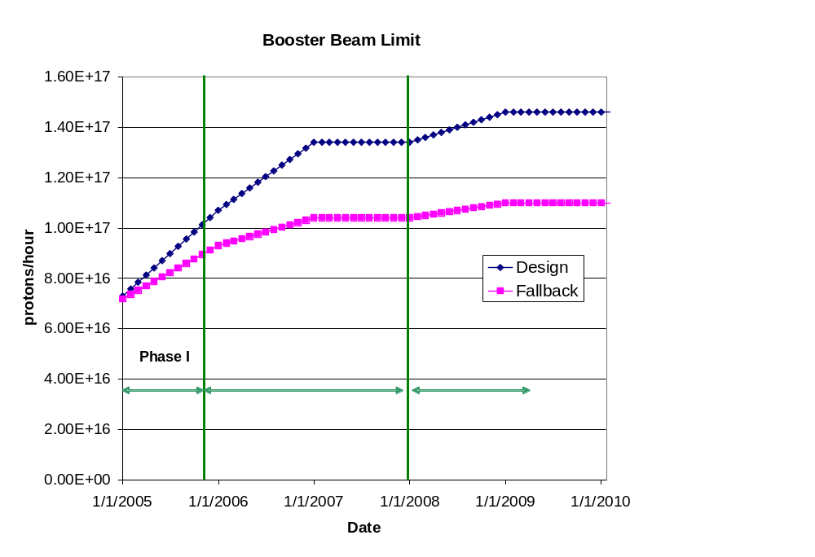
Booster Throughput
Major Improvements:
  New ORBUMP system (2005 shutdown)
  Relocate L13 dump to MI-8 line (2005 shutdown)
  New corrector system (2007)
  19th and 20th cavities added
Performance
  Rep rate (after 2005)
    7.5 Hz -> 8-9 Hz
  Total protons (by end 2008)
    8E16 pph -> 1.45E17 pph
  Batch size (by end 2008):
    5E12 -> 5.5E12
~7E20 p/yr

Slide 7
Main Injector Loading
Initial NuMI operation (“2+5”):
  Two batches are slip stacked for antiproton production
  Five more batches loaded for NuMI
  All are accelerated together
Ultimate NuMI operation (“2+9”):
  Five batches will be loaded into the Main Injector, leaving one empty slot
  Six more batches will be loaded and slipped with the first to make two for antiproton production and 9 for NuMI
  This may exceed the capacity of the current RF system

Slide 8
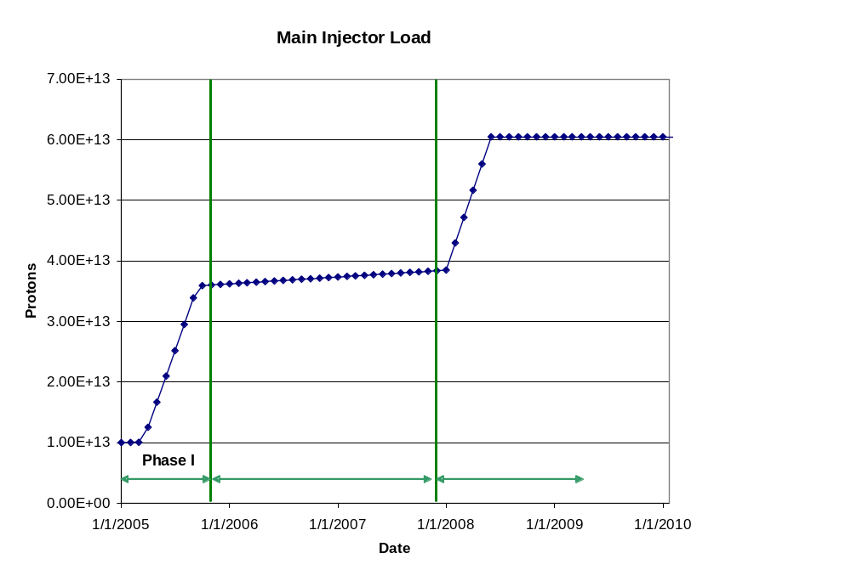
Main Injector Loading (cont’d)
Major Improvements:
  Large Aperture Quads (2005 shutdown)
  Loss monitoring and collimations system (TBD)
  Multi-batch operation
  Dual PA upgrade (??)
Performance
  2 (pbar) + 5 Numi 5E12 batches @ 2 sec in 2005
  2 (pbar) + 9 NuMI 5.5E12
  Batches @ 2.2 sec in 2008

Slide 9
Main Injector RF Issues
The Main Injector Upgrade path remains the single largest uncertainty in the Proton Plan
  Might be possible to reach intensities of the current Plan without upgrades of any kind.
Towards a decision
  Proceed with two/PA prototype
  Proceed with systematic studies in the Main Injector
  Organize a workshop this summer
    Will consider the following
      Potential of feed forward system
      Potential and concerns with two PA solution
      New RF system proposals.
    Will coordinate needs of current plan, Stage II Plan, and Proton Driver
    Generate a perfomance/price table
  Goal: reach a decision for Stage I by end of FY05
In the mean time, the uncertainty in the budget limits what we can do in the plan.

Slide 10
Recent Scope Changes
Criteria to be in plan (one of following):
  Critical path to plan goals.
  Expensive (>$200K)
  Requires significant coordination across departments
Descoped:
  Instrumentation upgrades
    However, it is hoped we can pursue instrumentation upgrades within department budgets, now that the proton plan has absorbed some of the burden.
  Booster solid state RF
Added (proposed):
  Booster dump relocation
  New booster notcher
  Main Injector injection kicker mods
  Pbar extraction kicker mods
  Stage II working group

Slide 11
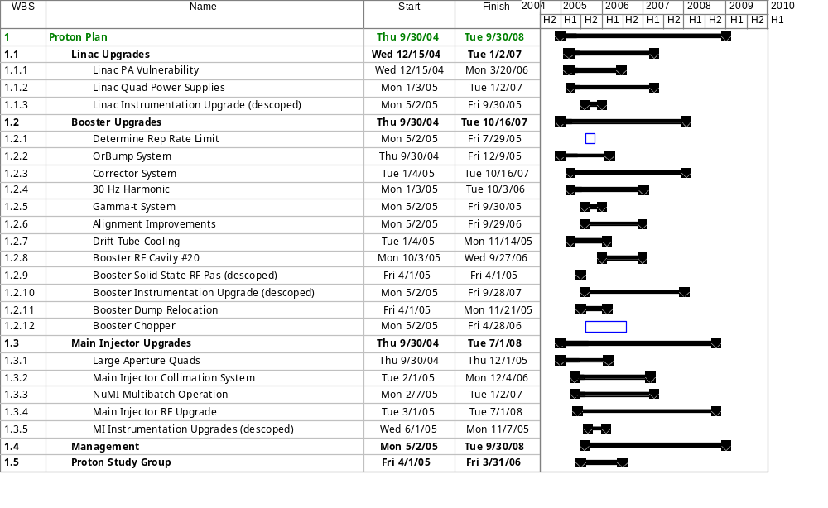
Proton Plan Schedule - Level 3 Summary
PP Inception 10/1/05

Slide 12

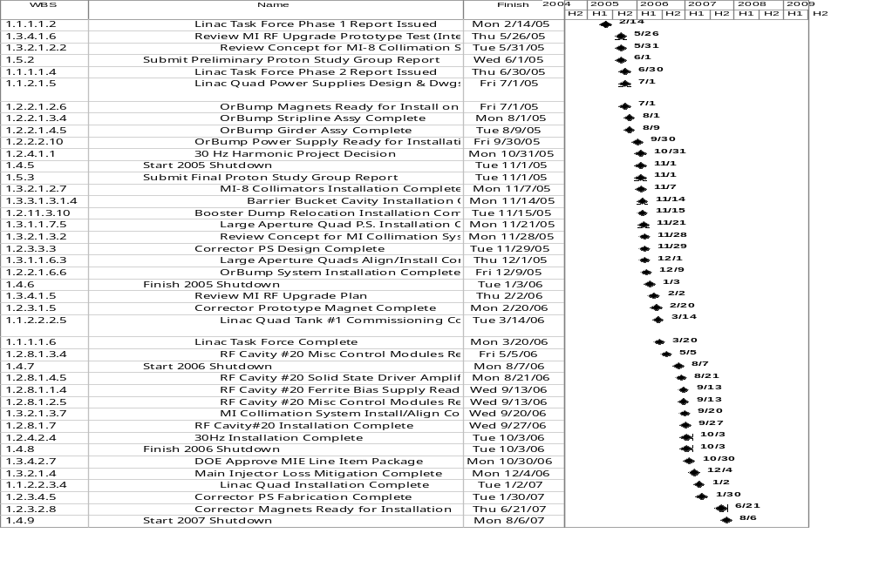
All Milestones

Slide 13
Proton Projections
Phases of Operation
  Phase I (now)
    Booster lattice distortions ameliorated
    Booster limited to 7.5Hz total repetition rate
    Main Injector limited to 4E13 protons (2+5 operation)
  Phase II (after 2005 shutdown)
    Injection bump (ORBUMP) replaced
    Drift tube cooling in Booster RF cooling finished
    Booster capable of 8-9Hz operation
    MI still limited to 2+5 operation
  Phase III (after 2007 shutdown)
    MI RF upgrade complete
    2+9 operation to NuMI

Slide 14
“Design” PoT from the document
 | Booster Batch Size | Main Injector Load | Cycle Time | MI Intensity | Booster Rate* | Total Proton Rate | Annual Rate at end of Phase
 |  | (AP + NuMI) | (sec) | (protons) | (Hz) | (p/hr) | NuMI | BNB
Actual Operation
July, 04 | 5.0E+12 | 1+0 | 2.0 | 0.5E+13 | 5.1 | 0.8E+17 | 0 | 3.3E+20
Proton Plan
Phase I | 5.10E+12 | 2+1→2+5 | 2.0 | 3.6E+13 | 6.3 | 1.0E+17 | 2.0E+20 | 1.5E+20
Phase II | 5.3E+12 | 2+5 | 2.0 | 3.7E+13 | 7.5 | 1.2E+17 | 2.2E+20 | 2.8E+20
Phase III | 5.50E+12 | 2+9 | 2.2 | 6.0E+13 | 8.3 | 1.5E+17 | 3.4E+20 | 2.2E+20
Beyond Scope of Present Plan
11 Hz | 5.50E+12 | 2+9 | 2.2 | 6.1E+13 | 11.0 | 2.0E+17 | 3.4E+20 | 5.0E+20

Slide 15
Controls Issues (in plan)
Linac
  (none)
Booster
  New Corrector System
    48 sub-periods x (2 dipoles + 2 quads + 2 sext) = 144 channels
    Dipoles controlled by individual ramps
    Quad and sextupole control TBD
    Installed 2007 shutdown.
Main Injector
  Collimator System (motion)
    MI-8: 1V + 1H “palmer”-style collimator
    MI ring: 1V+1H scraping collimators+4(??) booster-style secondary collimators (each with H+V only, no pitch or yaw).

Slide 16
Controls Issues (out of plan)
Linac (well under way)
  Issues
    No high speed digitization on Low energy Linac
    Only 1/3 of BPM’s instrumented
  Plan
    Instrument ~35 unused BPM’s
    Add ~8 channels * 10 MHz digitizers to each of the five stations in the Low Energy Linac low energy Linac
Booster
  Issues
    Booster instrumentation out of date
    Throughput incompatible with automated monitoring
    BPM readout system becoming difficult to service.
  Plan
    Short term (this year+next)
      Add 4 (128 channel) HRM crates worth of general digitization.
    Longer term (2005 or 2006)
      Replace ~100 BPM channels with HRM-based (??) solution.

Slide 17
Controls (out of plan, cont’d)
Main Injector
  Issues
    Monitoring beam quality in MI-8 Line
  Plan
    Install seven stations of NuMI-style foil planes
    Readout should connect to existing SWIC scanners (??)
    Motor control will require some modification.
  Note:
    Ongoing MI BPM/BLM upgrades part of Run II plan

