Slide 1
Proton Plan
Eric Prebys, FNAL Accelerator Division

Slide 2
Proton Plan Charge
Develop a plan for a set of upgrades and operational improvements to maximize proton delivery to:
  NuMI beamline (120 GeV from MI)
  Booster Neutrino Beam (BNB) (8 GeV from Booster)
(Original) Goal: complete the upgrades over the next 3 years, and operate through 2015 or beyond
  This plan precedes the Proton Driver replacement of the existing Proton Source (Linac+Booster).
  We are currently refining our plans in the wake of the BTeV cancellation.
Develop the budget and timeline for these improvements
Estimate projected proton delivery (PoT) to both beam lines

Slide 3
Management Organization
Accelerator Projects
Jeff Spalding (Head)
Bruce Baller (Deputy)
Project Support Team
(Bruce Baller), Leader
Ken Domann
Ann Nestander
Jeff Sims
Alan Wehmann
Proton Plan
Eric Prebys, PM
Jeff Sims, Deputy
Run II Upgrades
Pushpa Bhat, PM
Mike Martens (Deputy)
Benefit from experiences with the Run II plan
Project support team:
  Resource-Loaded Schedule (MS Project) – Domann
  Accounting - Cobra interface to Lab’s system - Nestander
  Project management support – Sims
  Web and documentation support - Wehmann

Slide 4
Context: Staged Approach to
Neutrino Program
Stage 0 (now):
  Goal: deliver 2.5E13 protons per 2 second MI cycle to NuMI (~2E20 p/yr
  Deliver 1-2E20 protons per year to Booster Neutrino Beam (currently MiniBooNE)
Stage 1 (~2008):
  A combination of Main Injector RF improvements and operational loading initiatives will increase the NuMI intensity to 4-5E13 protons per 2.2 second cycle (~3E20 p/yr)
  This will increase by ~20% as protons currently used for pbar production become available
  It is hoped we can continue to operate BNB at the 2E20 p/yr level during this period.
Stage 2 (post-collider):
  Consider (for example) using the Recycler as a preloader to the Main Injector and reducing the Main Injector cycle time
  The exact scope and potential of these improvements are under study
Stage 3 (proton driver)
  Main Injector must accommodate 1.5E14 protons every 1.5 seconds
  NuMI beamline and target must also be compatible with these intensities.

Slide 5
Limits to Proton Intensity
Total proton rate from Proton Source (Linac+Booster):
  Booster batch size
    Typical ~5E12 protons/batch
  Booster repetition rate
    15 Hz instantaneous
    Currently 7.5Hz average (limited by injection bump and RF cooling)
  Beam loss
    Damage and/or activation of Booster components
    Above ground radiation
Total protons accelerated in Main Injector:
  Maximum main injector load
    Six “slots” for booster batches (3E13)
    Up to ~11 with slip stacking (5.5E13)
    RF stability limitations (currently ~4E13)
  Cycle time:
    1.4s + loading time (1/15s per booster batch)
Operational Limit

Slide 6
Plan Strategy
See document: BEAMS-DOC-1441 (11/09/04) at http://beamsdocs.fnal.gov/cgi-bin/public/DocDB/DocumentDatabase
Increase the proton delivery from the Booster (to both NuMI and BNB)
  Increase acceptance by improving orbit control and beam quality
  Increase maximum average Booster repetition rate
Increase the beam intensity in the Main Injector for NuMI
  Main Injector multi-batch operation
  Slip stacking in Main Injector (probably requires RF upgrade)
Improve operational reliability
  Alleviate 7835 Problem
  Linac quad supplies

Slide 7
Current Budget Guidance
After the cancellation of BTeV, we have the following budget guidance (M&S+SWF):
This results in a scenario very close to the “delayed” scenario in the original document.
 | FY05 | FY06 | FY07 | FY08 | Total
Present Guidance | 7327 | 7845 | 6915 | 6116 | 28203

Slide 8
Recent Scope Changes
Criteria to be in plan (one of following):
  Critical path to plan goals.
  Expensive (>$200K)
  Requires significant coordination across departments
Descoped:
  Instrumentation upgrades
    However, it is hoped we can pursue instrumentation upgrades within department budgets, now that the proton plan has absorbed some of the burden.
  Booster solid state RF
Added (proposed):
  Booster dump relocation
  New booster notcher
  Main Injector injection kicker mods
  Pbar extraction kicker mods
  Stage II working group

Slide 9
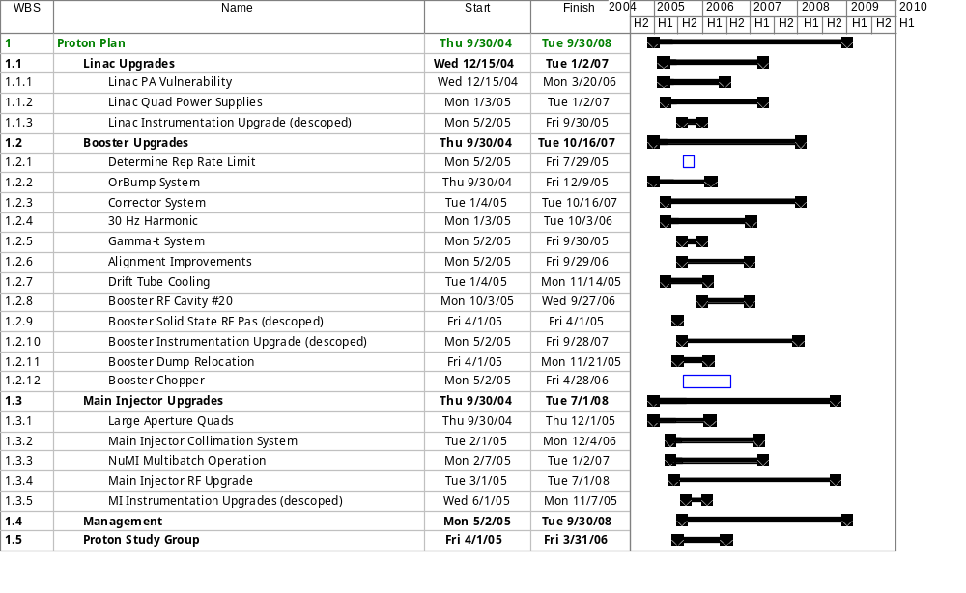
Proton Plan Schedule - Level 3 Summary
PP Inception 10/1/05

Slide 10
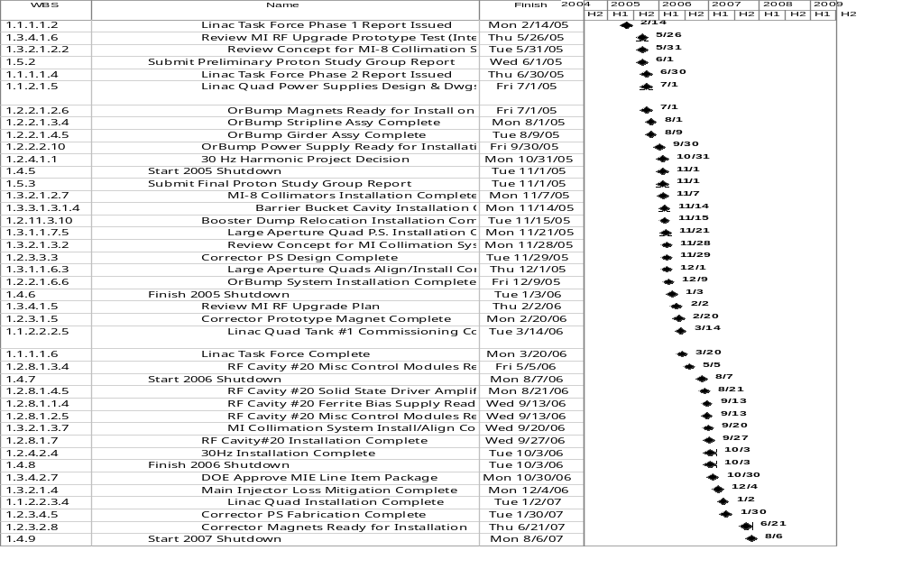

All Milestones

Slide 11
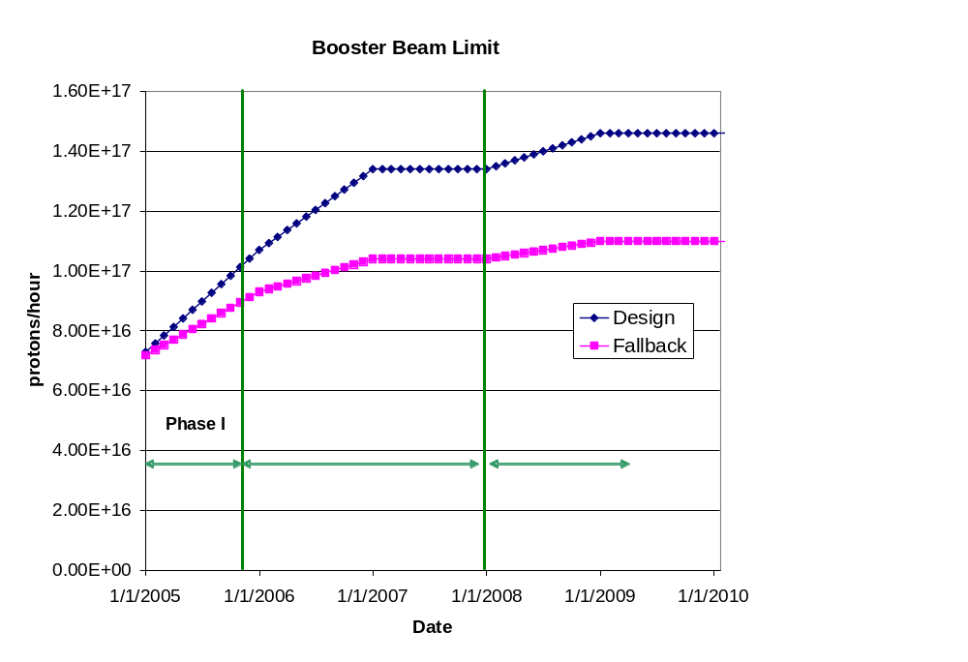
Booster Throughput
Major Improvements:
  New ORBUMP system (2005 shutdown)
  Relocate L13 dump to MI-8 line (2005 shutdown)
  New corrector system (2007)
  19th and 20th cavities added
Performance
  Rep rate (after 2005)
    7.5 Hz -> 8-9 Hz
  Total protons (by end 2008)
    8E16 pph -> 1.45E17 pph
  Batch size (by end 2008):
    5E12 -> 5.5E12
~7E20 p/yr

Slide 12
200 MHz Power Tube (7835) Situation
The 7835’s have been a historical weak spot in the complex
  Original technology
  Made by one company (Burle) which has had major quality control issues
  Often been forced to borrow spares from ANL, LANL, and BNL to keep program going.
The Proton Plan includes a working group to evaluate the 7835 situation
  Short term
    Maximize delivery of tubes to provide a two year supply of spares by end of 2006
    Determined best way was a single, large order
  Longer term
    Generate a plan should the supply of 7835’s cease
      Build them ourselves?
      New tube?
      Multibeam 200 MHz klystron?
      New low energy linac?
    These solutions will be beyond the scope of this plan, but we want to have them in place by 7/1/05

Slide 13
Recent Developments with Burle
Burle has been sold!!!!
  Buyer still confidential, but “foreign”, so must be approved by the government
  Rumored to “sort of” have “something to do” with “tubes” already
    might mean test tubes, tube socks, tube tops, etc.
  Must continue to support coaxitron for the Navy until ~2020
  In light of that, it is claimed that we are still profitable.
  We will keep our fingers crossed.
Present spares: 4 (+1 high hour tube)
Current delivery schedule (21 total):
  APR-05: 1
  MAY-05: 3
  JUN-05: 3
  JUL-05: 2
  AUG-05: 0
  SEP-05: 2
  OCT-05: 2
  NOV-05: 2
  DEC-05: 2
  JAN-06: 2
  FEB-06: 2
Standard order (4 new + 5 rebuilds)
Proton Plan order
(all new)

Slide 14
Main Injector Loading
Initial NuMI operation (“2+5”):
  Two batches are slip stacked for antiproton production
  Five more batches loaded for NuMI
  All are accelerated together
Ultimate NuMI operation (“2+9”):
  Five batches will be loaded into the Main Injector, leaving one empty slot
  Six more batches will be loaded and slipped with the first to make two for antiproton production and 9 for NuMI
  This may exceed the capacity of the current RF system

Slide 15
Main Injector RF (1.03.04)
The Main Injector Upgrade path remains the single largest uncertainty in the Proton Plan
  Might be possible to reach intensities of the current Plan without upgrades of any kind.
  Represents ~half the budget!!!
Towards a decision
  Proceed with two/PA prototype
  Proceed with systematic studies in the Main Injector
  Organize a workshop this summer
    Will consider the following
      Potential of feed forward system
      Potential and concerns with two PA solution
      New RF system proposals.
    Will coordinate needs of current plan, Stage II Plan, and Proton Driver
    Generate a perfomance/price table
  Goal: reach a decision for Stage I by end of FY05

Slide 16
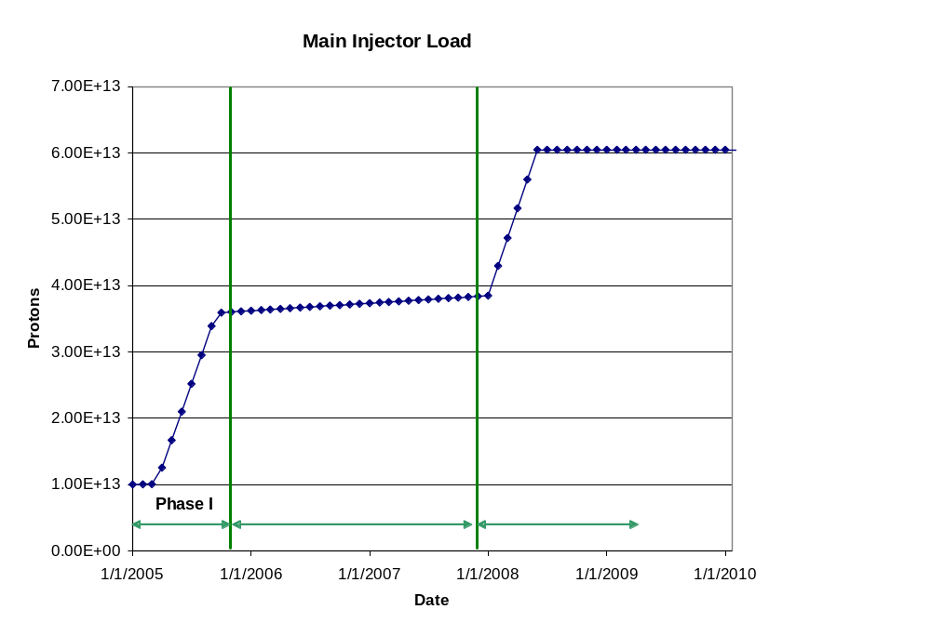
Main Injector Loading (cont’d)
Major Improvements:
  Large Aperture Quads (2005 shutdown)
  Loss monitoring and collimations system (TBD)
  Multi-batch operation
  Dual PA upgrade (??)
Performance
  2 (pbar) + 5 Numi 5E12 batches @ 2 sec in 2005
  2 (pbar) + 9 NuMI 5.5E12
  Batches @ 2.2 sec in 2008

Slide 17
Major Projects for 2005 Shutdown
Linac
  New pulsed power supplies for one tank
Booster
  New injection bump (ORBUMP) system
  Relocate Long 13 dump to MI-8 line
Main Injector
  Install seven large aperture quads

Slide 18
Proton Projections
Phases of Operation
  Phase I (now)
    Booster lattice distortions ameliorated
    Booster limited to 7.5Hz total repetition rate
    Main Injector limited to 4E13 protons (2+5 operation)
  Phase II (after 2005 shutdown)
    Injection bump (ORBUMP) replaced
    Drift tube cooling in Booster RF cooling finished
    Booster capable of 8-9Hz operation
    MI still limited to 2+5 operation
  Phase III (after 2007 shutdown)
    MI RF upgrade complete
    2+9 operation to NuMI

Slide 19
“Design” PoT from the document
 | Booster Batch Size | Main Injector Load | Cycle Time | MI Intensity | Booster Rate* | Total Proton Rate | Annual Rate at end of Phase
 |  | (AP + NuMI) | (sec) | (protons) | (Hz) | (p/hr) | NuMI | BNB
Actual Operation
July, 04 | 5.0E+12 | 1+0 | 2.0 | 0.5E+13 | 5.1 | 0.8E+17 | 0 | 3.3E+20
Proton Plan
Phase I | 5.10E+12 | 2+1→2+5 | 2.0 | 3.6E+13 | 6.3 | 1.0E+17 | 2.0E+20 | 1.5E+20
Phase II | 5.3E+12 | 2+5 | 2.0 | 3.7E+13 | 7.5 | 1.2E+17 | 2.2E+20 | 2.8E+20
Phase III | 5.50E+12 | 2+9 | 2.2 | 6.0E+13 | 8.3 | 1.5E+17 | 3.4E+20 | 2.2E+20
Beyond Scope of Present Plan
11 Hz | 5.50E+12 | 2+9 | 2.2 | 6.1E+13 | 11.0 | 2.0E+17 | 3.4E+20 | 5.0E+20
Each phase evaluated ~one year after associated improvements complete

Slide 20
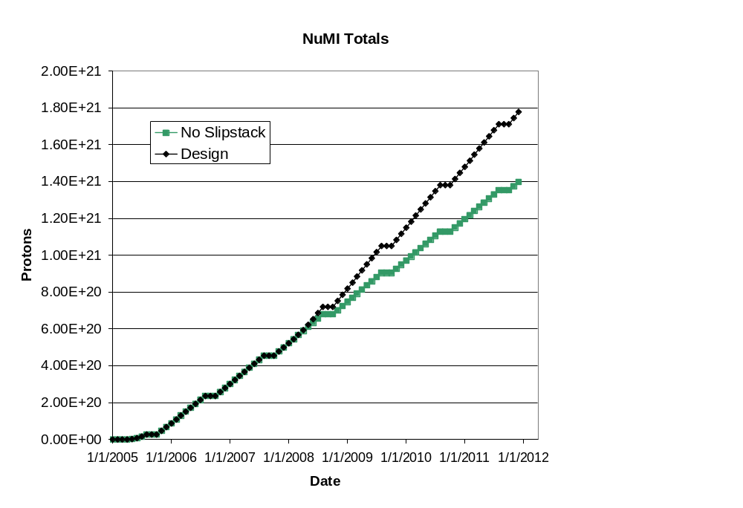
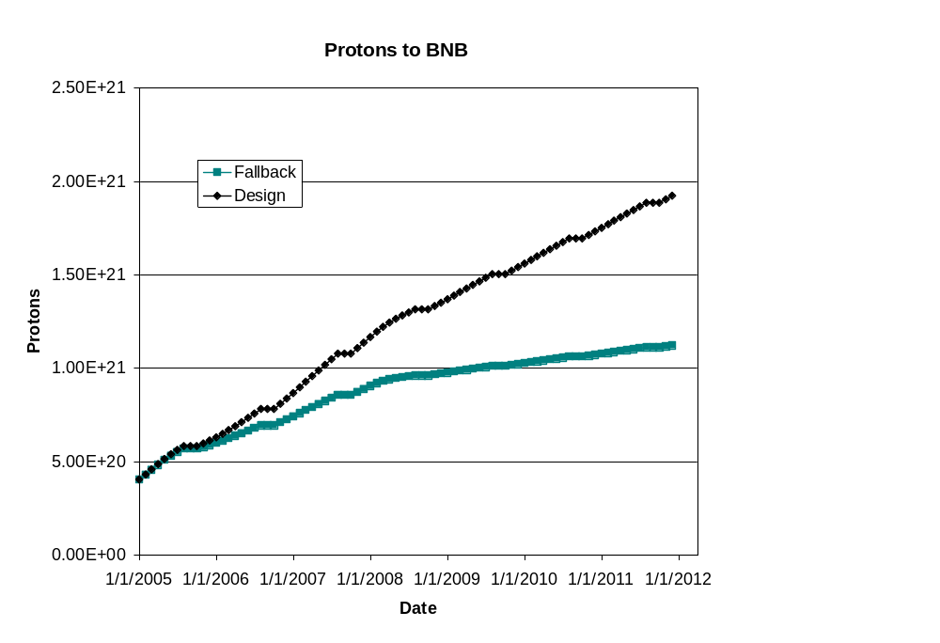
Long Term Projections
Note! Does NOT reflect NuMI’s recent troubles!
This turn-on is slower than in document
NuMI fallback = slip-stacking fails
BNB fallback = poor performance of Booster aperture upgrades
BNB only runs during shot setup

Slide 21
How are we doing so far?
In light of the NuMI target failure, it’s not meaningful to analyze separate NuMI and BNB progress separately.
After summarizing initial NuMI performance, we will concentrate on total proton delivery:
  Hourly rates: compare actual total rate to pbar+BNB+NuMI projections.
  Integrated total: compare MiniBooNE actual to BNB+NuMI projections.
Except for shutdown dates, these have not changed for 2005 since the November document.

Slide 22
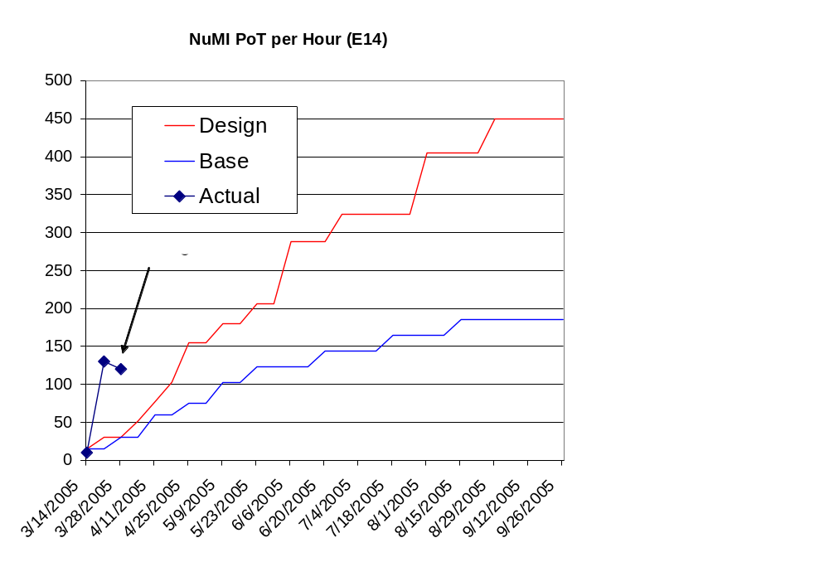
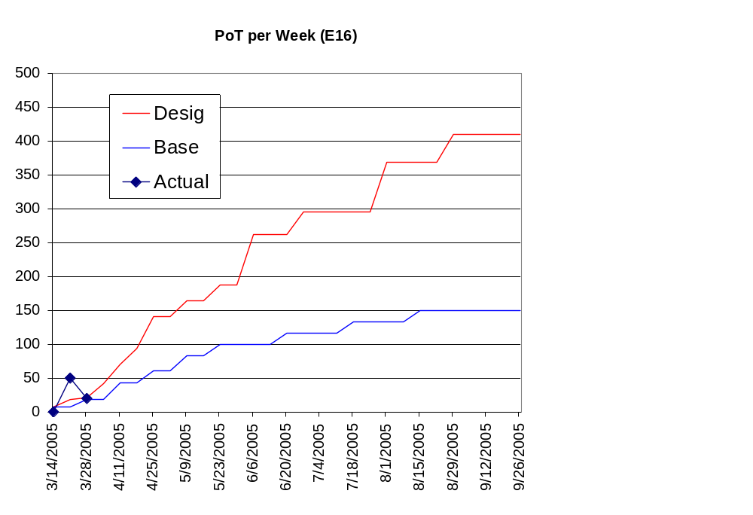
Initial NuMI Progress

Slide 23
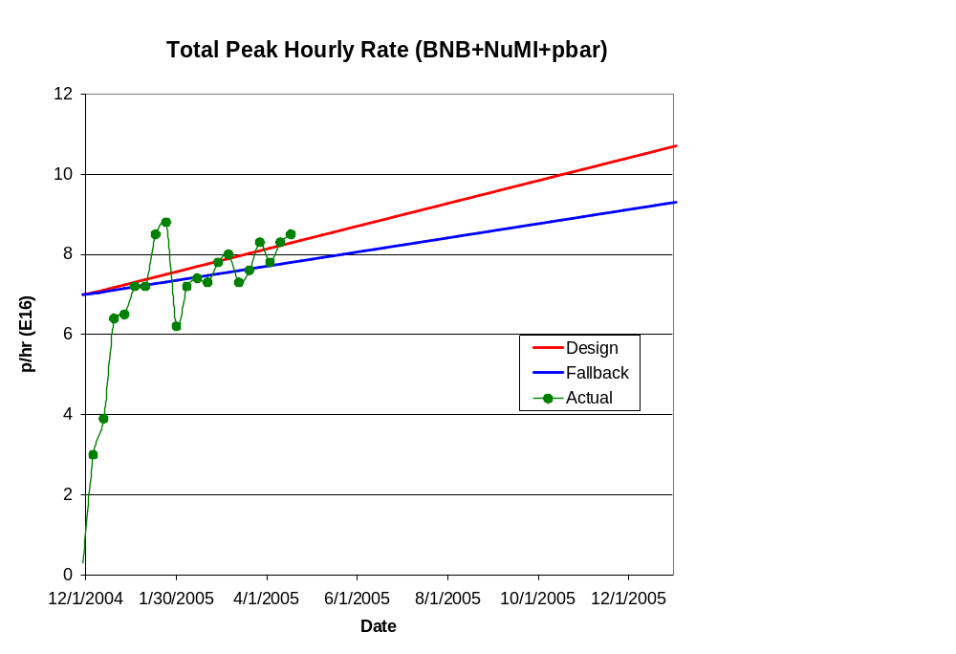
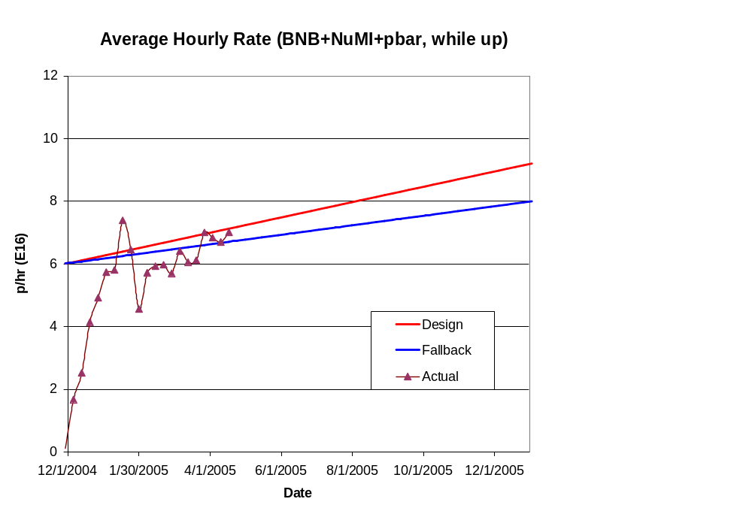
Hourly Proton Rate
Improved cogging stability

Slide 24
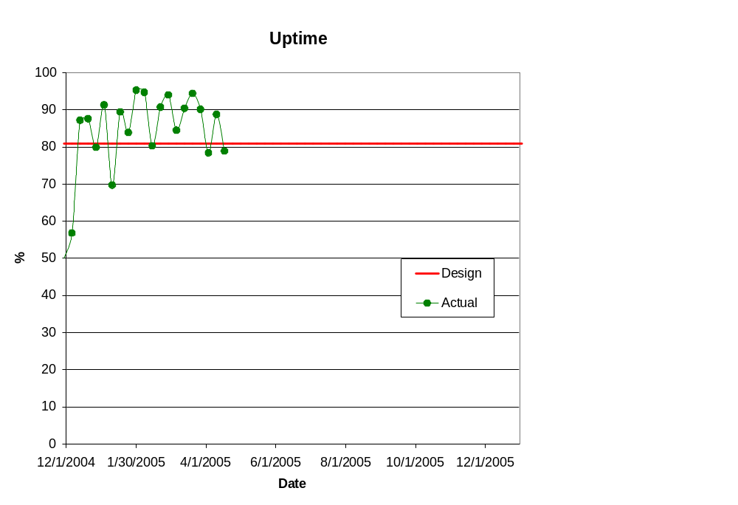
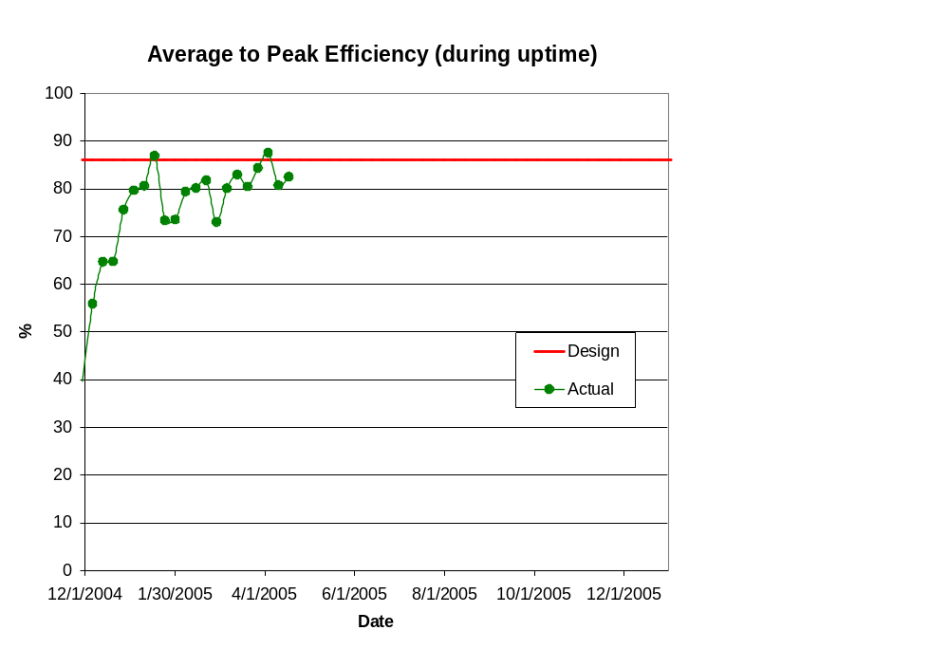
Efficiencies

Slide 25
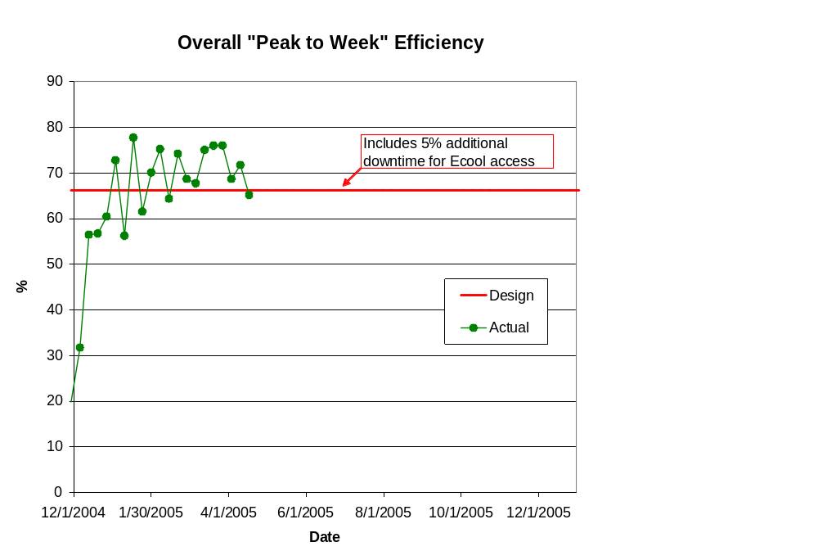
Overall “Peak to Week” Efficiency

Slide 26
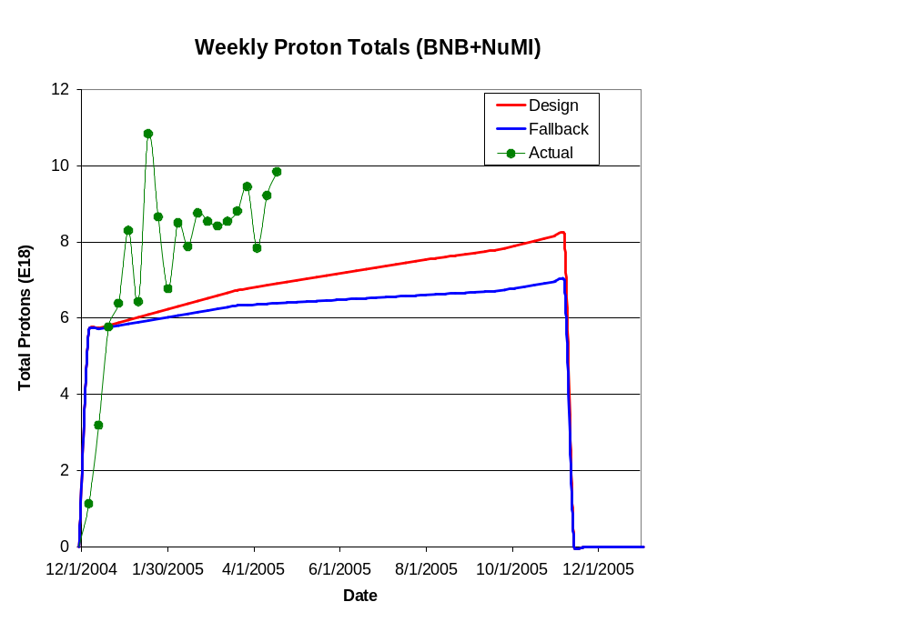
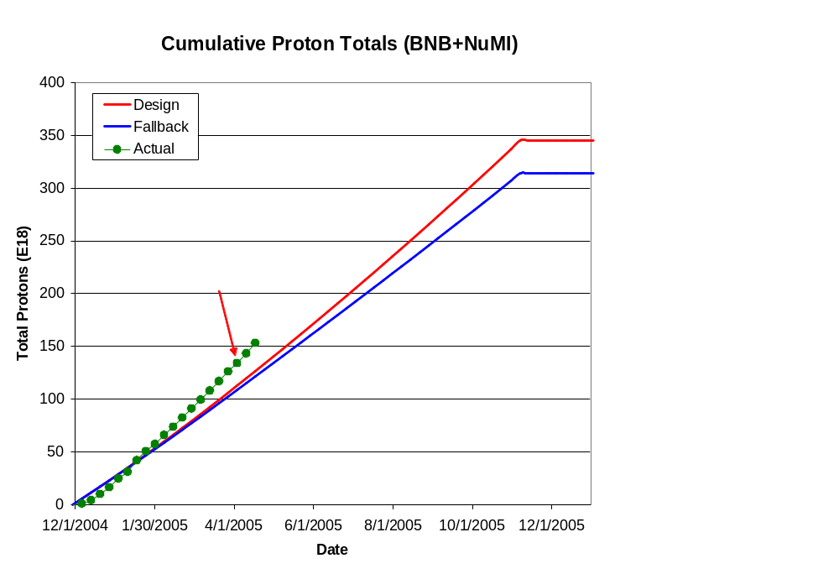
Integrated Delivery (BNB)

Slide 27
After the Collider
A number of suggestions have been made for ways to maximize proton output after Tevatron operation ceases:
  Stage II in my earlier slide
While these are beyond the scope of the present plan, we have begun a working group (WBS 1.5) to investigate them and present a report to the Division Head on June 1.

Slide 28
Summary
The Proton Plan encompasses accelerator improvements to maximize protons to NuMI and the 8 GeV line over the next 10 years
The implementation of the Plan will provide
  ~7E16 p/hr to NuMI (~3E20 p/yr)
  Up to ~4E16 p/hr (1-2E20 p/yr) for the 8 GeV line
We are studying concepts for further improvements in the post collider era (for example using the Recycler as a preloader)
We are working diligently toward a properly baselined, resource loaded project and schedule.

