Slide 1
Staged Neutrino Program
Current Proton Plan
  A combination of Main Injector RF improvements and operational loading initiatives will increase the NuMI intensity to 4-5E13 protons to NuMI per 2.2 second cycle (~3E20 p/yr).
  Ultimately 320 kW to NuMI (400 kW w/o pBar)
  Runs through end of collider program
ANU (“Accelerator NuMI Upgrades”, presently combined with NoVA as per DOE directive)
  Retask Recycler as a preloader to save proton loading time to the Main Injector
  ~700 kW to NoVA
Project X (or equivalent) HINS
  New 8 GeV proton Linac to Main Injector
  ~2 MW to NuMI
  Centerpiece of an “intensity-based” program
Scope of this talk

Slide 2
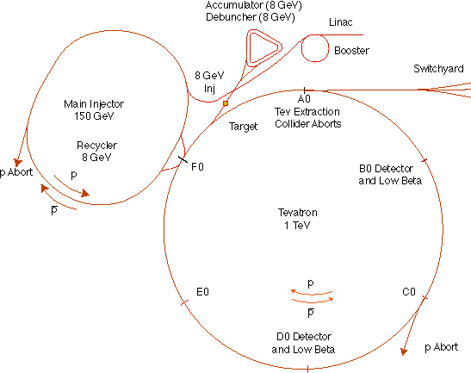
The Fermilab Accelerator Complex
MinBooNE
NUMI
=Proton Plan System
= Proton Plan Customer
=ANU system
= ANU Customer

Slide 3
Limits to Proton Intensity
Total proton rate from Proton Source (Linac+Booster):
  Booster batch size
    ~4-5E12 protons/batch, depending on beam quality required.
  Booster repetition rate
    15 Hz instantaneous
    Currently ~9Hz, limited by RF system.
  Beam loss
    Damage and/or activation of Booster components
    Above ground radiation
Total protons accelerated in Main Injector:
  Maximum main injector load
    Six “slots” for booster batches (3E13)
    Up to ~11 with slip stacking (4.5-5.5E13)
    Beam stability (RF issues)
    Beam loss concerns
  Cycle time:
    1.4s + loading time (1/15s per booster batch)
Historically our biggest worry
Critical path for NuMI/MINOS
Reson for using Recycler (ANU)

Slide 4
Proton Plan Charge
Develop a plan for a reasonable set of improvements and operational initiatives to maximize proton delivery to NuMI and the Booster Neutrino Beam (BNB) over the next ten years or so.
Estimate the budget and timeline for these improvements.
Estimate proton delivery to both beam lines if the Plan proceeds on schedule.
Very important

Slide 5
Significant Elements of Proton Plan
Linac
  Stockpile two year supply of spare 200 MHz power amplifier tubes (7835’s), in the event of an interruption in supply
  Characterize and improve Low Energy Linac Low Level RF
Booster:
  Replace and reconfigure injection bump (ORBUMP) system.
  Relocate 8 GeV dump from Booster tunnel to MI-8 transfer line
  Make Booster robust to 9 Hz, and understand requirements to go to 15 Hz
  Design, build, and install new corrector system
    Installed in ¼ of locations first
Main Injector:
  Replace seven quadrupoles with increased aperture versions, to reduce injection and extraction losses.
  Operationally develop multi-batch and multi-batch slip stacked operation
  Design and install collimation system, both in the MI-8 line and in the MI ring
  Modify injection kicker to allow multi-batch slip stacked operation
  Characterize and improve to RF system, to support high intensity operation.
Red = complete

Slide 6
Major achievements in last year
Booster:
  Correctors
    Installed ¼ of the new correctors, and fully integrated them into operation.
    Remainder of correctors will be complete in July, to be installed in the 2009 shutdown.
  Maintained sufficient beam quality to support 11 batch slip stacking in Main Injector while still delivering beam to 8 GeV program (MiniBooNE/SciBooNE)
Main Injector
  Installed collimation system needed to absorb longitudinal loss from 11 batch slip stacking
  Implemented 11 batch slip stacking (2-> pBar, 9-> NuMI) as standard operation.

Slide 7
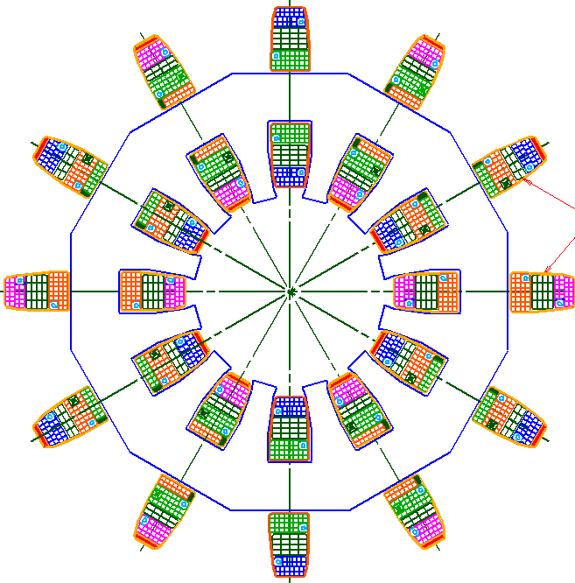
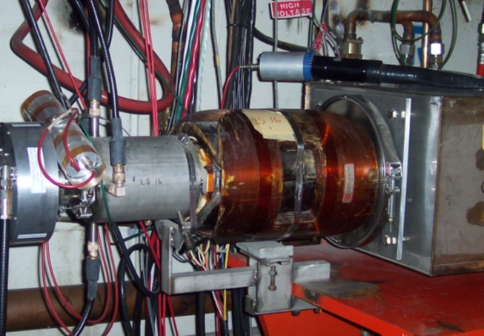
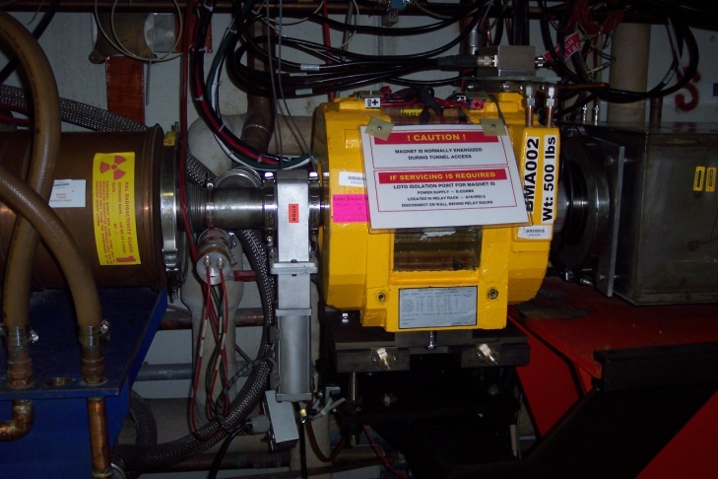
Booster Correctors
Installed ¼ of the new Booster corrector system (12
  Stronger
  Ramped quadrupoles and sextupoles at every period.
Remainder of system will be completed in July and installed in the 2009 shutdown.

Slide 8
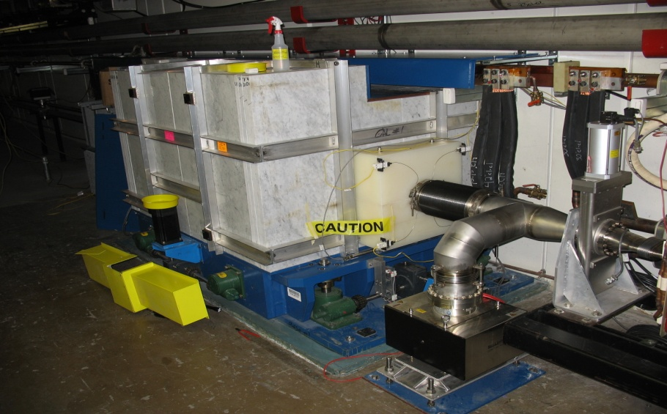
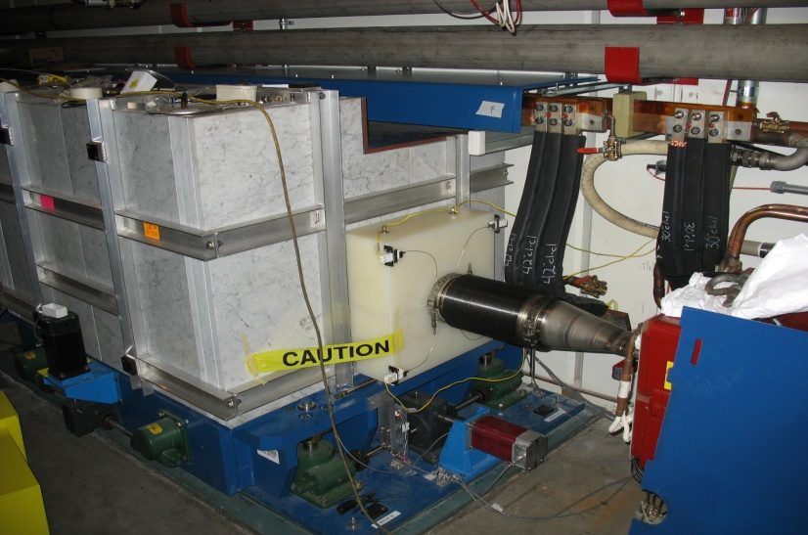
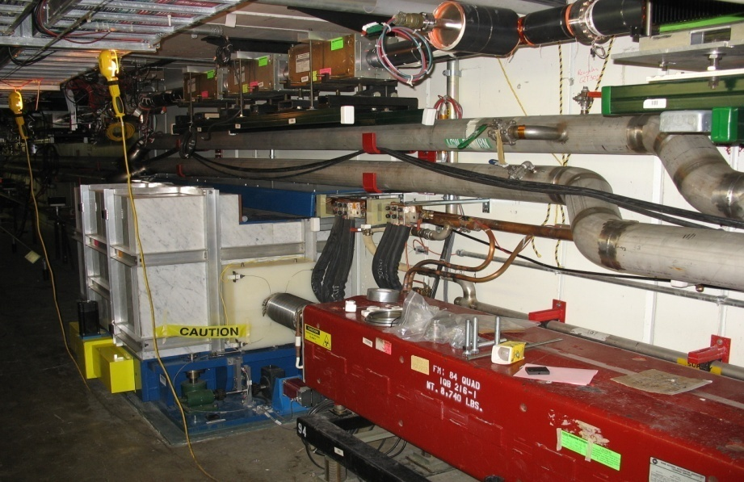
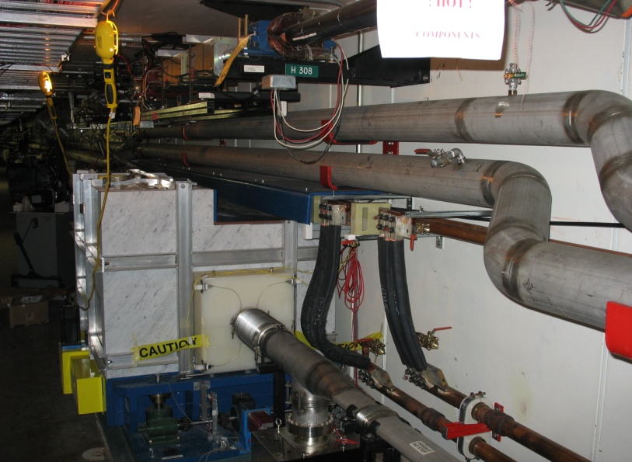
Main Injector collimation system
301
303
Required significant rerouting of services
307
309

Slide 9
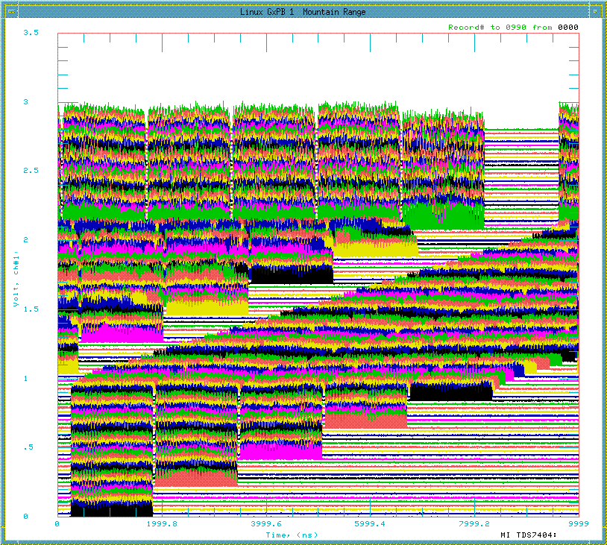
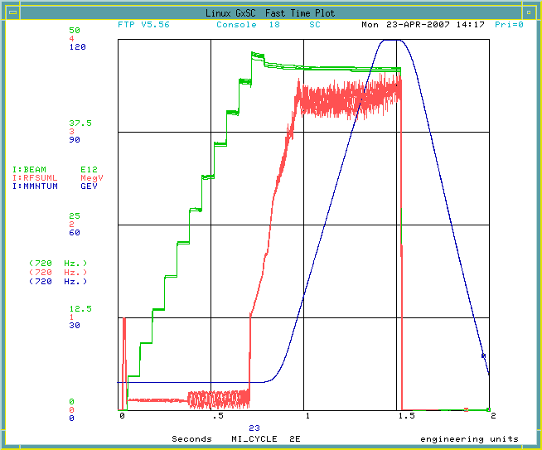
11 batch slip stacking now standard operation!!
Numi (11)
Record:
  4.63E13 protons to MI abort at 120 GeV.
  92% efficiency
Goal:
  4.5E13 protons to 120 GeV (NuMI + pBar)
  95% efficiency (Collimators)
11μsec (1 revolution)

Slide 10
Proton Plan Projections
The Proton Plan represents the first attempt to realistically estimate total proton output at Fermilab
  First projections were in 2004, and have been refined since.
Effects considered
  Rate and radiation limits to Booster
  Proton load and cycle time limits in Main Injector
  Linear ramp-up to see benefit of improvements
  Slip stacking efficiency
  Different Booster efficiency for cogged (pBar+NuMI) cycles and uncogged (BNB) cycles.
  Annual shutdowns (assume 2 mo/yr)
  Scale by uptimes and “average to peak” ratios outside of shutdowns (determined based on historic performance)

Slide 11
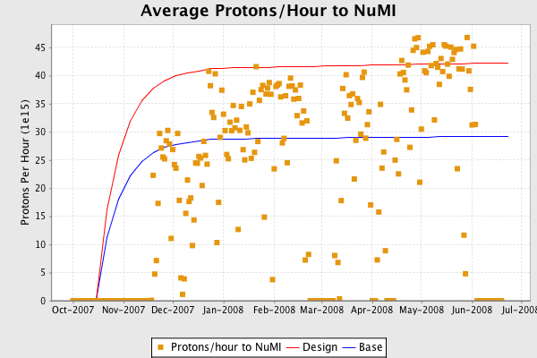
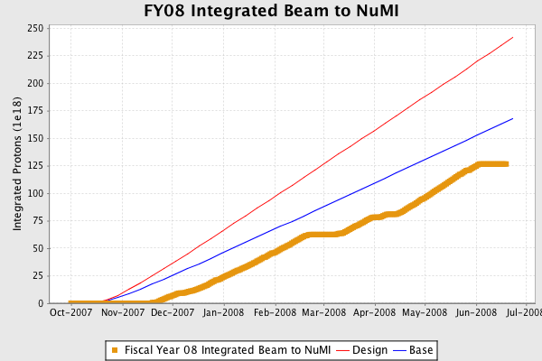
Beam to NuMI in FY08
Success of multibatch slip stacking
Down time dominated by horn problems
Total since 3/2005: 4.9E20 protons

Slide 12
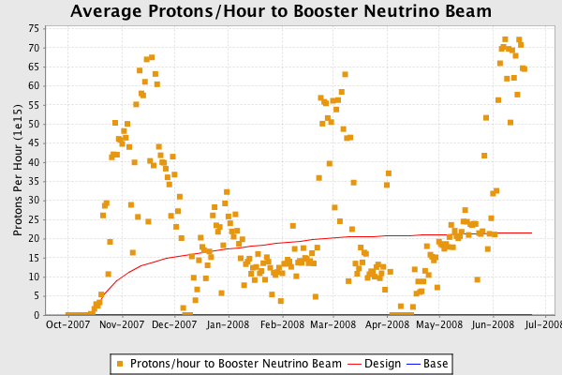
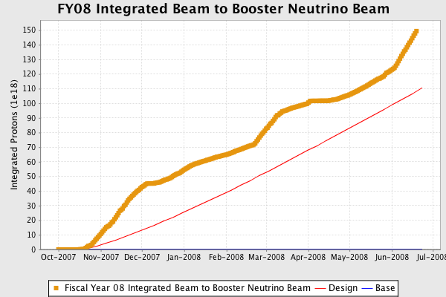
Beam to MiniBooNE/SciBooNE
NuMI has priority, so 8 GeV program gets the difference between the output capacity of the Booster and the acceleration capacity of the Main Injector
  Large uncertainty
  Blue base projection (slip stacking going well, Booster running badly) is NO beam to 8 GeV
Total since 10/2002: 10.9E20
  > 50% of all the protons Fermilab has ever produced (including NuMI)!
schaddenfreude

Slide 13
Remaining Proton Plan
Remaining Booster correctors
  Final magnets in production. Complete ~ July
  Install in 2008 shutdown
Linac Low Level RF
  Will stablize beam energy out of linac
  Prototype system tested on station 5 (last of 5)
  Will be adiabatically implemented over the next few months
Fast Booster “chopper/notcher”
  Will reduce beam loss due to extraction loss
  Being designed. Hope for 2008 shutdown
Main Injector “comb filters”
  Will allow maximum intensity in Main Injector
  Will be installed over the next year.

