Slide 1
Proton Plan
Eric Prebys, FNAL Accelerator Division

Slide 2
Charge
Develop a plan for a reasonable set of improvements and operational initiatives to maximize proton delivery to NuMI and the Booster Neutrino Beam (BNB) over the next ten years or so.
Estimate the budget and timeline for these improvements.
Estimate proton delivery to both beam lines if the Plan proceeds on schedule.
Note: this plan precedes the Proton Driver replacement of the existing Proton Source (Linac+Booster).

Slide 3
Management Re-organization
Accelerator Projects
Jeff Spalding (Head)
Bruce Baller (Deputy)
Project Support Team
(Bruce Baller), Leader
Ken Domann
Ann Nestander
Jeff Sims
Alan Wehmann
Proton Plan
Eric Prebys, PM
Jeff Sims, Deputy
Run II Upgrades
Pushpa Bhat, PM
Mike Martens (Deputy)
Project support team:
  Resource-Loaded Schedule (MS Project) – Domann
  Accounting - Cobra interface to Lab’s system - Nestander
  Project management support – Sims
  Web and documentation support - Wehmann

Slide 4
Staged Approach to
Neutrino Program
Stage 0 (now):
  Goal: deliver 2.5E13 protons per 2 second MI cycle to NuMI (~2E20 p/yr), limited by MI RF system.
  Deliver 1-2E20 protons per year to Booster Neutrino Beam (currently MiniBooNE)
Stage 1 (~2008):
  A combination of Main Injector RF improvements and operational loading initiatives will increase the NuMI intensity to 4-5E13 protons to NuMI per 2.2 second cycle (~3E20 p/yr).
  This will increase by ~20% as protons currently used for pbar production become available.
  It is hoped we can continue to operate BNB at the 2E20 p/yr level during this period.
Stage 2 (post-collider):
  In this phase, we will consider using the Recycler as a preloader to the Main Injector and possibly reducing the Main Injector cycle time.
  The exact scope and potential of these improvements are under study.
Stage 3 (proton driver)
  Main Injector RF must accommodate 1.5E14 protons every 1.5 seconds
  NuMI beamline and target must also be compatible with these intensities.

Slide 5
Limits to Proton Intensity
Total proton rate from Proton Source (Linac+Booster):
  Booster batch size
    ~5E12 protons/batch
  Booster repetition rate
    15 Hz instantaneous
    Currently 7.5Hz average (injection bump+RF)
  Beam loss
    Damage and/or activation of Booster components
    Above ground radiation
Total protons accelerated in Main Injector:
  Maximum main injector load
    Six “slots” for booster batches (3E13)
    Up to ~11 with slip stacking (5.5E13)
    RF stability limitations (currently ~4E13)
  Cycle time:
    1.4s + loading time (1/15s per booster batch)
Our biggest worry!

Slide 6
Plan Strategy
See full document: BEAMS-DOC-1441
Increasing the proton delivery from the Booster to NuMI and MiniBooNE
  Increase maximum average Booster repetition rate.
  Increase acceptance by improving orbit control and beam quality.
Increasing the beam intensity in the Main Injector for NuMI
  Main Injector multi-batch operation.
  Slip stacking in Main Injector (requires RF upgrade).
Improving operational reliability and radiation limitations
  Linac quad supplies
  Booster and Linac Instrumentation
  Booster RF Upgrade
  Alleviate 7835 Problem

Slide 7
Current Budget Guidance
After the cancellation of BTeV, we have the following budget guidance (M&S+SWF):
Most Likely Scenario
  Main Injector RF project and Booster Corrector System get delayed by one year, relative to the original plan.
  Booster RF Solid State PA upgrade deferred indefinitely.
 | FY05 | FY06 | FY07 | FY08 | Total
Present Guidance | 7327 | 7845 | 6915 | 6116 | 28203

Slide 8
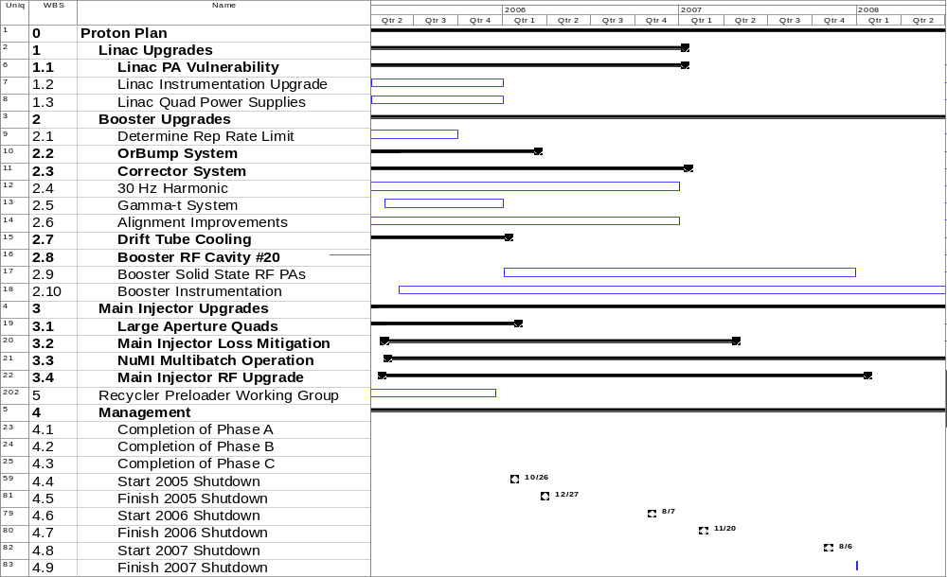
Existing Plan (not fully rescoped)
New

Slide 9
Resource-Loaded Schedule
Cost and Schedule Reporting
Building resource loaded schedule:
For several L3 projects the work is already ongoing (TD building Orbump, large aperture quads…)
  Budget codes established and capturing costs
Scope under development for some L3 projects (eg. MI RF proto phase then production)
  Developing milestones, strategy and decision points
  Will include estimates with large contingency as place-holders
Will use the same cost and schedule reporting tools as the Run II Upgrades
Reporting via monthly PMG
Change control similar to Run II Upgrades

Slide 10
Status of Major Work
Linac (1)
  (1.1) 7835 Task force
    Placed order for 12 extra spare tubes (two year supply) over the next two years
    Studying lifetime issues (filament current, etc)
    Formulating replacement plan
  (1.3) LEL quad power supplies
    Working on prototype, based on HEL supplies
Booster (2)
  (2.2) ORBUMP System
    Magnets:
      First magnet built and tested, proceeding with the rest
    Power Supply
      Procuring and assembling
  (2.3) Corrector System
    Conceptual design complete
    Working on detailed design
    Working on PS specs
  (2.4) 30 Hz
    Work Proceeding on Prototype

Slide 11
Status of Major Work (cont’d)
(3) Main Injector (except RF)
  (note that the BLM/BPM upgrades are under the Run II)
  (3.1) Large Aperture Quads
    In fabrication. Will be ready for 05 shutdown
  (3.2) Loss mitigation/collimator system
    Working group formed
    Identifying collimator candidates for MI-8
    Starting ring collimator system design based on Booster
  (3.3) Multi-batch operation
    Demonstrated maximum of 2.5E13 load to NuMI
    Demonstrated mixed mode (2+5) operation w/ 5 batches of 2E12 to NuMI

Slide 12
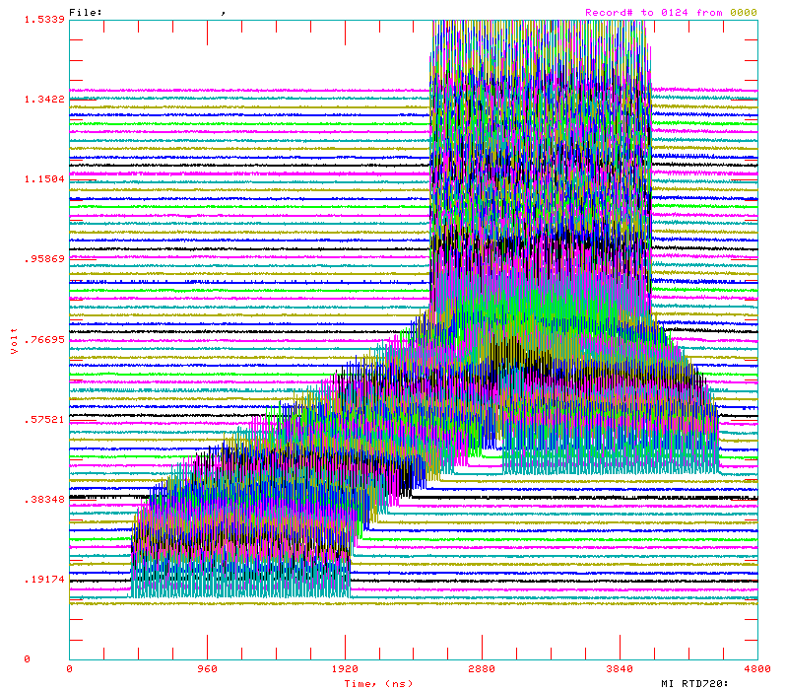
Review: Main Injector Loading
The Main Injector has six usable “slots”, into which Booster batches may be placed.
More batches may be loaded, using “slip stacking”, in which an initial batch in the Main Injector is accelerated such that a subsequent batch will be at a slightly different energy. The two will then drift together and can be captured as a single batch (with at least twice the longitudinal emittance).

Slide 13
Main Injector Loading
Initial NuMI operation (“2+5”):
  Two batches will be slip stacked for antiproton production.
  Five more batches will be loaded for NuMI
  All will be accelerated together.
Ultimate NuMI operation (“2+9”):
  Five batches will be loaded into the Main Injector, leaving one empty slot.
  Six more batches will be loaded and slipped with the first to make two for antiproton production and 9 for NuMI.
  This is beyond the capacity of the current RF system.

Slide 14
Main Injector RF
Our present system:
  Number of cavities: 18
  Total Power Available: 175 kW/cavity (single PA)
  Total Power dissipated: 58.6 kW/cavity
  Power available for acceleration: 116.4 kW/cavity
  Maximum acceleration rate: 200 GeV/s
In the absence of beam loading compensation, an RF system is stable until the energy expended in accelerating the beam is equal to the energy dissipated in the cavity.
Feed forward loops can increase this stability threshold
For our system
  Maximum guaranteed stable intensity: 3.3E13 protons
  With feed-forward: 4E13 likely
  Power limited intensity: 6.5E13 protons

Slide 15
Options
By adding an additional (175/2 – 58.6 =) 28.9 kW passive load to each cavity, we could ensure 87.5 kW of power for stable acceleration
  ~$2M
  4.9E13 protons/load limit
Each cavity has an additional port for a second PA, potentially giving 350 kW of total power.
  ~$12M
  9.8E13 protons/load in the most conservative case (175 kW power dissipation)
  Possibly higher with feedback loops

Slide 16
Main Injector RF in FY05 (3.4)
Build prototype cavity from existing spare
  Passive load:
    Existing port?
    Cut new port?
  Second PA
Carry out a series of studies in the Main Injector
  Determine effectiveness of feed-forward loops
  Determine optimal passive load and predict intensity limit for one- and two- PA scenarios
Refine cost estimate for passive load and PA upgrades.
Use this information to determine longer range plan.

Slide 17
Proton Projections
Phases of Operation
  Phase I (now)
    Booster lattice distortions ameliorated
    Booster limited to 7.5Hz total repetition rate
    Main Injector limited to 4E13 protons (2+5 operation)
  Phase II
    After 2005 shutdown
    Injection bump (ORBUMP) replaced
    Drift tube cooling in Booster RF cooling finished
    Booster capable of 8-9Hz operation
    MI still limited to 2+5 operation
  Phase III
    After 2007 shutdown
    MI RF upgrade complete
    2+9 operation to NuMI

Slide 18
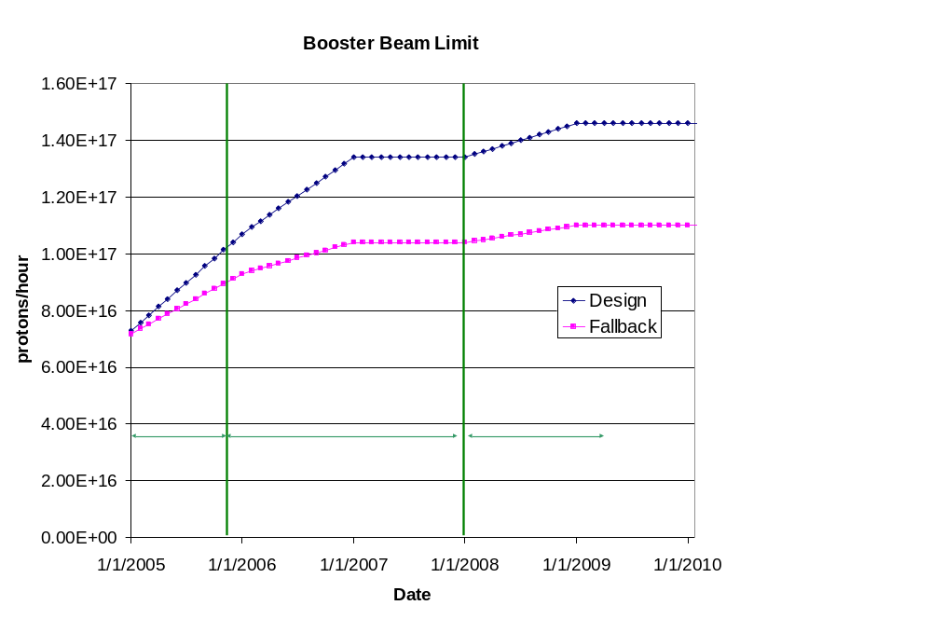
Predicted Peak Proton Intensity Limits
Demonstrated

Slide 19
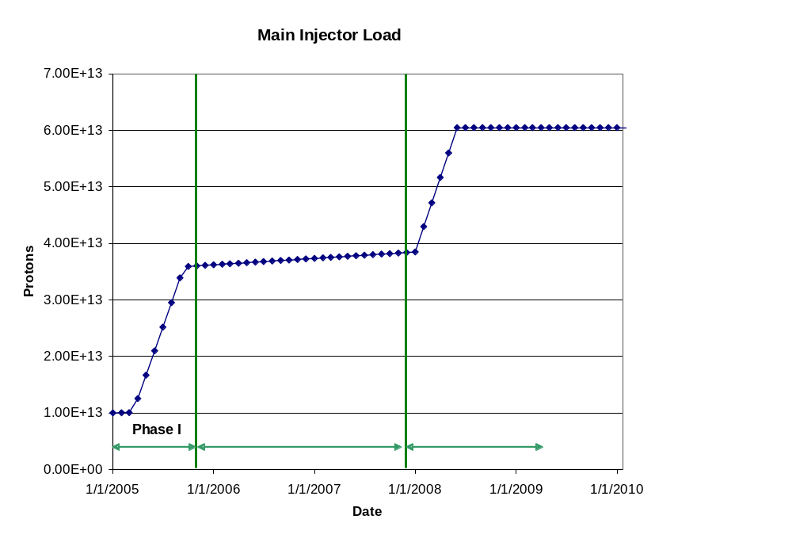
Main Injector Loading

Slide 20
“Design” PoT
 | Booster Batch Size | Main Injector Load | Cycle Time | MI Intensity | Booster Rate* | Total Proton Rate |  | Annual Rate at end of Phase
 |  | (AP + NuMI) | (sec) | (protons) | (Hz) | (p/hr) |  | NuMI | BNB
Actual Operation
July, 04 | 5.0E+12 | 1+0 | 2.0 | 0.5E+13 | 5.1 | 0.8E+17 | 0 |  | 3.3E+20
Proton Plan
Phase I | 5.10E+12 | 2+1→2+5 | 2.0 | 3.6E+13 | 6.3 | 1.0E+17 | 2.0E+20 |  | 1.5E+20
Phase II | 5.3E+12 | 2+5 | 2.0 | 3.7E+13 | 7.5 | 1.2E+17 | 2.2E+20 |  | 2.8E+20
Phase III | 5.50E+12 | 2+9 | 2.2 | 6.0E+13 | 8.3 | 1.5E+17 | 3.4E+20 |  | 2.2E+20
Beyond Scope of Present Plan
11 Hz | 5.50E+12 | 2+9 | 2.2 | 6.1E+13 | 11.0 | 2.0E+17 | 3.4E+20 |  | 5.0E+20

Slide 21
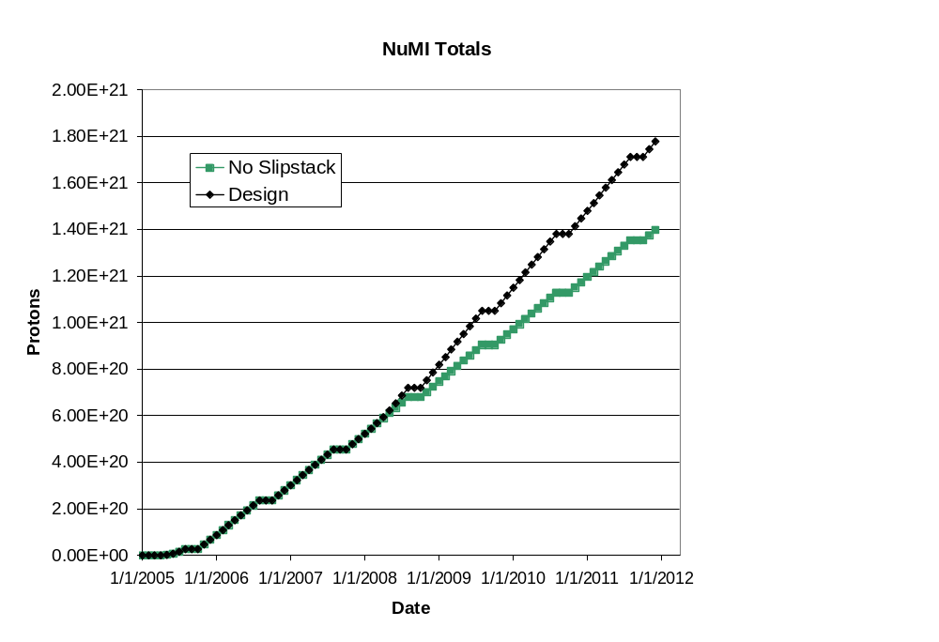
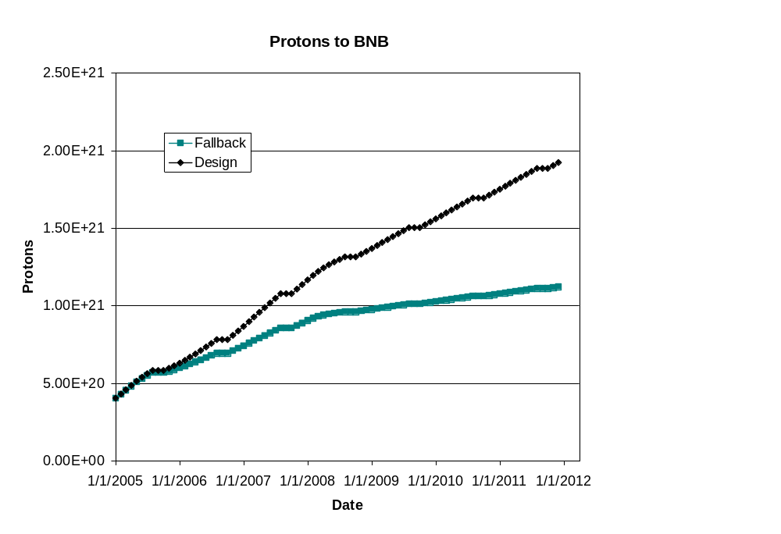
Projections (~“delayed” scenario in document)
This turn-on is slower than in document
BNB only runs during shot setup

Slide 22
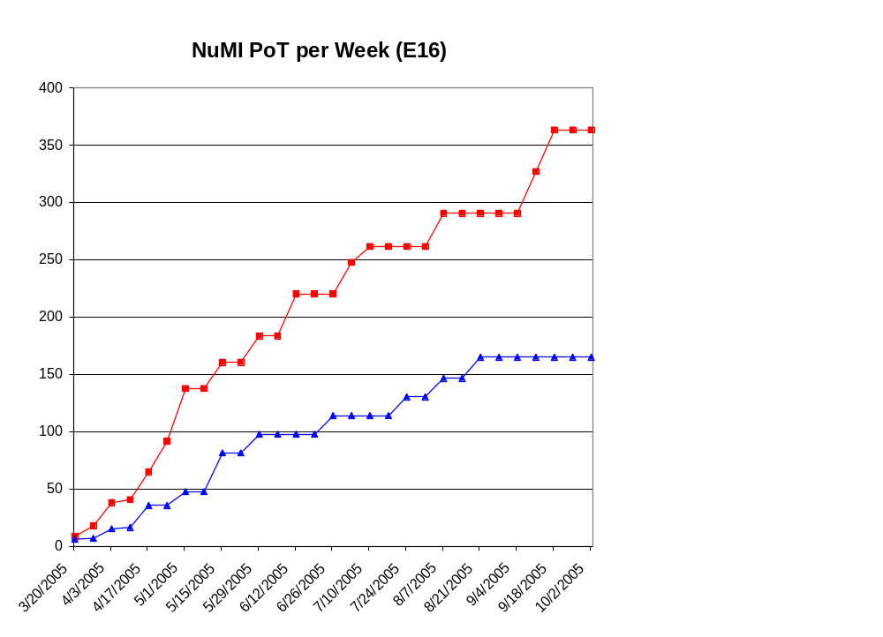
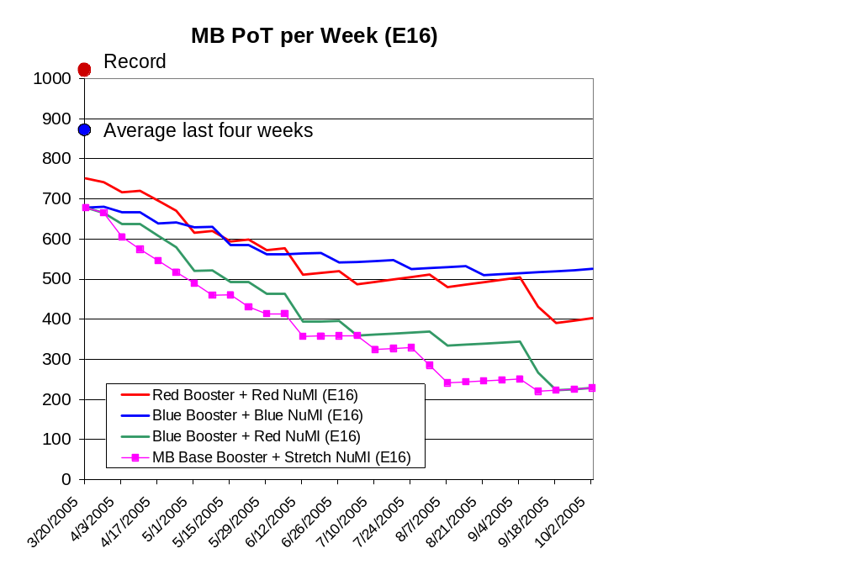
Proton Projections for FY05

Slide 23
Summary
The Proton Plan: accelerator improvements to maximize protons to NuMI and the 8 GeV line.
The implementation of the Plan will provide
  ~7E16 p/hr to NuMI (~3E20 p/yr)
  Up to ~4E16 p/hr (1-2E20 p/yr) for the 8 GeV line.
We are investigating concepts for further improvements in the post collider era, possibly involving the recycler.
A Resource-loaded schedule and cost and schedule tracking system are in development

