Slide 1
Proton Plan
Eric Prebys, FNAL Accelerator Division

Slide 2
Proton Plan Charge
Develop a plan for a reasonable set of improvements and operational initiatives to maximize proton delivery to NuMI and the Booster Neutrino Beam (BNB)
Estimate the budget and timeline for these improvements.
Estimate proton delivery to both beam lines if the Plan proceeds on schedule.
Note:
  This project precedes other work that must be done to support the NoVA program
  This project precedes a proton driver or other significant improvements to the complex that are under discussion.

Slide 3
Staged Approach to Neutrino Program
Stage 0 (now):
  Goal: deliver ~2.5E13 protons per 2-2.5 second MI cycle to NuMI (~2E20 p/yr), limited by MI RF system. (~250 kW)
  Deliver 1-2E20 protons per year to Booster Neutrino Beam (currently MiniBooNE)
Stage 1 (~2007):
  A combination of Main Injector operational loading initiatives (and possibly RF improvements) will increase the NuMI intensity to 4-5E13 protons to NuMI per 2.2 second cycle or around 3.5E20 p/yr. (~400 kW)
  This will increase by ~20% as protons currently used for pbar production become available.
  It is hoped we can continue to operate BNB at the 2E20 p/yr level during this period.
Stage 2 (post-collider, “SNuMI” Nova era):
  In this phase, we will consider using the Recycler as a preloader to the Main Injector to reduce the Main Injector cycle time.
  ~6.5E20 p/yr (700 kW)
Stage 3 (proton driver or equiv.)
  Main Injector RF must accommodate 1.5E14 protons every 1.5 seconds
  NuMI beamline and target must also be compatible with these intensities.
  10-20E20 p/yr (1-2 MW)
This plan

Slide 4
Limits to Proton Intensity
Total proton rate from Proton Source (Linac+Booster):
  Booster batch size
    ~4-5E12 protons/batch
  Booster repetition rate
    15 Hz instantaneous
    Prior to shutdown: 7.5Hz average (injection bump+RF)
  Beam loss
    Damage and/or activation of Booster components
    Above ground radiation
Total protons accelerated in Main Injector:
  Maximum main injector load
    Six “slots” for booster batches (3E13)
    Up to ~11 with slip stacking (4.5-5.5E13)
    Possible RF stability limitations (under study)
  Cycle time:
    1.4s + loading time (1/15s per booster batch)
Historically our biggest worry

Slide 5
Main Injector Loading
Initial NuMI operation (“2+5”):
  Two batches slip stacked for antiproton production.
  Five more batches loaded for NuMI
  All will be accelerated together.
  This is the current standard operation.
Ultimate NuMI operation (“2+9”):
  Five batches will be loaded into the Main Injector, leaving one empty slot.
  Six more batches will be loaded and slipped with the first to make two for antiproton production and 9 for NuMI.

Slide 6
Proton Plan Developments Since Last Ops Review
AD Review, July 2005
Director’s Review, August 2005
“Baseline”, September 2005
Since baseline:
  Plan tracked with monthly PMG meetings
  Change control through formal change request (CR) procedure.
    So far, five complete CR’s with three more in process

Slide 7
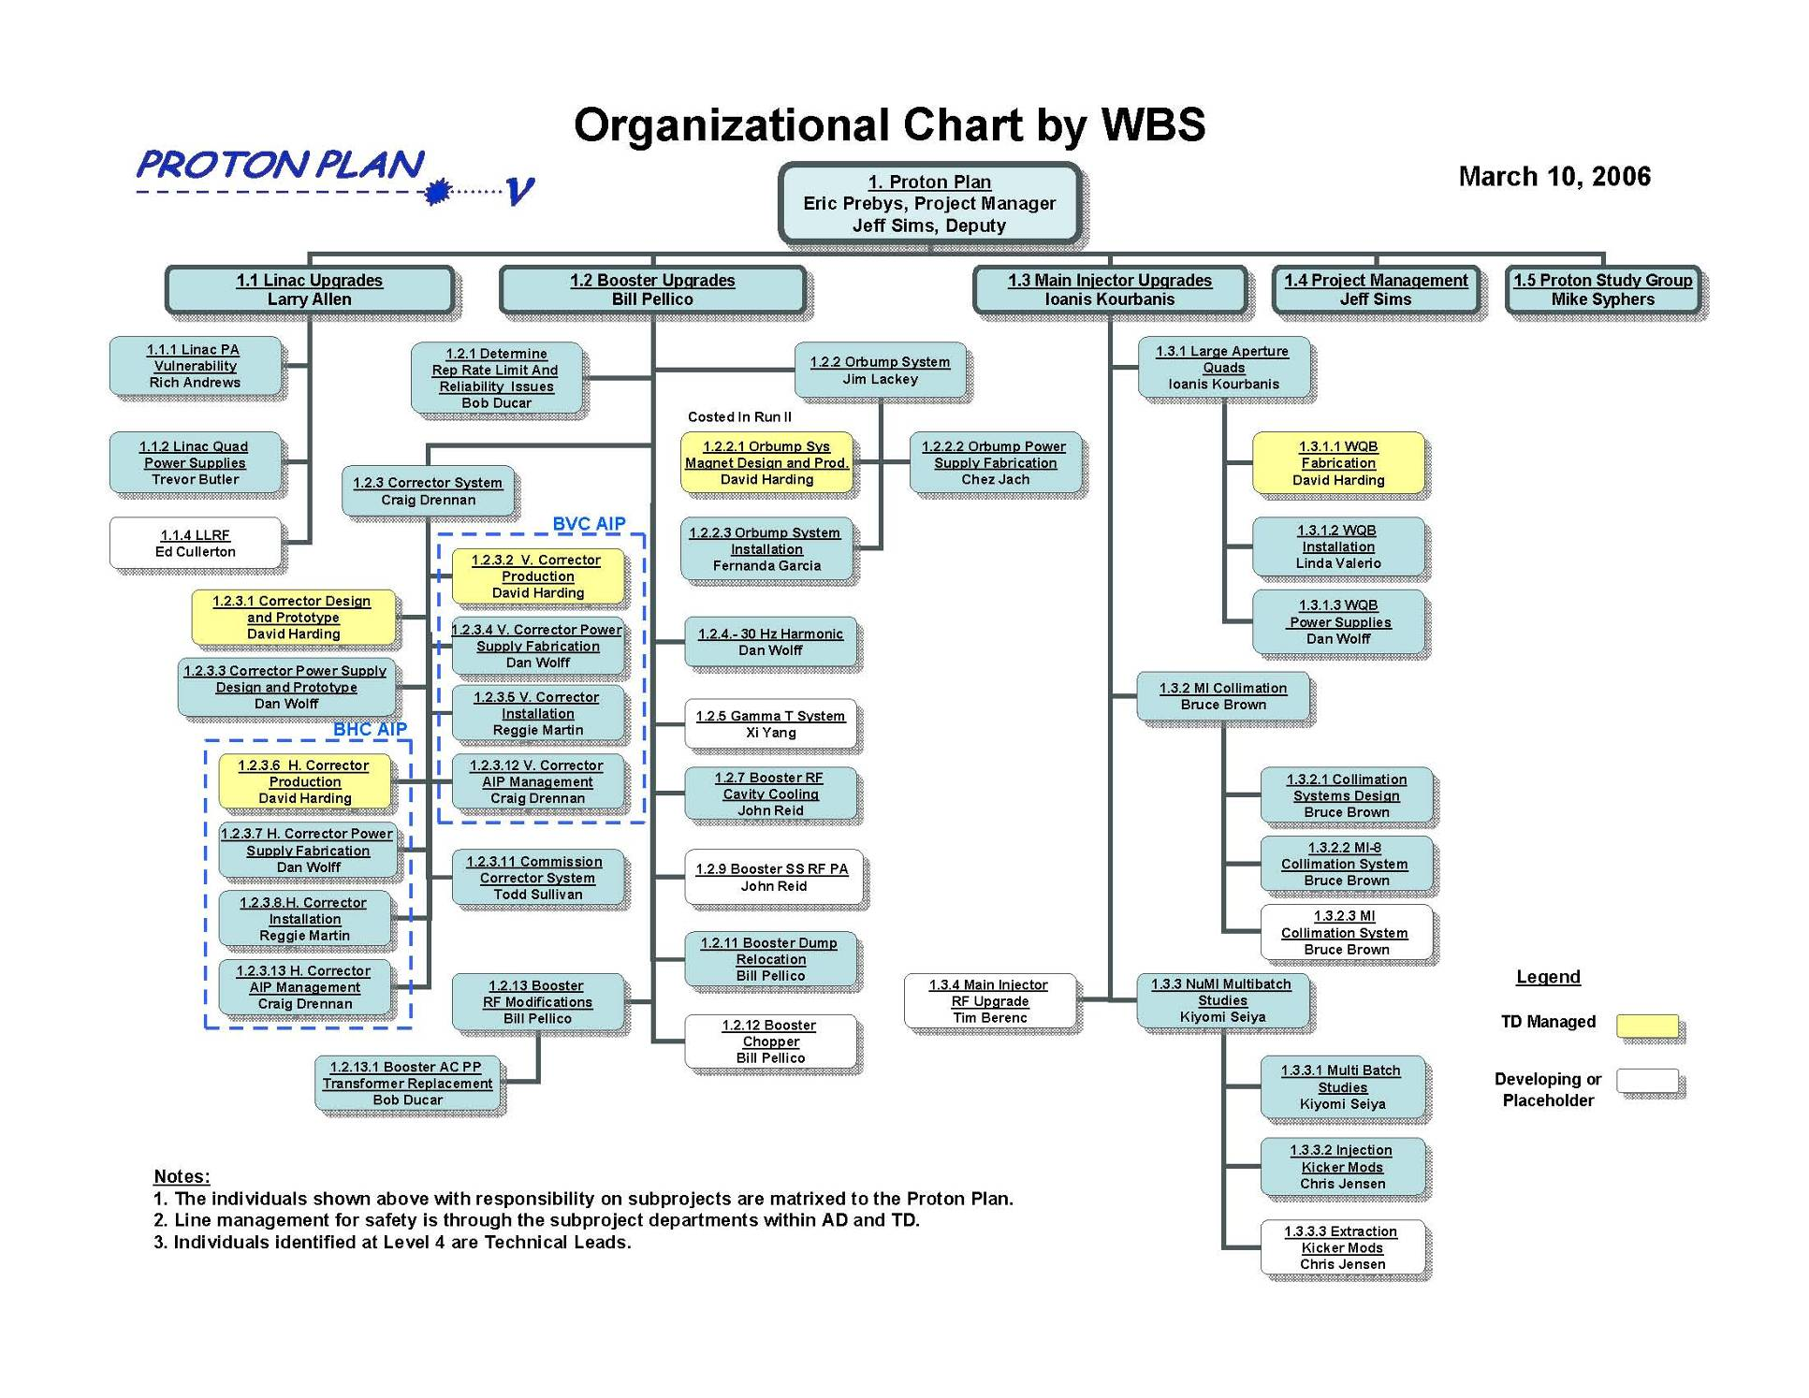

Slide 8
Plan Strategy
Increasing the proton delivery from the Booster to NuMI and MiniBooNE
  Increase maximum average Booster repetition rate.
  Increase acceptance by improving orbit control and beam quality.
Increasing the beam intensity in the Main Injector for NuMI
  Main Injector multi-batch operation.
  Slip stacking in Main Injector (requires injection kicker improvement and possibly some RF improvements).
Improving operational reliability and radiation limitations
  Linac pulsed quad supplies
  Booster RF upgrades, possibly significant
  Alleviate Low Energy Linac 200 MHz PA (“7835”) supply problem
Organized along the Run II model
  “campaign” rather than “project”

Slide 9
Summary: Significant Elements of Plan
Linac
  Stockpile two year supply of spare 200 MHz power amplifier tubes (7835’s), in the event of an interruption in supply
  Characterize and improve Low Energy Linac Low Level RF
Booster:
  Replace and reconfigure injection bump (ORBUMP) system.
  Relocate 8 GeV dump from Booster tunnel to MI-8 transfer line
  Make Booster robust to 9 Hz, and understand requirements to go to 15 Hz
  Design, build, and install new corrector system
Main Injector:
  Replace seven quadrupoles with increased aperture versions, to reduce injection and extraction losses.
  Operationally develop multi-batch and multi-batch slip stacked operation
  Design and install collimation system, both in the MI-8 line and in the MI ring
  Modify injection kicker to allow multi-batch slip stacked operation
  Characterize and perhaps make improvements to RF system, to support high intensity operation.
Red = to be completed this shutdown

Slide 10
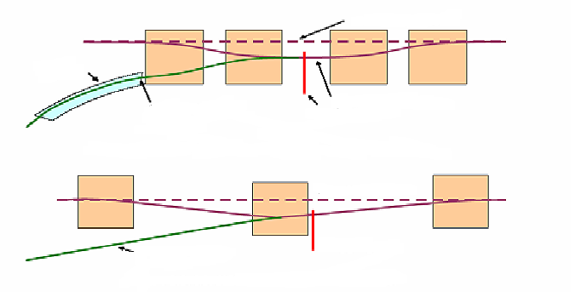
ORBMP/Injection
New Booster Injection - ORBMP Girder & PS
  A simplified 3 Bump injection scheme
      Septum Magnet not required
      Better Lattice Match
      Alignment of Circulating beam with Injected beam
  New ORBMP ps and magnets that can run at 15 Hz
      Present system limited to 7.5 Hz due to heating
Circulating Beam
Septa
Injected Beam
Present Injection Girder
Foil
Circulating Beam
Injected Beam
Foil
New Injection Girder
Provided by Jim Lackey and Fernanda Garcia

Slide 11
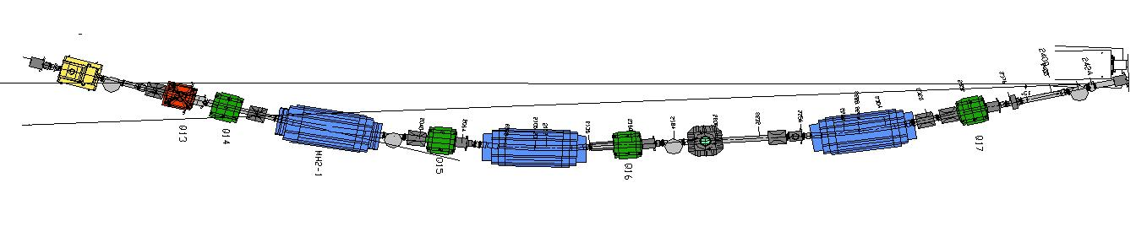
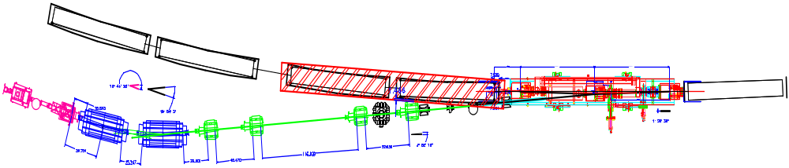
Injection Modifications
Current Scheme
New Scheme
ORBMP Girder
Booster
ORBMP MAGNETS
New 400 MeV Injection Layout
Provided by Jim Lackey and Fernanda Garcia

Slide 12
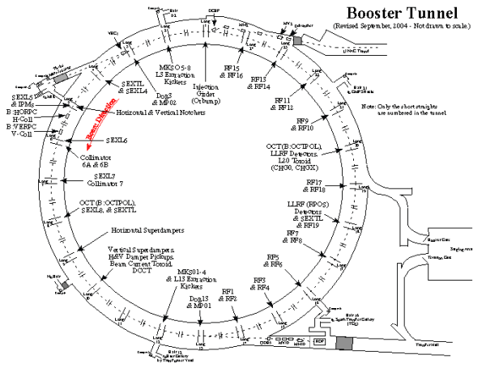
Booster Dump Relocation
L3 Extraction to MI
L13 Extraction Dump
This extraction region is being relocated to the MI-8 transfer line

Slide 13
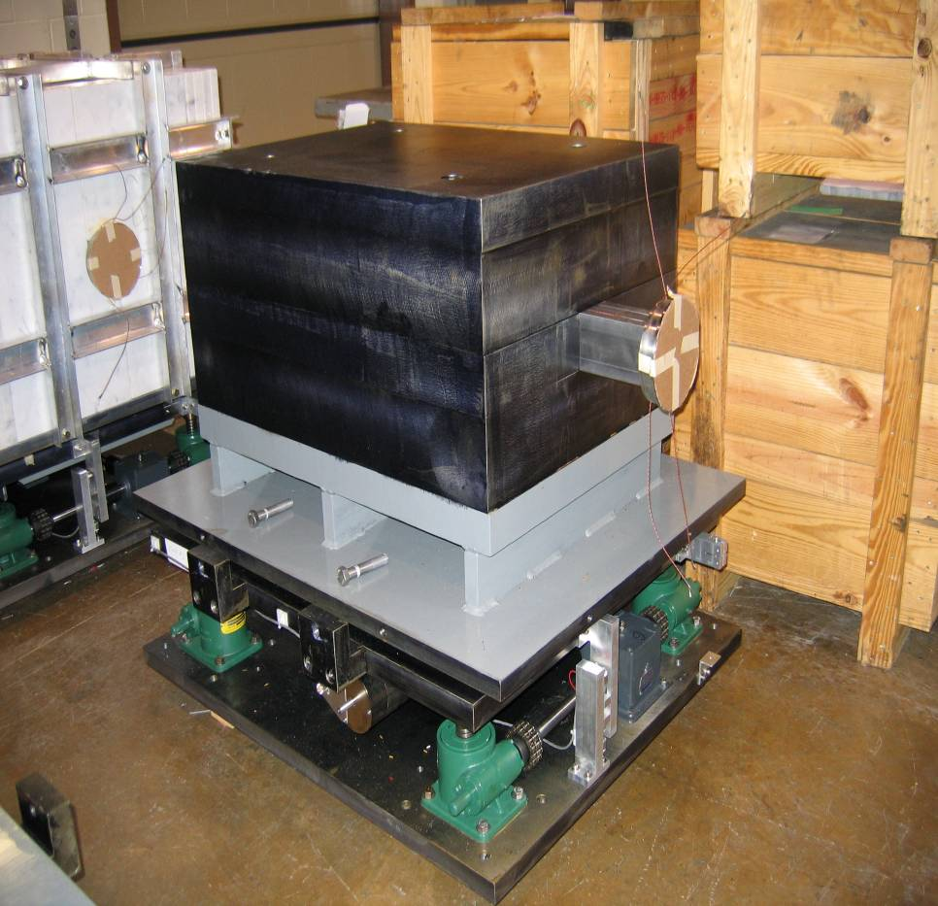
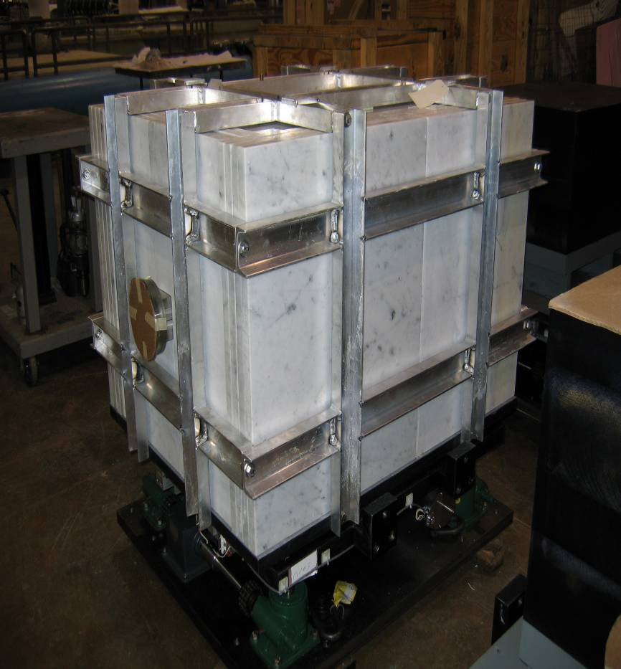
MI-8 Collimator
w/o marble (moving configuration)
Fully clad

Slide 14
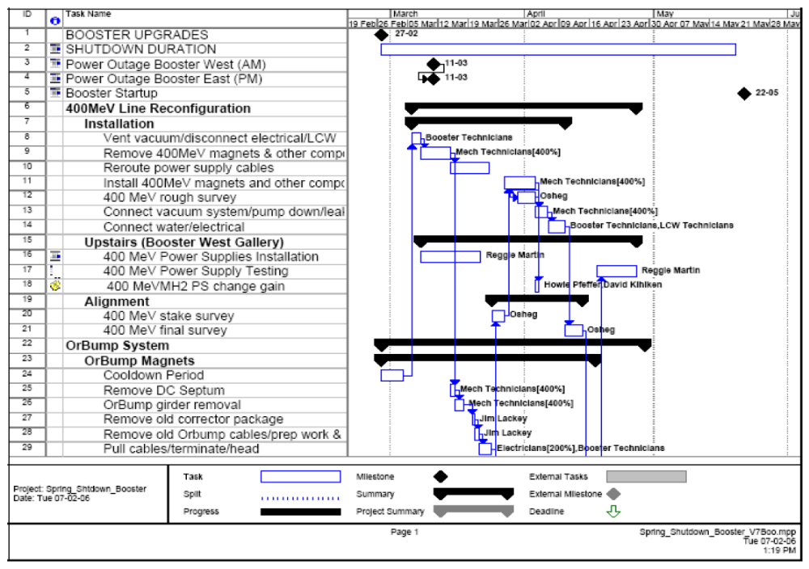
Shutdown Schedule (partial)

Slide 15
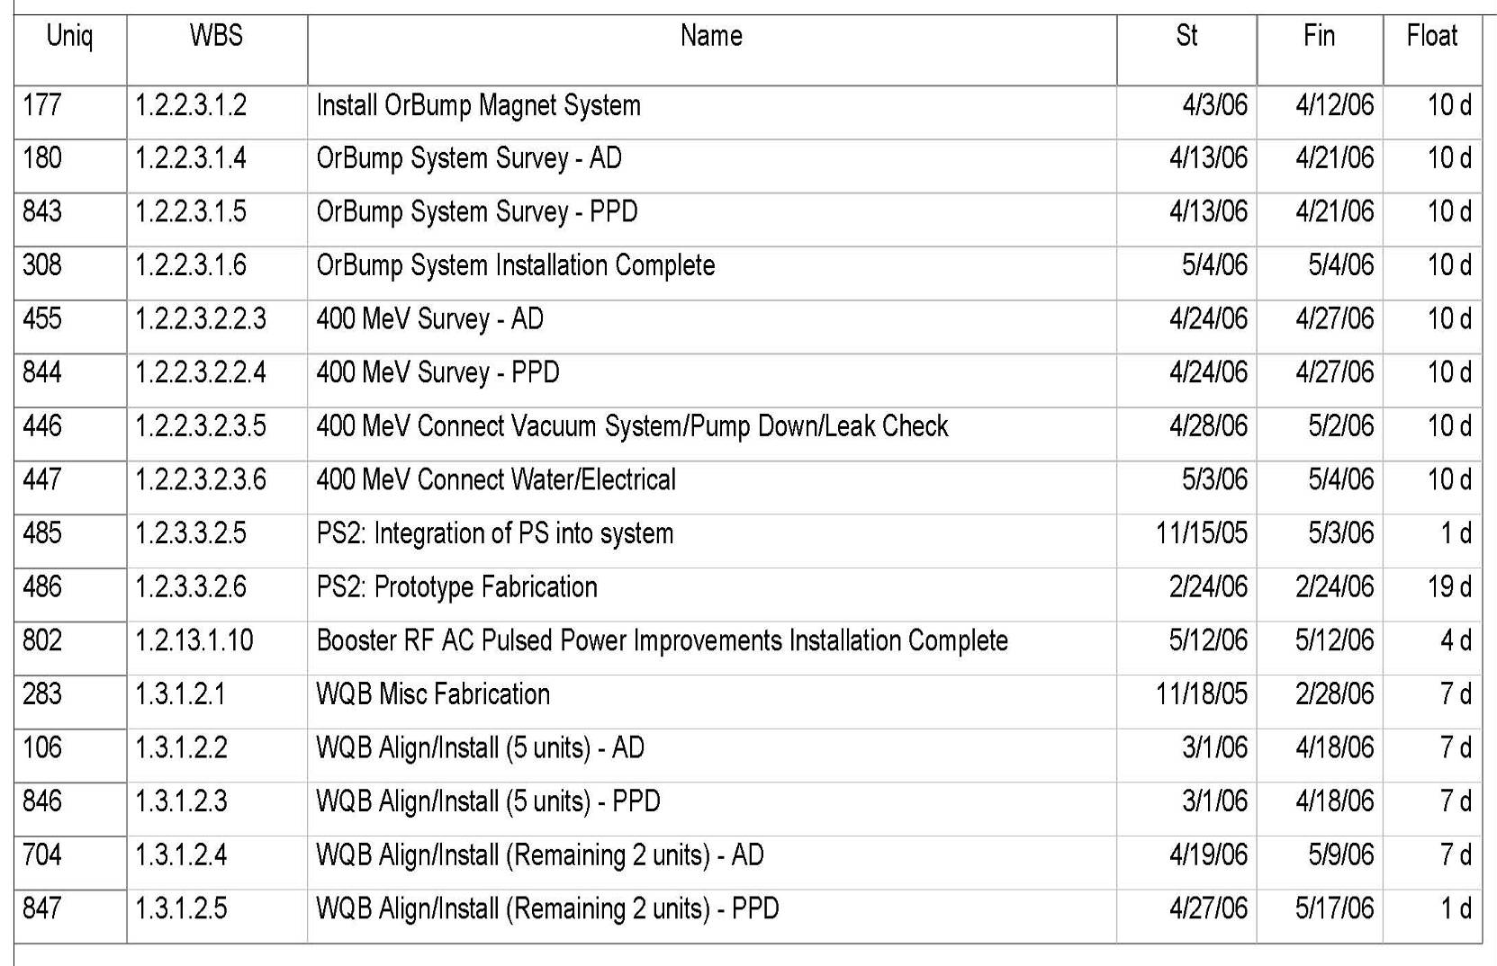
Critical Path Analysis to mid 2006
Orbump
Booster
Correctors
Booster Tformers
Stands, Spool Pieces
WQB
<10 days on installation related tasks
<30 days on fabrication related tasks

Slide 16
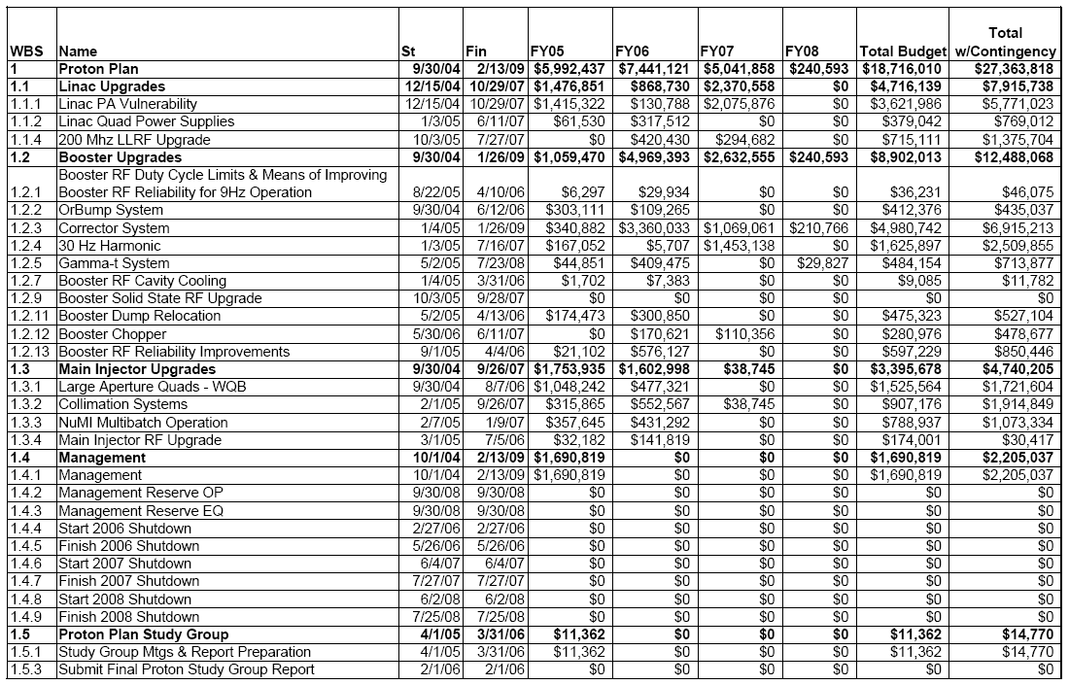
Level 3 Breakdown with Budget

Slide 17
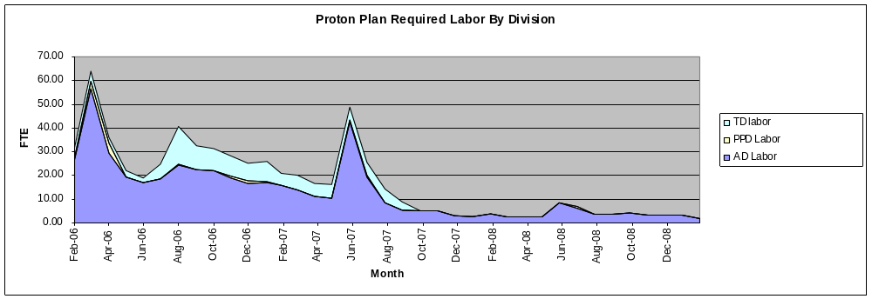
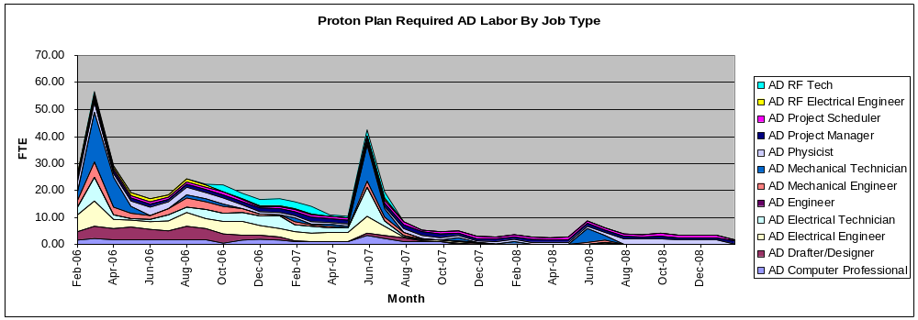
Labor Profiles
2008 Shutdown
2006 Shutdown
Build Correctors
2007 Shutdown
FY06
FY07
FY08
FY09

Slide 18
Major Accomplishments This Year
Linac
  10/12 strategic spare 7835’s delivered so far
  Design of pulsed quad supplies ongoing
  LEL LLRF studies well under way
Booster
  Operationally supported slip stacking for pBar production, NuMI, and MiniBooNE
    Required operational cogging
    Logitudinal properties improved with the intervention of Rapid Response Team (RRT)
  Worked in preparation for this shutdown
    More about this shortly
  Finalized specifications and prototype design for new Booster corrector system.
Main Injector
  Initiated routine full 2+5 operation
    Rate maximum until slip stacking begins after shutdown
  Did studies related to full slip stacking
    Demonstrated accelerated 2+9 operation at low intensity

Slide 19
Booster Corrector Upgrade
Goals
  Horizontal and Vertical Position Control through cycle
  Horizontal and Vertical Tune Control through cycle
  Horizontal and Vertical Chromaticity Control through cycle
Hardware
  New combined function magnets
  Rewiring of power distribution
  New power supplies
  New correction package support girder
  Utilities – cooling water
  Controls – firmware and software
Issues
  Gallery space – rack issues
  Schedule – A lot of complicated magnets to build and test!
This is a major project. Even without a Proton Plan, it would require significant management.

Slide 20
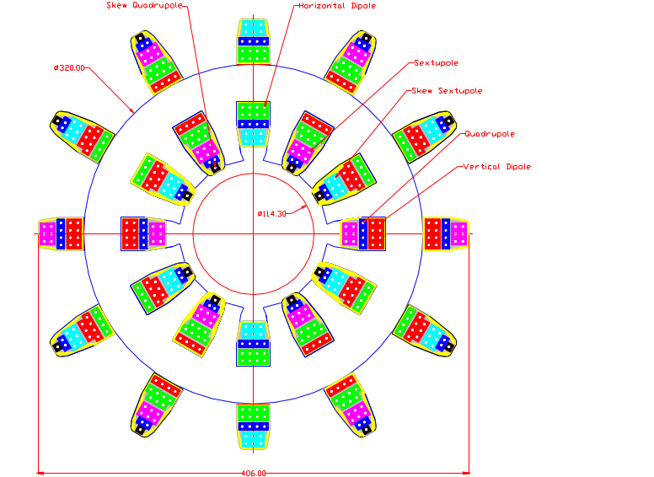
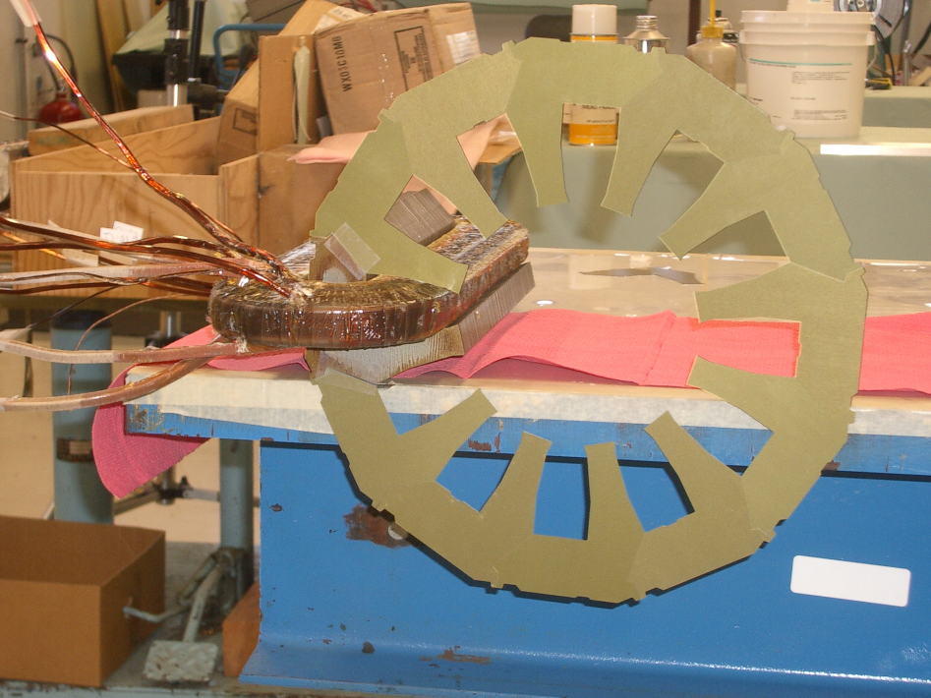
Booster Corrector Design: 12 Pole Magnet
Prototype in progress
Wound to give 6 discrete multipoles.

Slide 21
Proton Projections
Phases of Operation
  Phase I (prior to shutdown)
    Booster lattice distortions ameliorated
    Booster limited to 7.5Hz total repetition rate
    Main Injector limited to ~4E13 protons (2+5 operation)
  Phase II
    After present shutdown
    Injection bump (ORBUMP) replaced
    Drift tube cooling in Booster RF cooling finished
    Booster capable of 8-9Hz operation
    Begin to implement 2+9 full NuMI slip stack operation.
  Phase III
    Full NuMI 2+9 slip stack operation.
    Might require some MI RF modifications (under study)

Slide 22
Procedure for estimating Proton Delivery
Assume traditional operational priority:
  Protons for pBar production
    Limited by ability to slip stack
    Limited by max cooling rate
  Protons for NuMI
    Limited by max Booster batch size
    Limited by max MI cycle rate
    Limited by max MI proton capacity
    (will be) limited by ability to slip stack NuMI protons in MI
  Protons for BNB (currently MiniBooNE)
    Determined by difference between Booster capacity and maximum MI loading.
    Currently limited by Booster losses, and will continue to be for some time.
    Ultimately limited by Booster rep. rate.
    Extremely sensitive to fluctuations in total Booster output

Slide 23
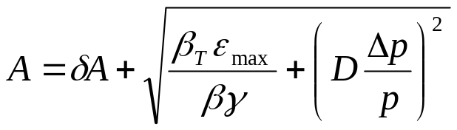
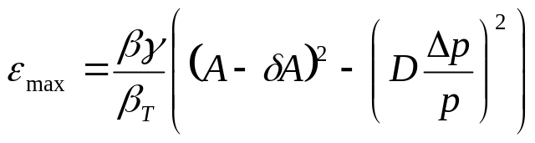
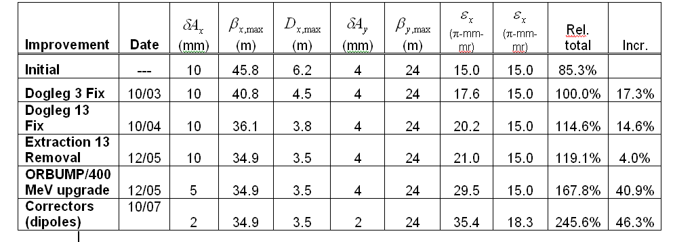
Evaluate Effect of Booster Improvements
Calculate effect of various improvements based on increased acceptance:
Use:
Effective aperture
reduction
Booster Dump Relocation
06/06
06/06
“Design” projection: 50% of calculated benefit after 1 year
“Baseline” projection: 25% of calculated benefit after 1 year

Slide 24
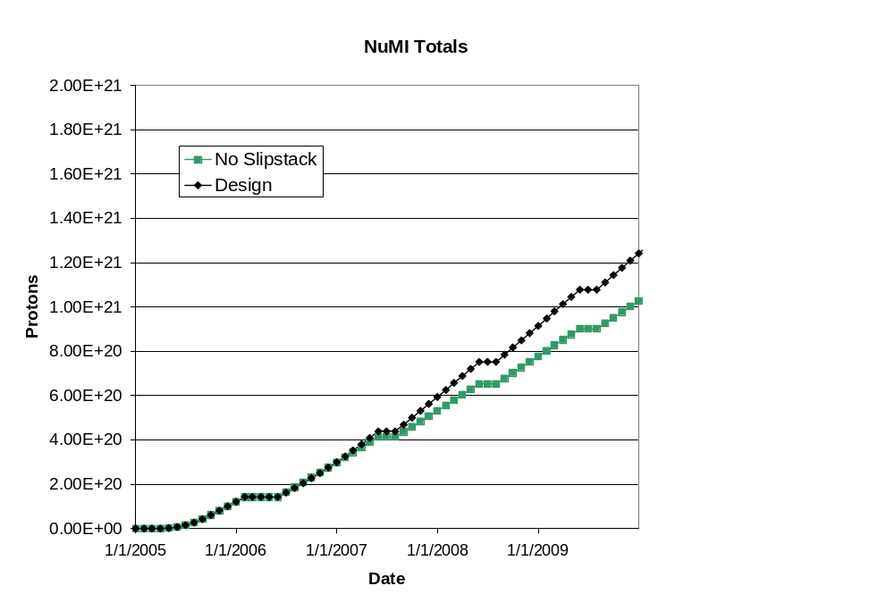
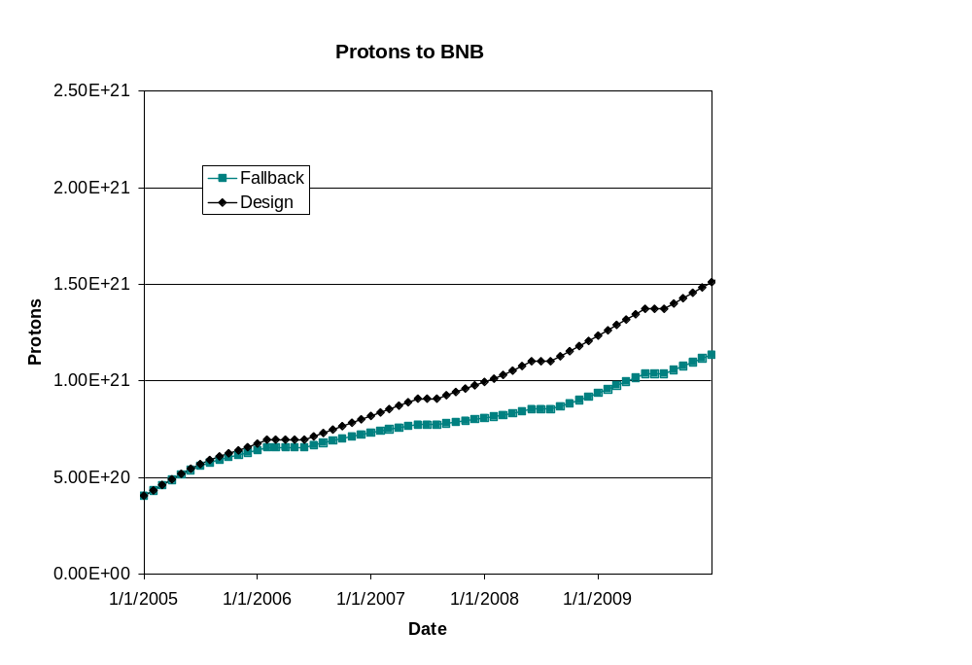
Long Term Projections
These projections do not take in to account effects of collider turning off or possible improvements thereafter.

Slide 25
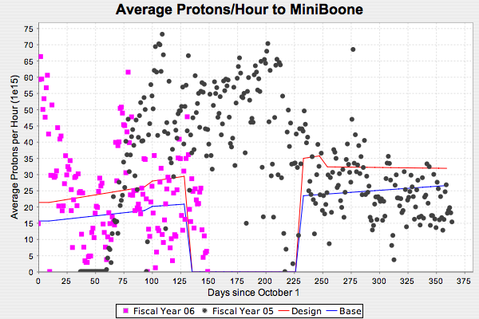
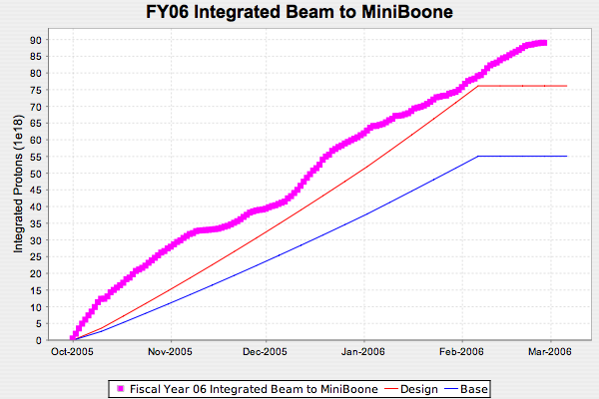
FY06 Proton to MiniBooNE

Slide 26
Operational Summary for MiniBooNE
We continued to deliver protons to the MiniBooNE experiment as NuMI ramped up through the year.
  This was still considered problematic as little as six months before the NuMI turn on
  It reflects a significant achievement by both the Proton Source personnel and Operations.
MiniBooNE benefited from periodic NuMI downtimes.
There were no significant operational issues for the MiniBooNE experiment since the last Ops review.

Slide 27
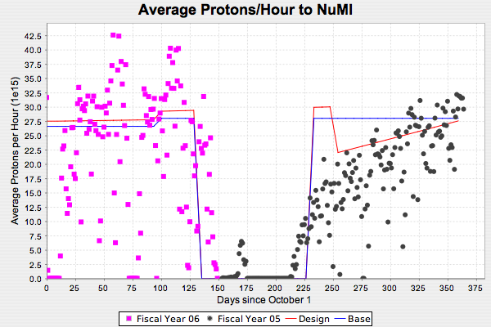
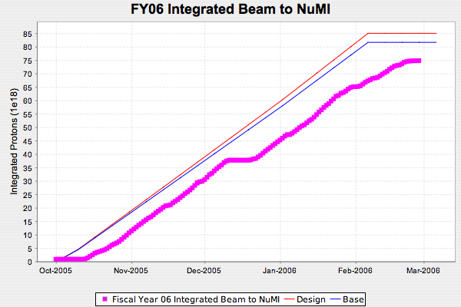
Protons to NuMI

Slide 28
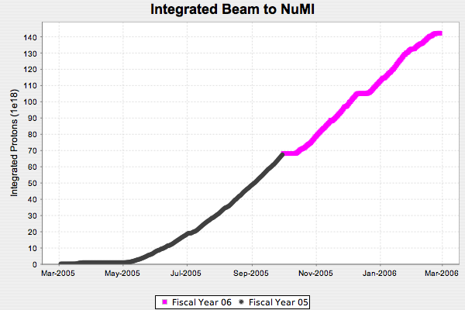
NuMI Operational Issues*
Install system to collect
tritiated water from
target pile air cooling
March 2005:
Project completion,
beam-line commissioning
Clear horn
ground fault
(foot shook loose)
Infant mortality
of target water line,
do “patch” on target system
Integrated
1.4 x 10²⁰ POT
(equivalent to 1MW-month
of continuous beam)
*slide courtesy Jim Hylen

Slide 29
Problem Detail: Target Leak
Shortly after the experiment started up (3/05), target scans revealed water in the target chamber:
  The target was removed to the hot cell and the leak vanished.
  The target was returned with a Helium backpressure system to prevent cooling water from leaking into the (previously evacuated) volume.
  Shortly thereafter, Helium was found in the return water line.
  There is no evidence of water in the target chamber.
  -> The solution appears to be working.

Slide 30
Problem Detail: Ground Fault
In ~10/05, the second NuMI horn developed a hard ground fault.
The horn was removed to the hot cell.
The problem was eventually tracked down to a foot, which had vibrated loose and was contacting a grounded base plate.
This problem was repaired, but in the process, it was discovered that the Nickel plating on the power supply strip lines housing is significantly flaking.
  This has been blamed for a number of subsequent ground faults, all of which have eventually cleared.

Slide 31
Present Horn Status
The NuMI second horn has developed a leak in the water return line.
The horn was removed to the hot cell to study this.
It is believed the problem is a cracked ceramic standoff.
Unfortunately, this is on the horn side of the quick disconnect.
Optimistic problem can be repaired.
  Running w/o a second horn would mean a ~50% in neutrino flux
  The second horn will probably be ready in “October or November”

Slide 32
The Year in Review
Things which went well
  Operationally continuing to run MiniBooNE with NuMI
  Uptime better than anticipated
  Less access needed for ECool than planned
  Understanding the MI RF needs led to a drastically reduced scope of proposed MI RF work
Things which fell a bit short
  Peak Booster intensity has not risen as fast as expected
    Projected peaks of 1E17 pph by this time.
    In fact peaks of ~9E16 pph have been observed.
  Assorted problems with NuMI beam line

Slide 33
Summary
In the last year, the Proton Plan has gone from a concept to an official project, with monthly oversight and change control
We are successfully ramping up NuMI operation while continuing to deliver beam to MiniBooNE
There have been some unfortunate incidents involving the NuMI beamline, but we feel that they are under control.

Slide 34
Backup Slides

Slide 35
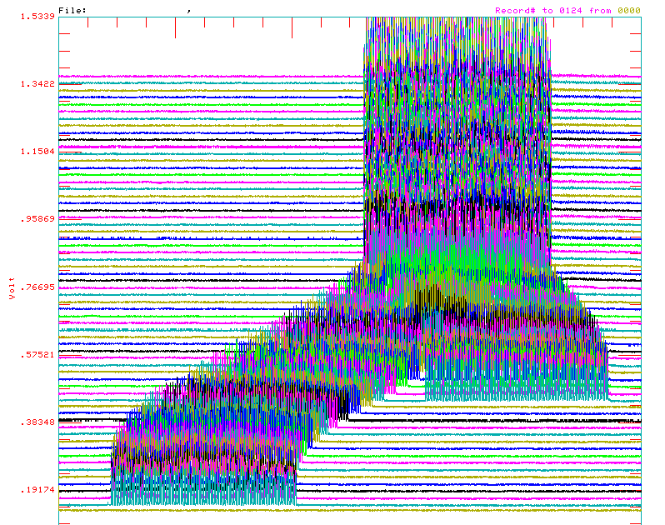
Review: Main Injector Loading
The Main Injector has six usable “slots”, into which Booster batches may be placed.
More batches may be loaded, using “slip stacking”, in which an initial batch in the Main Injector is accelerated such that a subsequent batch will be at a slightly different energy.
The two will then drift together and can be captured as a single batch (with at least twice the longitudinal emittance).

Slide 36
Linac Elements
Linac (1.1)
  (1.1.1) Linac PA vulnerability
    Placed large order for 12 7835’s (10 delivered)
    Investigating Thales 628 replacement option
  (1.1.2) Pulsed quad power supply
    Replacing control cards
      1/8 designed and out for bids
  (1.1.4) LEL LLRF (Improve phase and amplitude stability)
    Working with RF group to characterize current system
    Developing improved design

Slide 37
Booster Elements
(1.2) Booster
  (1.2.1) Determine Rep. Rate Limit
    Identify obstacles to reaching 9Hz (being addressed under 1.2.2, 1.2.7, 1.2.13)
    Determine necessary steps to go to 15 Hz (almost complete; not addressed under this plan)
  (1.2.2) ORBUMP System/400 MeV Line
    Replace injection bump system with new system capable of 15 Hz operation with improved injection characteristics.
    Rearrange 400 MeV injection line to accommodate
    Will be completed this shutdown
  (1.2.3) New Corrector System
    Replace 48 corrector packages with improved versions
      2 dipole+ 2quad + 2 sextupoles
    Half in 2007, Half in 2008
    Currently in prototype phase
    Biggest single project in plan!!!

Slide 38
Booster Elements (cont’d)
  (1.2.4) 30 Hz Harmonic
    Scheme to modify Booster acceleration ramp by adding 30 Hz component to resonant circuit.
    After detailed studies, terminated at review (2/24/06)
  (1.2.5) Gamma-t System
    Investigate and integrate Booster gamma-t jump system to preserve longitudinal properties at high intensity.
    Initial studies and models look promising
    Must modify existing system to accommodate new corrector system.
  (1.2.7) Booster RF cavity drift tube cooling
    Install cooling on drift tubes of RF cavities
    Tiny project, but vital to rates > 7.5 Hz
    Will be completed this shutdown.
  (1.2.9) Booster solid state RF upgrade
    Replace outdated Booster RF distributed amplifier drivers with solid state versions (like Main Injector)
    Potentially large part of plan
    Awaiting cost-benefit justification and CR.

Slide 39
Booster Elements (cont’d)
  (1.2.11) Booster Dump Relocation
    Eliminate original extraction region of Booster (Long 13)
    Install dump in MI-8 line to take it’s place
    Major project, will be done this shutdown
  (1.2.12) Booster Chopper
    Design chopper to create cleaner Booster extraction notch
    In design
  (1.2.13) Booster RF Improvements
    Catch all task to cover generic improvements to improve reliability at high rates
    Current largest project is dual 13.8 transformer replacement being done this shutdown.

Slide 40
Main Injector Elements
Main Injector (1.3)
  (1.3.1) Large Aperture Quads
    Install seven large aperture quads to eliminate aperture restrictions at injection and extraction regions
    Will be completed this shutdown.
  (1.3.2) MI Collimation Systems
    Install collimation system in MI-8 line this shutdown
    Continue studies to design optimum collimation system for ring in future shutdown, if necessary
  (1.3.3) MI Multibatch Operation
    Operational initiatives for multi-batch operation
      Routine 2+5 operation
      Demonstrated 2+9 at low intensity
    Improvements to MI-10 injection kicker to allow rates necessary for full 2+9 operation
      Will be done this shutdown
  (1.3.4) MI RF Upgrade
    Leftover from what was once a large RF upgrade, deemed unnecessary
    Now a placeholder for whatever RF improvements may be needed for high intensity operation.

Slide 41
Studies
(1.5) Post collider studies
  Investigate option of retasking Recycler as a Main Injector preloader
  Report turned into AD Division Head
  Task will move into SNuMI project.

