Slide 1
Proton Plan
Eric Prebys and Ioanis Kourbanis,
FNAL Accelerator Division

Slide 2
Outline
Overview of the Proton Plan
Progress since last review
Plans for upcoming shutdown
Projections and performance

Slide 3
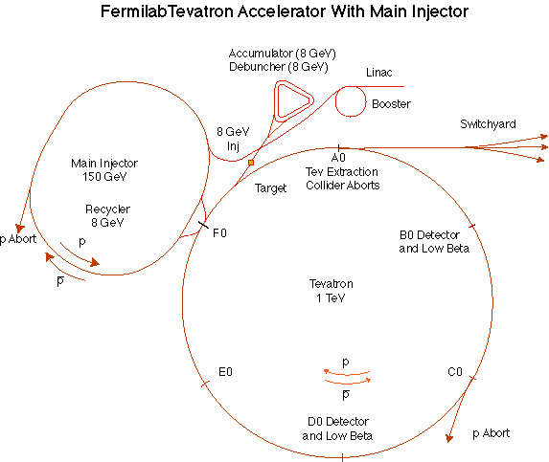
The Fermilab Accelerator Complex
MinBooNE
NUMI
=Proton Plan System
=Proton Plan Customer

Slide 4
Proton Plan Charge
Develop a plan for a reasonable set of improvements and operational initiatives to maximize proton delivery to NuMI and the Booster Neutrino Beam (BNB) over the next ten years or so.
Estimate the budget and timeline for these improvements.
Estimate proton delivery to both beam lines if the Plan proceeds on schedule.
Very important

Slide 5
Staged Neutrino Program: What’s in a Name?
Current Proton Plan
  A combination of Main Injector RF improvements and operational loading initiatives will increase the NuMI intensity to 4-5E13 protons to NuMI per 2.2 second cycle (~3E20 p/yr).
  Ultimately 320 kW to NuMI (400 kW w/o pBar)
  Runs through end of collider program
ANU (“Accelerator NuMI Upgrades”, combined with NoVA as per DOE directive)
  Retask Recycler as a preloader to save proton loading time to the Main Injector
  ~700 kW to NoVA
  Presently being formalized and baselined
SNuMI (formerly “SNuMI II”)
  Use pBar accumulator to momentum stack protons prior to boxcar stacking in the Recycler
  Ultimately ~1.2 MW to NuMI
  Still in the conceptual planning stage
HINS (formerly “Proton Driver”)
  New 8 GeV proton Linac to Main Injector
  Exploit synergy with ILC
  ~2 MW to NuMI
  Not part of our official planning at this point
Scope of this talk

Slide 6
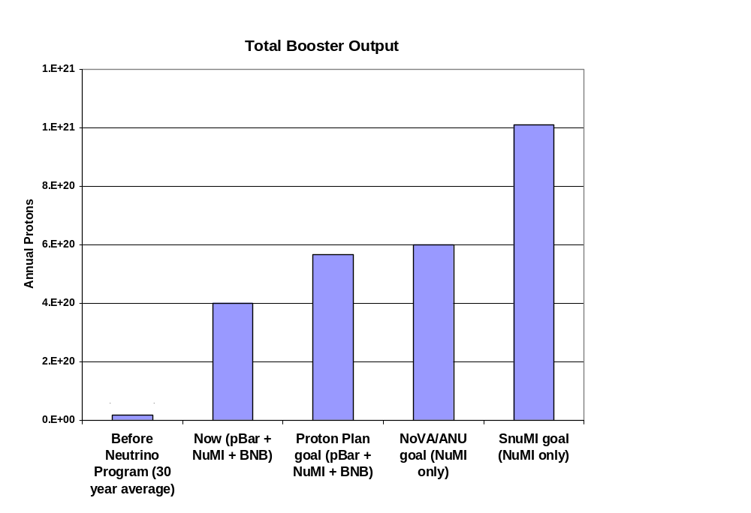
Total Protons
Present

Slide 7
Limits to Proton Intensity
Total proton rate from Proton Source (Linac+Booster):
  Booster batch size
    ~4-5E12 protons/batch, depending on beam quality required.
  Booster repetition rate
    15 Hz instantaneous
    Currently ~9Hz, limited by RF system.
  Beam loss
    Damage and/or activation of Booster components
    Above ground radiation
Total protons accelerated in Main Injector:
  Maximum main injector load
    Six “slots” for booster batches (3E13)
    Up to ~11 with slip stacking (4.5-5.5E13)
    Beam stability (RF issues)
    Beam loss concerns
  Cycle time:
    1.4s + loading time (1/15s per booster batch)
Historically our biggest worry
Critical path for NuMI/MINOS

Slide 8
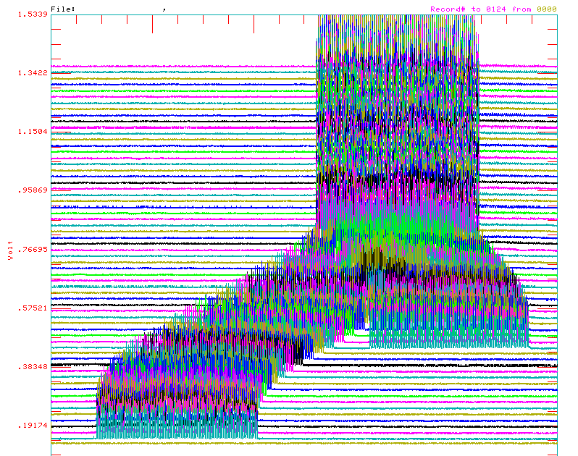
Review: Main Injector Loading
The Main Injector has six usable “slots”, into which Booster batches may be placed.
More batches may be loaded, using “slip stacking”, in which an initial batch in the Main Injector is accelerated such that a subsequent batch will be at a slightly different energy.
The two will then drift together and can be captured as a single batch (with at least twice the longitudinal emittance).

Slide 9
NuMI Operating Modes
Present NuMI operation (“2+5”):
  Two batches are slip stacked for antiproton production.
  Five more batches are loaded for NuMI
  All accelerated together.
  pBar batches extracted, followed by NuMI batches.
Ultimate NuMI operation (“2+9”):
  Five batches will be loaded into the Main Injector, leaving one empty slot.
  Six more batches will be loaded and slipped with the first to make two for antiproton production and 9 for NuMI.

Slide 10
Slip Stacking Goals
Intensity:
  11 x 4.3E12 at injection
  11 x 4.0E12 at extraction
Power
  80 kW -> pBar production
  320 kW -> NuMI
Pbar
Numi multi-batch
Mixed mode
Numi ONLY
Numi multi-batch
Bucket #
0
84
588

Slide 11
Plan Strategy
Increase the total proton capacity of the
  Increase maximum average Booster repetition rate.
  Increase acceptance by improving orbit control and beam quality.
Increase the beam intensity in the Main Injector for NuMI
  Main Injector multi-batch operation.
  Slip stacking in Main Injector.
Improve operational stability and reliability
Organized along the Run II model
  “campaign” rather than “project”
Budget ($K, loaded)
FY07 | FY08 Preliminary | FY09 Request
$10,855.6 | $3,941.9 | $324.4

Slide 12
Summary: Significant Elements of Plan
Linac
  Stockpile two year supply of spare 200 MHz power amplifier tubes (7835’s), in the event of an interruption in supply
  Characterize and improve Low Energy Linac Low Level RF
Booster:
  Replace and reconfigure injection bump (ORBUMP) system.
  Relocate 8 GeV dump from Booster tunnel to MI-8 transfer line
  Make Booster robust to 9 Hz, and understand requirements to go to 15 Hz
  Design, build, and install new corrector system
    Installed separately in long and short straights
Main Injector:
  Replace seven quadrupoles with increased aperture versions, to reduce injection and extraction losses.
  Operationally develop multi-batch and multi-batch slip stacked operation
  Design and install collimation system, both in the MI-8 line and in the MI ring
  Modify injection kicker to allow multi-batch slip stacked operation
  Characterize and improve to RF system, to support high intensity operation.
Red = complete

Slide 13
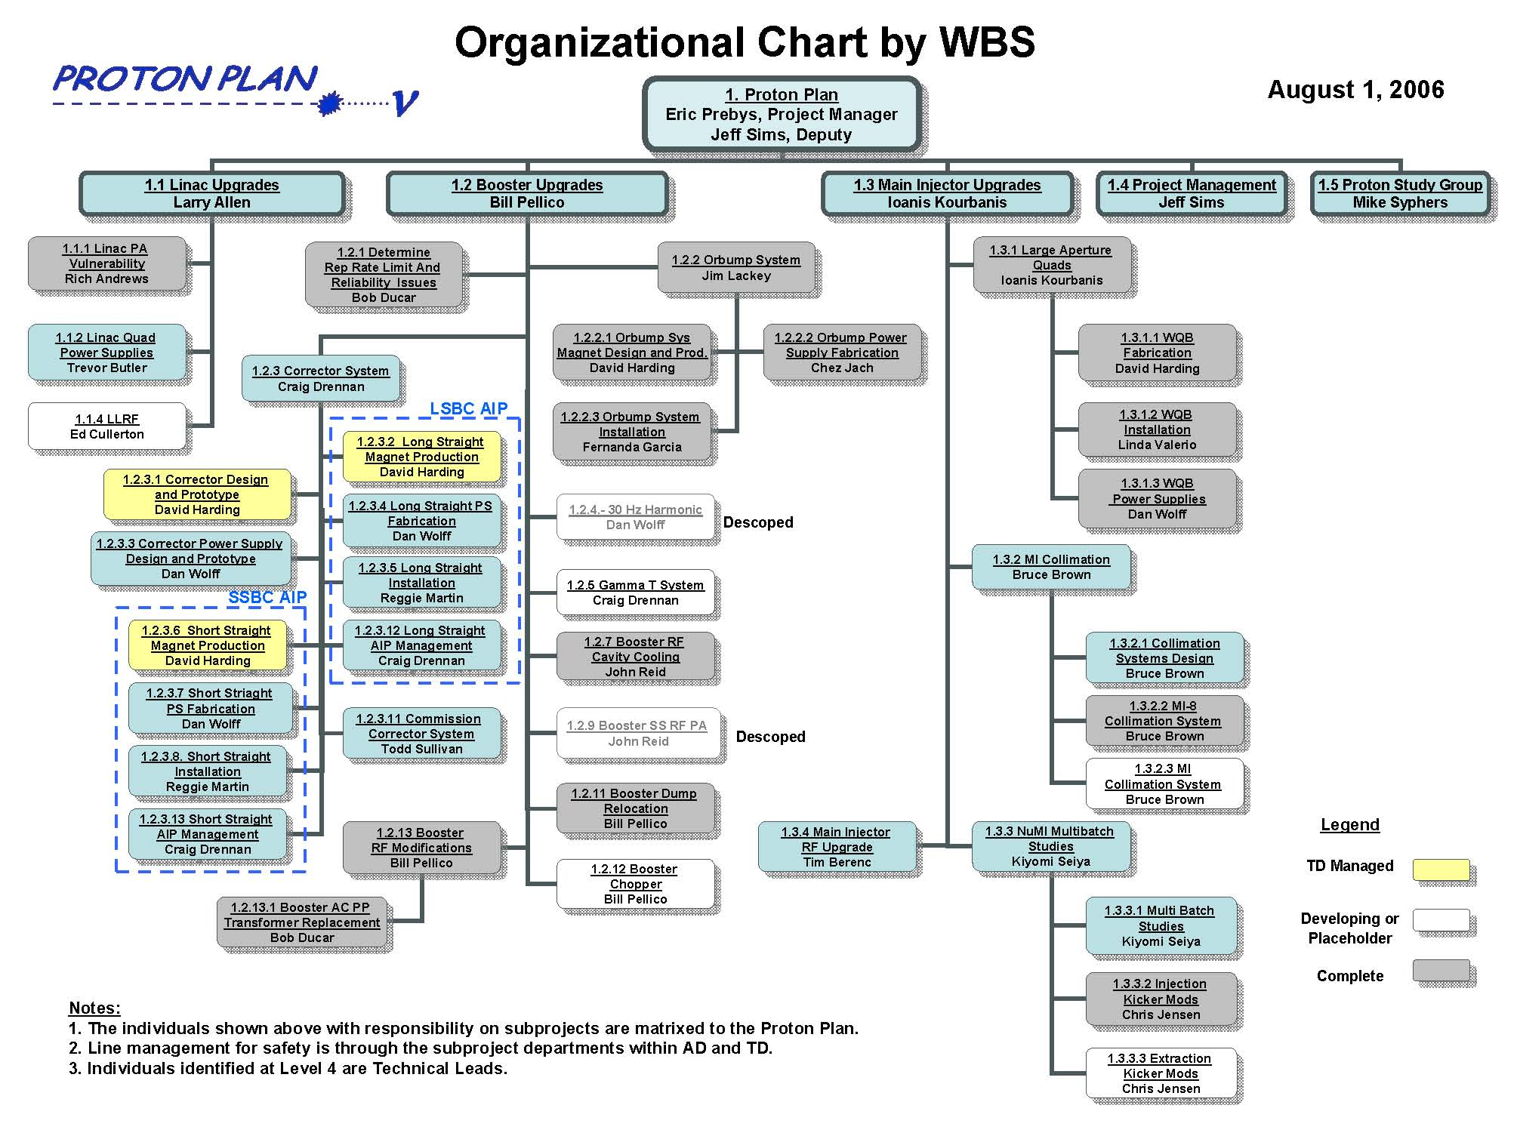
Bruce Baller
Bruce Baller
This has now become the ANU part of NoVA

Slide 14
Since Last Operational Review
The last operational review took place near the end of a shutdown in which several critical Proton Plan projects were under way.
  Booster injection bump (ORBUMP) replacement and 400 MeV injection line reconfiguration.
    Eliminate rate limitation and improve injection aperture
  8 GeV Dump Relocation
    Move one of the two Booster extraction regions to the MI-8 line to reduce acceleration losses in Booster
  Install 7 large aperture quads in Main Injector
    Reduce losses at extraction Lamertsons
  MI-8 collimation system
    Reduce first turn losses in Main Injector

Slide 15
Linac Power Amplifiers
The Low Energy Linac requires 5 200 MHz power amplifier tubes (“7835’s”)
For many years, it was difficult to maintain an adequate supply of these tubes:
  Often had to resort to borrowing tubes from other labs
  Consistently identified as a significant concern for the long term viability of the Linac
As part of the Proton Plan (1.1.1), an investigation was launched which considered three options:
  Work with vendor to increase yield of good tubes
  Replace 200 MHz RF system
  Replace entire LEL with 400 MHz, klystron-driven version.
Recommendation:
  Work with BNL and vendor to improve QA procedure
  Place order for two year supply of “strategic spares” (12 tubes), against the possibility that the vendor will stop producing tubes.
  This is in addition to our normal rebuild and replace cycle which aims to maintain a one year supply of spares (6) at all times.
Result
  Now have 17 spares.
  Plan to keep 12 “sacrosanct” and continue the normal procurement cycle to maintain ~6 additional spares indefinitely.

Slide 16
Benefits of Booster Work
ORBUMP
  Maximum repetition rate increased
    No limit from ORBUMP
    Overall limit increase from 7->9Hz (from RF system)
      sufficient for Proton Plan Goals
  Injection slewing reduced from ~1cm to ~2mm
    Efficiency increased
    Injection tuning much less sensitive
  Greatly improved reliability
8 GeV dump relocation
  Ramp losses reduced
Result
  Record intensities
    1 hr
      9E16 pph MiniBooNE
      1E17 pph total
    1 week
      1.1E19 protons to MiniBooNE
      1.2E19 protons total
Note: NuMI did not directly benefit from these total rate increases

Slide 17
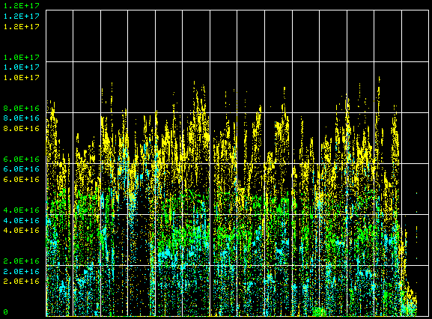
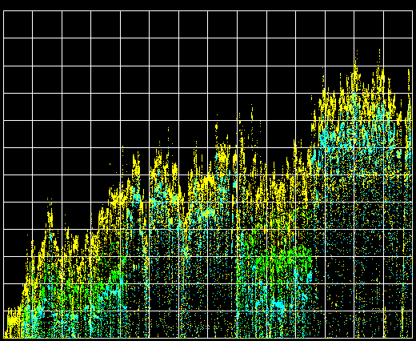
Effect of Shutdown Work on Booster Rates
protons/hr (NuMI)
protons/hr (MiniBooNE)
protons/hr (total)
1E17
11/23/05
6/1/06
2/29/06
8/28/06
Before Shutdown
After Shutdown

Slide 18
Benefits of MI-8/Main Injector Work
MI-8 Collimation
  Reduces first turn losses in Main Injector
  Now commissioned and used operationally
Large aperture quads
  Significantly reduce radiation at extraction Lambertsons
Injection kicker modifications
  All rates necessary to do 2+9 slip stacking

Slide 19
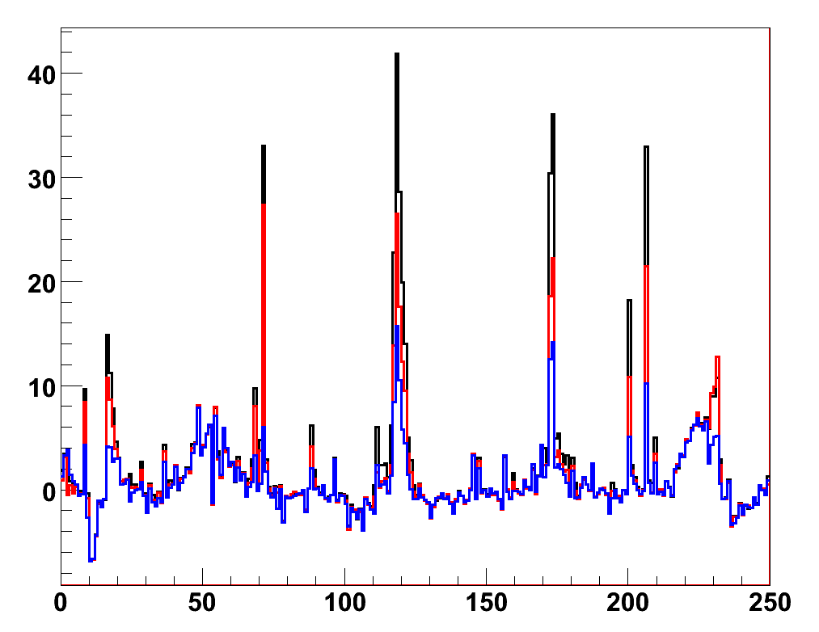
Effect of MI-8 collimation
No Collimators
H Collimators
H&V Collimators
Loss (R/s)
BLM #

Slide 20
Slip Stacking Progress
When the Proton Plan was first formalized, it was believed that we could begin ramping up to NuMI slip stacking following the 2006 shutdown.
As we began to understand the process, we realized that there were limitation in the Main Injector which would prevent operational 2+9 operation:
  RF limited by series tube power dissipation RF stability
  95% capture efficiency means 5% beam loss at 8GeV in Main Injector
    Unacceptable
    Ring collimation required
These improvements will be implemented during the next shutdown.
It’s vital that we do sufficient studies this year, such that we may quickly ramp up to full slip stacked operation after next shutdown.
  Current projections assume 3 month ramp up.

Slide 21
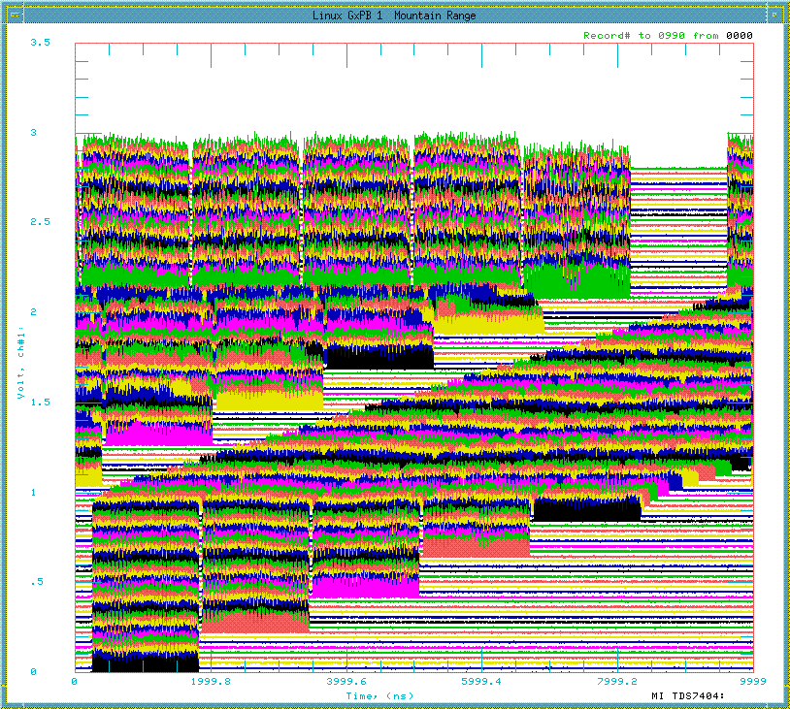
Multi-batch slip stacking status
Numi (11)
Record:
  4.05E13 protons to NuMI (NuMI only)
  90% efficiency
Goal:
  4.4E13 protons to 120 GeV (NuMI + pBar)
  95% efficiency
11μsec (1 revolution)

Slide 22
Response to 2006 Recommendation
2006 Tev Operations Review - 3. Accelerator Operations & Integration
No. | Recommendations | Status
3.2.1 | Evaluate the high intensity limitations of the proton plan. | Complete. We have achieved MI intensities up to 4.1E13 protons (90% of the Proton Plan design intensity) without any problems with instabilities. The growth rates of the transverse coupled bunch modes have been measured and compared with predictions. Based on those measurements we expect our transverse bunch by bunch damper system to be adequate. Ref: X. Huang, P. Adamson et al Beams-doc-2059 and Beams-doc-2120, B. Zwaska, Beams-doc-2166. Due to the large longitudinal emittance of the slipped stacked bunches we do not expect to have problems with the longitudinal coupled bunch modes. Ref: V. Wu, Beams-doc-2275. We have started simulations and measurements of the e-cloud effect in MI. So far we do not anticipate e-cloud to be a problem at the Proton Plan intensities. Ref: M. A. Furman, K. Sonnad, and J.-L. Vay, LBNL-61921/CBP-761. B. Zwaska, “Electron Cloud measurements in MI” Beams-doc-2278

Slide 23
Significant Projects for 2007 Shutdown
Linac
  We will implement an improved low level RF system for the low energy Linac
    The goal is to improve energy and phase stability, resulting in more consistent Booster operation.
Booster
  The largest single project in the Proton Plan is the replacement of the Booster corrector system with a vastly improved version
    Half of these will go in in this shutdown
Main Injector
  A two stage collimation system will be implemented, to handle the 5% beam loss anticipated for 2+9 slip stacked operation.
  The RF system will be upgraded to reduce series tube power dissipation and insure stability

Slide 24
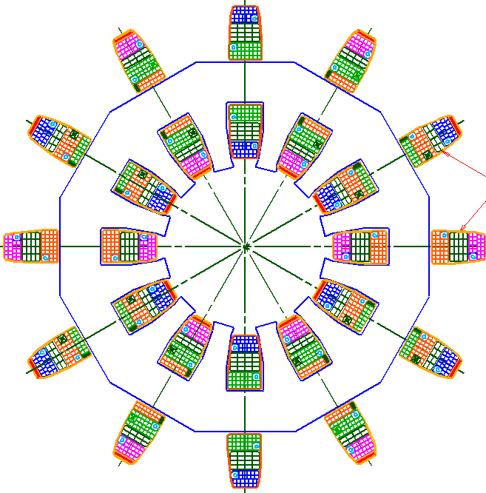
Booster Corrector System
Replace all 48 (original) Booster corrector packages.
  Unique new design
Six independent multipoles
  Stronger H and V dipoles
    ±1cm beam motion throughout cycle
  Stronger quad
    Arbitrary tune working point throughout cycle
  Skew quad
    Coupling, same strength as before.
  Sextupole and skew sextupole at every period.
    Less emittance blowup
    More control of harmonic resonances.
Integrated BPM
  Saves space
~16”

Slide 25
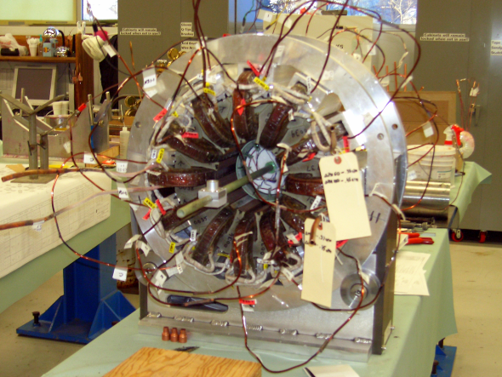
Correctors: Status
Two prototypes built
  Tests look good
Coils and cores arriving from vendors
Assembly fixtures being completed at Technical Division
Power supplies in procurement
Half of correctors will installed in 2007 shutdown.
Second half in 2008 shutdown.

Slide 26
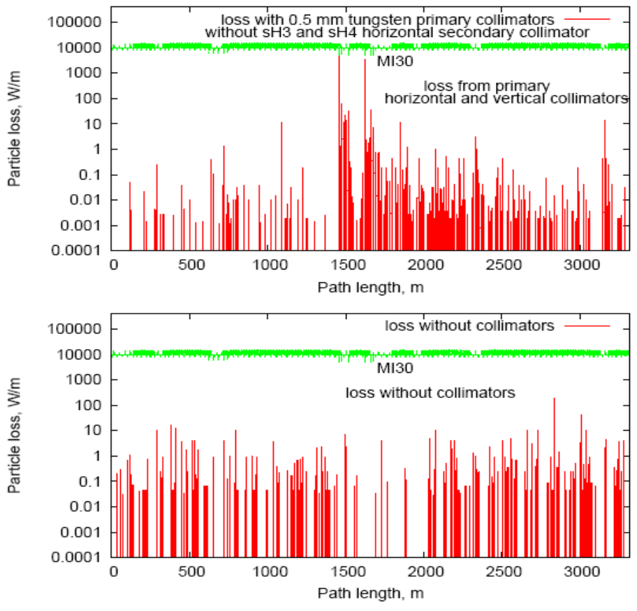
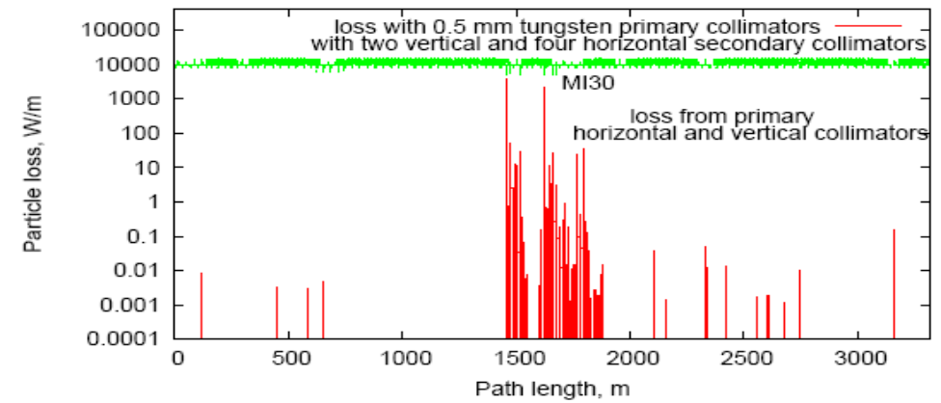
Main Injector Collimation
Collimation system designed to handle loss from multi-batch slip stacked cycles
Similar to Booster collimation system
  .5 mm thin tungsten primary (scattering) collimators
  Four secondary collimators
On track for installation in 2007 shutdown
w/o collimation
with collimation

Slide 27
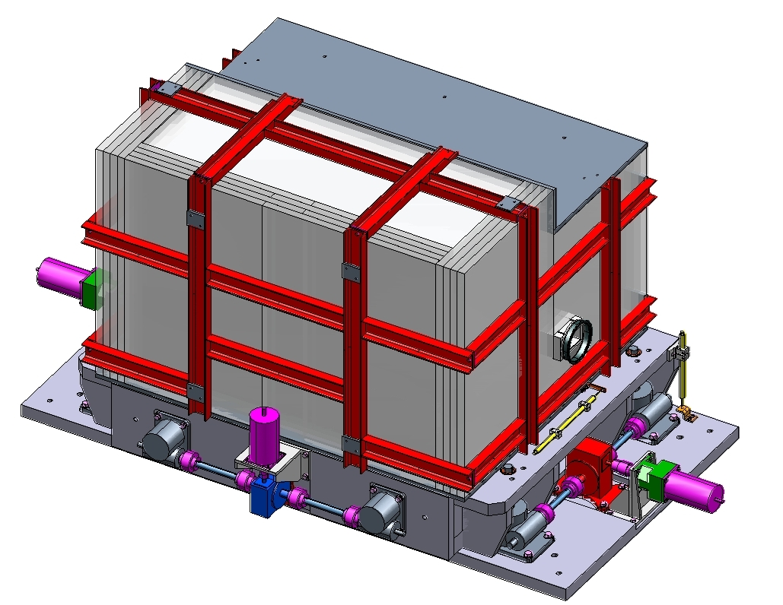
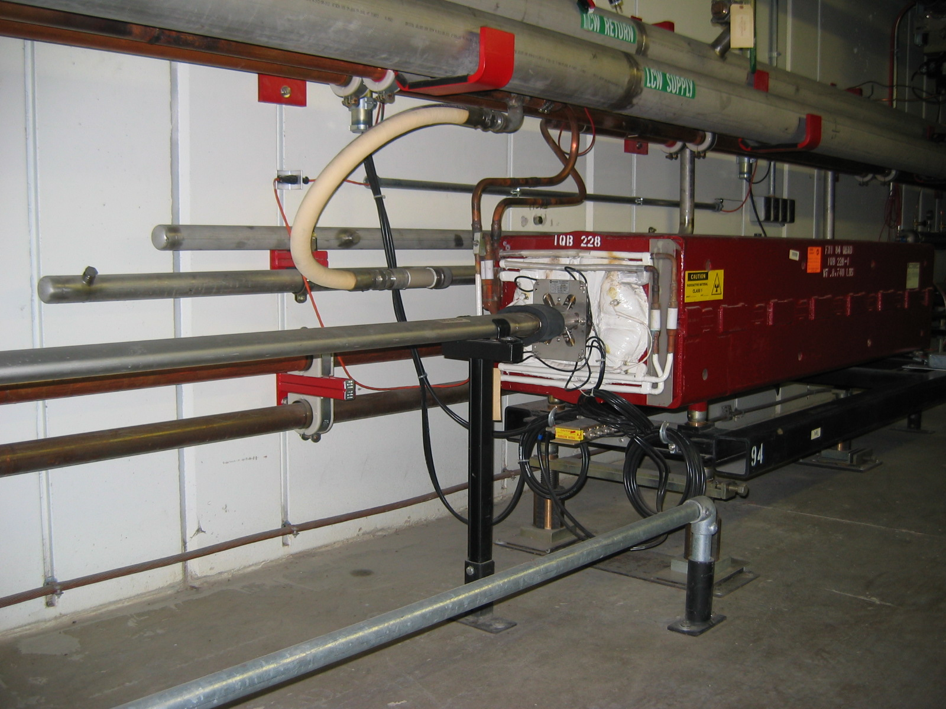
Collimator Design and Installation
Marble cladding to reduce residual surface activation
“Booster style” fixed aperture with integrated shielding
Horizontal and vertical motion
Installation will require re-routing of water and power.

Slide 28
Main Injector RF Upgrade
In progress…

Slide 29
After the 2007 Shutdown
After the 2007 shutdown, the remaining Proton Plan Projects will he
  Second half of the Booster correctors
    In the 24 short straight sections.
  Upgraded gamma-t jump system in Booster
    Capable of running at required repetition rate
    Must be installed along with correctors
  Booster chopper notcher
    Reduce losses when creating exraction loss
These are all currently scheduled for the 2008 shutdown
We allow a year after this to achieve the ultimate benefits
  Proton plan will officially end in mid to late 2009
It is likely that the plan will absorb some scope to enable full 15 Hz operation.
  Refurbish RF anode supply
  Retrofit half the RF bias supplies
  Recommission RF cavity tuner cooling
  Not necessary for NuMI

Slide 30
Proton Plan Projections
Proton Plan represents the first ever attempt to accurately predict total proton output from Booster.
Determining Booster output capacity is challenging. Our procedure is to:
  Evaluate the potential of particular improvements based on effective aperture increase or uncontrolled beam loss reduction:
    For example, if something reduces uncontrolled loss by 10%, it has the potential to allow us to send 10% more beam.
  Consider the following scenarios:
    “Design”: After one year of tuning, we realize half of the potential benefit.
    “Fallback”: After one year of tuning, we realize one quarter of the potential benefit.

Slide 31
Factors Considered in Projections
Linear ramp-up to see benefit of improvements
Slip stacking efficiency
Different Booster efficiency for cogged (pBar+NuMI) cycles and uncogged (BNB) cycles.
  Added in for 2006 review
Annual shutdowns (assume 2 mo/yr)
  Overall asymptotic ramp-up after shutdown (improved for FY06)
Uptimes: based on MiniBooNE 2004 and NuMI 2005
  Modified for 2006
Peak to average corrections
  Accounts for non-optimal running

Slide 32
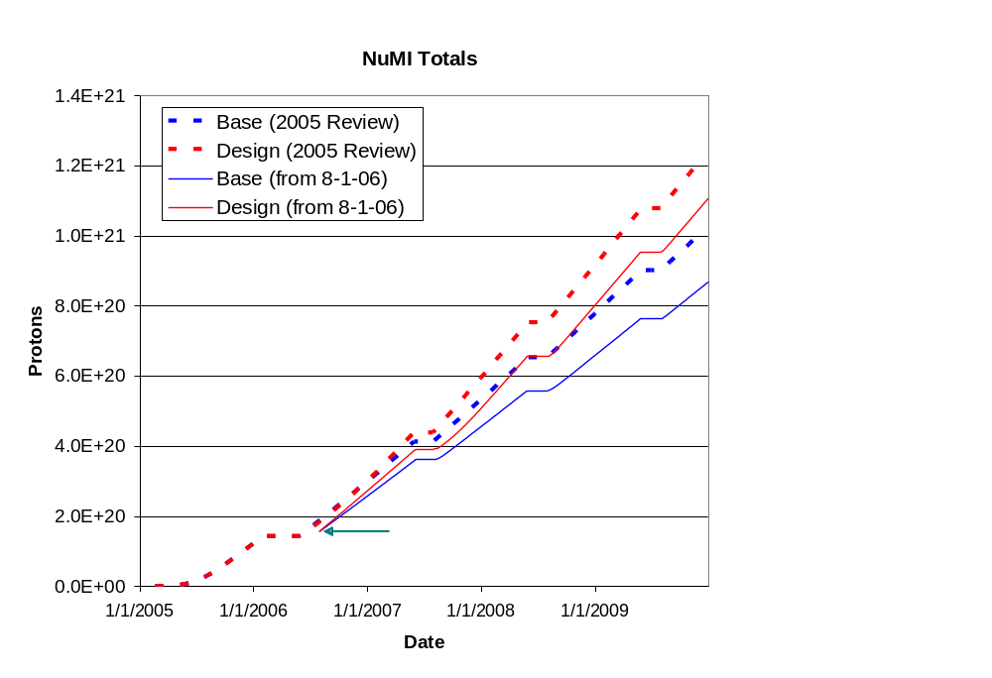
Long Term Projections
The 2006 revision was the basis for the FY07 projections

Slide 33
NuMI Cycle Time Issues
Because pBar and NuMI batches are accelerated together, the NuMI cycle time is locked to the pBar production cycle time.
Original assumption:
  NuMI and pBar would run at 2 second cycle times during 2+5 operation (limited by minimum pBar rep. rate)
  Cycle time would change to 2.2 seconds for 2+9 operation (limited by MI loading time)
In fact:
  pBar has problems running below 2.4 seconds, significantly reducing beam to NuMI
  The effect was originally largely cancelled by NuMI only cycles (during shot setup and “interleaved” mode when the accumulator had large stacks)
  Now with fast transfers to Recycler, there are very limited NuMI-only cycles
Present status:
  Working to optimize pBar for 2.2 cycle time
  Will lock complex to that time through end of collider program
  Not yet accounted for in this year’s projections

Slide 34
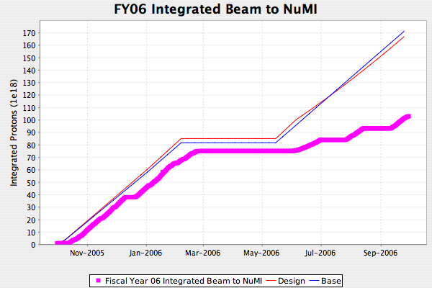
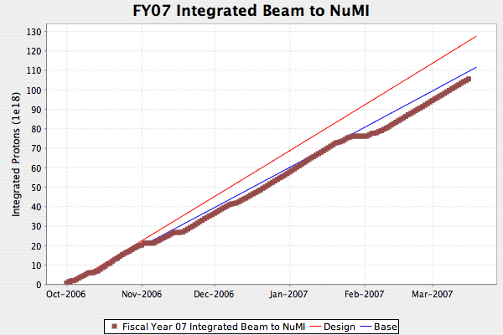
NuMI Beam Delivery (since last ops review)
Water leak at horn (heroic repair)
Dotted lines show curves for 2.4 sec cycle time
Slow Booster turn-on
F-sector TeV problem
NuMI magnet water leak
Resin beads in NuMI horn water system
In spite of the unrealistic timeline assumptions, we are currently delivering beam at roughly the advertised design rate.
This is due primarily to increased up time and high intensity NuMI only cycles, when possible.

Slide 35
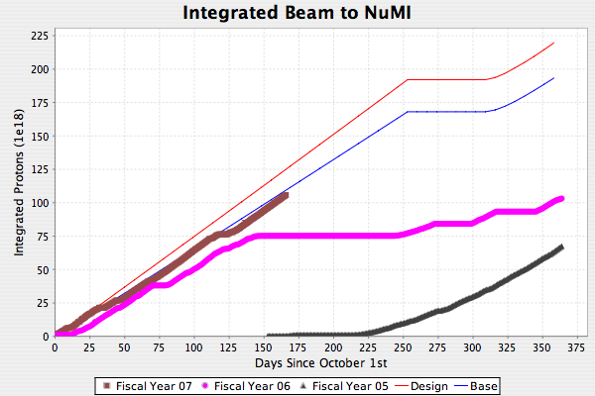
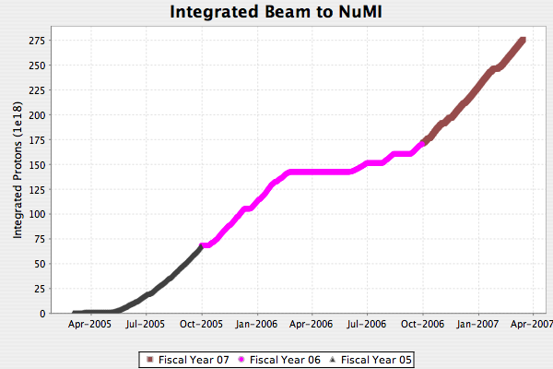
Total NuMI Beam
Total: 2.75E20
FY07 (already best year)
FY06
FY05
Not yet corrected for actual shutdown date, which will certainly be a bit later
Expect at least 2E20 for the fiscal year, bringing the total close to 4E20.

Slide 36
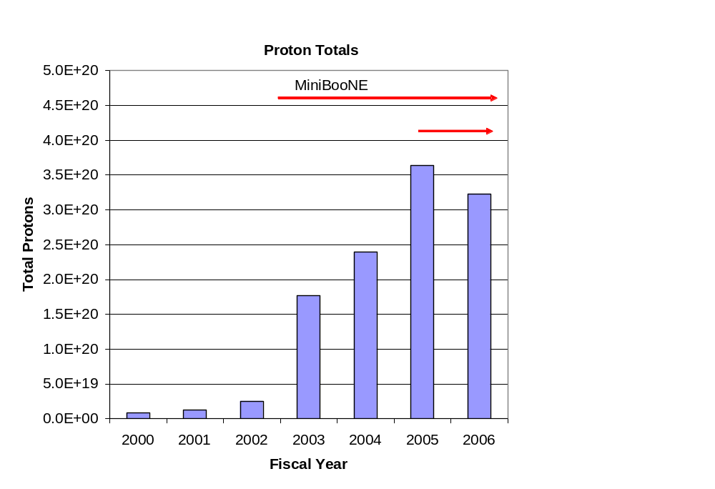
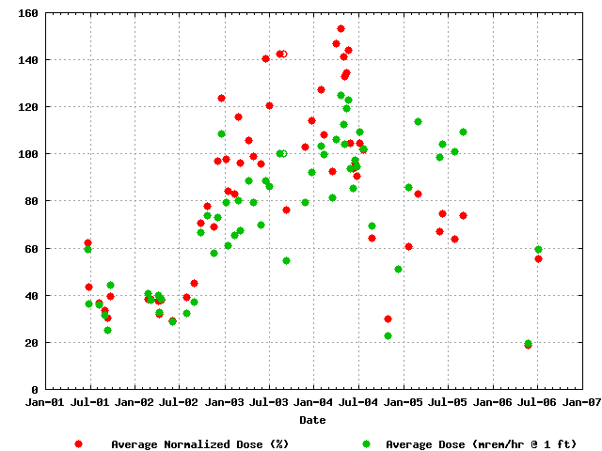
Success of Plan
Total Protons Delivered
Average Booster Activation
MiniBooNE
NuMI
Factor of 15 increase in protons

Slide 37
Conclusions
The Proton Plan has enabled us to manage a large number of diverse activities necessary to deliver the unprecedented proton intensities required by the neutrino program.
The major projects in the Booster and Main Injector that were under way at the time of the last Operations Review have been commissioned and have allowed us to reach record proton intensities.
We are in good shape for implementing the remaining Proton Plan improvements on schedule.
We have done a good job of estimating the proton delivery to the experimental program.

Slide 38
Backup Slides

Slide 39
Linac Elements
Linac (1.1)
  (1.1.1) Linac PA vulnerability
    Placed large order for 12 7835’s (10 delivered)
    Investigating Thales 628 replacement option
  (1.1.2) Pulsed quad power supply
    Replacing control cards
      1/8 designed and out for bids
  (1.1.4) LEL LLRF (Improve phase and amplitude stability)
    Working with RF group to characterize current system
    Developing improved design

Slide 40
Booster Elements
(1.2) Booster
  (1.2.1) Determine Rep. Rate Limit
    Identify obstacles to reaching 9Hz (being addressed under 1.2.2, 1.2.7, 1.2.13)
    Determine necessary steps to go to 15 Hz (almost complete; not addressed under this plan)
  (1.2.2) ORBUMP System/400 MeV Line
    Replace injection bump system with new system capable of 15 Hz operation with improved injection characteristics.
    Rearrange 400 MeV injection line to accommodate
    Will be completed this shutdown
  (1.2.3) New Corrector System
    Replace 48 corrector packages with improved versions
      2 dipole+ 2quad + 2 sextupoles
    Half in 2007, Half in 2008
    Currently in prototype phase
    Biggest single project in plan!!!

Slide 41
Booster Elements (cont’d)
  (1.2.4) 30 Hz Harmonic
    Scheme to modify Booster acceleration ramp by adding 30 Hz component to resonant circuit.
    After detailed studies, terminated at review (2/24/06)
  (1.2.5) Gamma-t System
    Investigate and integrate Booster gamma-t jump system to preserve longitudinal properties at high intensity.
    Initial studies and models look promising
    Must modify existing system to accommodate new corrector system.
  (1.2.7) Booster RF cavity drift tube cooling
    Install cooling on drift tubes of RF cavities
    Tiny project, but vital to rates > 7.5 Hz
    Will be completed this shutdown.
  (1.2.9) Booster solid state RF upgrade
    Replace outdated Booster RF distributed amplifier drivers with solid state versions (like Main Injector)
    Potentially large part of plan
    Awaiting cost-benefit justification and CR.

Slide 42
Booster Elements (cont’d)
  (1.2.11) Booster Dump Relocation
    Eliminate original extraction region of Booster (Long 13)
    Install dump in MI-8 line to take it’s place
    Major project, will be done this shutdown
  (1.2.12) Booster Chopper
    Design chopper to create cleaner Booster extraction notch
    In design
  (1.2.13) Booster RF Improvements
    Catch all task to cover generic improvements to improve reliability at high rates
    Current largest project is dual 13.8 transformer replacement being done this shutdown.

Slide 43
Main Injector Elements
Main Injector (1.3)
  (1.3.1) Large Aperture Quads
    Install seven large aperture quads to eliminate aperture restrictions at injection and extraction regions
    Will be completed this shutdown.
  (1.3.2) MI Collimation Systems
    Install collimation system in MI-8 line this shutdown
    Continue studies to design optimum collimation system for ring in future shutdown, if necessary
  (1.3.3) MI Multibatch Operation
    Operational initiatives for multi-batch operation
      Routine 2+5 operation
      Demonstrated 2+9 at low intensity
    Improvements to MI-10 injection kicker to allow rates necessary for full 2+9 operation
      Will be done this shutdown
  (1.3.4) MI RF Upgrade
    Leftover from what was once a large RF upgrade, deemed unnecessary
    Now a placeholder for whatever RF improvements may be needed for high intensity operation.

