Slide 1
Proton Plan
Eric Prebys, FNAL Accelerator Division

Slide 2
Charge
Develop a plan for a reasonable set of improvements and operational initiatives to maximize proton delivery to NuMI and the Booster Neutrino Beam (BNB) over the next ten years or so.
Estimate the budget and timeline for these improvements.
Estimate proton delivery to both beam lines if the Plan proceeds on schedule.
Note: this plan is exclusive of the Proton Driver, which we assume will one day replace the existing Proton Source (Linac+Booster).
Note: not yet fully updated to reflect BTeV decision

Slide 3
Review: What Limits Total Proton Intensity?
Maximum number of Protons the Booster can stably accelerate: 5E12
Maximum average Booster rep. Rate: currently 7.5 Hz, may have to go to 10 Hz for NuMI+ (full) MiniBooNE
(NUMI only) Maximum number of booster batches the Main Injector can hold: currently 6 in principle, possibly go to 11 with fancy loading schemes in the future
(NUMI only) Minimum Main Injector ramp cycle time (NUMI only): 1.4s+loading time (at least 1/15s*nbatches)
Losses in the Booster:
  Above ground radiation
  Damage and/or activation of tunnel components
Our biggest worry at the moment and probably forever

Slide 4
Plan Strategy
See full document: BEAMS-DOC-1441
Increasing the proton delivery from the Booster to NuMI and MiniBooNE
  Increase maximum average Booster repetition rate.
  Increase acceptance by improving orbit control and beam quality.
Increasing the beam intensity in the Main Injector for NuMI
  Main Injector multi-batch operation.
  Slip stacking in Main Injector (requires RF upgrade).
Improving operational reliability and radiation limitations
  Linac quad supplies
  Booster and Linac Instrumentation
  Booster RF Upgrade
  Investigate 7835 Problem

Slide 5
Breakdown of Plan
WBS | Description
1 | Proton Plan
1.1 | Linac Upgrades
1.1.1 | Linac PA Vulnerability
1.1.2 | Linac Quad Power Supplies
1.1.3 | Linac Instrumentation Upgrade
1.2 | Booster Upgrades
1.2.1 | Determination of Rep Rate Limit
1.2.2 | ORBUMP System
1.2.3 | Corrector System
1.2.4 | 30 Hz Harmonic Upgrade
1.2.5 | Gamma-t System
1.2.6 | Alignment Improvements
1.2.7 | Drift Tube Cooling
1.2.8 | Booster RF Cavity #20
1.2.9 | Booster Solid State RF PA’s
1.2.10 | Booster Instrumentation Upgrade
1.3 | Main Injector Upgrades
1.3.1 | Large Aperture Quads
1.3.2 | Main Injector Collimator
1.3.3 | NuMI Multi-batch Operation
1.3.4 | Main Injector RF Upgrade
1.4 | Management

Slide 6
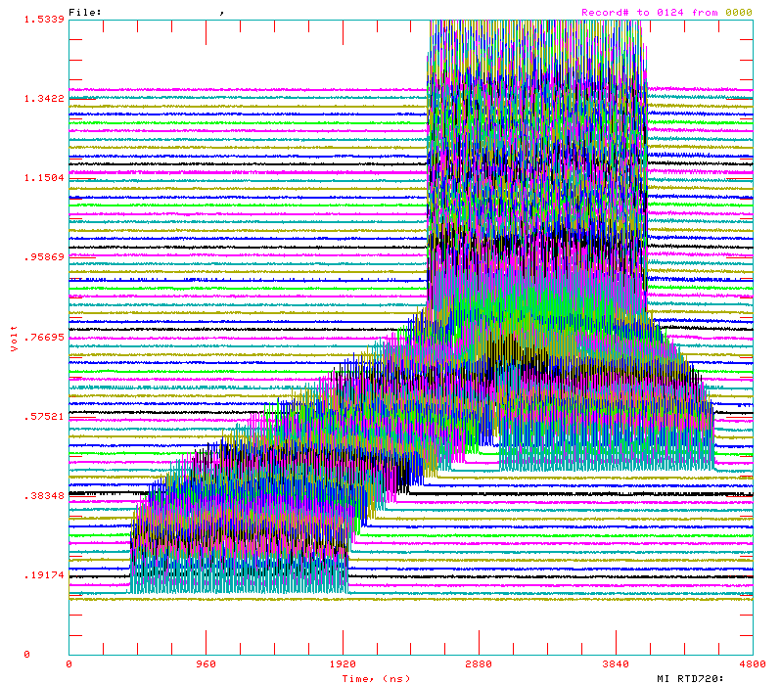
Review: Main Injector Loading
The Main Injector has six usable “slots”, into which Booster batches may be placed.
More batches may be loaded, using “slip stacking”, in which batches are injected at slightly different energy, drift together, and are captures as one batch (with at least twice the longitudinal emittance).

Slide 7
Main Injector Loading (cont’d)
Initial NuMI operation (“2+5”):
  Two batches will be slip stacked for antiproton production.
  Five more batches will be loaded for NuMI
  All will be accelerated together.
Ultimate NuMI operation (“2+9”):
  Five batches will be loaded into the Main Injector, leaving one empty slot.
  Six more batches will be loaded and slipped with the first to make two for antiproton production and 9 for NuMI.
  This is beyond the capacity of the current RF system.

Slide 8
Main Injector RF 101
Our present system:
  Number of cavities: 18
  Total Power Available: 175 kW/cavity (single PA)
  Total Power dissipated: 58.6 kW/cavity
  Power available for acceleration: 116.4 kW/cavity
  Maximum acceleration rate: 200 GeV/s
In the absence of beam loading compensation, an RF system is stable until the energy expended in accelerating the beam is equal to the energy dissipated in the cavity.
Feed forward loops can increase this stability threshold
For our system
  Maximum guaranteed stable intensity: 3.3E13 protons
  Power limited intensity: 6.5E13 protons

Slide 9
Options
By adding an additional (175/2 – 58.6 =) 28.9 kW passive load to each cavity, we could ensure 87.5 kW of power for stable acceleration
  4.9E13 proton per batch limit
Each cavity has an additional port for a second PA, potentially giving 350 kW of total power.
This could potentially give
  9.8E13 protons/batch in the most conservative case (175 kW power dissipation)
  Possibly higher with feedback loops

Slide 10
Proton Projections
Phases of Operation
  Phase I
    After this shutdown
    Dogleg problem ameliorated
    Booster limited to 7.5Hz total repetition rate
    Main Injector limited to 4E13 protons (2+5 operation)
  Phase II
    After 2005 shutdown
    ORBUMP replaced
    RF cooling finished
    Booster capable of 9Hz operation
    MI still limited
  Phase III
    After 2006 shutdown
    MI RF upgrade complete
    2+9 operation to NuMI
2007

Slide 11
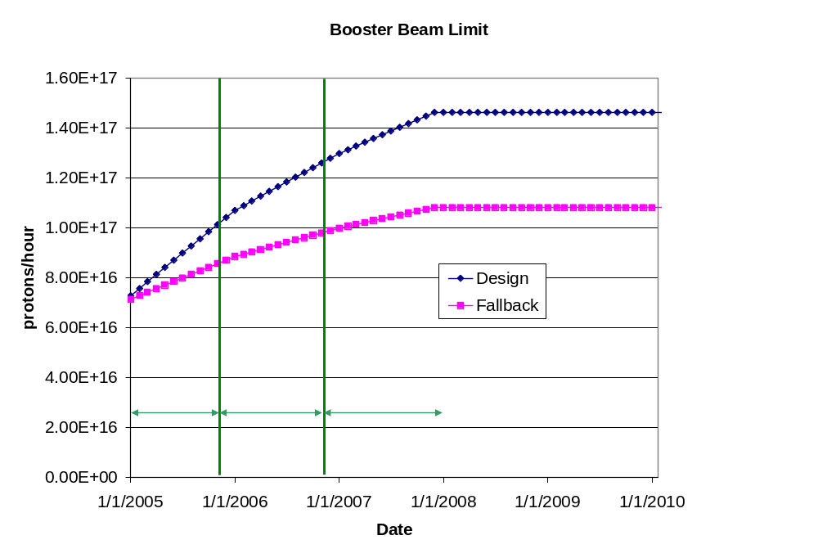
Predicted Peak Proton Intensity Limits
Actual

Slide 12
Calculating NuMI PoT
Even the fallback scenario accommodates NuMI operation.
Assume the following
  Booster batch intensity rises steadily to 5.5E12 over the next three years.
  Ramp up to full 2+5 operation by April 2005
  Ramp up to full 2+9 batch slipstacked operation a few months after MI RF upgrade.
  90% efficiency for slip stacking.
  10 month operation each year.
  81% total uptime for remainder of year
    based on MiniBooNE. Includes scheduled and unscheduled downtime
  90% avg/peak operating efficiency
  10% down time for shot setup
  5% down time for fast Recycler transfers
  5% down time during 2005 for Ecool accesses.
  Does NOT include SY120

Slide 13
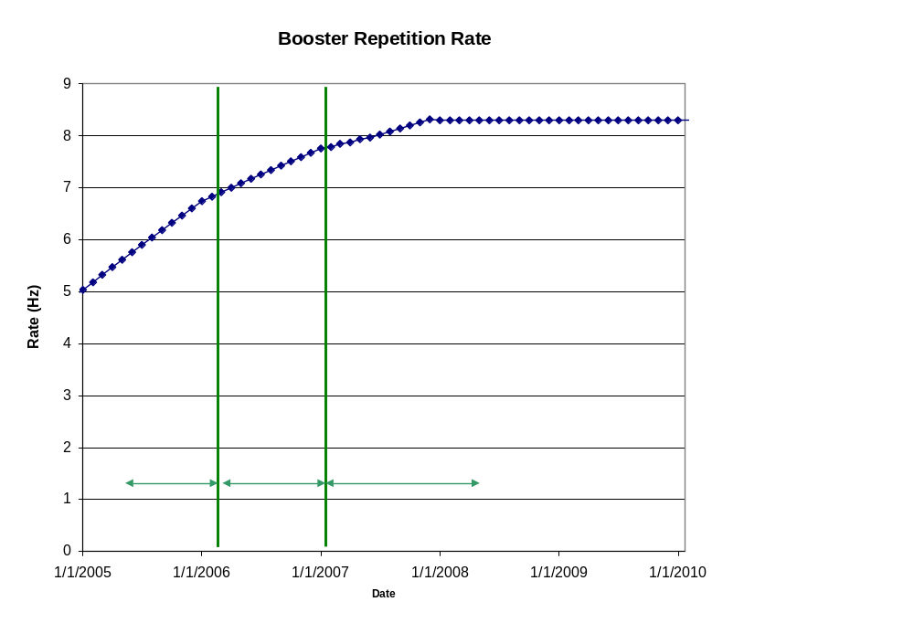
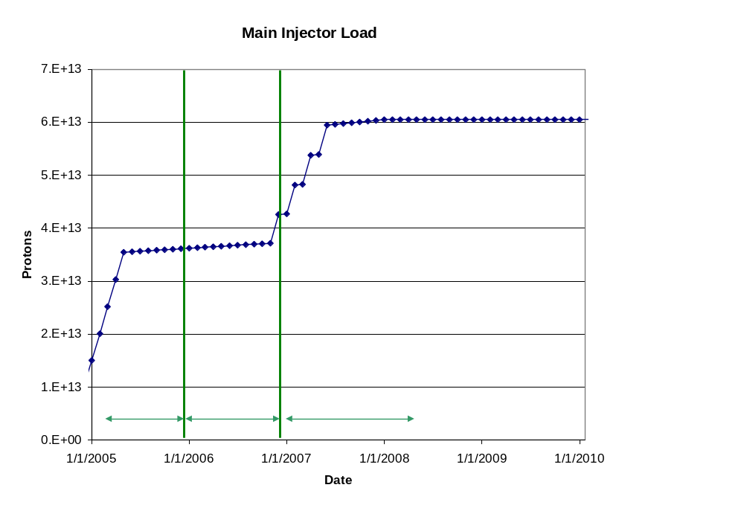
Machine Loading

Slide 14
“Design” PoT
 | Booster Batch Size | Main Injector Load | Cycle Time | MI Intensity | Booster Rate* | Total Proton Rate | Annual Rate at end of Phase
 |  | (AP + NuMI) | (sec) | (protons) | (Hz) | (p/hr) | NuMI | BNB
Actual Operation
July, 04 | 5.0E+12 | 1+0 | 2.0 | 0.5E+13 | 5.1 | 0.8E+17 | 0 | 3.3E+20
Proton Plan
Phase I | 5.10E+12 | 2+1→2+5 | 2.0 | 3.6E+13 | 6.3 | 1.0E+17 | 2.0E+20 | 1.5E+20
Phase II | 5.3E+12 | 2+5 | 2.0 | 3.7E+13 | 7.5 | 1.2E+17 | 2.2E+20 | 2.8E+20
Phase III | 5.50E+12 | 2+9 | 2.2 | 6.0E+13 | 8.3 | 1.5E+17 | 3.4E+20 | 2.2E+20
Beyond Scope of Present Plan
11 Hz | 5.50E+12 | 2+9 | 2.2 | 6.1E+13 | 11.0 | 2.0E+17 | 3.4E+20 | 5.0E+20

Slide 15
Fallback Scenarios
NuMI
  Project totals if the MI RF upgrade is delayed by a year (probable!!)
  Project totals if slip stacking fails entirely for one reason or another (pessimistic)
BNB
  Project totals if both the MI RF upgrade and the corrector upgrade are delayed by a year (probable)
  Project totals if the aperture improvements have only 25% of their calculated benefit (pessimistic)

Slide 16
Since Initial Report
The first “reality check”:
  Funding limited
  Defer indefinitely:
    Linac quad upgrade
    30 Hz harmonic
    Booster solid state RF
    Instrumentation upgrade
  Significantly delay:
    Main Injector RF
Effect of canceling BTeV:
  Budget very front-loaded
  Most things back:
    Probably not Booster solid state RF
  Most likely scenario “delayed”:
    Booster correctors and MI RF installed in 07 shutdown.

Slide 17
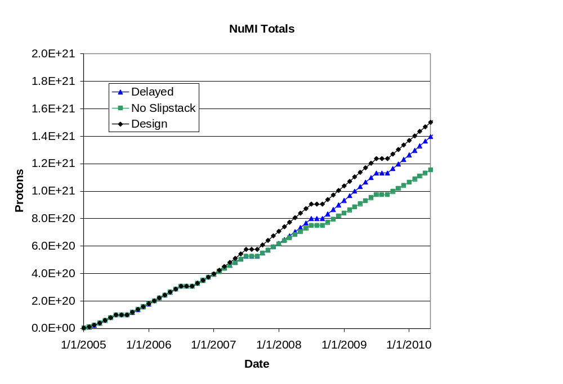
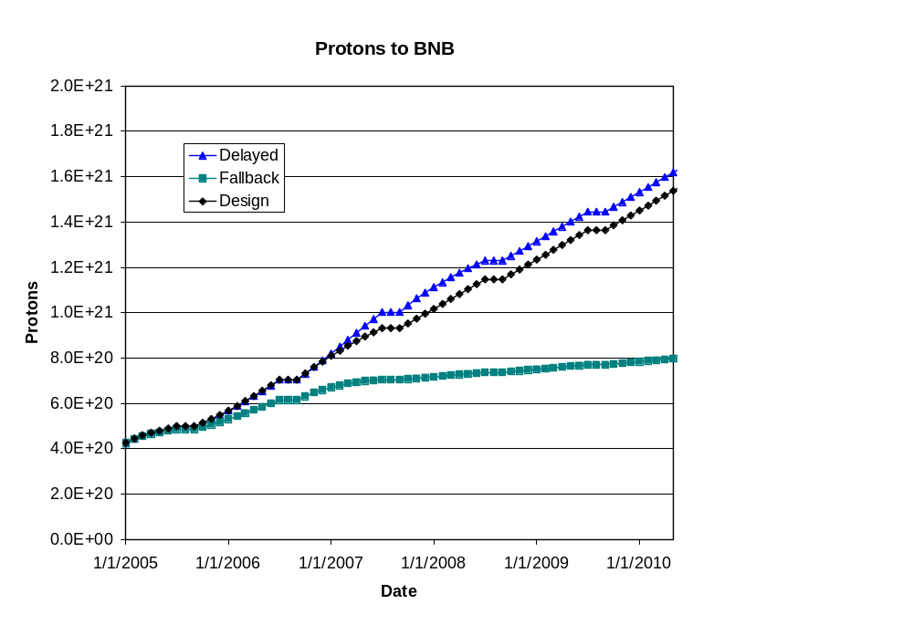
Fallback Projections (delayed scenario most likely)
BNB benefits from delayed slip stacking
BNB only during shot setup

Slide 18
Extra Slides for Questions…

Slide 19
Status of Major Work
Linac
  7835 Task force
    Burle OK for now
    Buy tubes (12 extra by end of 06)
  LEL quad power supplies
    Working on prototype, based on HEL supplies
Booster:
  ORBUMP magnets:
    First magnet built and tested, proceeding with the rest
  ORBUMP PS:
    Procuring and assembling
  Corrector System
    Conceptual design complete
    Working on detailed design
    Working on PS specs

Slide 20
Status of Major Work
Main Injector
  Large Aperture Quads
    In fabrication. Will be ready for 05 shutdown
  5-batch commissioning
    In progress
  Loss mitigation/collimator system
    Working group formed
    Identifying collimator candidates for MI-8
    Starting ring collimator system design based on Booster
  Miscellaneous projects (added since first draft)
    Barrier bucket cavity:
      In procurement
    Injection kicker modification:
      Being designed

Slide 21
Status of MI RF Work
Build prototype cavity
  Passive load:
    Existing port?
    Cut new port?
  Second PA
Carry out a series of studies in the Main Injector
  Determine effectiveness of feed-forward loops
  Determine optimal passive load and predict intensity limit for one- and two- PA scenarios
Refine cost estimate for passive load and PA upgrades.
Use this information to determine longer range plan.

Slide 22
Status of Plan
Working with Project Support to complete WBS chart.
All major elements at least have reasonably accurate placeholders.

Slide 23
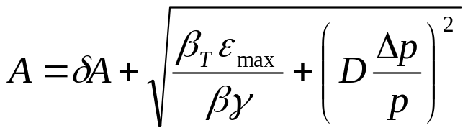
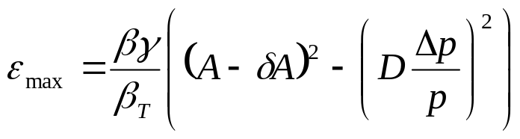
Evaluate Effect of Booster Improvements
Calculate effect of various improvments based on increased acceptance (a la McGinnis):
Use:
Effective aperture
reduction
Condition | Date | δA | max D | max beta | Acceptance | Relative
 | Completed | (mm) | (m) | (m) | (π-mm-mr) | Increase (%)
Start of MiniBooNE | --- | 10 | 6.2 | 45.8 | 15.7 | -15
Dogleg 3 Fix | Oct-03 | 10 | 4.5 | 40.8 | 18.4 | 0
Dogleg 13 Fix | Oct-04 | 10 | 3.8 | 36.1 | 21.0 | 14
Alignment | Oct-05 | 8 | 3.8 | 36.1 | 24.3 | 32
ORBUMP | Oct-05 | 5 | 3.8 | 36.1 | 29.5 | 60
correctors | Oct-06 | 2 | 3.8 | 36.1 | 35.2 | 92
Ideal | --- | 0 | 3.19 | 33.7 | 42.3 | 130

Slide 24
Effect on Max Proton Intensity
Prior to this shutdown, regularly delivering 7.5E16pph with ~40% reduction in activation around most of the Booster.
  Assume after another year of tuning and collimator optimization, we could have hit 1E17 pph with no other improvments (“fallback” = .9E17).
Operational experience: tuning asymptotically approaches benefit of a particular improvement:
  Assume after one year of tuning, 50% of the benefit of a particular improvement is realized (fallback = 25%).
Date | “Design” Limit (1E16 p/hr) | Fallback Limit (1E16 p/hr) | Comment
1/2006 | 10.7 | 9.3 | Effect of collimators, dogleg fix, plus some alignment
1/2007 | 13.0 | 10.4 | Alignment and ORBUMP
1/2008 | 14.6 | 11.0 | New corrector system

Slide 25
Estimating PoT
Even the fallback proton scenario accommodates NuMI operation.
Total proton output continues to be limited by radiation losses, rather than Booster repetition rate.
We assume:
  NuMI and antiproton production get what they need
  The BNB gets whatever it can beyond that, within the total output limit of the Booster
This is a programmatic decision:
  Protons can be diverted from NuMI to the BNB, but not the other way around.
The BMB PoT estimates are extremely sensitive to the total proton limit, which is uncertain.

Slide 26
Calculating BNB PoT
Trickier:
  Still limited by beam loss, NOT rep. rate.
  Assume antiproton and NuMI have priority, so
  BNB VERY sensitive to proton limit and its fluctuations.
Use:
(avg pph) = (pph lim.)*η – (NuMI pph) – (pbar pph)
Also assume:
  10 month operation
  81% up time (based on 2004)
  5% downtime in 2005 for ECool access
  BNB gets all the beam during shot setup (10% of the time)
Booster output limit, as discussed
Avg/pk ~ 86% from July 2004 MiniBooNE operation

Slide 27
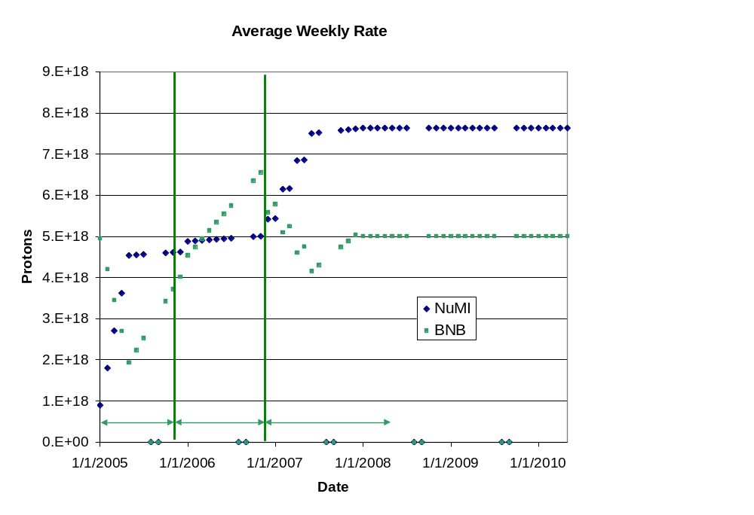
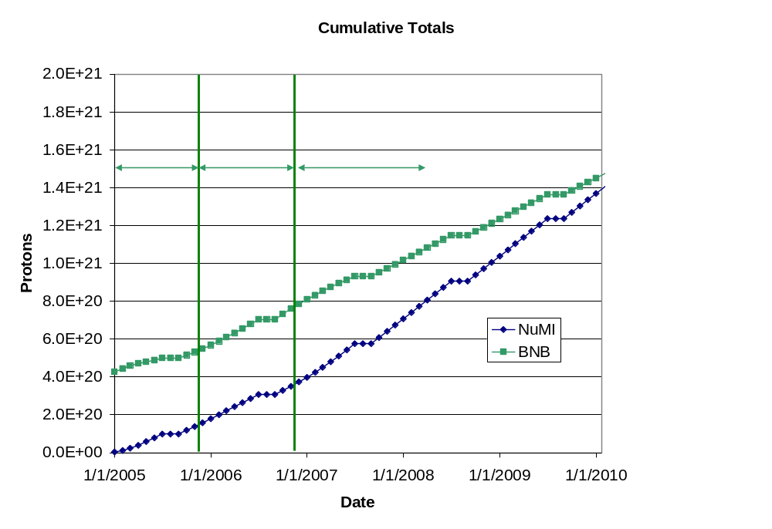
“Design” Totals (almost certainly outdated)
Last 4 weeks

