Slide 1
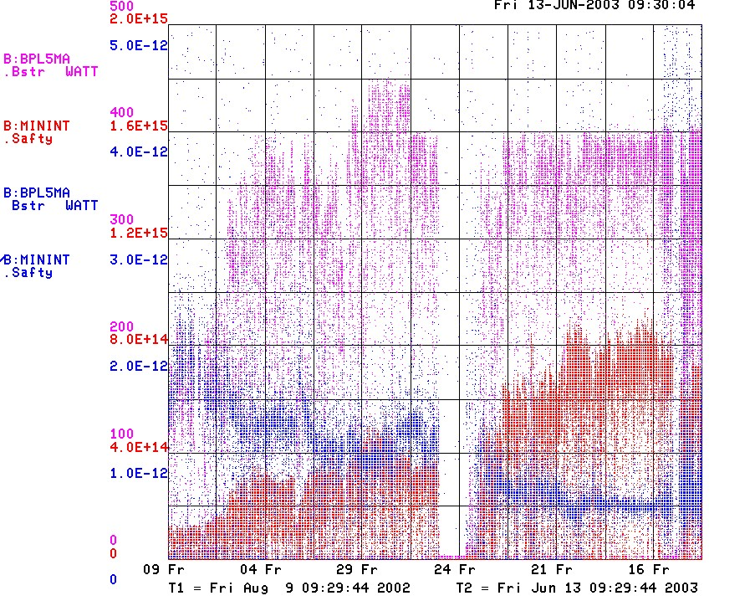
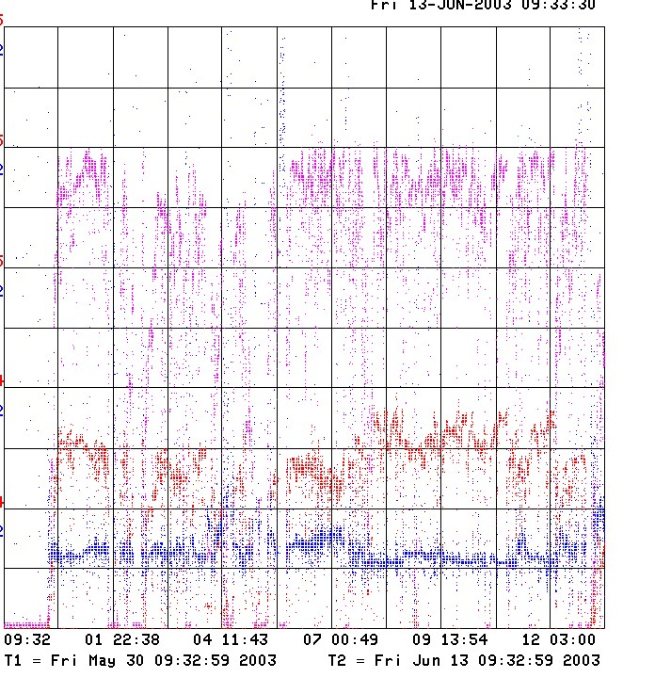
How are we doing?
Since MiniBooNE
Last 2 Weeks
Unstable Running
Energy lost per proton

Slide 2
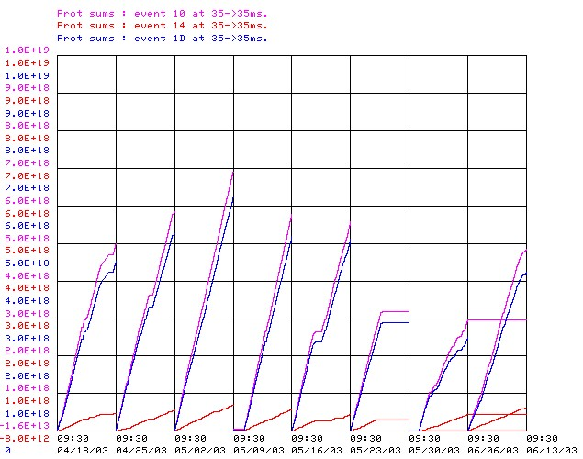
Protons Delivered (last 8 weeks)
Record

Slide 3
Problems
Returning from power outage (need to get better at this)
Linac problems (how are these doing?)
Regulation problems with MH2. Was rated for 60V and was running at 63.5. Reduced to 62, and tuned 400 MeV line to compensate. New supply identified.
Various losses, particularly L21 (sensitive to VIMIN??)
How can we be more systematic about tuning machine?

