Slide 1
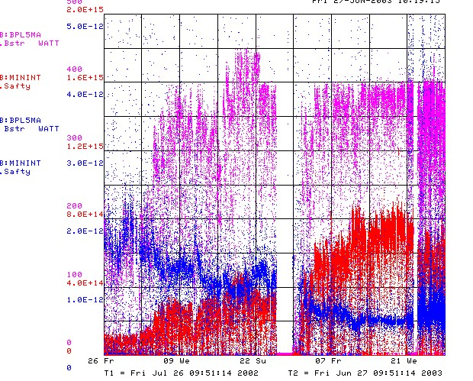
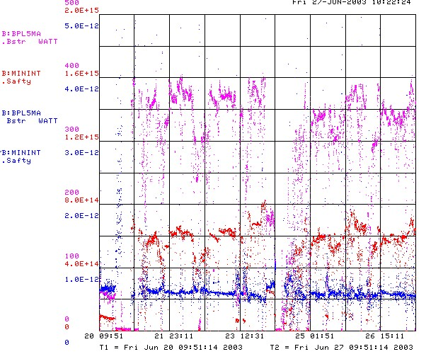
How are we doing?
Since MiniBooNE
Last 2 Weeks
Unstable Running
Energy lost per proton
Better

Slide 2
Linac/400 MeV Line
The first step in improving repeatability is to characterize and reproduce the characteristics of beam going into the Booster!!!
Tools:
  Velocity/phase meter: Use them!!
  400 MeV line BPM’s: save during good performance
  400 MeV line MW’s??
  RWM/ bunch length meter?
  Ideas?

Slide 3
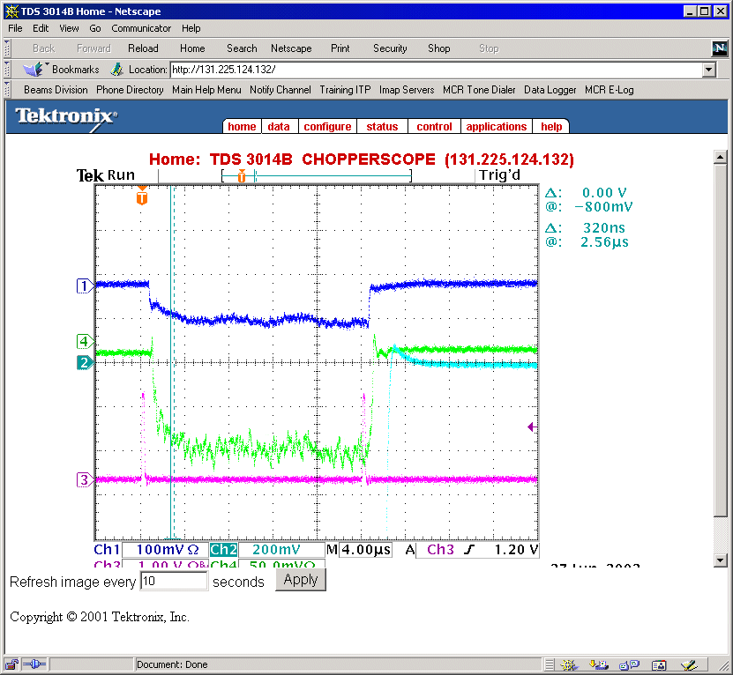
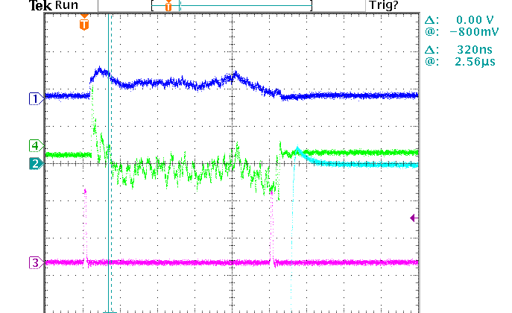
Linac phase and velocity
Bad
OK
Use mults to correct Energy and tilt
Use debuncher phase to correct phase.

Slide 4
Standard Booster Reference
When things are running well:
  Store BLM’s on B136
  Store orbit group on B40
  What else?

