Slide 1
Summer Shutdown
The good news: ALL of the major Booster and Linac projects are back on the table for the summer shutdown.
The good news: ALL of the major Booster and Linac projects are back on the table for the summer shutdown.
Purpose of this meeting:
  Start to establish a timeline
  Identify access conflicts
  Possibly identify manpower needs

Slide 2
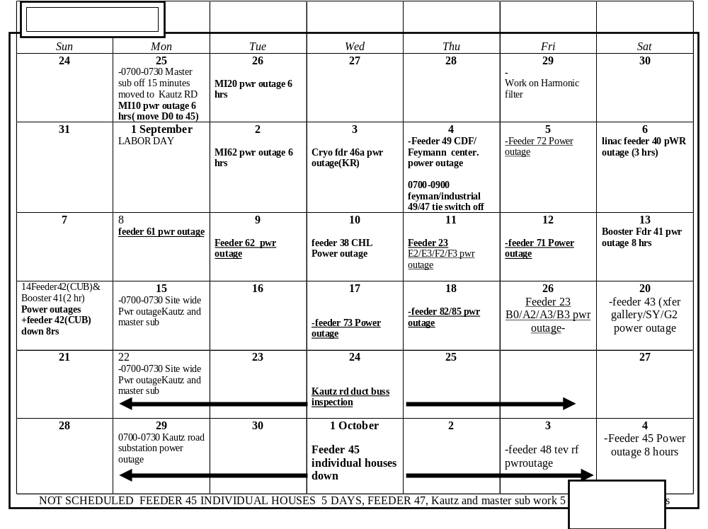
Shutdown Schedule

Slide 3
Summary of Major Projects for the Summer Shutdown
Stretch out Long 3 extraction region (ameliorates dogleg problem).
Install collimator system.
Replace 2 (of 18) RF cavities with wide aperture prototypes.
New dedicated damping cavity for additional longitudinal modes.
Do complete vertical alignments !! (as-founds are ongoing)
Install new Linac Lamberston (will improve 400 MeV optics and reduce losses)
Install four new wide aperture (EDWA) magnets in 8 GeV line.
Install new MP01 power supply and cable to new cable header (preparation for new MP01 septum.
Install new vacuum gauges as part of vacuum system upgrade.
Cautiously optimistic we can reach the MiniBooNE baseline goal after this shutdown!!

