Slide 1
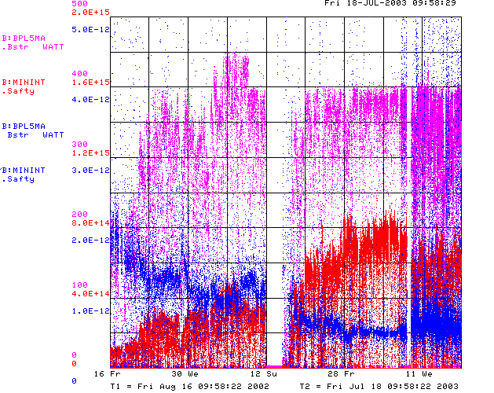
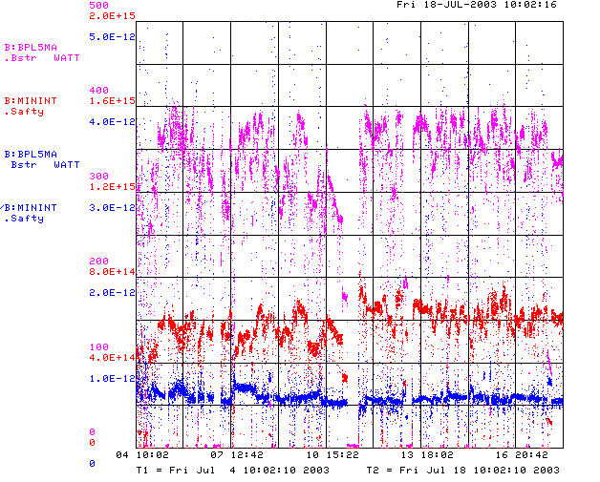
How are we doing?
Since MiniBooNE
Last 2 weeks
Getting better
MH2 Replaced

Slide 2
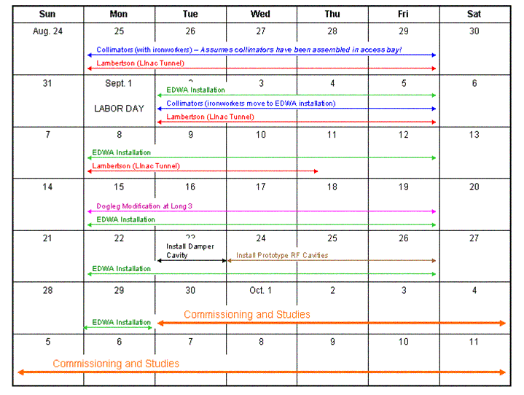
Shutdown Schedule

Slide 3
Shutdown News
Considering delaying shutdown 1-2 weeks to increase chance of reaching 225 pb-1 this fiscal year.
  Most contracts are still in the system.
  Decision will be made by next Wednesday or it becomes very expensive.
  Do we have any problems with this?
Strong possibility that shutdown will be extended to 10 weeks.
  Decision will be made by Monday
  Might want to change our schedule
    Possibly wait a week to start anything??? (discuss)
    Delay dogleg work by 1 week?
    Come up after dogleg work complete, tune up a bit, then shut down again to install large aperture RF cavities?
    Any other ideas?

Slide 4
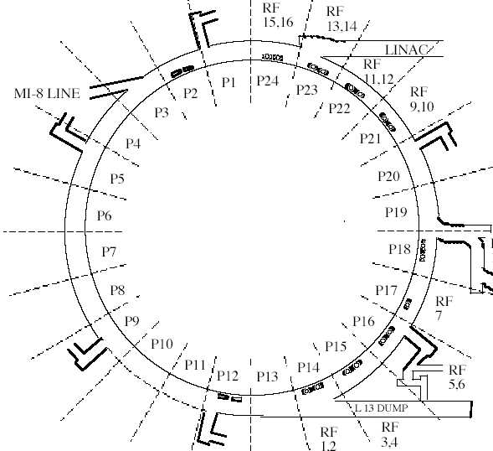
ALARA, etc
What special
precautions should we take and what special preparations can we make?
EDWA job
dogleg job
Will this be a problem?
Collimator job
RF job?

Slide 5
Penetrations?

