Slide 1
Proton Source Meeting
Reorganization – Prebys
FY04 Priorities – Prebys
What happens to Elliott? – Elliott
Studies?

Slide 2
Beams Division Reorganization
Replace “Run Coordinator” with “Systems, Operations and “Integration Department”.
  They advise Dave McGinnis.
  Develop procedures for operations.
  More operational authority to Crew Chief (like Run 1b)
Existing “Beam Physics Group” disolved
  Some go to the new department
  The rest are absorbed into the systems departments
  We will get ~3, whose names are not finalized.

Slide 3
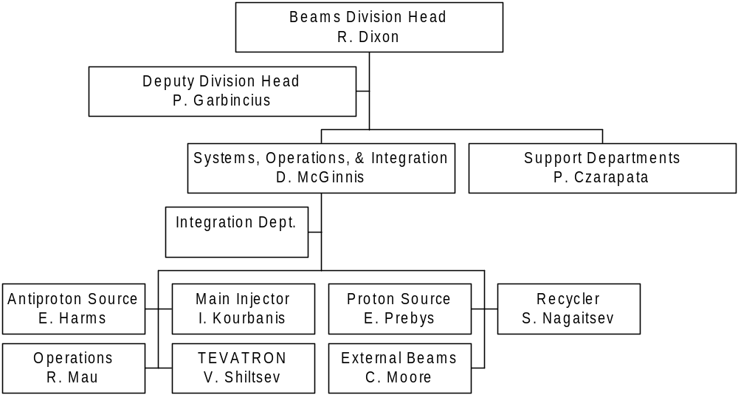
Systems, Operations, & Integration Organization

Slide 4
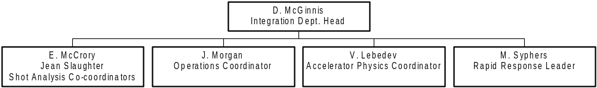
Integration Department Organization

Slide 5
New Proton Source Organization
Eric Prebys
Dept. Head
E. McCrory
Linac Group Leader
B. Pellico
Booster Group Leader
C. Ankenbrandt
Beam Physics Group Leader
M. Popovic
X. Huang
?
?
?
New

Slide 6
First Look at the Budget
Too early to say anything definite
  Without “Proton Plan”, we have almost nothing
  With proton plan, we might have more money than we know how to spend (~entire rest of our budget)
Priorities:
  Obtain a statement from the lab about running MiniBooNE and NuMI together in ’05
  ORBUMP power supply
    Minimal
      Complete Ken’s new switch network
      Keep buying capacitors
    Hope
      Whole new power supplies with better capacitors
  ORBUMP magnets (funded under run II)
    Cooled versions of existing magnets which are powerful enough to accommodate possible new injection schemes
  Long 13 work
    Assemble septum spares
    Build new doglegs and stands
  Linac instrumentation (at least the LEL part)
  Everything else (will likely be cut without proton plan)

