Slide 1
Ramped Correctors
Old approach
  Calculate a closed orbit at each timeslot
Problem
  Not enough corrector power beyond a few ms
  Algorithm minimizes RMS: not always the optimum philosophy.
  Hard to “tweak” after the fact.
New approach (inspired by Bill):
  Focus on ramping 3-bumps at individual problem locations.
  Knob on a limited number of individual timeslots.

Slide 2
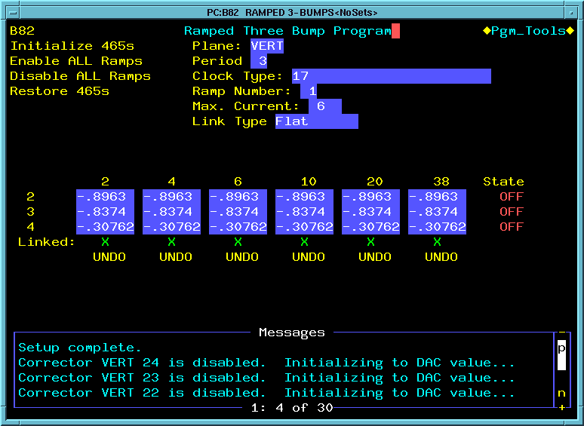
B82 Program
Commands
Setup Parameters
Weighting for linked time slots (flat or p-weighted
Timebreaks (hardwired)
Periods
Ramp State
Linked slots

Slide 3
Program Operation
Parameters:
  Plane
  Period
  Ramp #
  Clock Event(s)
  Current limit (gracefully limits)
  Weighting for linked timeslots
    Flat: knob all linked timeslots with same value
    P-weighted: knob linked timeslots weighted by momentum
Commands:
  Initialize 465s: For the present ramp# and plane
    If cards are NOT ramping, initialize all timeslots with DAC value.
    If cards are ramping with DIFFERENT timeslots, load new timeslots and initialize all with the slot[0] value.
    If cards are ramping with the correct timeslots, leave them alone.
  Enable ALL 465s: start all ramps
  Disable ALL 465s: disable all ramps. Set ramping cards to slot[0] value.
  Restore: restore everything to it’s state when the program started, or the last time the ramp or plane was changed, whichever is more recent.

Slide 4
Program operation (cont’d)
Data entry:
  Ramp states can be toggled with the state field at the right.
  Timeslots can either be knobbed, or a value can be entered for one corrector and the others will be loaded according to the bump ratios.
  Timeslots with an “X” in the link field will be knobbed together (according to the weighting model).
  UNDO will return a timeslot (and any linked timeslot to its state at the last a plane/period was selected).
  Slots can be ramped until a corrector hits the current limit; ratios will be mantained.

Slide 5
Improvements in the works
An SA to plot transmitted intensity as a function of knob position (in progress).
Possibly also display TBT for the period?
More sophisticated Save/Restore capabilities.
Base current limit on RMS calculation.
Return ramp to 0 to reduce RMS?
Vary bump ratios at different timeslots
  Program is set up to do this.
  I have the data in hand, but just have to analyze it.
Other suggestions??

