Slide 1
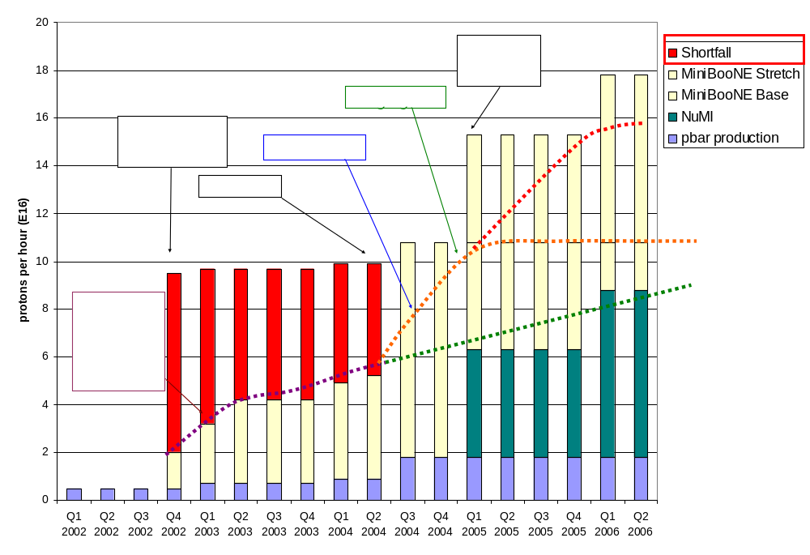
Making Projections
Stretch
Optimistic
Conservative

Slide 2
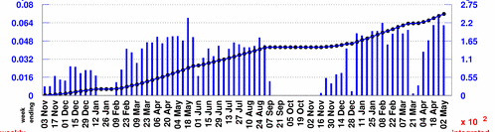
Projecting to MiniBooNE
Rather than use the instantaneous rate, will scale from typical weekly MiniBooNE totals:
Baseline Scenario:
  Improvements compensate for increased protons to pBar -> Continue to average 5.5E18/wk
  MBooNE shuts OFF 1/05
Optimistic Scenario:
  MBooNE rate increases more or less linearly to 10E18/wk at 1/05
  5.5E18/wk after NuMI turns on.
Stretch Scenario:
  MBooNE rate increases linearly to 10E18/wk at 1/05
  5.5E18/wk after NuMI turns on.
  Linearly to 10E18/wk on 1/06
Typically 5.5E18/wk

Slide 3
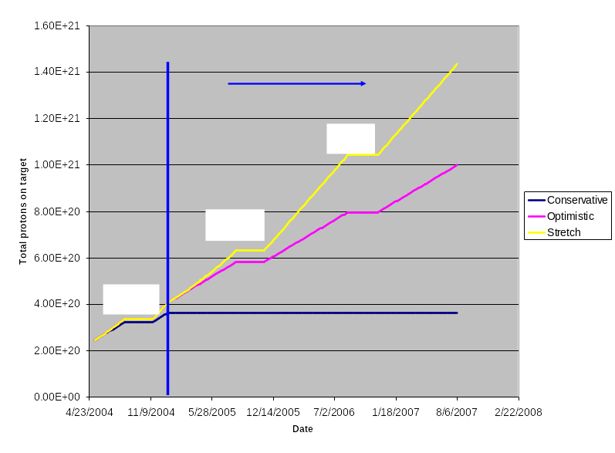
Protons to MiniBooNE

Slide 4
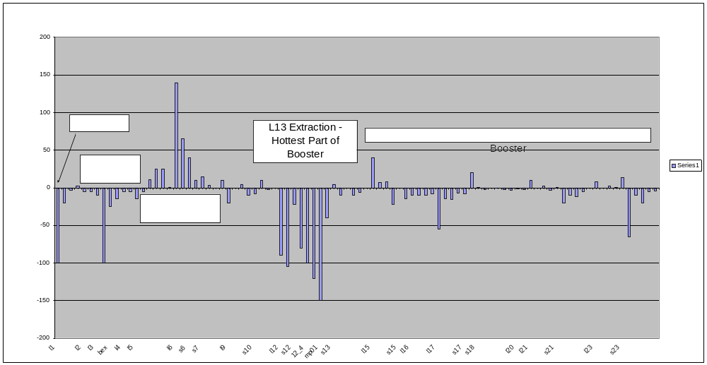
Reasons for Optimism
One week of continuous collimator operation….
  Difference from previous week measurement (mr/hr @ 1ft)

Slide 5
How to exploit effect of collimators?
Power meter will no longer be accurate
Discussion with McGinnis:
  Attempt to maintain current level of activation (???)
    Has not changed significantly in about 1.5 years
    We seem to be able to live with it.
  Make weekly measurements (2-3 hour hit, with cooldown)
  Determine a set of “important” survey points, possibly with weighting (e.g. RF cavities, L13 weighted higher).
  If survey goes down by N%, raise intensity by N%
    Factoring in cooldown, this is actually more conservative than it sounds.
  Back off if the next week’s survey shows problems.
Issues:
  What to do with individual loss limits?
  Do we want to lower losses in specific areas, or overall?
  Beam permit tied to collimators?

