Slide 1
Shutdown Jobs
Linac
  Water Upgrades
    Station 1-5
  Water Maintenance
    Everything
  Mechanical
    Tank 5
    400 MeV line ?
    Extraction modification ?
    MuCool extraction (and beamline???)
  HEL LLRF Upgrade
  Anything else?

Slide 2
Shutdown Jobs (cont’d)
Booster
  LCW
    Debuncher skid maintenance
    Anode skid upgrade
    Peek installation
    Station 19 water
  RF
    Add station 19 and prep for station 20
  L13
    Remove everything
    Install
      New doglegs
      New MP01
      New ML01
      New striplines
  ORBUMP Power supply
    Anything/Nothing?
  Alignment
    Complete 3D as-found
    Complete cavity alignment
  What else???

Slide 3
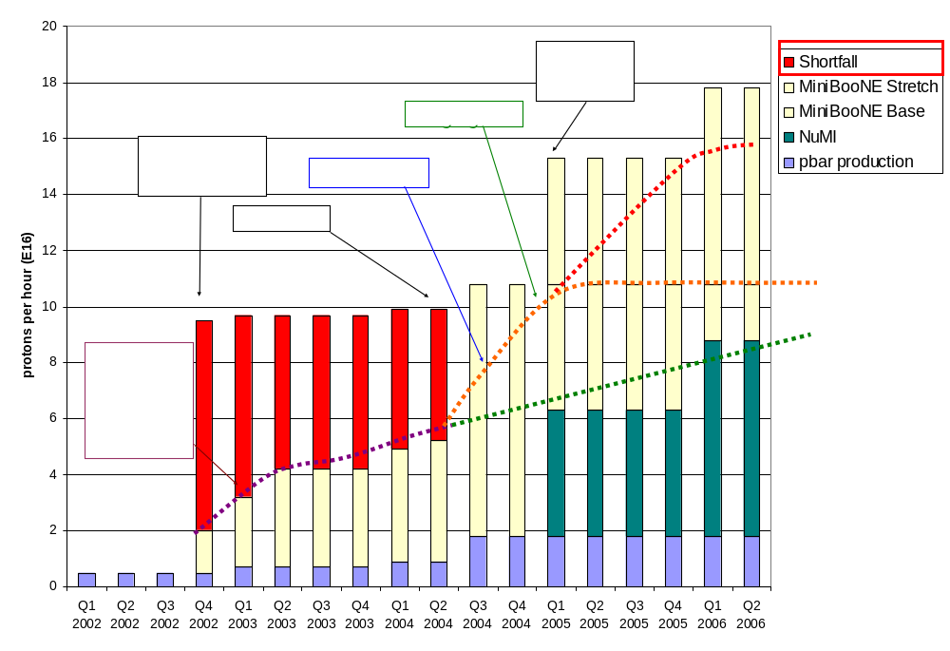
Making Projections
Stretch
Optimistic
Conservative

Slide 4
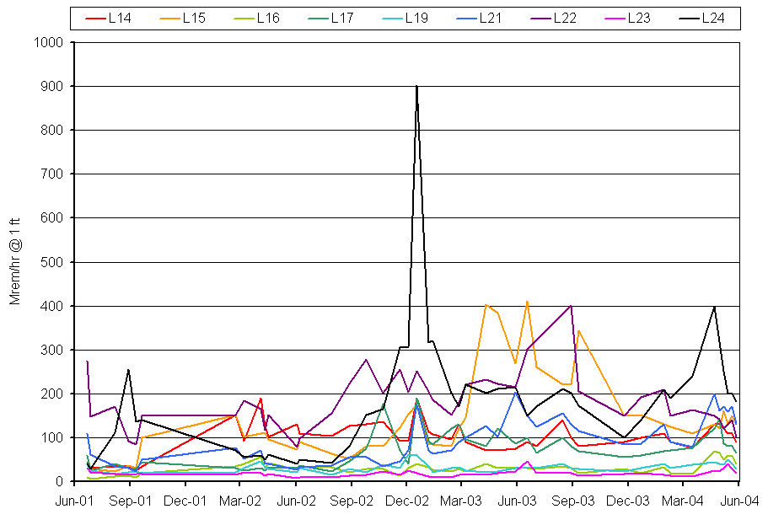
Can We Raise the Watt limit?

