Slide 1
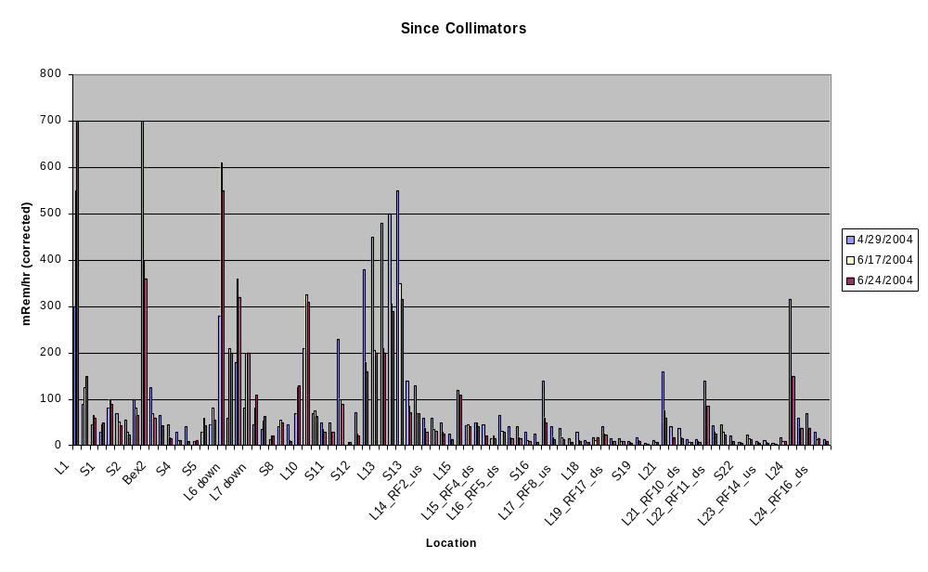
Activation Since Collimators

Slide 2
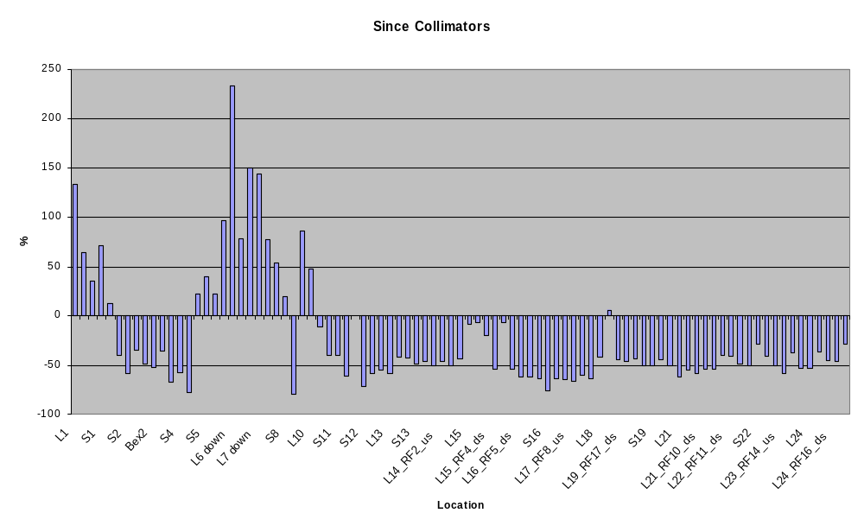
Relative Change

Slide 3
Comments
We have reduced activation by 40-50% around much of the ring.
With our current 475 Watt limit, we regularly hit 7.5E16 pph total when we’re tuned well.
In order to be able to deliver full MiniBooNE intensity at all times, we would have to deliver about 33% more protons (~650 W limit),25% to hit full intensity during shot setup (575 W limit).
This would probably NOT bring the Booster back to it’s previous activation at most location, including L13 and the RF cavities.
We can afford to collimate a little less to mitigate the activity at periods 6-8 somewhat.
Perhaps try running with reduces (or eliminated) primary collimation???

