Slide 1
MiniBooNE Resistive Wall Monitor Analysis
Entire spill digitized at 2.5GHz for every $1D event.
  All data available on tape
Sparse sample of data available on disk back to about the beginning of 2003.
I’ve looked at a sampling of events as a function of time
  Time plotted in days since first MiniBooNE beam (8/24/02)
  Restrict data to 3.5E12<E:TOR875<4.5E12

Slide 2
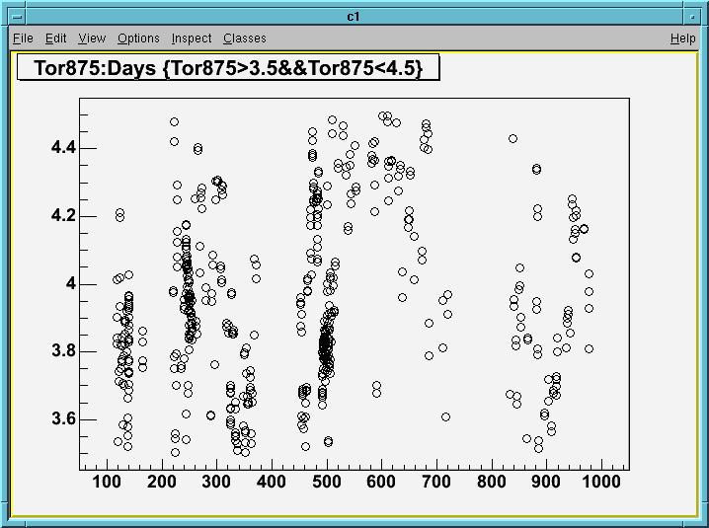
Batch Intensity vs Time 3.5<TOR875<4.5

Slide 3
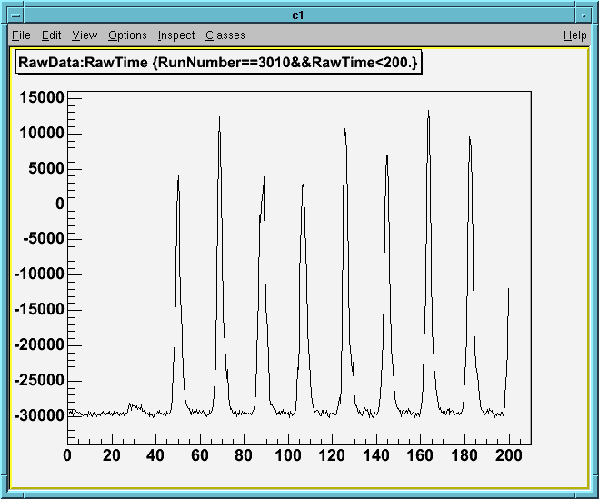
Early Data (early 2003)

Slide 4
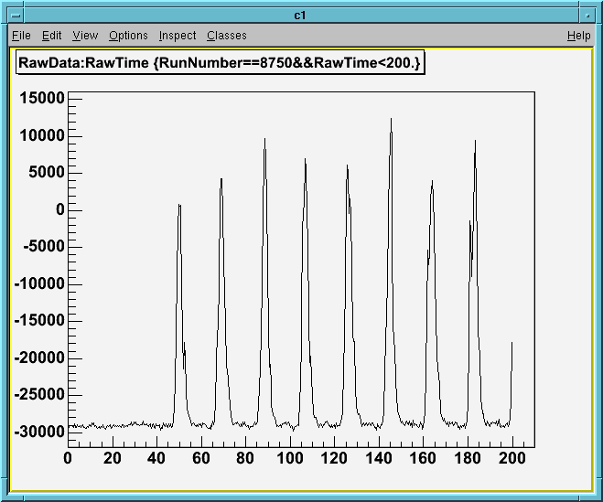
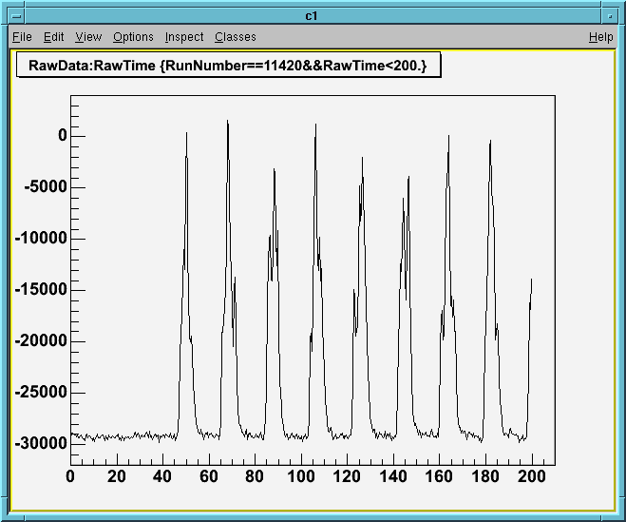
Compare Data Before and after last shutdown
Just Before Shutdown
Most Recent

Slide 5
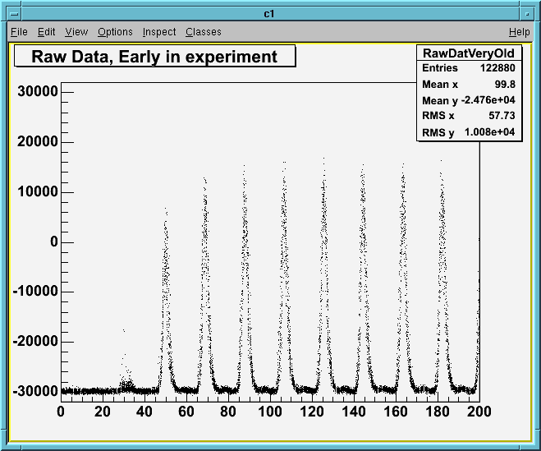
~30 overlayed events (early 2003)

Slide 6
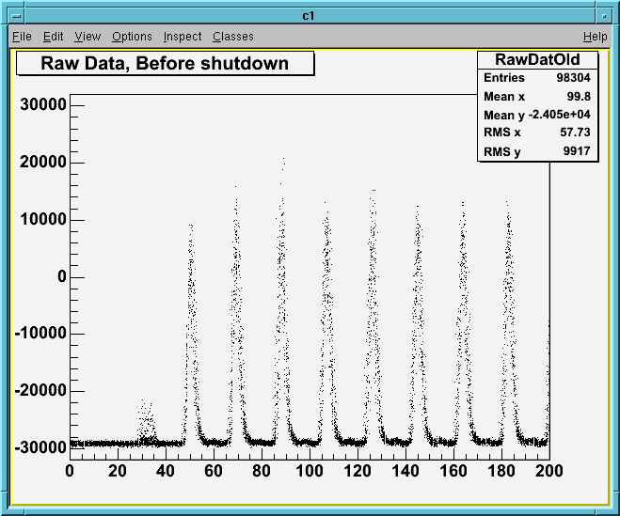
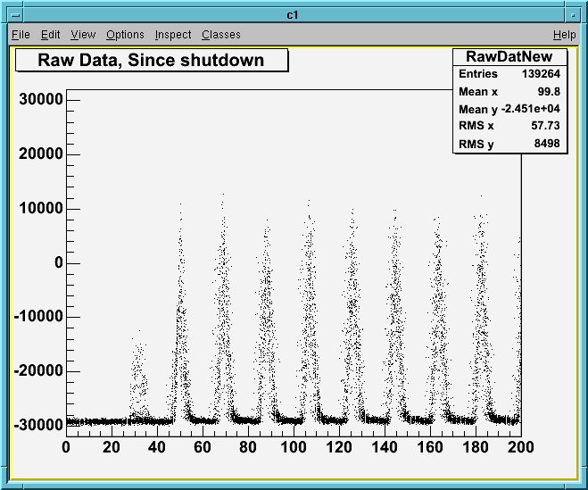
~30 overlayed events before and after shutdown
Before shutdown
Recent

Slide 7
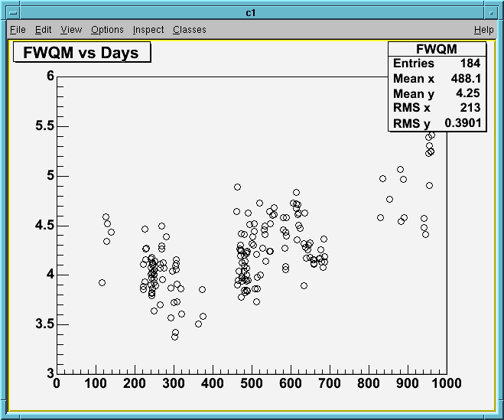
FWQM Reasonable figure of merit

Slide 8
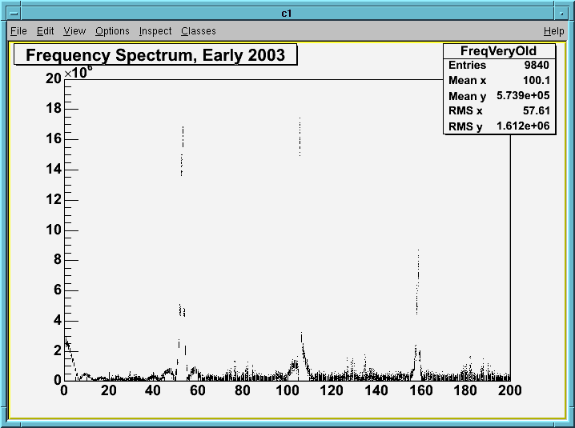
Frequency Spectrum, Early 2003

Slide 9
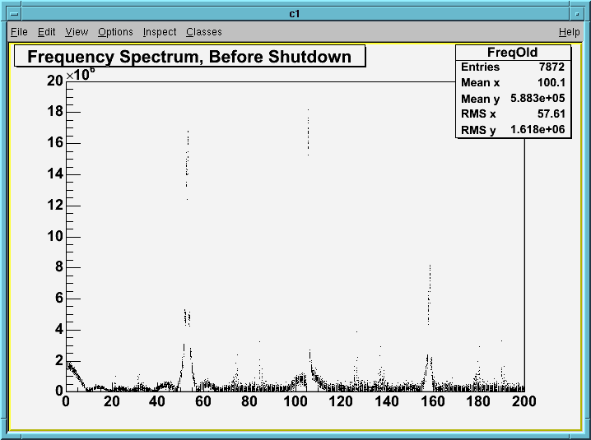
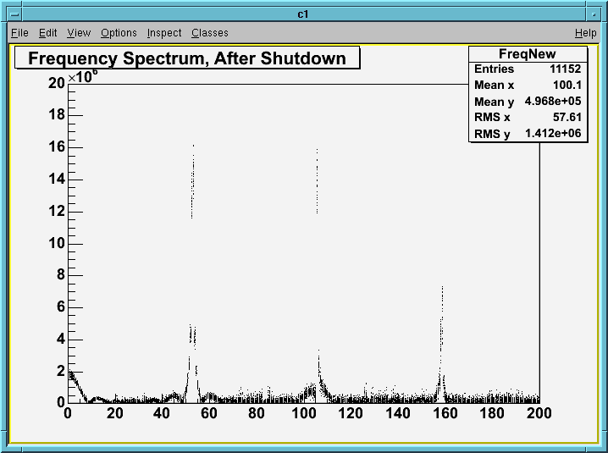
Frequency Spectrum, before and after shutdown
Less coupled-bunch in new data

Slide 10
Conclusions
Something has changed since the shutdown
Bunch structure generally “messier”
Not sure why
Should monitor this more closely in the future.

