Slide 1
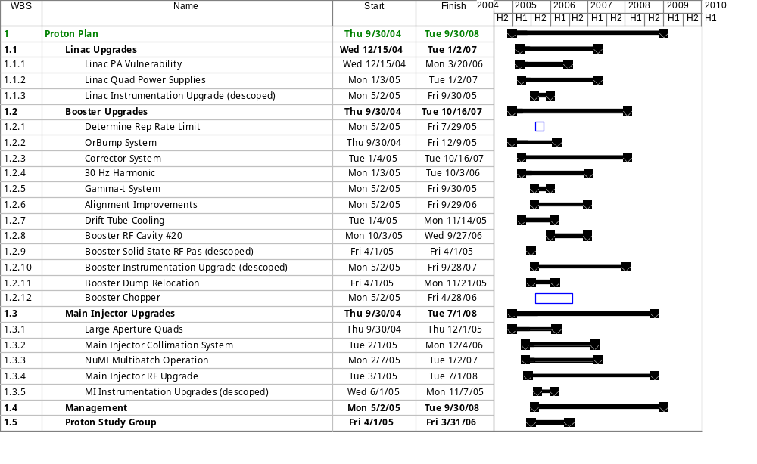
Proton Plan
PP Inception 10/1/05

