Slide 1
The Problem
Beam is injected into the Booster of several revolutions (turns), completely filling it.
As this beam is extracted, it sweeps across the extraction septum, which would create unacceptable losses if nothing were done.
We create a ~60 ns “notch” in the beam early in the cycle, to accommodate the rise time of the extraction kicker and reduce losses at extraction.
Cumulative phase errors in the Booster RF system result in a time variation between the creation of the notch and the extraction of the beam.
This is OK for 8 GeV batches (MiniBooNE), but creates a problem multibatch operation of the Main Injector (pBar production, NuMI), so…

Slide 2
Beam Cogging
In order to fix the time between notch creation and extraction, a microprocessor:
  Analyses the phase error early in the cycle to determine the optimum notch locations
  The radial position is manipulated later in the cycle to insure that the notch lines up with the extraction septum at extraction.
While this technique works well, the radial motion results in increased beam losses:
  Total booster throughput is limited by losses
  This will limit the maximum beam the Booster can produce.

Slide 3
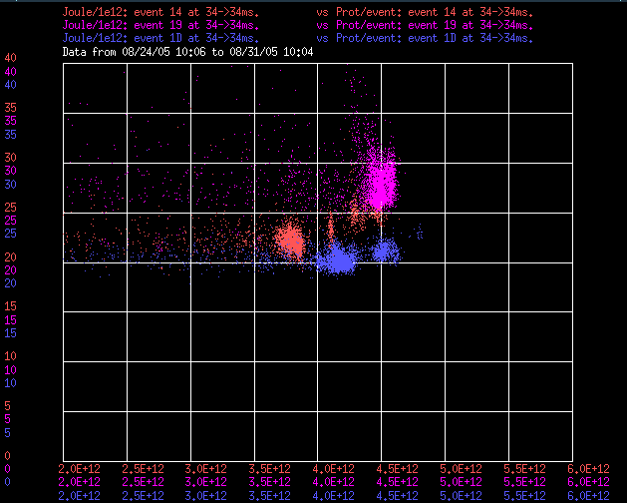
Total Energy Loss
Cogged Cycles
Normalized Energy Loss (kJ/E12)
Uncogged Cycles
Intensity limit inversely related to energy loss
Batch Size

Slide 4
Solution?
The bunch separation of the beam is 19ns
If we could cleanly extract the beam between bunches, we would have no need of cogging
  Not to mention we would avoid dumping 4% of the beam into the tunnel.
This is hard.

Slide 5
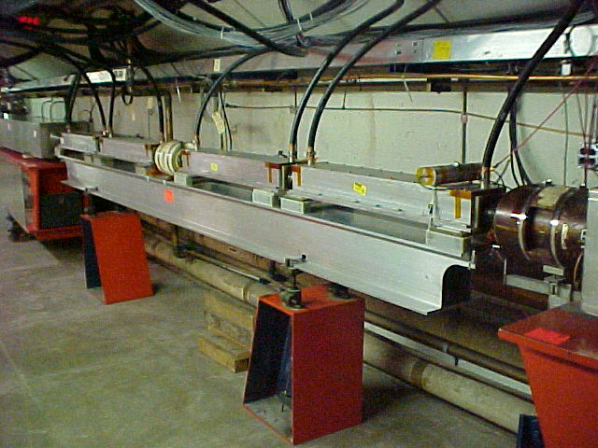
Existing Kicker System
System of four ferrite stripline magnets kick beam into “slow” (~100 μsec) extraction septum in next period.
Rise time: ~40 ns

Slide 6
Specifications (approximate)
Available length: 4m
Aperture: ~6 cm”
Kick: ~1 mRad@ 8 GeV KE
Field (if full length is used)
  .008 T OR
  2.5 MV/m (150 kV over aperture)
Pulse length: 1.6 μsec
Risetime+jitter (0-99%): ~10 ns
Repetition rate: 15 Hz
Flatness/repeatability: ~1%

