Slide 1
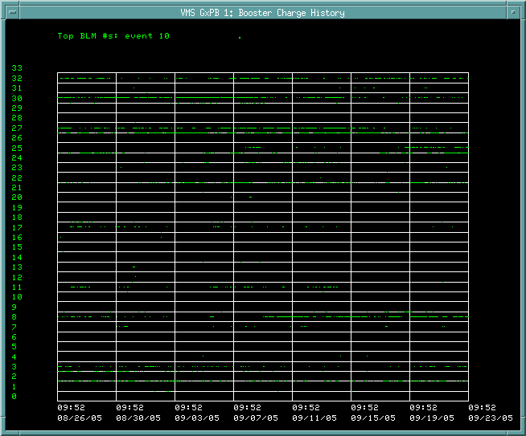
Which Monitors Limit us?
L3 Extraction
S22
S8

Slide 2
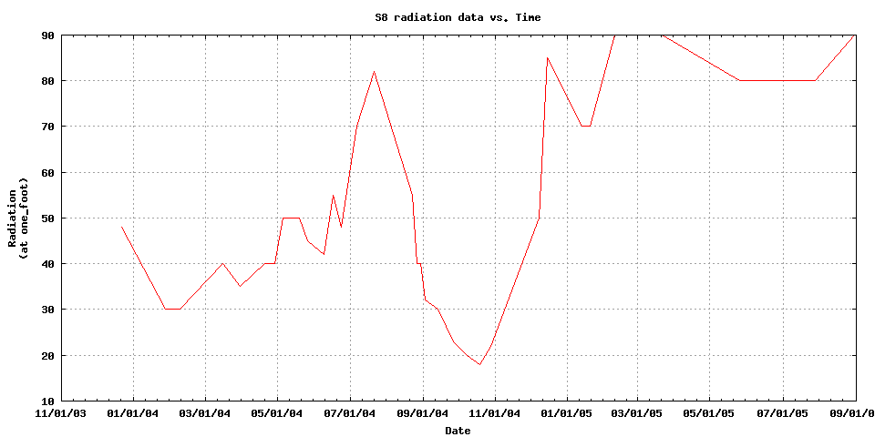
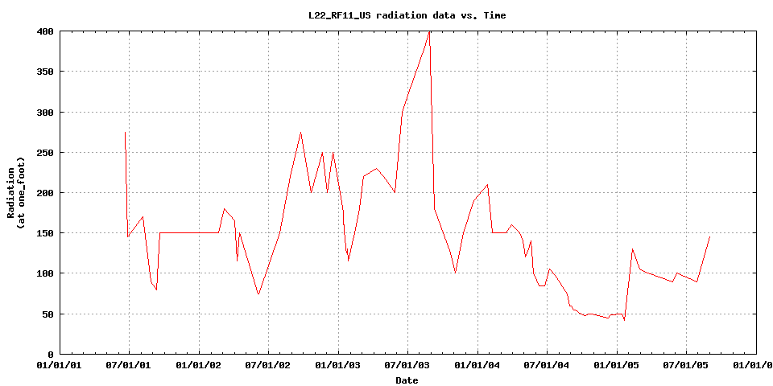
Short 8 and 22 Activation
S8
L22 (RF11_US)

Slide 3
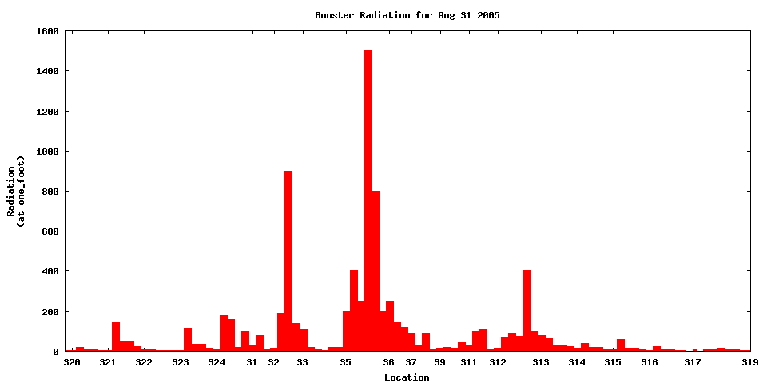
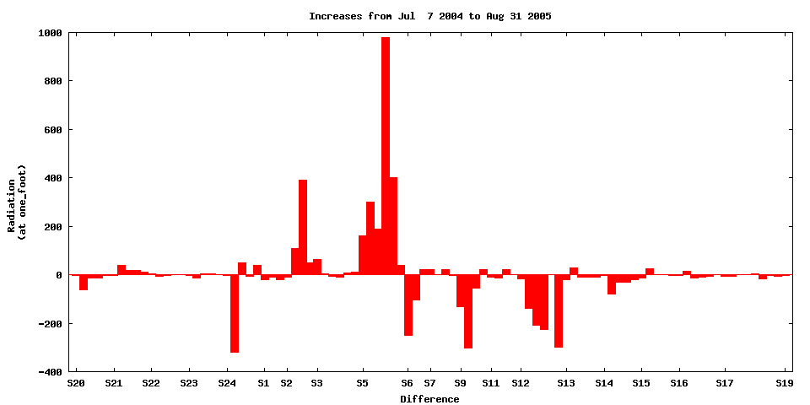
Ring Wide Activation
Last Measurement (8/31/05)
L3 Extract
Cols
Injection
S22
S8
Difference since 7/7/04

Slide 4
General Comments
Of the loss regions that typically limit us, only S8 looks like a possible candidate for increased limit.

